Slide 1
Spring Boot Microservices

Slide 2
What is Spring Boot?
A framework that it easy to
Create stand-alone, production-grade Spring-based applications
Run applications with minimal configuration ("just run")
Embed Tomcat, Jetty or Undertow directly (no need to deploy WAR files)
Provide opinionated 'starter' dependencies to simplify your build configuration
Automatically configure Spring and 3rd party libraries whenever possible
Provide production-ready features such as metrics, health checks, and externalized configuration
Absolutely no code generation and no requirement for XML configuration

Slide 3
Spring CLI
The Spring Boot CLI is a command line tool that you can use to bootstrap a new project.
https://docs.spring.io/spring-boot/installing.html#getting-started.installing.cli
Some Commands
spring version
spring init --dependencies=web,data-jpa my-project

Slide 4


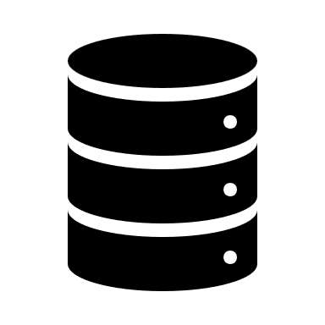

Rest Template
RestTemplate is a class in Spring Framework used to make HTTP requests to RESTful services.
It provides methods for common HTTP operations like GET, POST, PUT, DELETE, etc.
Simplifies communication between microservices or external APIs.
Automatically handles data conversion between Java objects and HTTP responses using serializers like JSON or XML.
Can easily integrate with authentication, headers, and other HTTP configurations.
UI/REST Client
REST Template
HTTP

Slide 5
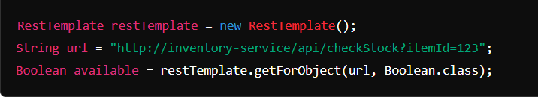
Rest Template
Use Case
A RestTemplate can be used in an Order Service to send a request to an Inventory Service to check if items are available. The Order Service calls the Inventory Service's API using RestTemplate to retrieve the stock availability before confirming the order.

Slide 6
Content Negotiation
In Spring Boot, Content Negotiation allows your RESTful web services to serve different formats of data, such as JSON and XML, based on the client's request. By default, Spring Boot supports JSON, but it also allows serving XML if needed. Content negotiation happens based on the Accept header or the file extension provided in the request.

Slide 7
How Content Negotiation Works
Client Request: The client specifies the format it wants (JSON, XML, etc.) using the Accept header or a file extension in the URL (like .json or .xml).
Spring Response: Spring Boot checks the requested media type and returns the response in that format if it's supported.
Spring Boot includes the jackson-databind dependency by default for JSON. For XML support, you'll need the Jackson XML dependency.
Steps to Enable JSON and XML Content Negotiation in Spring Boot
@GetMapping(value = "/order", produces = { "application/json", "application/xml" })
@JacksonXmlRootElement(localName = "order") public class Order {}

Slide 8
Spring JMS
Java Message Service (JMS) is an API for messaging between applications.
It enables asynchronous communication, decoupling the sender and receiver.
Commonly used for messaging in microservices, enterprise applications, etc.
Key Features:
Provides messaging reliability and durability.
Supports both point-to-point (queues) and publish-subscribe (topics) messaging models.
Integrated in Spring for seamless usage.

Slide 9
JmsTemplate
Overview:
JmsTemplate is a central class in Spring’s JMS support, offering a simplified API for sending and receiving messages.
Handles connection management and simplifies sending/receiving JMS messages.
Key Methods:
convertAndSend() - Sends a message to a specified destination.
receiveAndConvert() - Receives a message from the destination and converts it.

Slide 10

Health Endpoint
Overview
Purpose: To provide the health status of a Spring Boot application.
Component: Part of Spring Boot’s Actuator module.
Access: Accessible via /actuator/health.
Key Features of the Health Endpoint
Auto-configuration: Spring Boot auto-configures the health check endpoint when Actuator is added as a dependency.
Customizable: Developers can create custom health indicators to enhance application monitoring.

Slide 11

How to Enable the Health Endpoint
Add Dependency implementation 'org.springframework.boot:spring-boot-starter-actuator’
Enable in application.properties management.endpoints.web.exposure.include=health

Slide 12
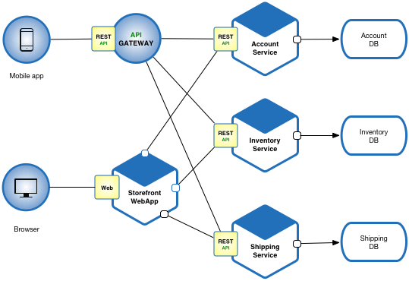
Microservices
Microservices - also known as the microservice architecture- is an architectural style that structures an application as a collection of services that are:
Independently deployable
Loosely coupled
Services are typically organized around business capabilities. Each service is often owned by a single, small team.

Slide 13
Characteristics
Independence
Each microservice can be deployed, updated, and scaled independently.
Bounded Context
Each service encapsulates a distinct business function or process.
Technology Agnostic
Services can be built with different programming languages or technologies.

Slide 14
Why & How
Microservices allow organizations to build and scale complex applications faster, improve resilience, and enhance flexibility.
By breaking a monolithic application into smaller, more manageable parts, microservices enable continuous delivery, independent development, and deployment of services.

Slide 15
Decentralized Governance, Scalability, Fault Tolerance
Decentralized Governance: Each microservice is developed and governed independently, enabling technology and process freedom.
Scalability: Microservices are scalable both vertically and horizontally, focusing on the demand of individual services.
Fault Tolerance: With microservices, failures in one service do not affect the entire system. Built-in resilience allows other services to continue functioning.

Slide 16
Decentralized Governance: Why & How
Why : Allows for innovation and agility as different teams use different stacks.
How: Independent teams deploy different microservices governed by their requirements.

Slide 17
Scalability: Why & How
Why : Scale individual services based on traffic or usage.
How: Horizontal scaling of stateless services or vertical scaling of stateful ones.

Slide 18
Horizontal vs Vertical Scaling
Vertical Scaling: Increasing the capacity of a single instance (e.g., more CPU, RAM). However, there’s a limit to how much a single machine can handle, and this isn't always a cost-effective option.
Horizontal Scaling: Adding more instances of a service to distribute the load. Microservices are ideally suited for horizontal scaling, where each service can be scaled independently based on its own demands.

Slide 19
Auto-Scaling Strategies
Auto-scaling with Cloud Platforms
Most cloud providers (AWS, Azure, GCP) support auto-scaling of services based on real-time demand.
Define thresholds (e.g., CPU usage, memory, request rates) that automatically trigger the creation of new instances.
Container Orchestration (e.g., Kubernetes)
Kubernetes’ Horizontal Pod Autoscaler (HPA) scales the number of pods based on observed metrics like CPU or custom metrics.
Works seamlessly with cloud platforms for elastic scaling.

Slide 20

Load Balancing
Role of Load Balancers: Efficient distribution of incoming traffic across multiple instances of a service.
Techniques:
Round-robin: Requests are distributed sequentially across instances.
Least connections: Requests are sent to the instance with the fewest active connections.
Latency-based routing: Traffic is directed to the instance with the lowest latency.

Slide 21
Key Differences
Feature | Server-Side Load Balancing | Client-Side Load Balancing
Traffic Flow | Through a centralized load balancer | Direct from client to service instance
Complexity | Centralized in the load balancer | Distributed across clients
Load-Balancing Algorithms | Managed by the load balancer (e.g., NGINX, HAProxy) | Handled by the client (e.g., Spring LoadBalancer, Ribbon)
Service Discovery | Not needed; the load balancer knows all instances | Requires service discovery for clients to know instances
Single Point of Failure | Load balancer is a potential point of failure | No central point of failure
Latency | Potentially higher due to extra network hop | Lower, as requests go directly to service

Slide 22
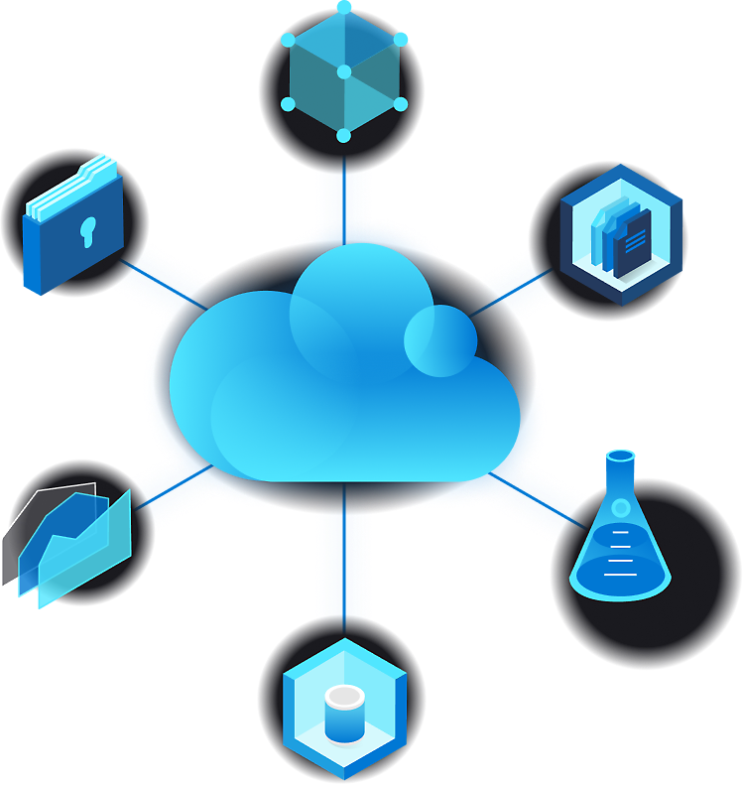
Cloud Computing
Cloud computing is the delivery of various computing services over the Internet ("the cloud").
Services include servers, storage, databases, networking, software, analytics, and intelligence.
It offers faster innovation, flexible resources, and economies of scale.
You typically pay only for the cloud services you use.
Helps in lowering operating costs.
Allows running infrastructure more efficiently.
Supports scaling as business needs change.

Slide 23
Types
IaaS (Infrastructure as a Service): Virtual machines, storage.
PaaS (Platform as a Service): Cloud-based platforms for building, testing, and deploying apps.
SaaS (Software as a Service): Fully managed applications provided over the internet.

Slide 24
Spring Cloud
A set of tools from the Spring ecosystem designed for building microservices in a cloud environment.
Components:
Service Discovery: Eureka
Config Management: Spring Cloud Config
Load Balancing: Ribbon
Circuit Breakers: Resilience4J, Hystrix
API Gateway: Zuul, Spring Cloud Gateway

Slide 25
Service and Client Discovery
Service Discovery: Mechanism for finding services within a system.
Server-Side Discovery: Load balancers handle service discovery.
Client-Side Discovery: The client is responsible for finding available services.
Client Discovery: Eureka, Consul, or Zookeeper allow clients to locate services dynamically without hardcoding their locations.
Why & How:
Why: Facilitates dynamic scaling and failover of services, essential for microservices architecture.
How: Register microservices with a discovery service (e.g., Eureka) and enable clients to discover services at runtime.

Slide 26
Netflix OSS
Netflix Open-Source Software: A suite of cloud and microservices tools designed by Netflix to support their microservices architecture.
Key Tools:
Eureka: Service discovery.
Hystrix: Circuit breaker for fault tolerance.
Zuul: Edge service for routing, monitoring, and security.
Ribbon: Client-side load balancer.
Why & How:
Why: Provides a proven, robust solution for microservices architecture in a cloud environment.
How: Integrating tools like Hystrix for fault tolerance and Eureka for service discovery into your Spring Cloud or microservices ecosystem.

