Slide 1

The FrontEnd Kidz: THE PUZZLE MAKERS
Serena Johnson
Amber Pradhan
Jomo Morris

Slide 2
Problem Statement: The art of puzzles
During these critical times, many young children and teens are stuck in the home without much to do expect for schoolwork, chores, and sleep. With developing a website that allows users to play a game with puzzles, it will not only allow for the user to have critical thinking skills, but also help with the ability to have observation skills , intuitive abilities, and start developing concentration.

Slide 3
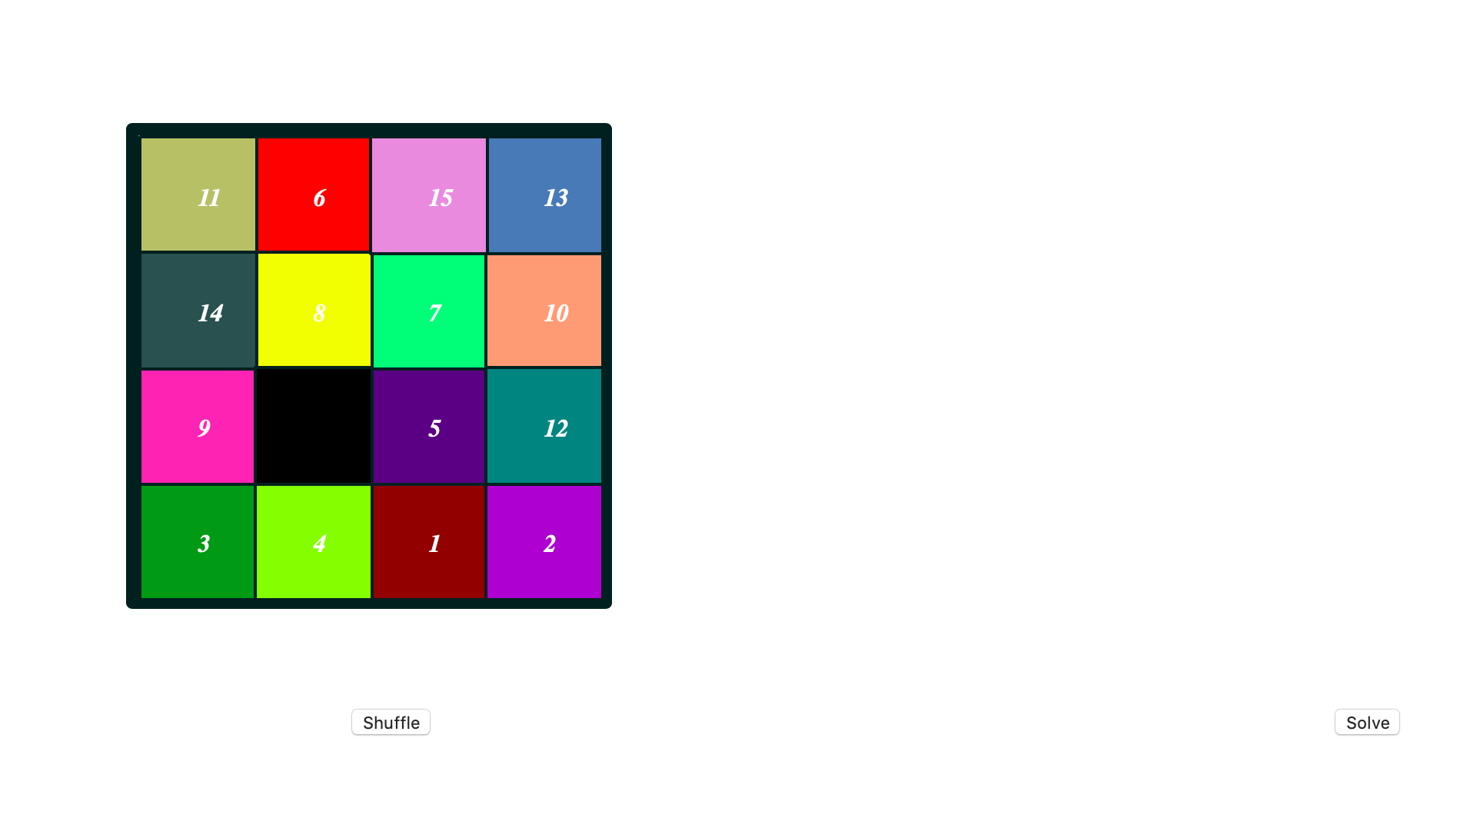
User interface

Slide 4
Requirements
user requirements
system requirements
User can shuffle cards within game
Users can get hints and the solution
Ability to give users hints/solutions
Ability to allow user to change games if needed
Ability to allow user to know it moves

Slide 5
Key design features
Ability to find out the correct solution
Ability to move numbers around until they are in chorological order
Ability to shuffle numbers for a new game

Slide 6

Project Code

Slide 7

Html

Slide 8
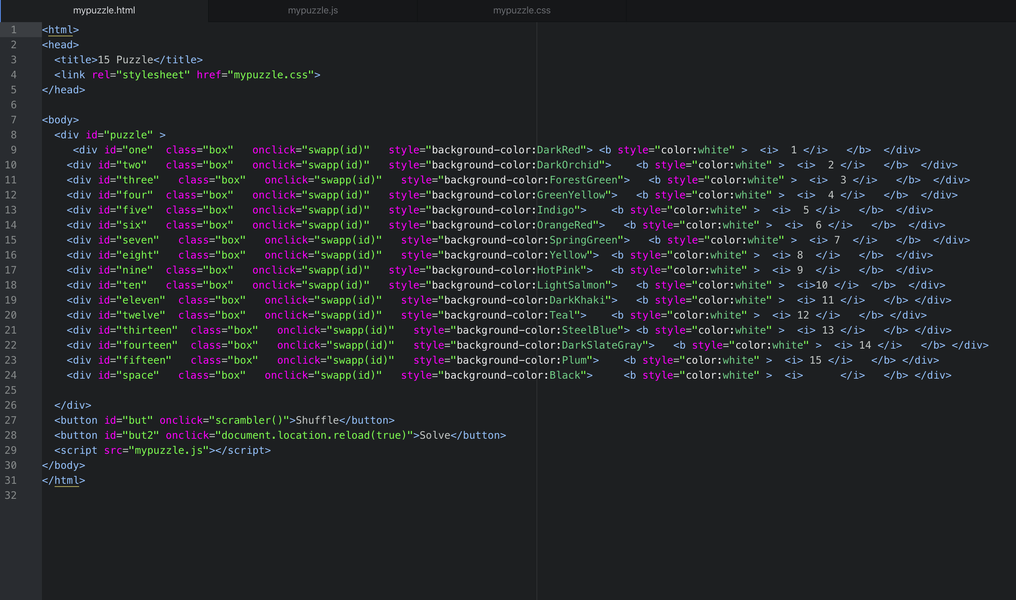

Slide 9

CSS

Slide 10
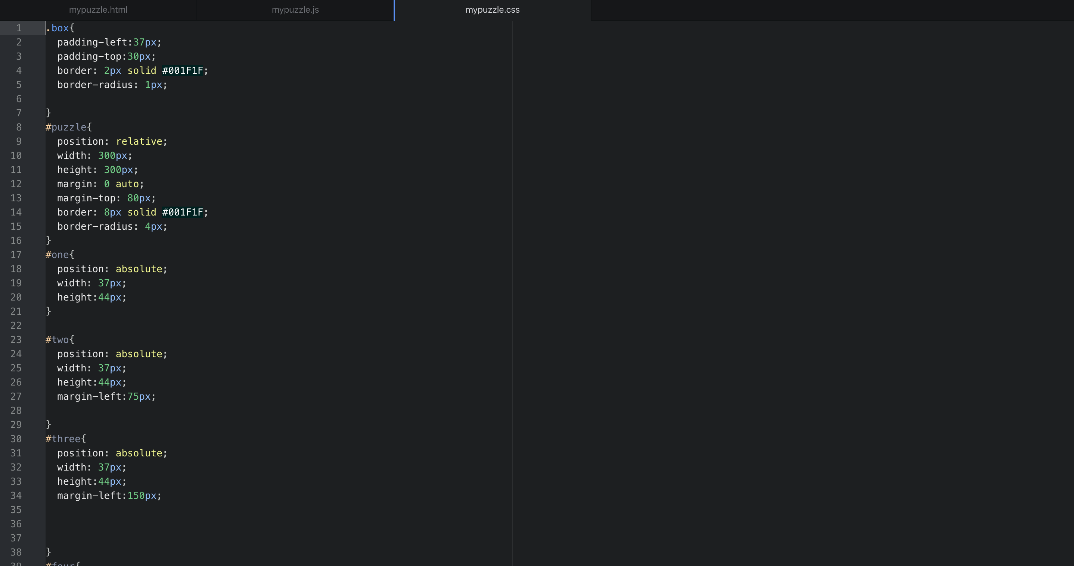

Slide 11

Javascript

Slide 12
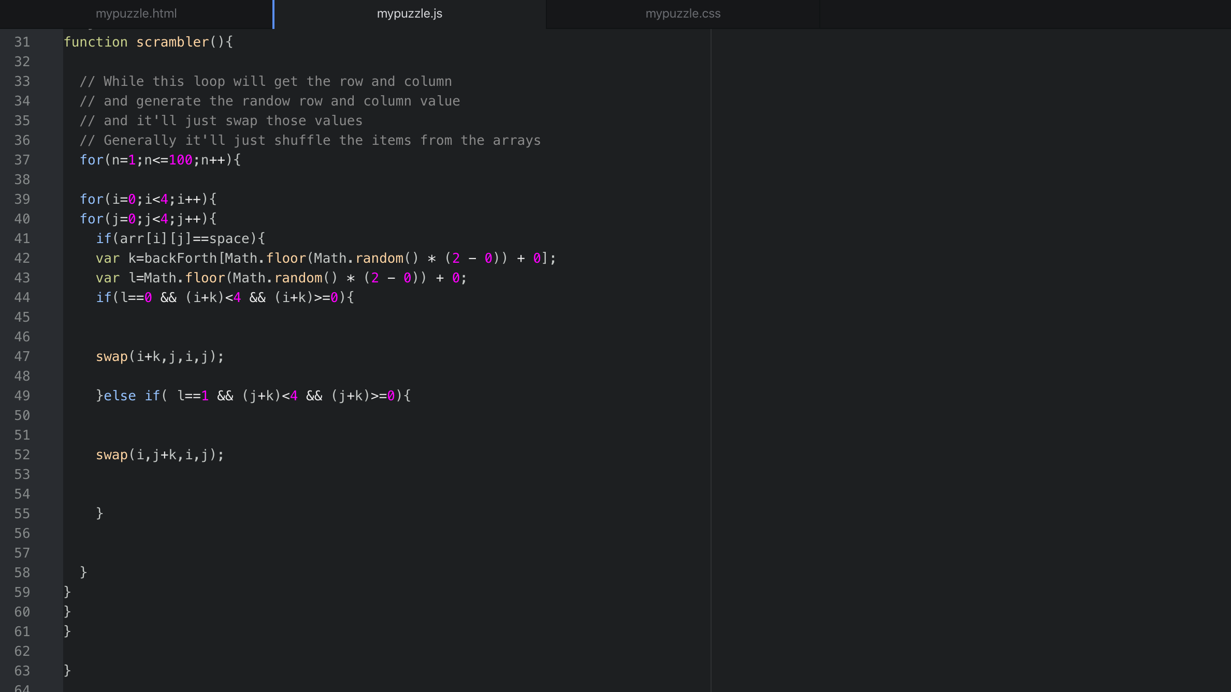
FUNCTION SCRAMBLER()

Slide 13
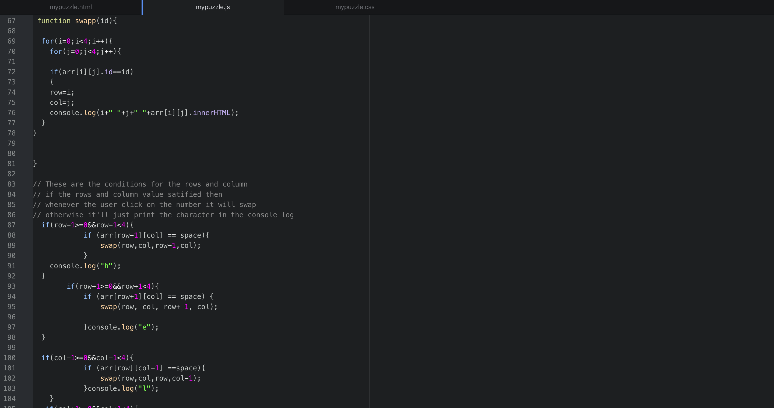
FUNCTION SWAP

Slide 14
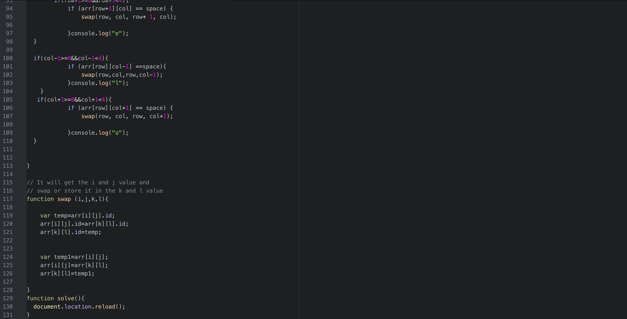
FUNCTION SWAP

Slide 15
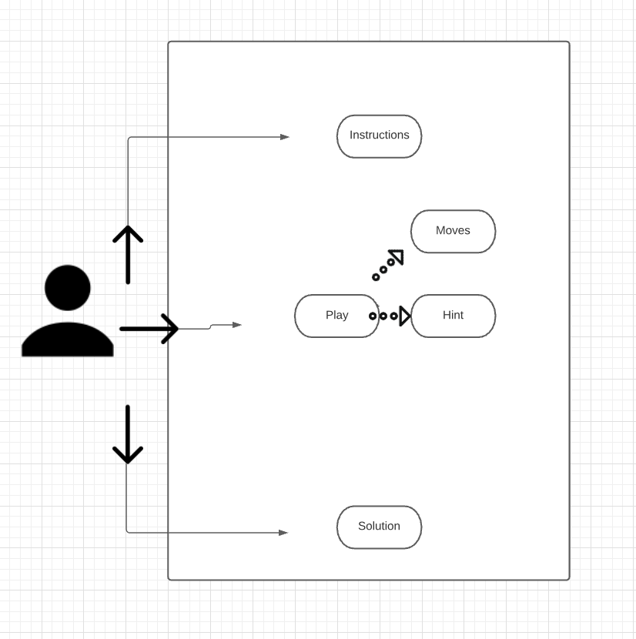
uml diagram

Slide 16
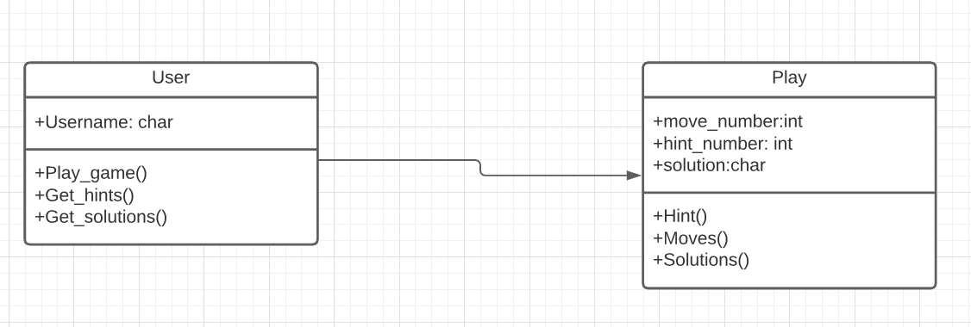
class diagram

Slide 17
THANKS FOR LISTENING!

