Slide 1
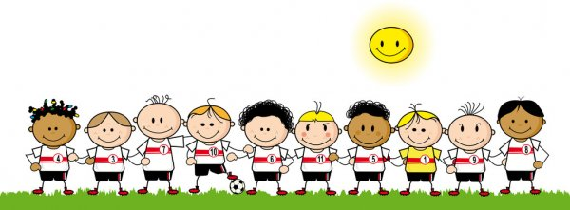
THE FRONTEND SOCCER KIDS
SERENA JOHNSON
AMBER PRADHAN
JOMO MORRIS

Slide 2
PROBLEM STATEMENT: THE GREAT GAME
During these critical times, many young children and teens are stuck in the home without much to do expect for schoolwork, chores, and sleep. With developing a website that allows users to play the game of soccer, it will not only allow for the user to have entertainment, but also help with the ability to have observation skills , intuitive abilities, and start developing better alertness and concentration.

Slide 3
REQUIREMENTS
User Requirements
System Requirements
The user can choose their own player
The user will be able to play a soccer game until the user wins or loses
The user will be able to say whether or not they wish to continue to a new game or quit
The user has an option to play alone or with another player
Once user finishes a game, a score will be shown and information on if the user won or lost
System allows for user to be notified whether or not if they can continue on to a new game

Slide 4
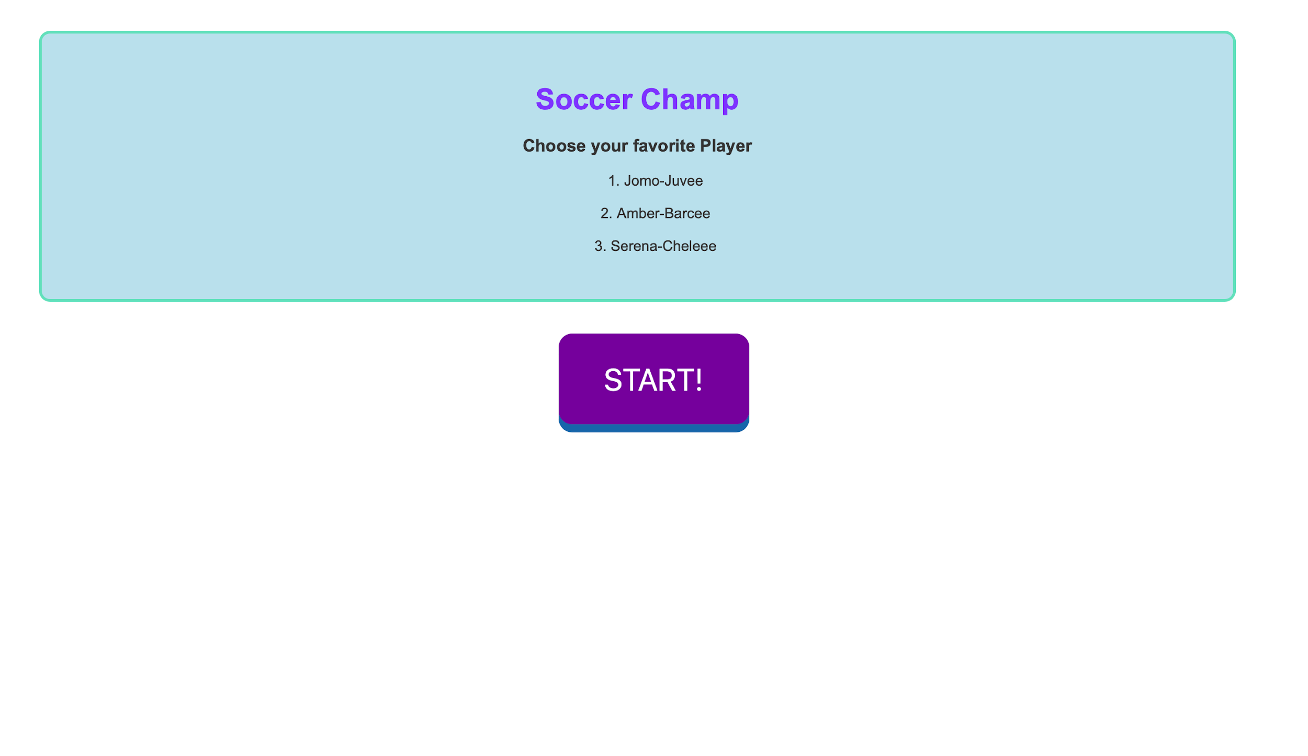
USER INTERFACE

Slide 5
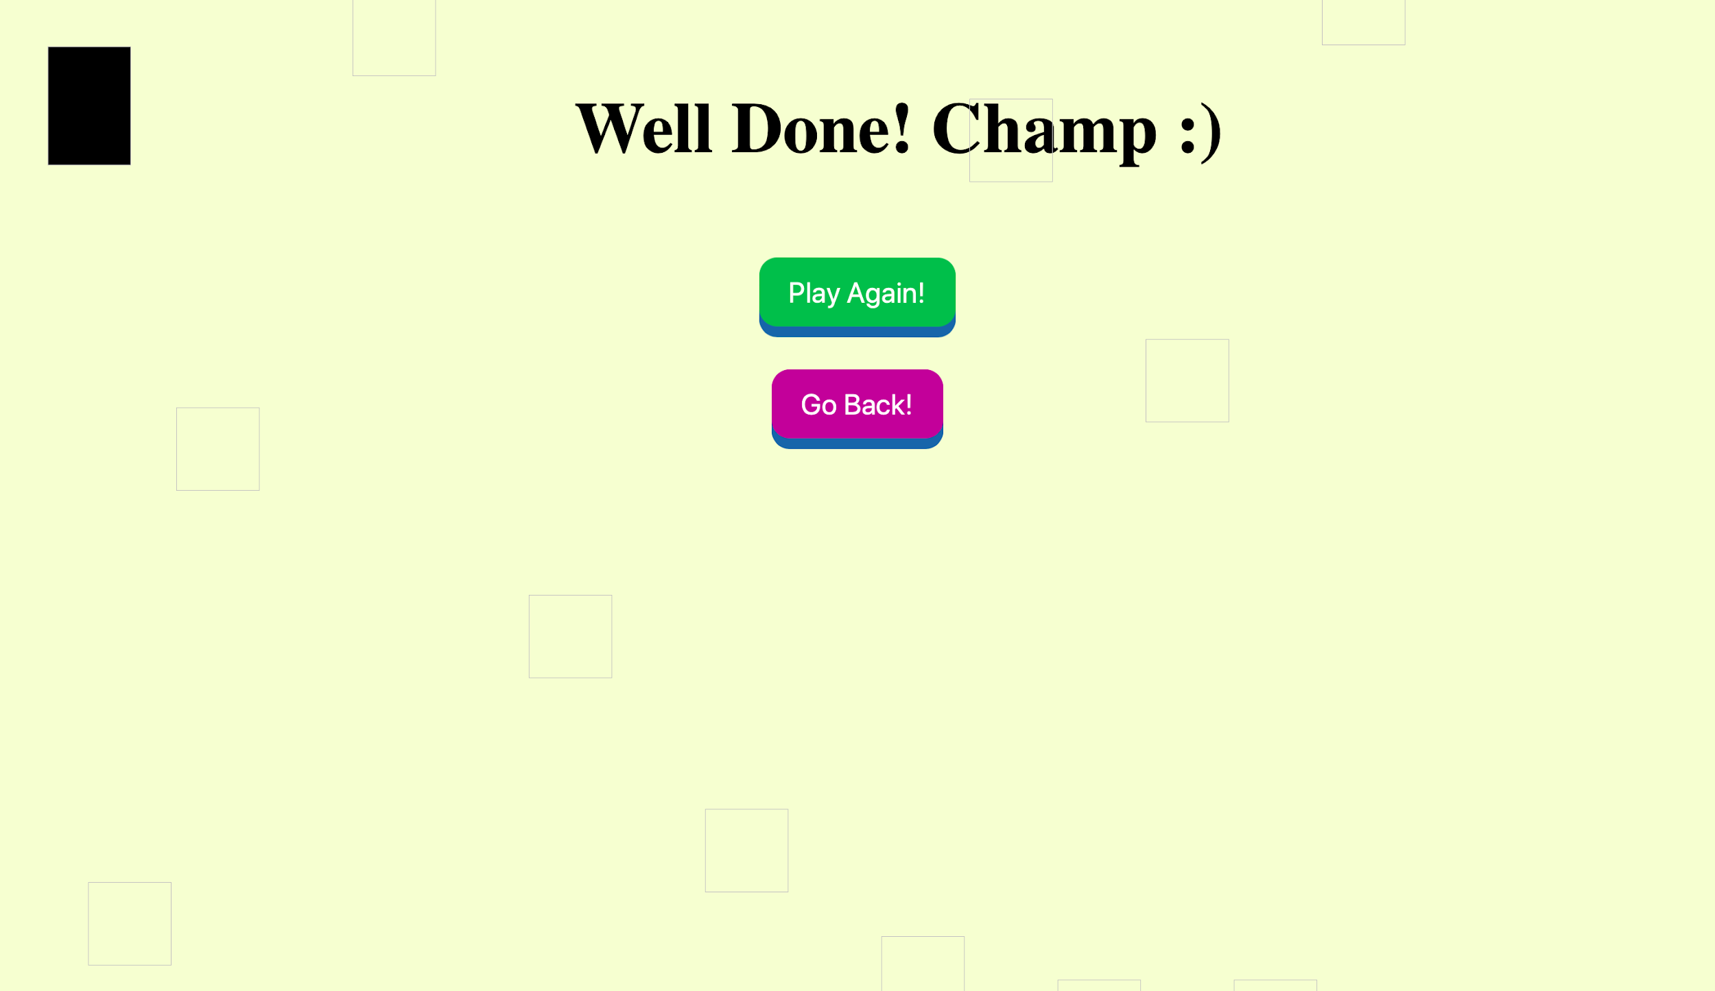
USER INTERFACE

Slide 6
KEY DESIGN FEATURES
ability to choose to play another game after winning/losing previous game
ability to play alone or multiplayer
choice of players
accessible to all users

Slide 7

OUR CODE

Slide 8
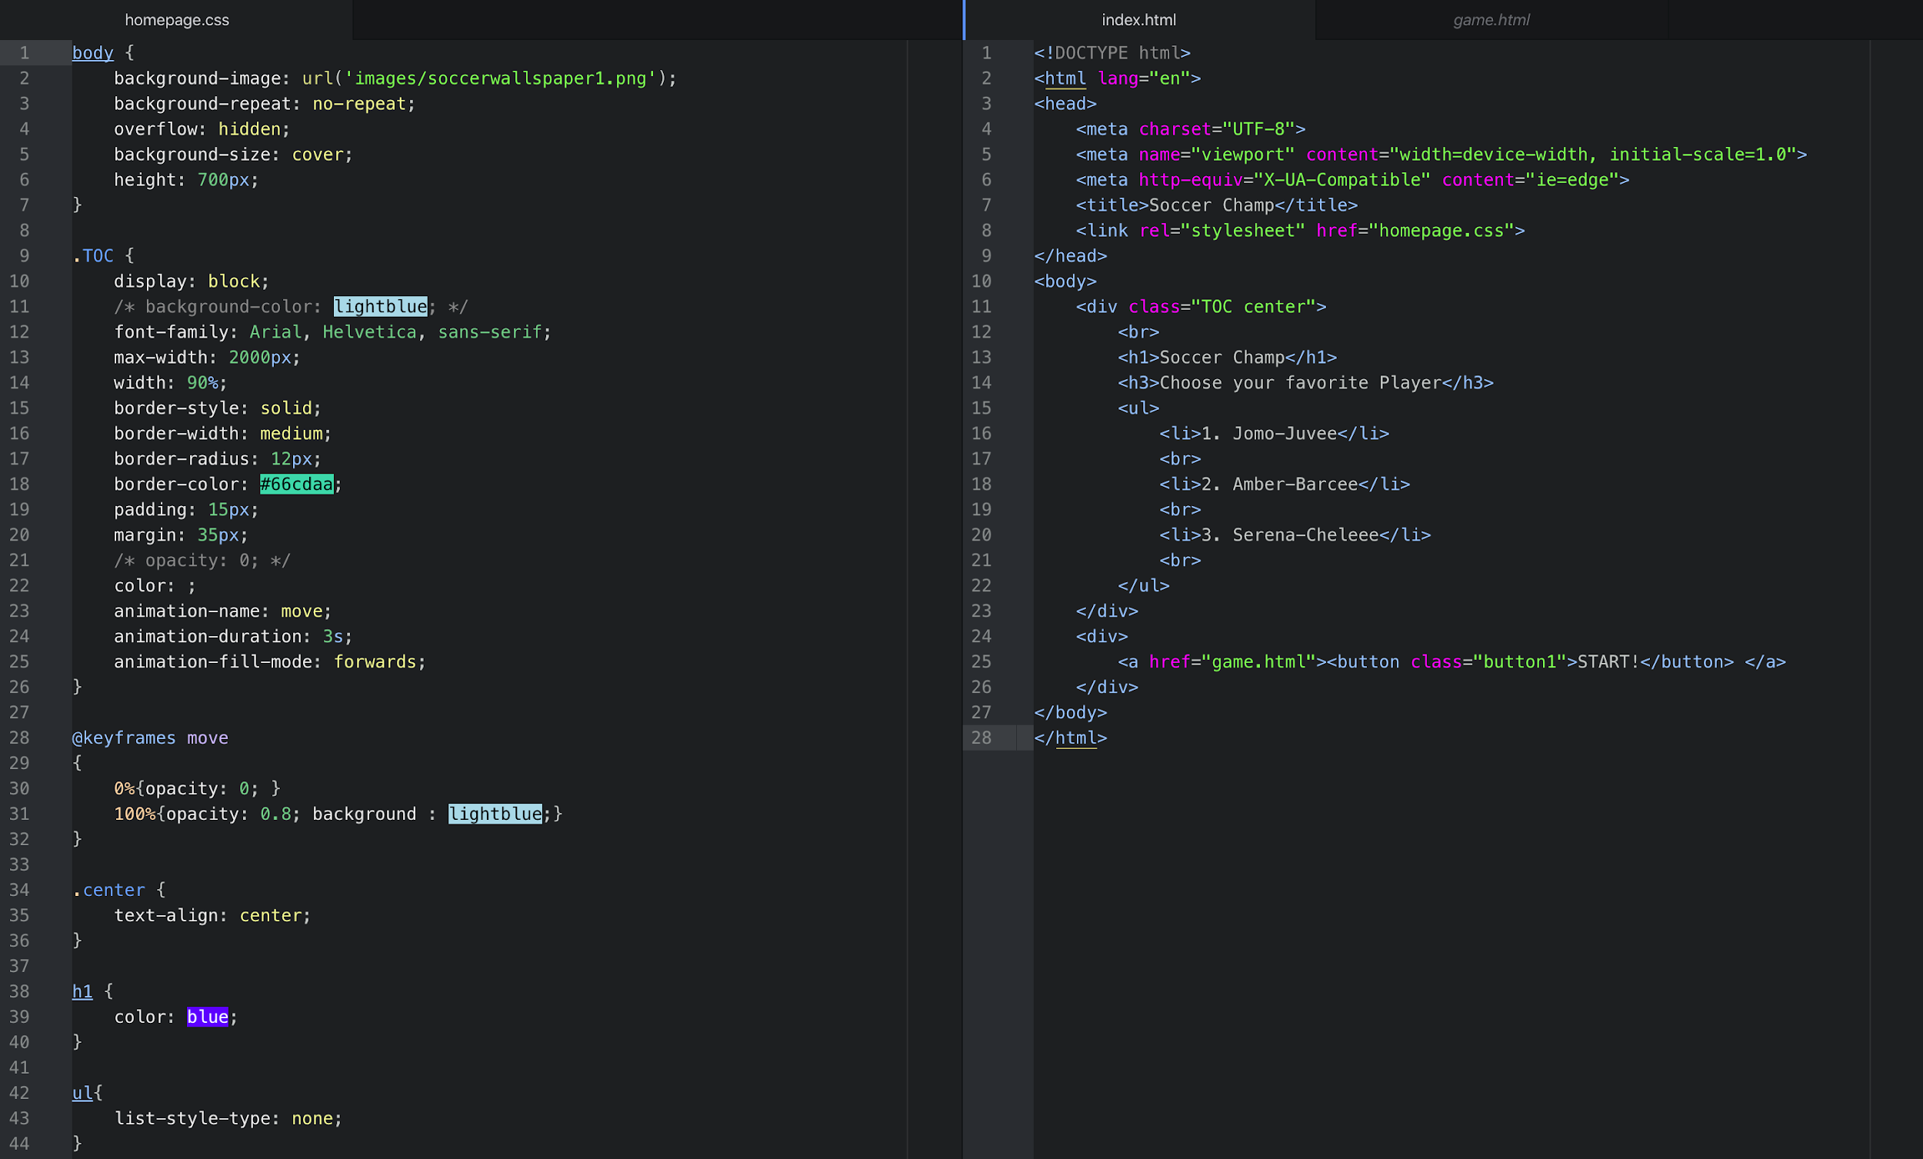

Slide 9
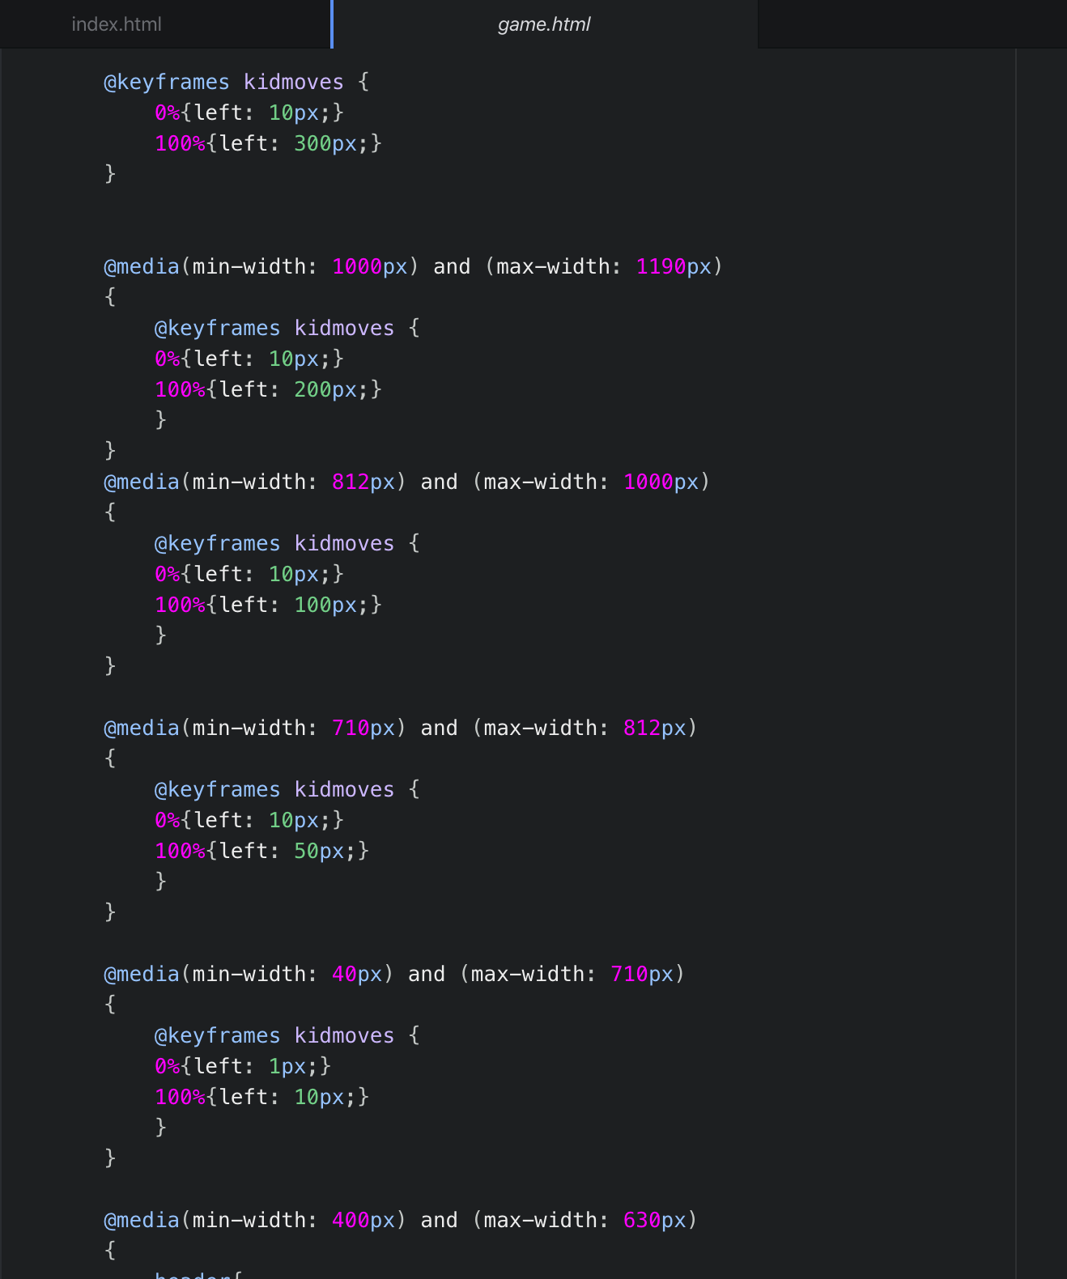
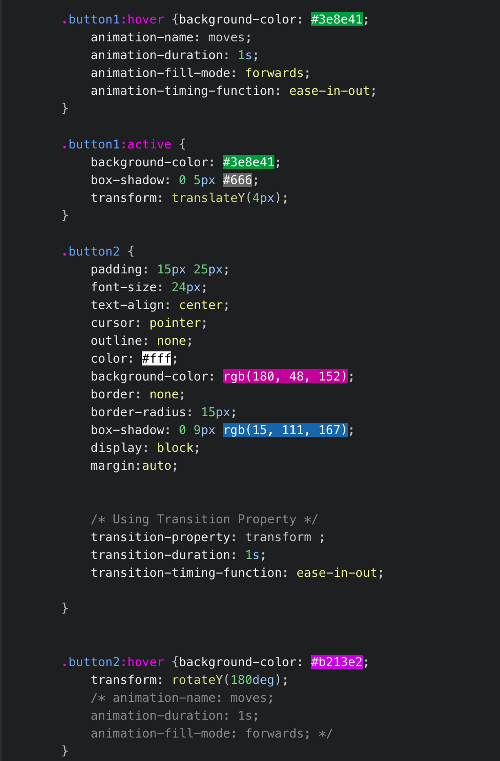

Slide 10
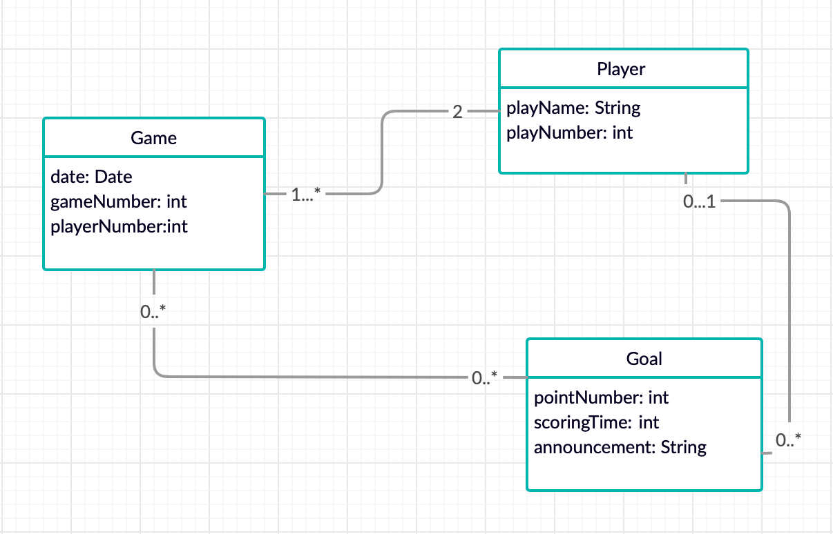
CLASS DIAGRAM

Slide 11
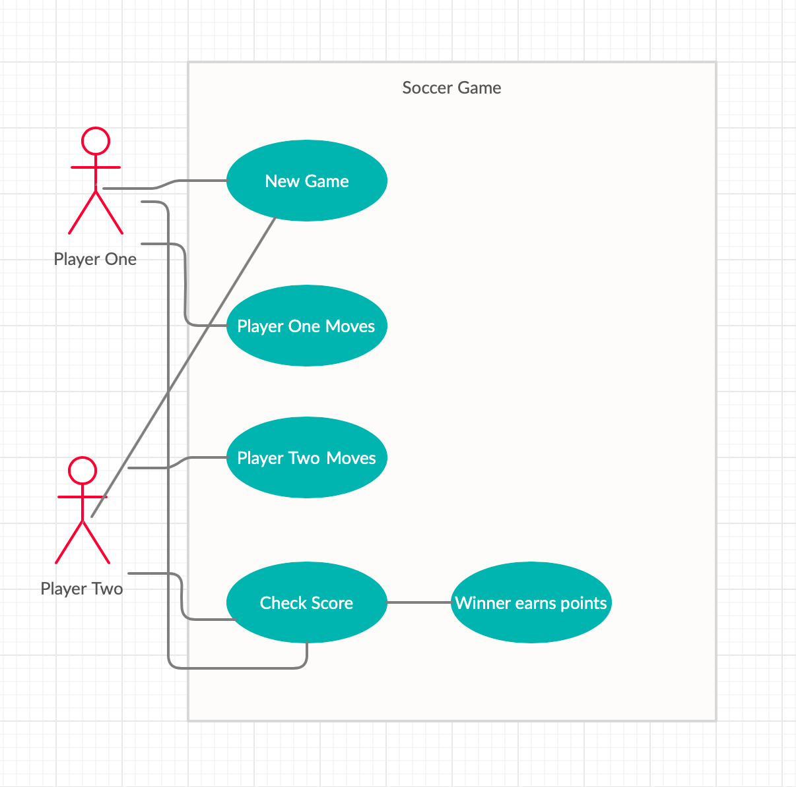
USE CASE DIAGRAM

Slide 12
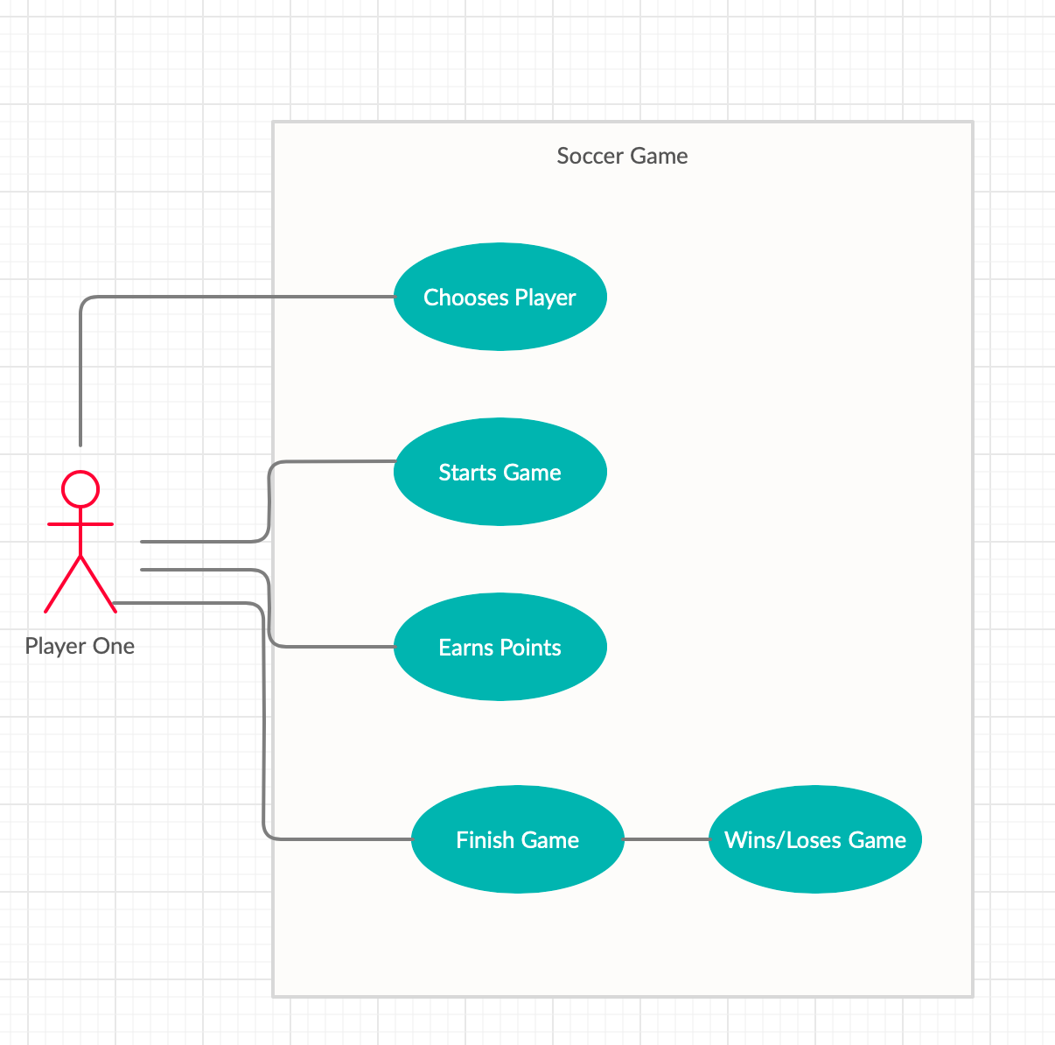
USE CASE DIAGRAM

Slide 13
Thanks for listening!

