Slide 1

Ciao Coffee
Presented By-
James Joy
Shallu Rana
Jessy Felix
Sandeep Kaur
Pinu Raja
Kevin

Slide 2


Slide 3
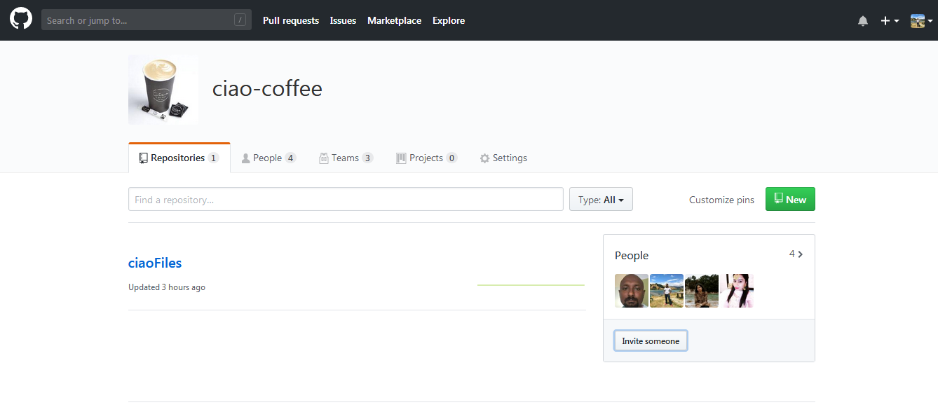
GITHUB Organisation – Ciao Coffee

Slide 4
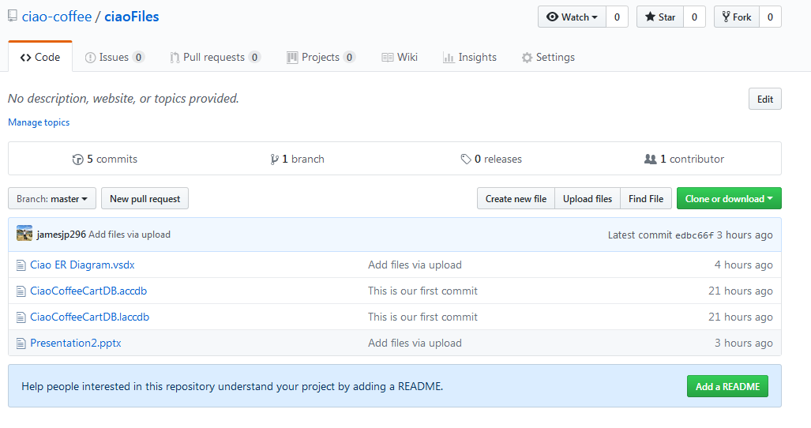
Manage Files

Slide 5
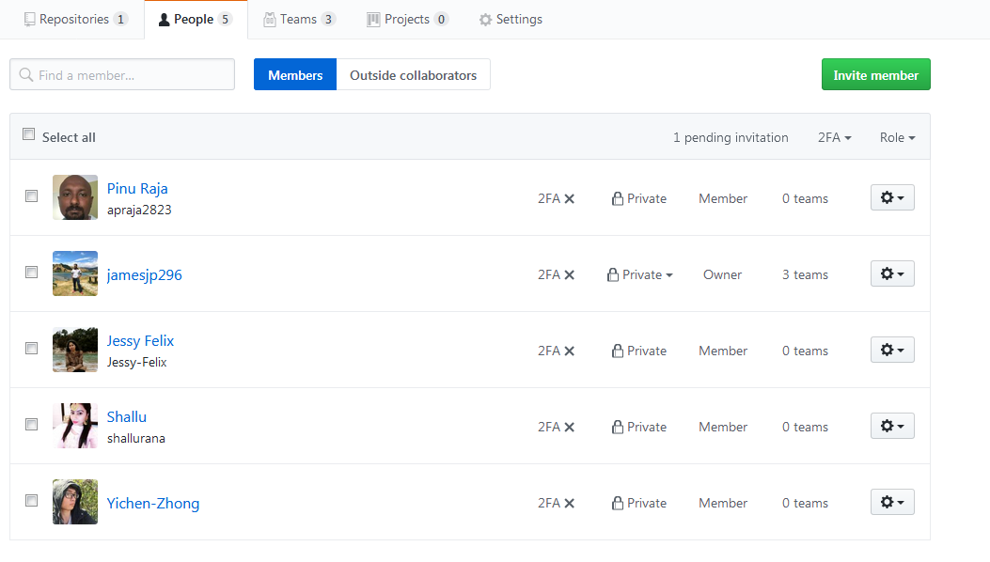
Team Members

Slide 6
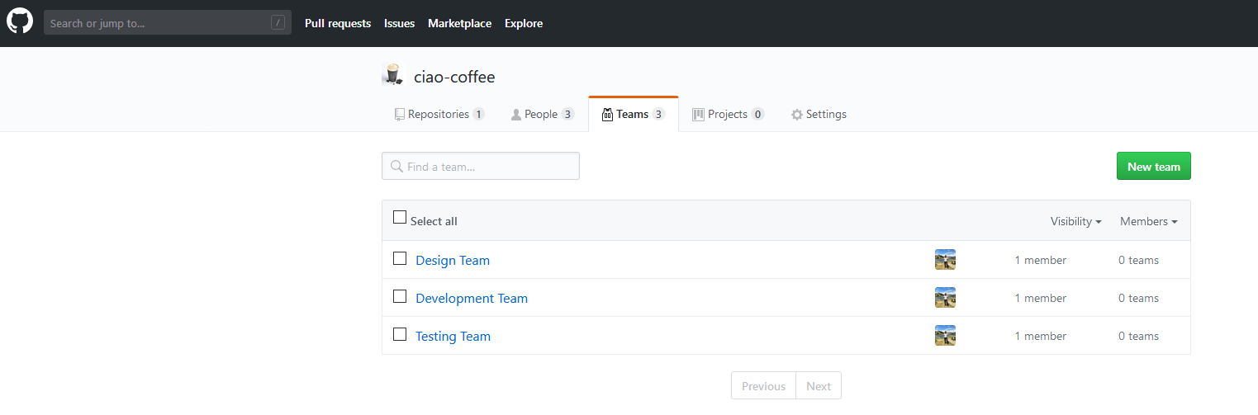
Teams in the Project

Slide 7
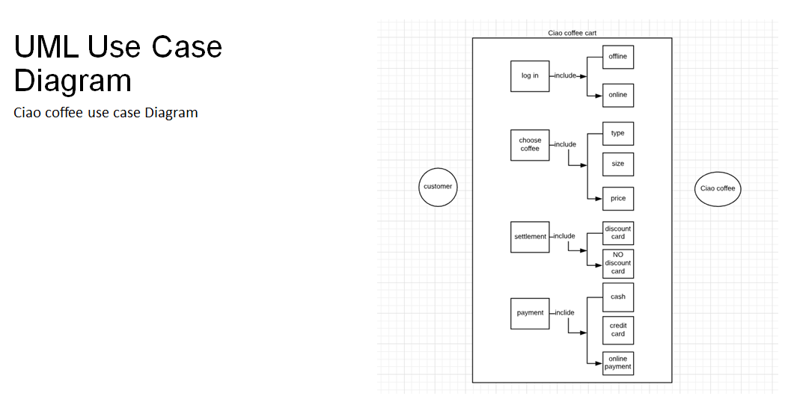
UML Diagram

Slide 8
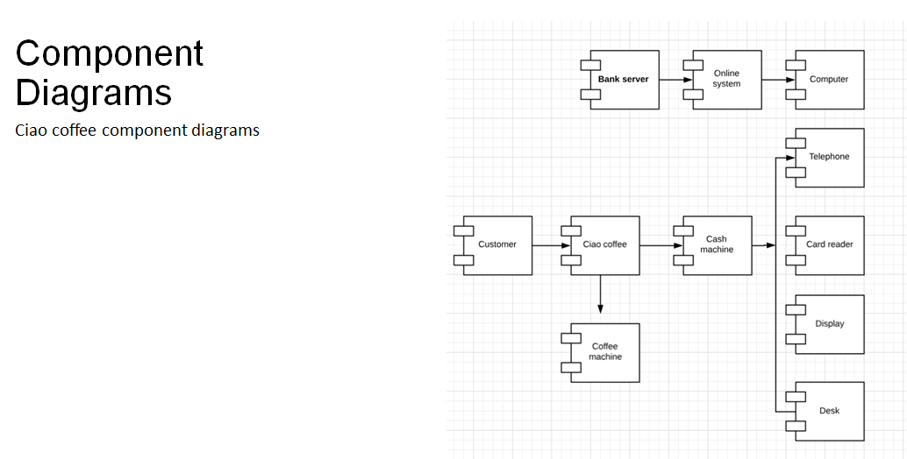
Component Diagram

Slide 9
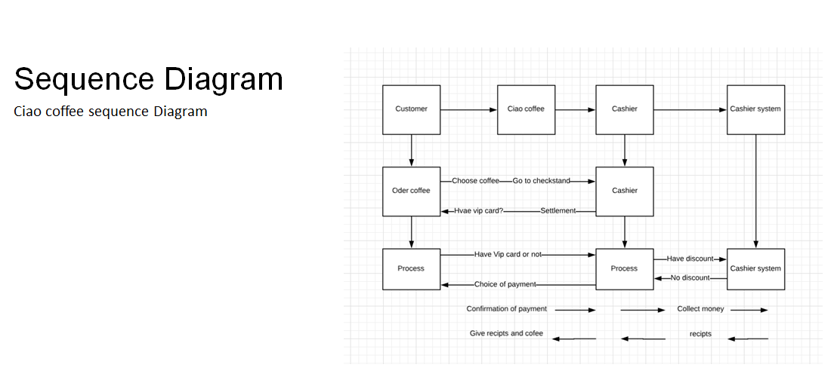
Sequence Diagram

Slide 10
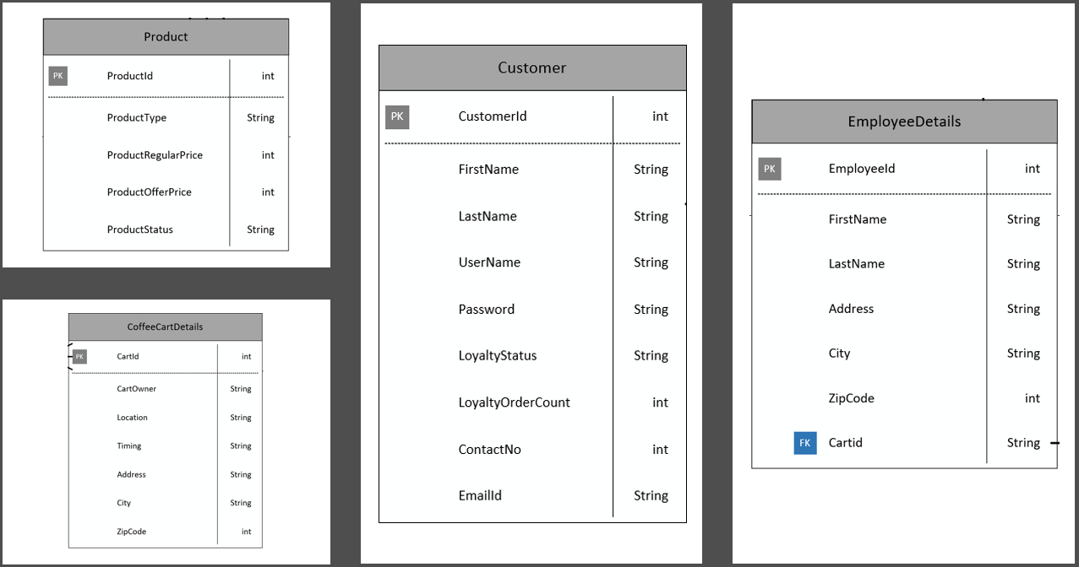
Master Entities

Slide 11
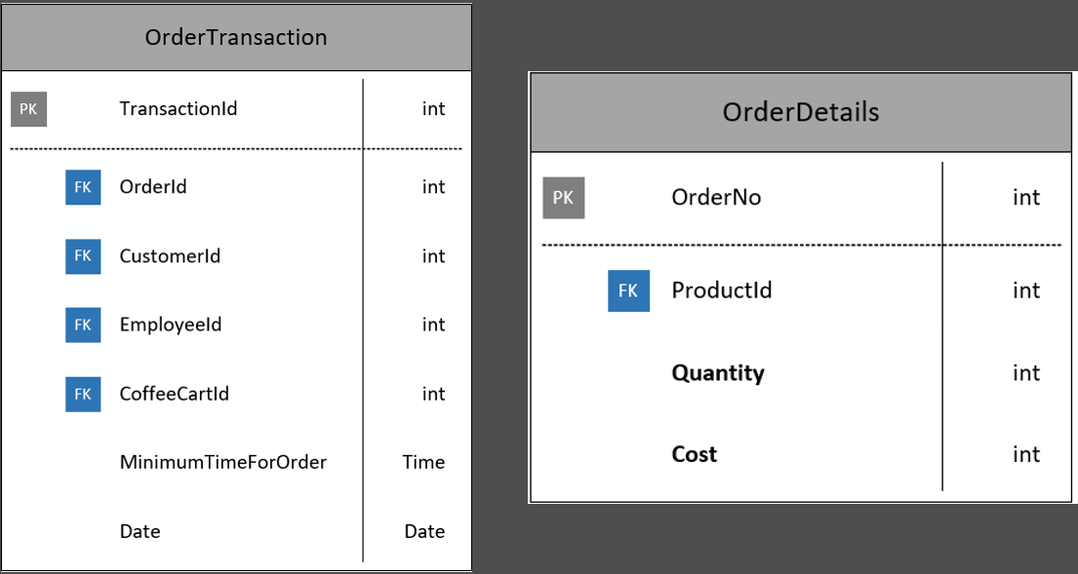
Transactional Entities

Slide 12
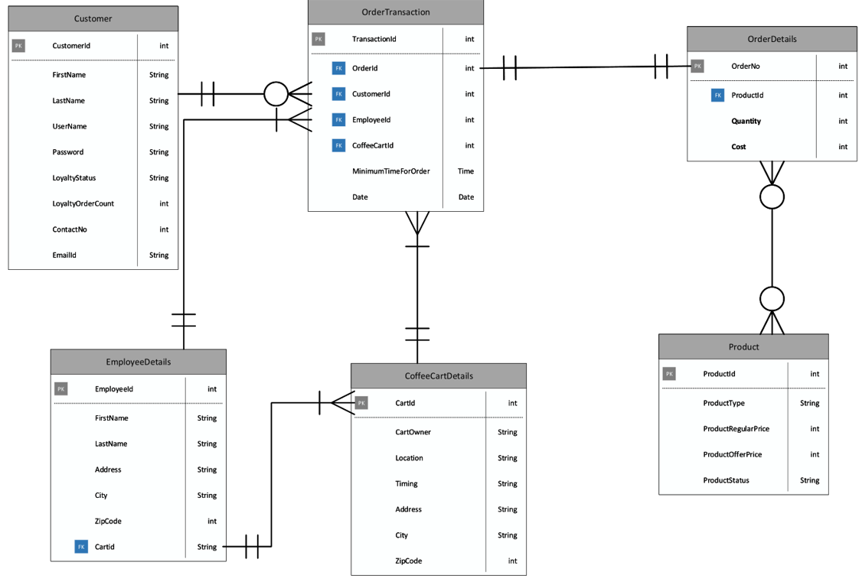
CIAO ER Diagram

Slide 13
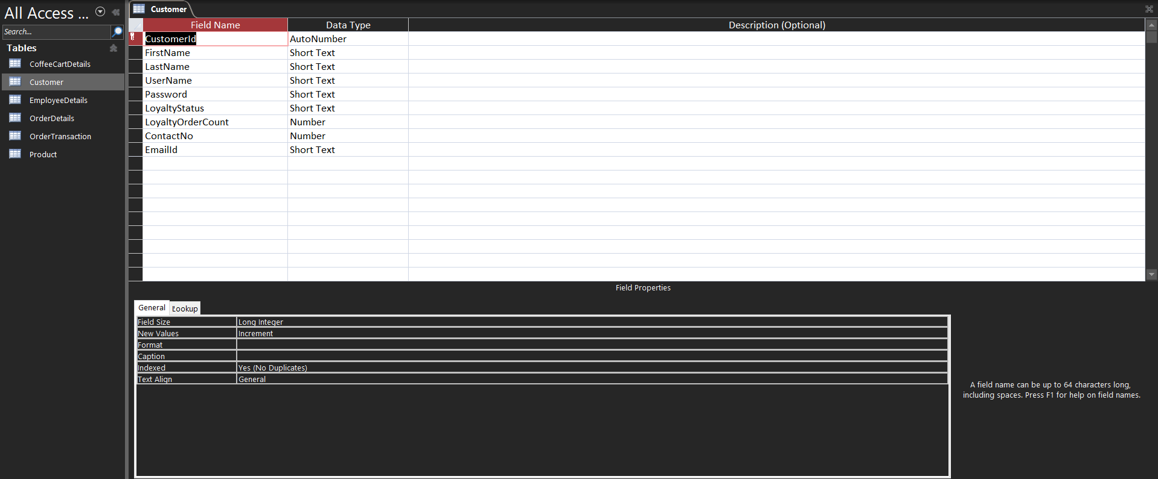
Customer Table

Slide 14
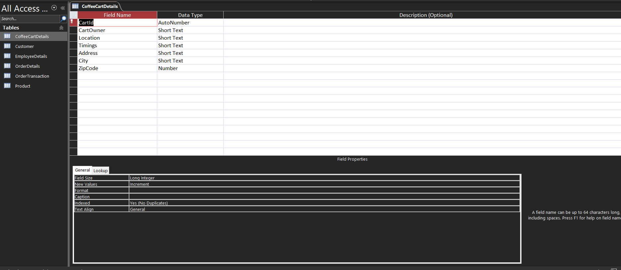
Ciao Coffee Cart Details Table

Slide 15
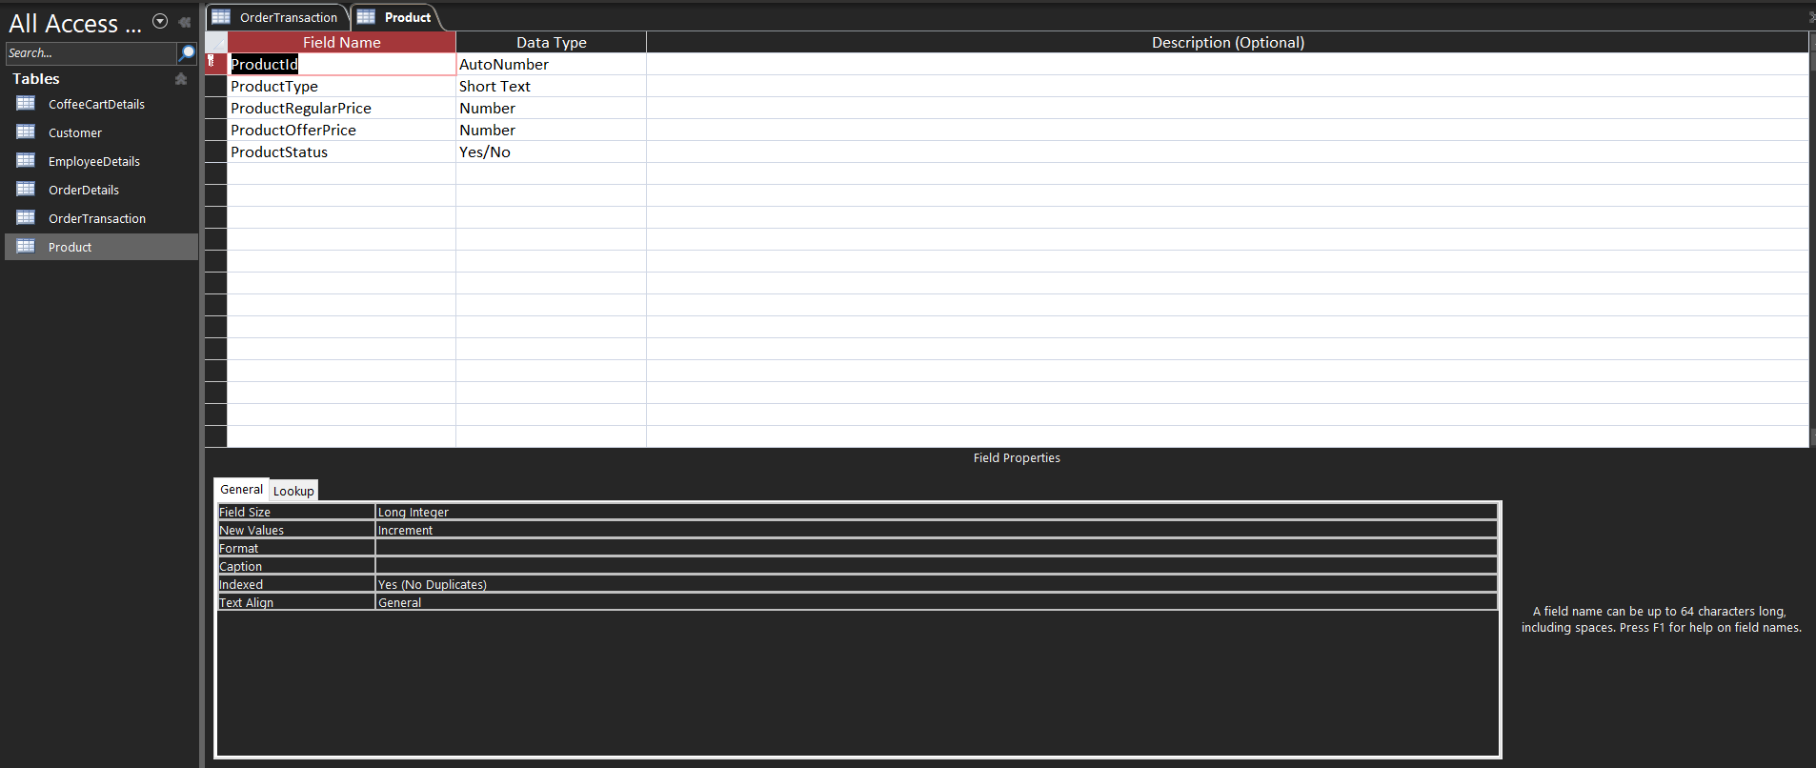
Product Table

Slide 16

Employee Table

Slide 17
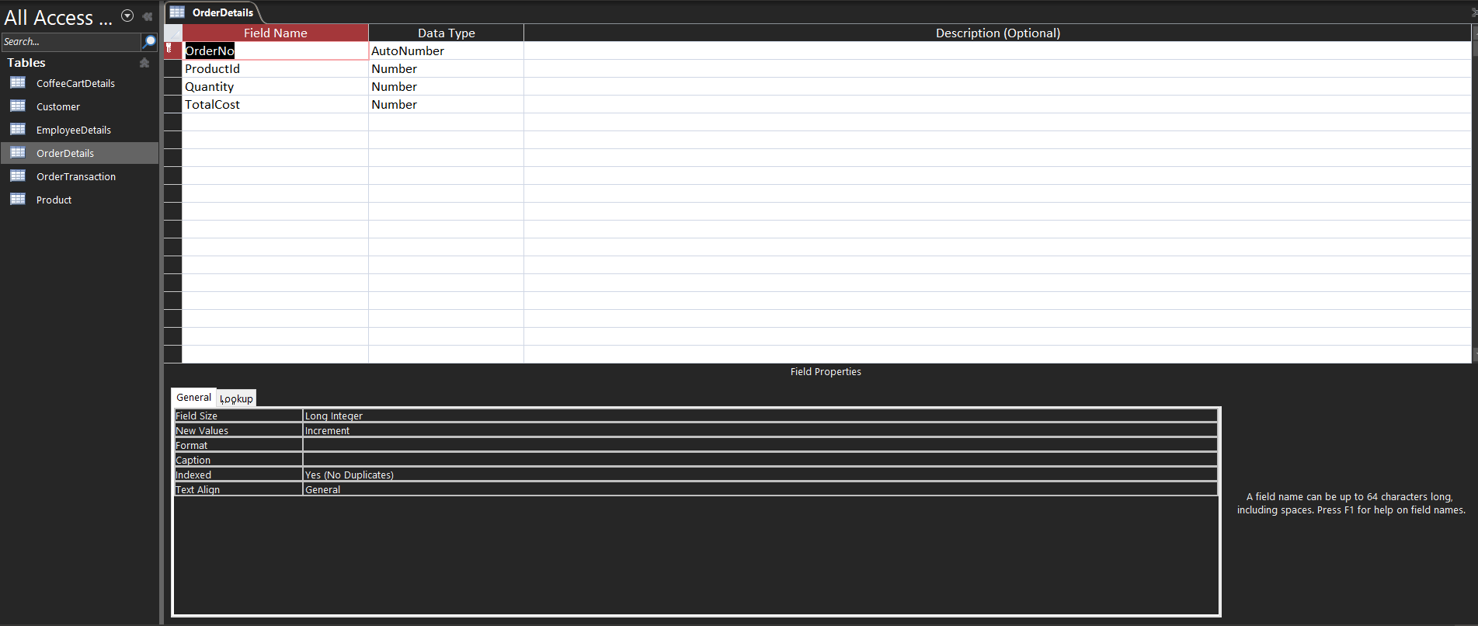
Order Details Table

Slide 18

Transaction Table

Slide 19
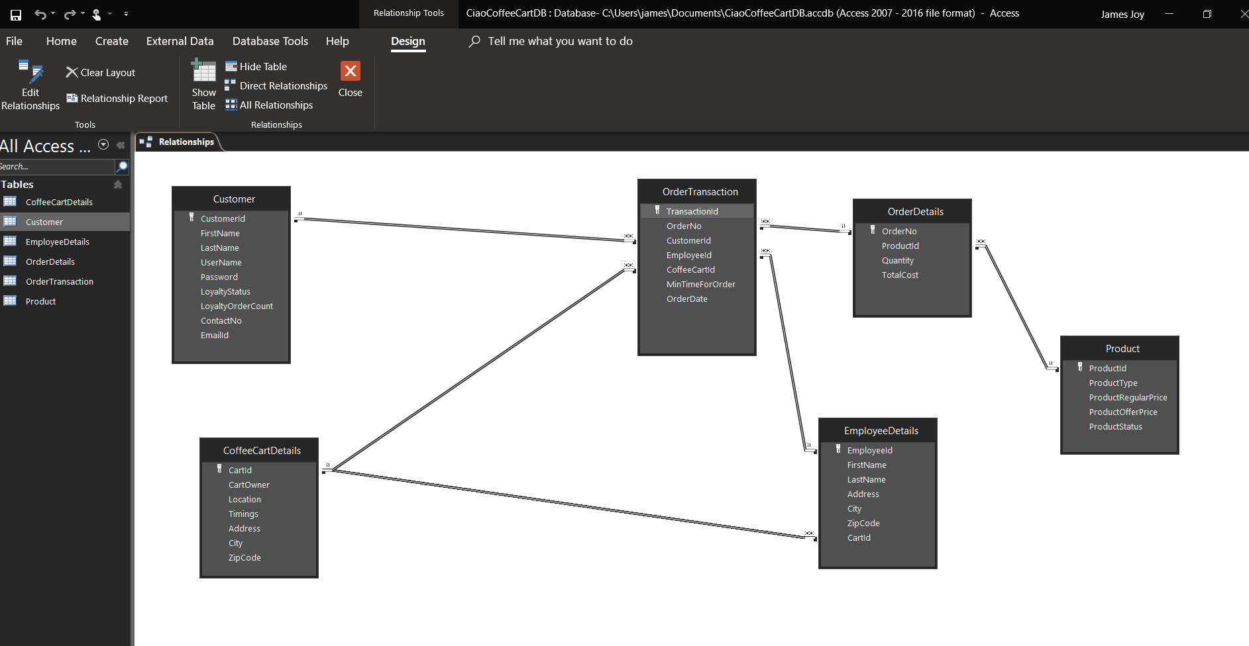
Access Relationship Diagram

Slide 20
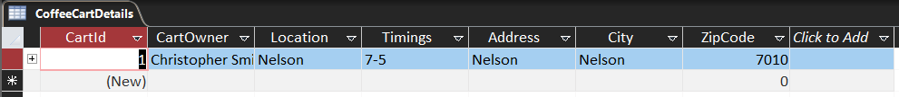
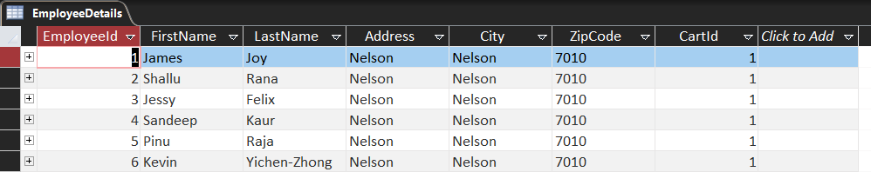
Access Tables
Coffee Cart Details
Employee Details

Slide 21
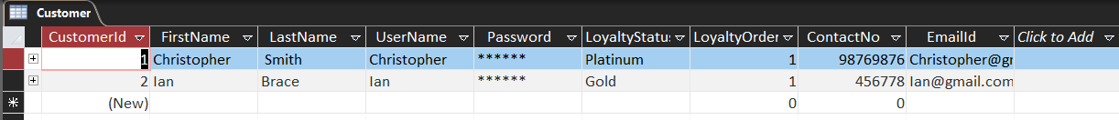
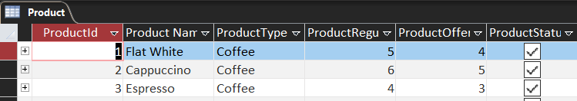
Access Tables
Customer Details
Product Details

Slide 22
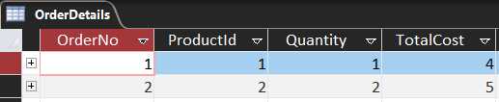
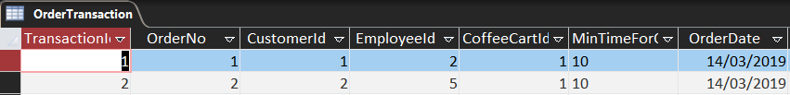
Access Tables
Order Details
Transaction Details

Slide 23
Thank You

