Slide 1

Ciao Coffee
Presented By-
James Joy
Shallu Rana
Jessy Felix
Sandeep Kaur
Pinu Raja
Kevin

Slide 2

Third Sprint
Make Data tables in Access Database
Create Data Entry Forms
Create Queries to fetch
Number of Coffee’s Sold
Types of Coffee’s Sold
Profit Made
Types of Customer (Online, Phone etc..)

Slide 3
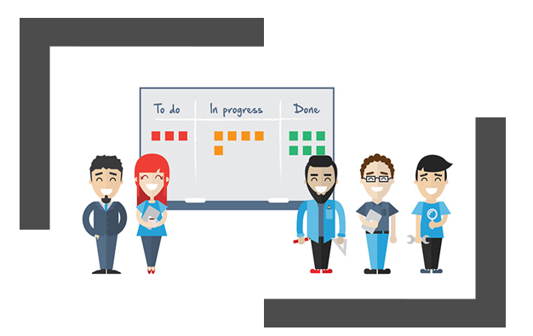

What we achieved
We created data table in Access Database
We created Data Entry Forms
We created Reports in Access that displays
Number of Coffee's Sold
Types of Coffee's Sold
Monthly Report of the Profit Made
Types of Customer (Online , Phone, etc...)
P.S :We are still using GitHub

Slide 4
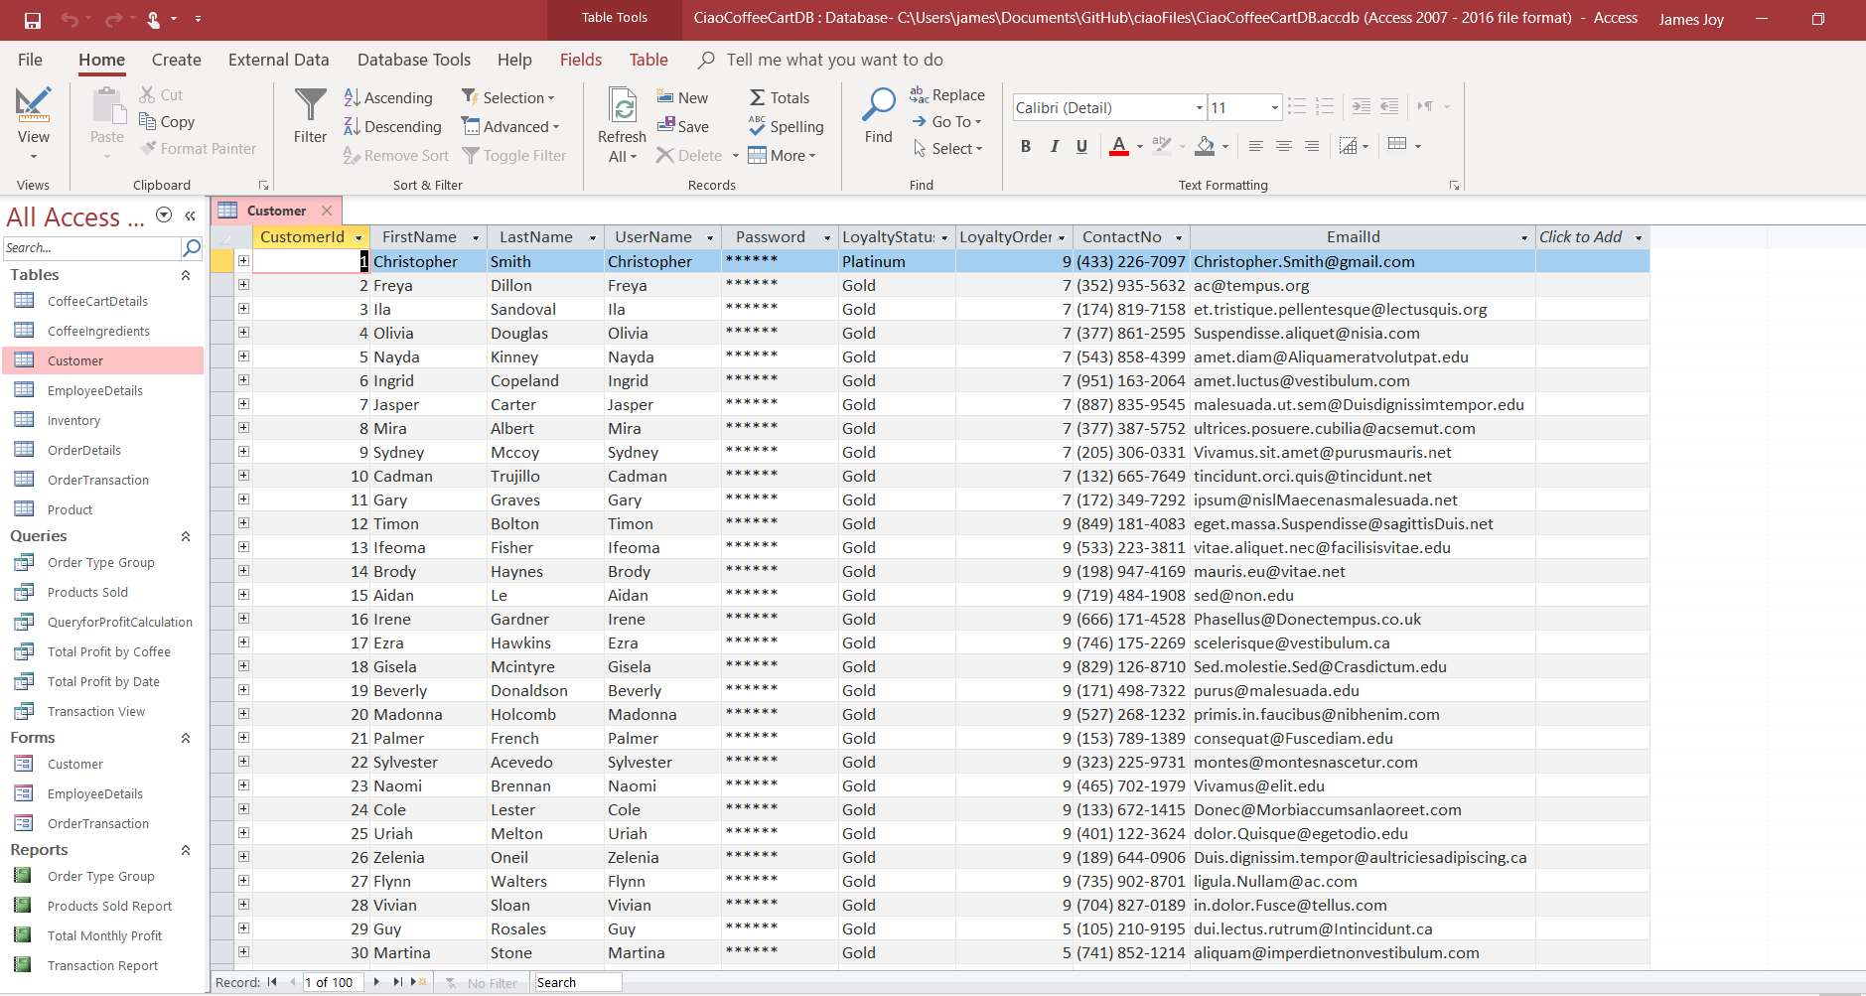
Customer Details Table

Slide 5
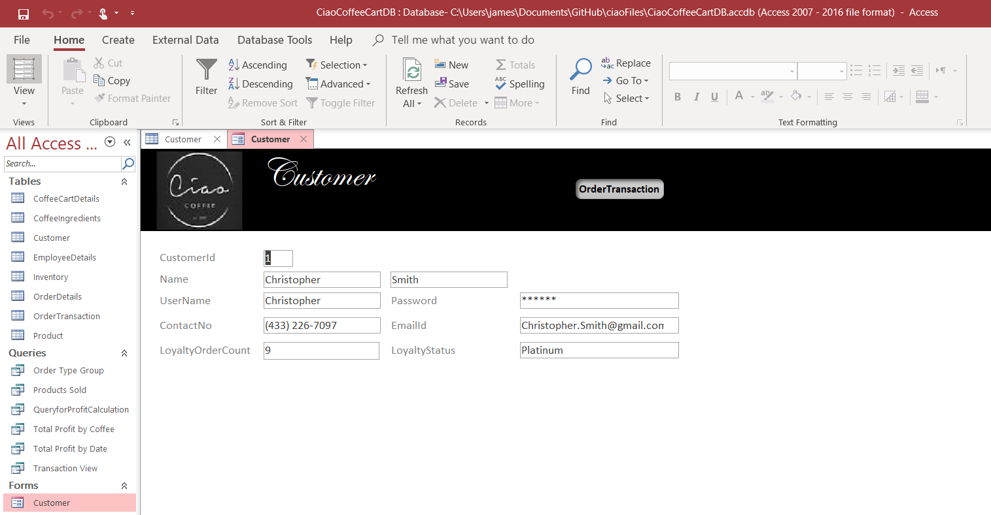
Customer Data Form

Slide 6
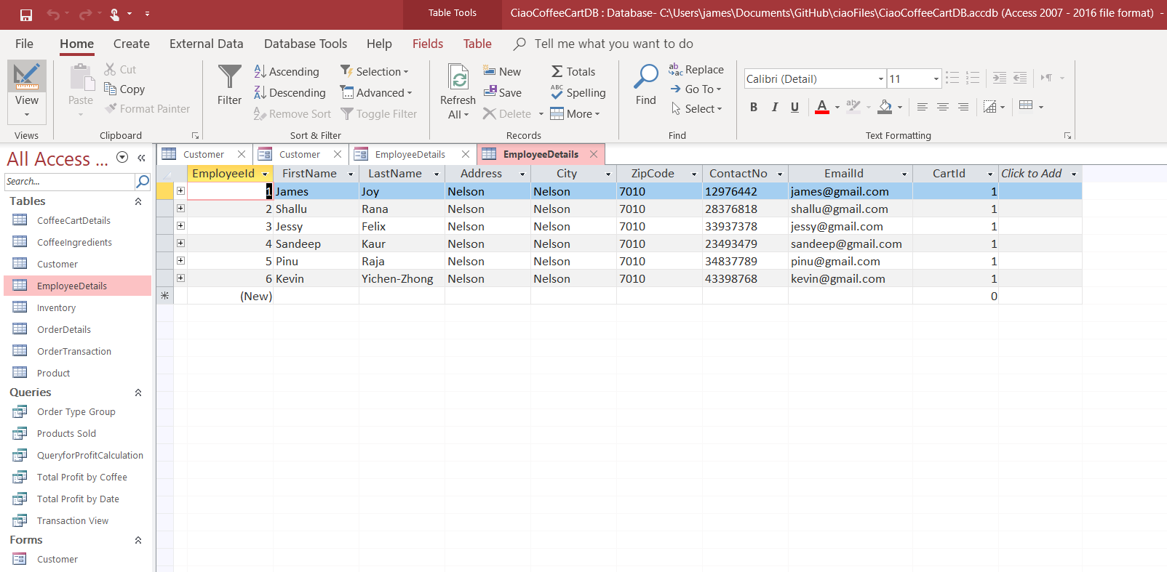
Employee Details Table

Slide 7
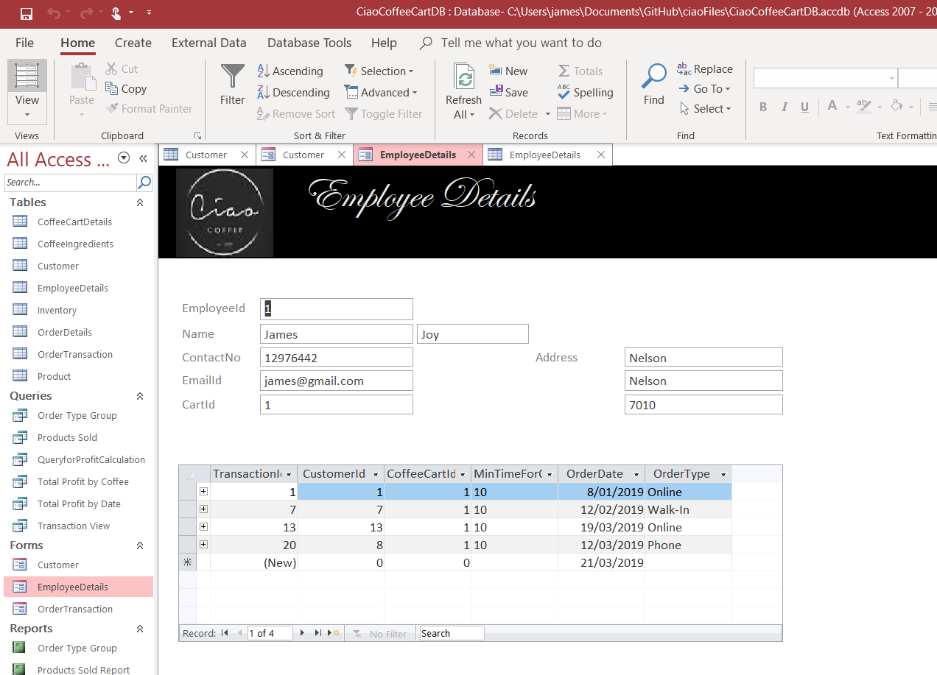
Employee Details Table

Slide 8
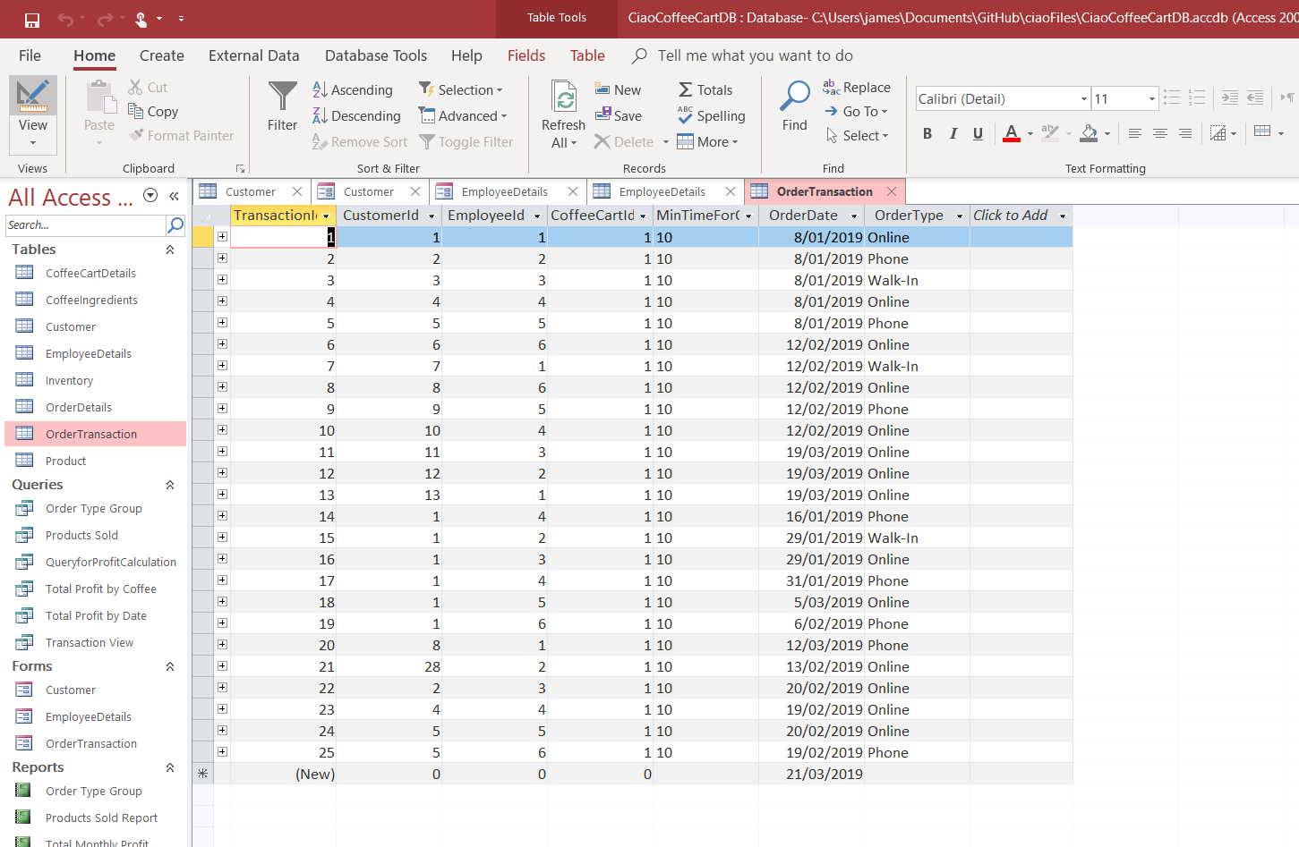
Transaction Details Table

Slide 9
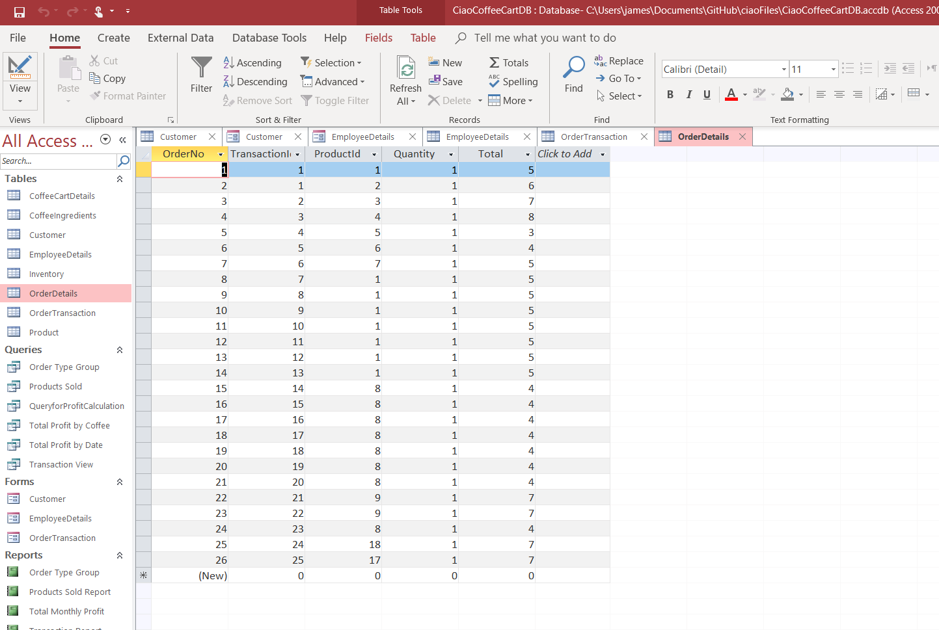
Order Details Table

Slide 10
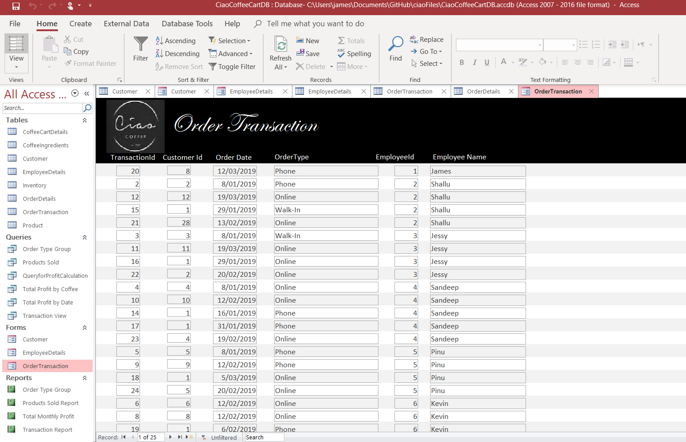
Order Details Form

Slide 11
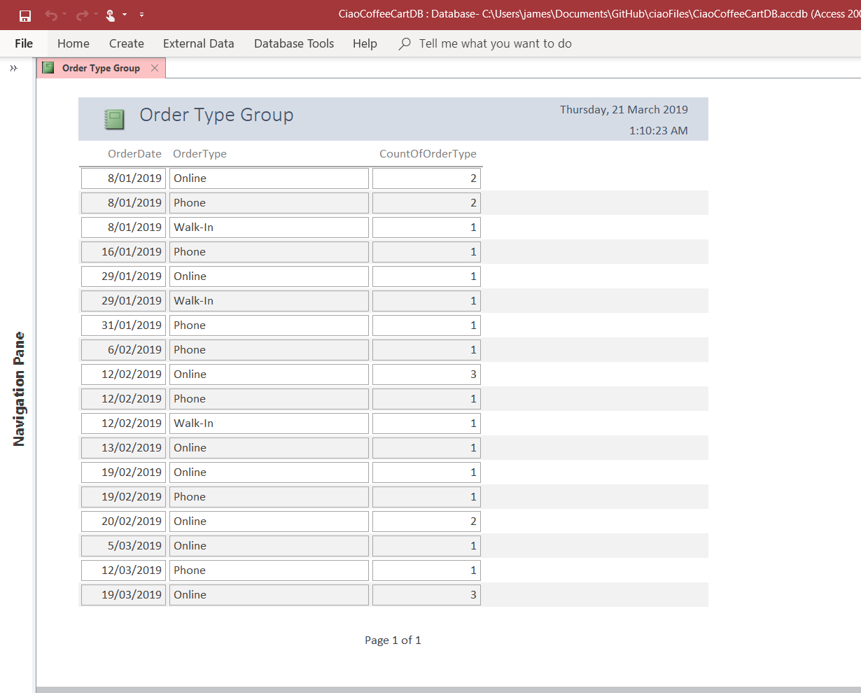
Order Type Report

Slide 12
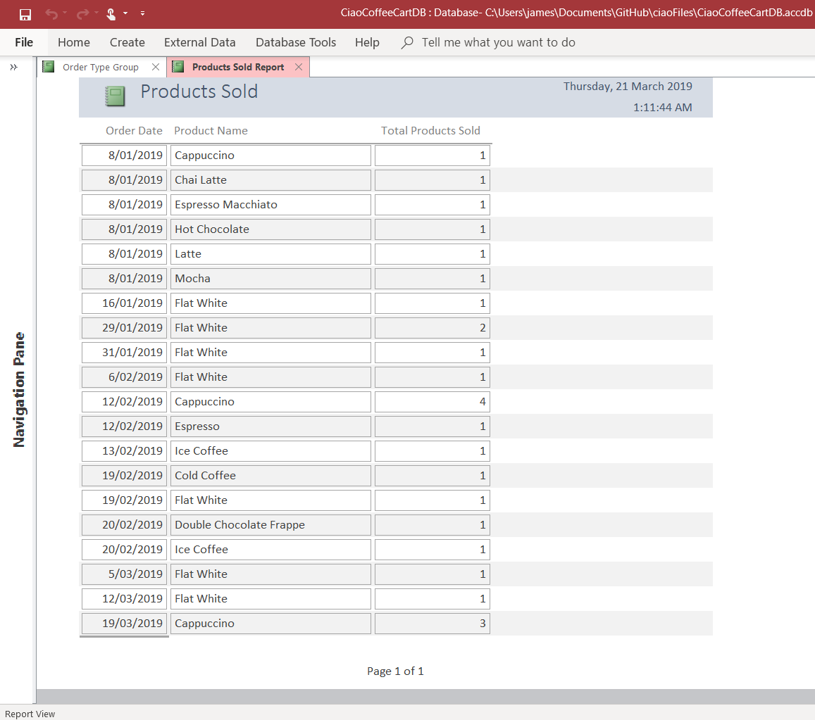
Products Type Report

Slide 13
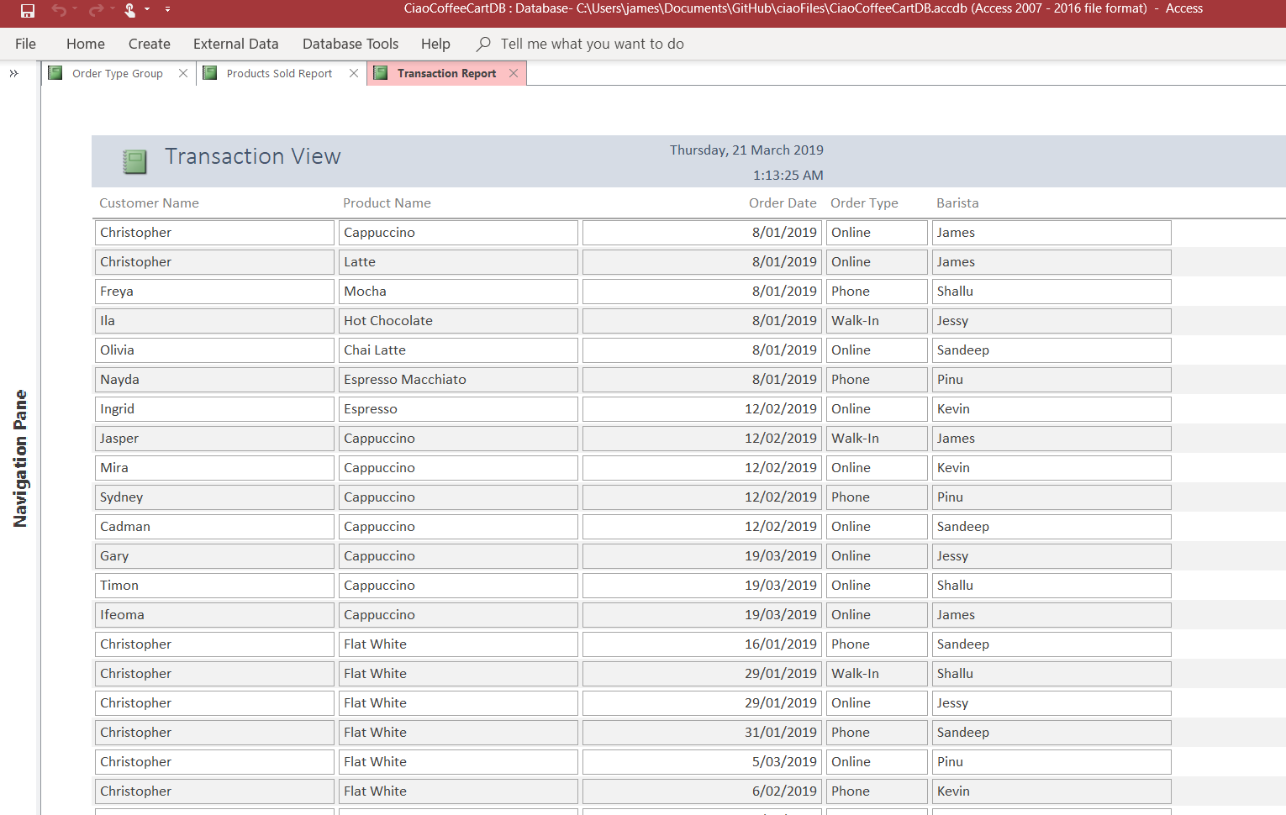
Transaction Report

Slide 14
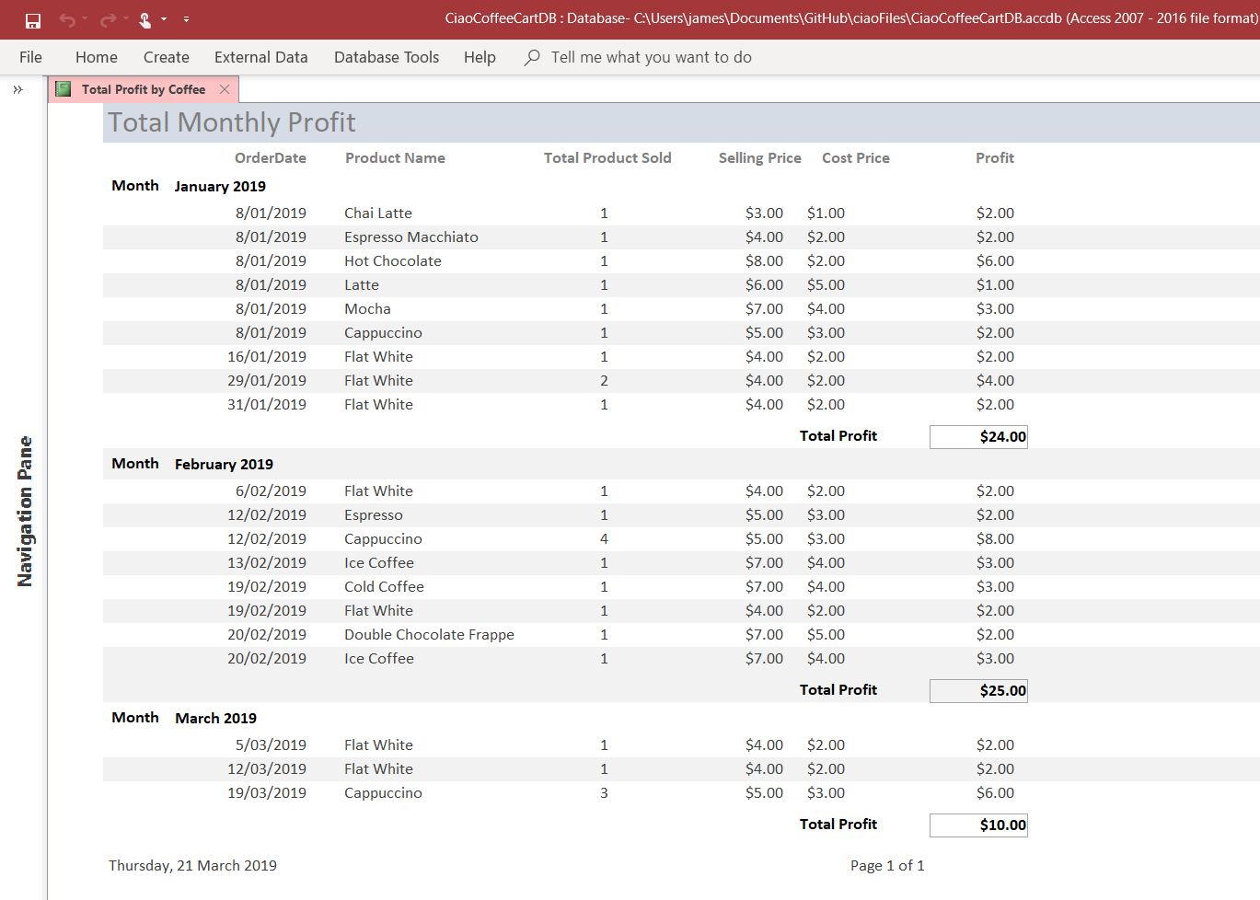
Monthly Profit Report

Slide 15
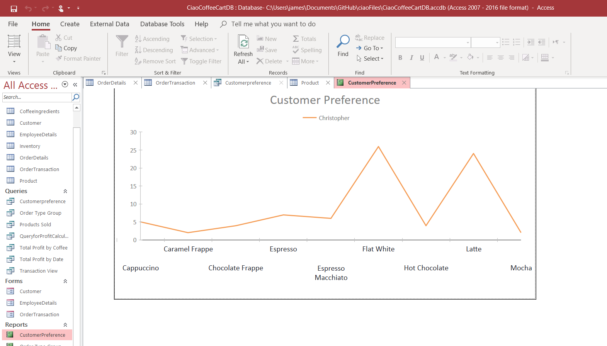
Customer Preference Graph

Slide 16
Thank You

Slide 17
References
GitHub. (n.d.). In Wikipedia. Retrieved from https://en.wikipedia.org/wiki/GitHub
Novoseltseva, E. (2017).Benefits of using Github. Retrieved from https://apiumhub.com/tech-blog-barcelona/using-github/
Laurence, B. (2019).What Is GitHub, and Why Should I Use It?. Retrieved from https://www.thebalancecareers.com/what-is-github-and-why-should-i-use-it-2071946
GitHub. (2016). Hello World. Retrieved from https://guides.github.com/activities/hello-world/
Microsoft. (2019). Create a Database Model (also known as Entity Relationship diagram). Retrieved from https://support.office.com/en-us/article/create-a-database-model-also-known-as-entity-relationship-diagram-7042e719-384a-4b41-b29c-d1b35719fc93
Quackit. (2019).Microsoft Access Tutorial. Retrieved from https://www.quackit.com/microsoft_access/tutorial/
DatabaseGuide. (2016).Microsoft Access Tutorial. Retrieved from https://database.guide/microsoft-access-tutorial/

