Slide 1

Ciao Coffee
Presented By-
James Joy
Shallu Rana
Jessy Felix
Sandeep Kaur
Pinu Raja
Kevin

Slide 2


Slide 3
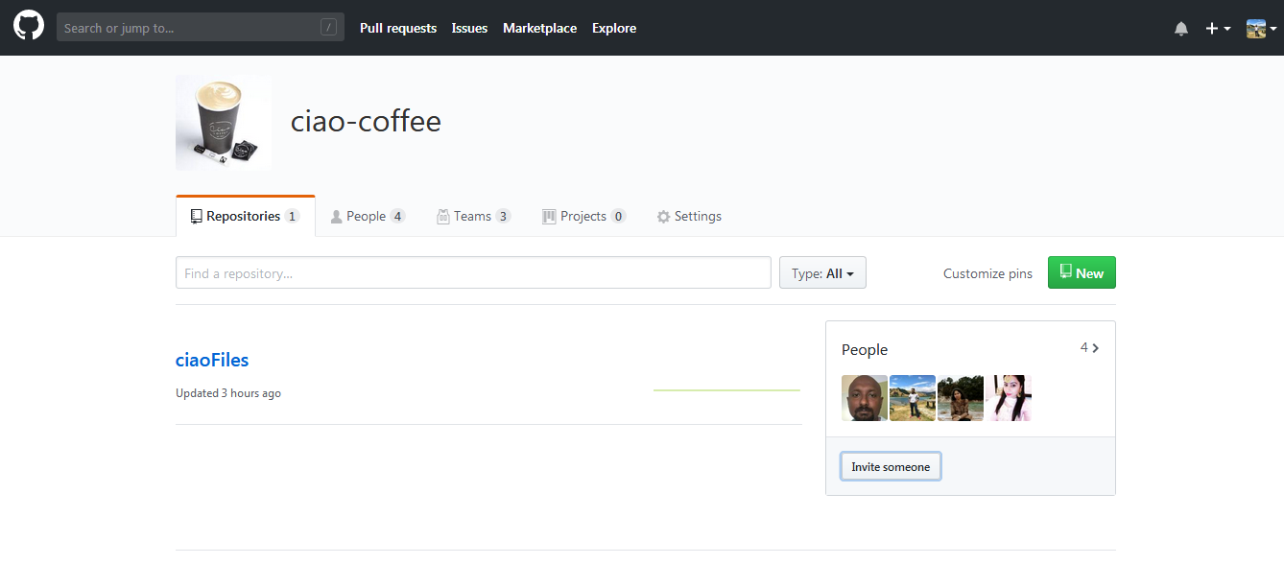
GITHUB Organisation – Ciao Coffee

Slide 4
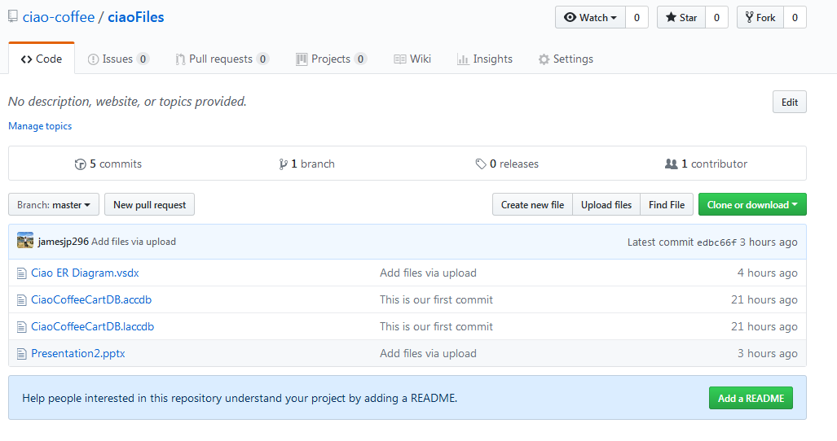
Manage Files

Slide 5
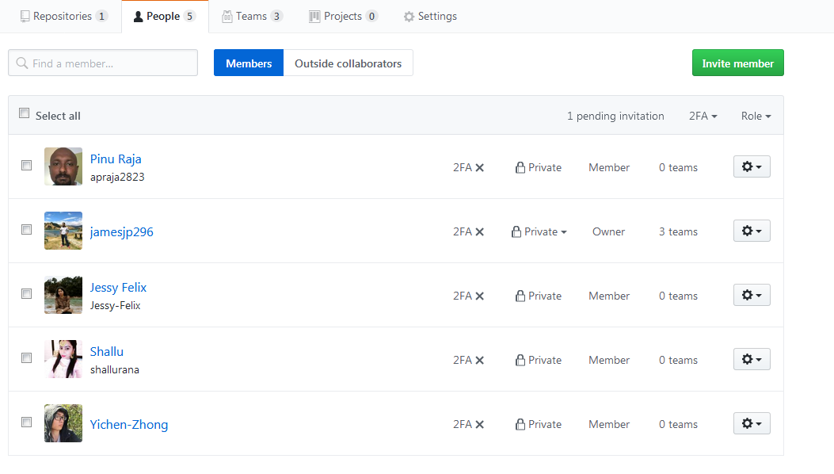
Team Members

Slide 6
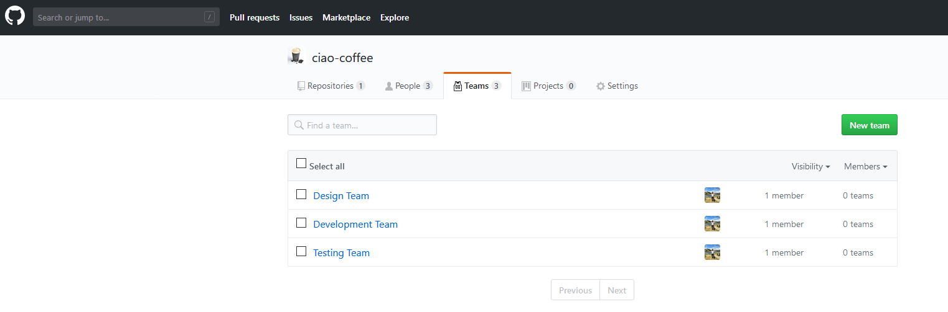
Teams in the Project

Slide 7
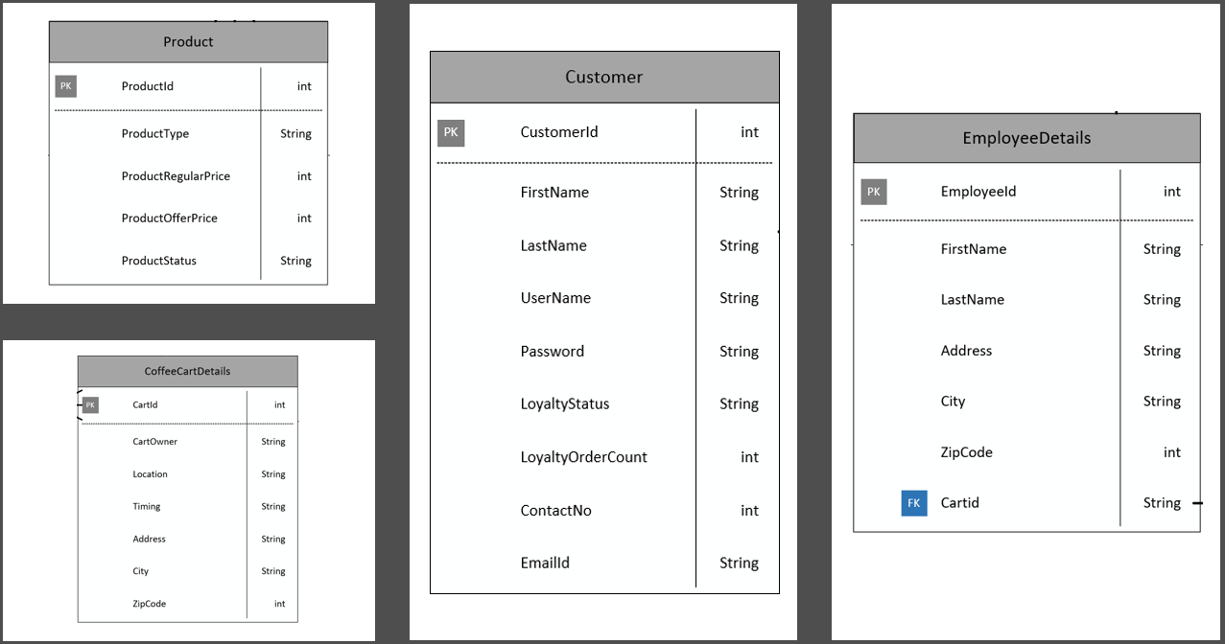
Master Entities

Slide 8
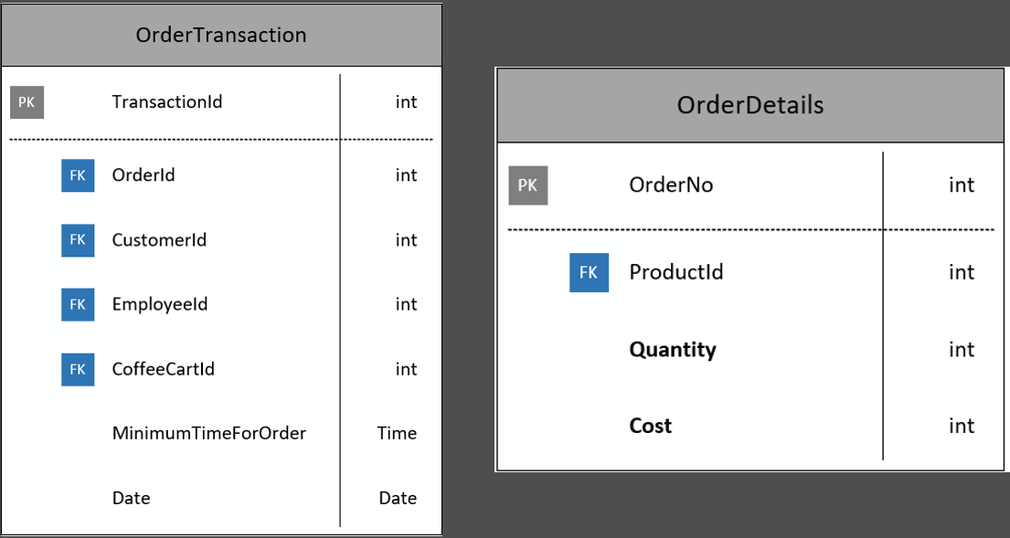
Transactional Entities

Slide 9
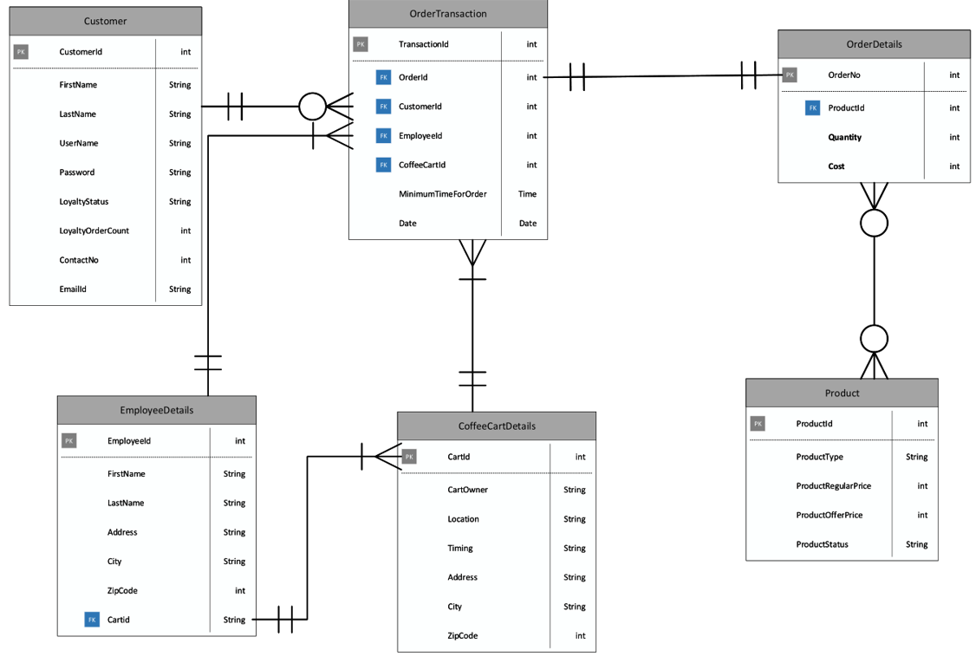
CIAO ER Diagram

Slide 10
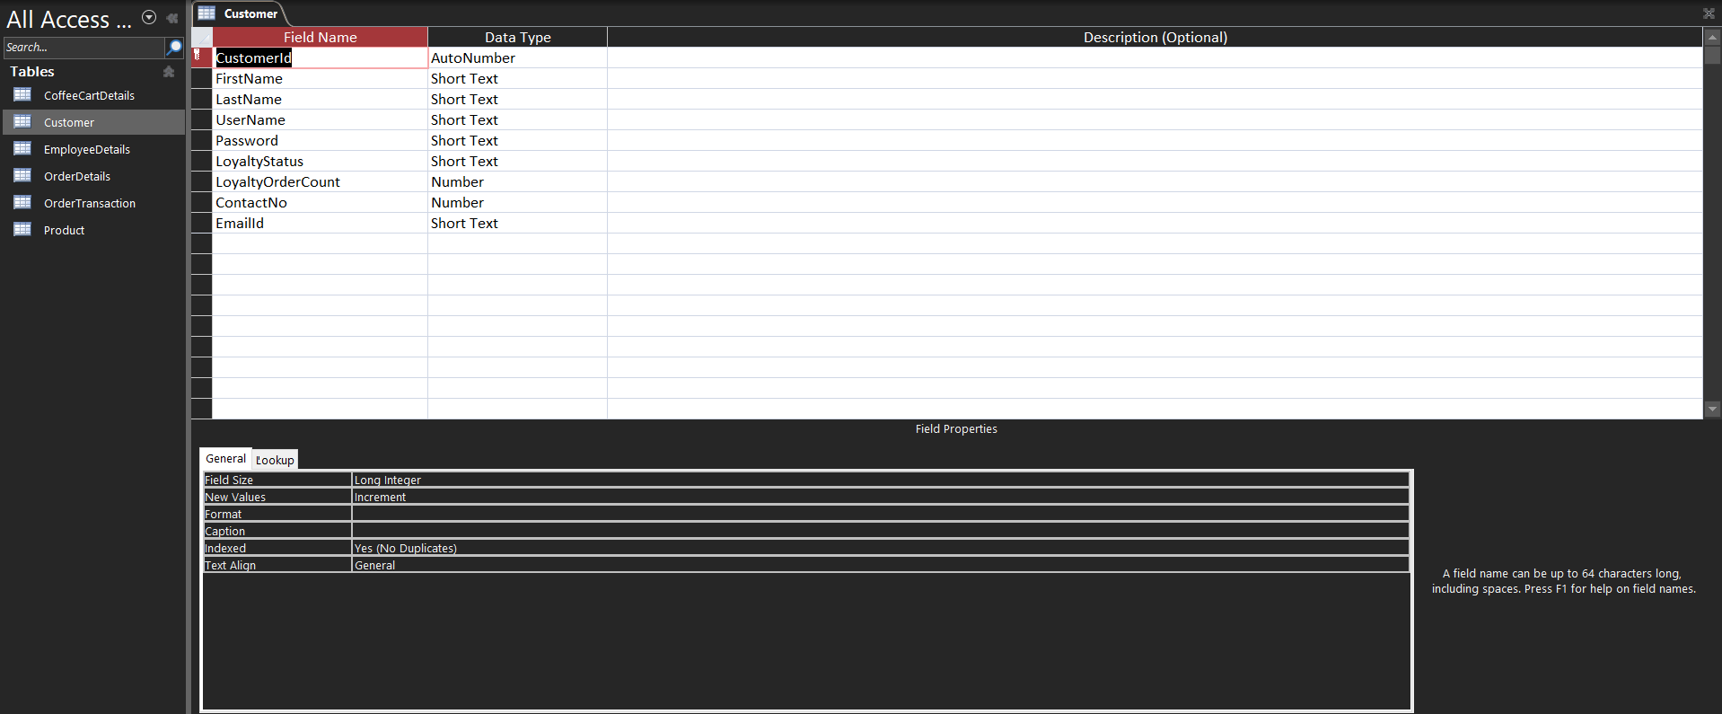
Customer Table

Slide 11
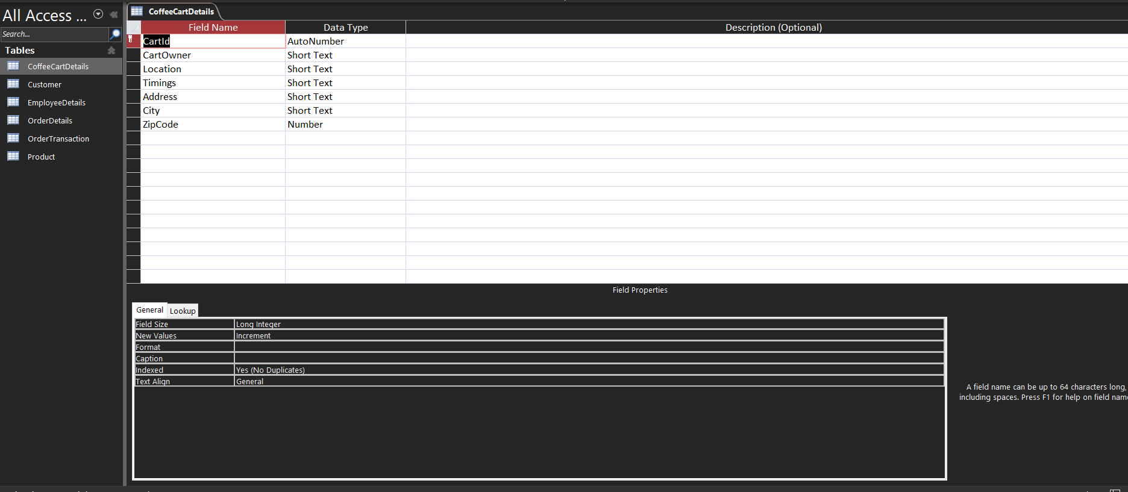
Ciao Coffee Cart Details Table

Slide 12
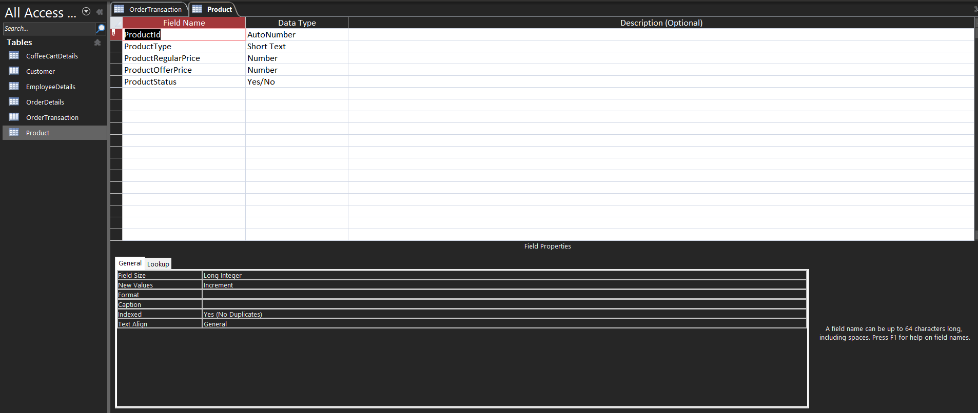
Product Table

Slide 13

Employee Table

Slide 14
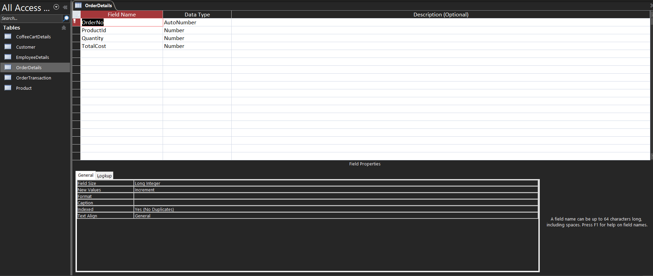
Order Details Table

Slide 15

Transaction Table

Slide 16
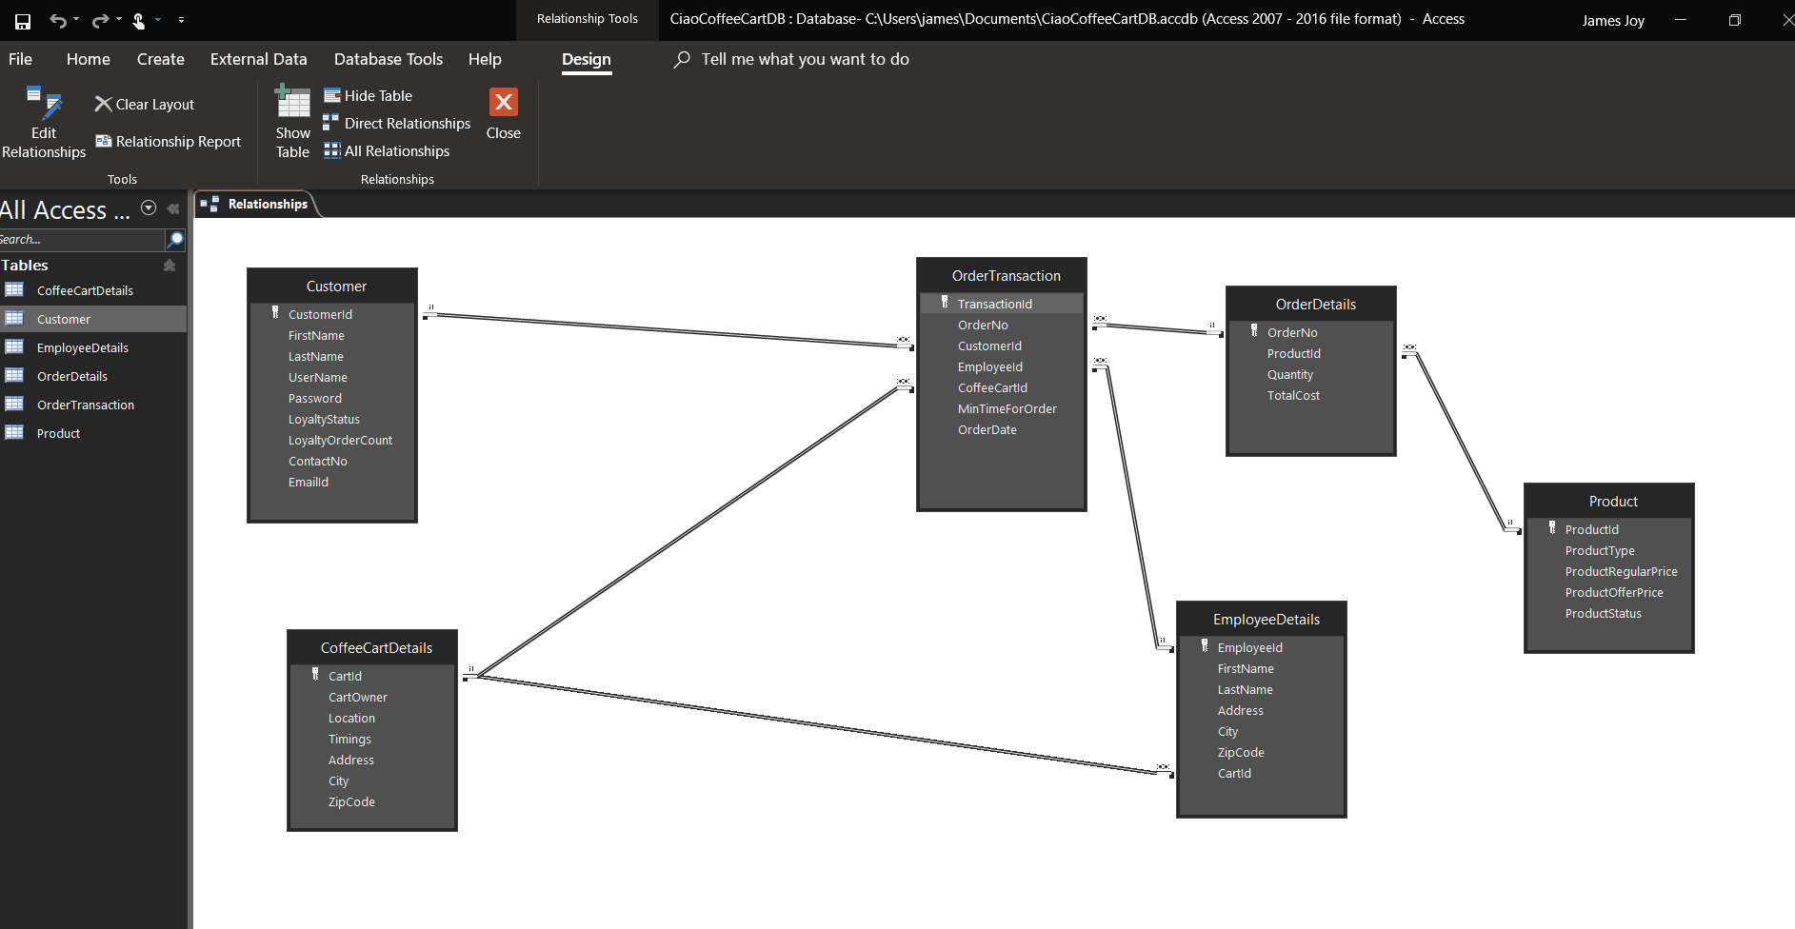
Access Relationship Diagram

Slide 17
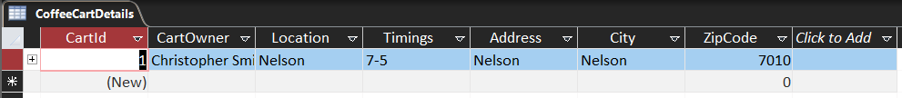
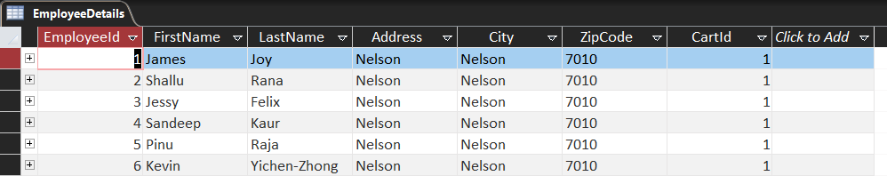
Access Tables
Coffee Cart Details
Employee Details

Slide 18
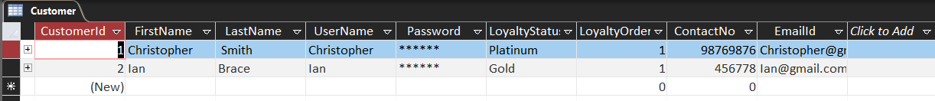
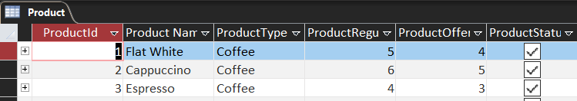
Access Tables
Customer Details
Product Details

Slide 19
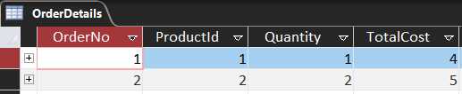
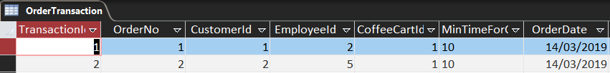
Access Tables
Order Details
Transaction Details

Slide 20
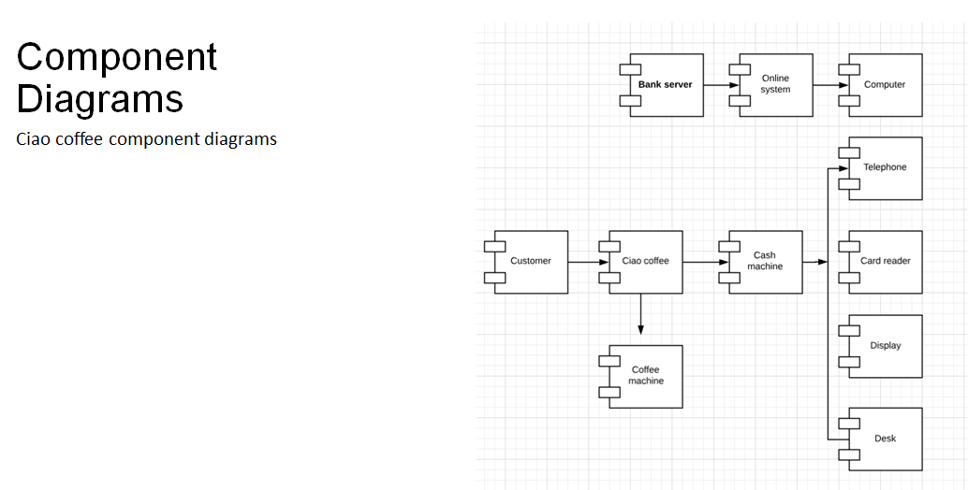
Component Diagram

Slide 21
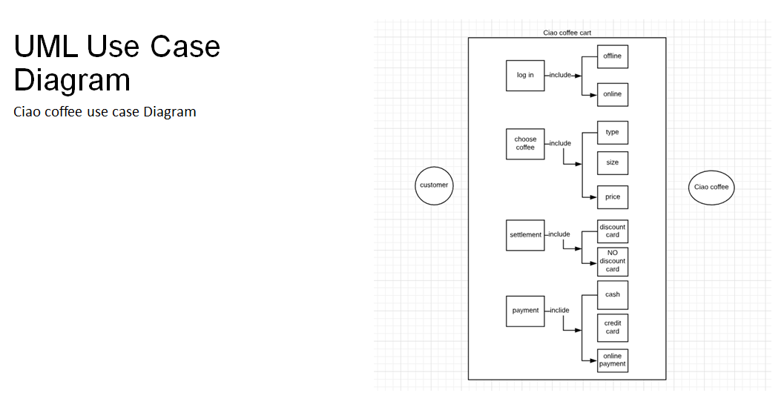
UML Diagram

Slide 22
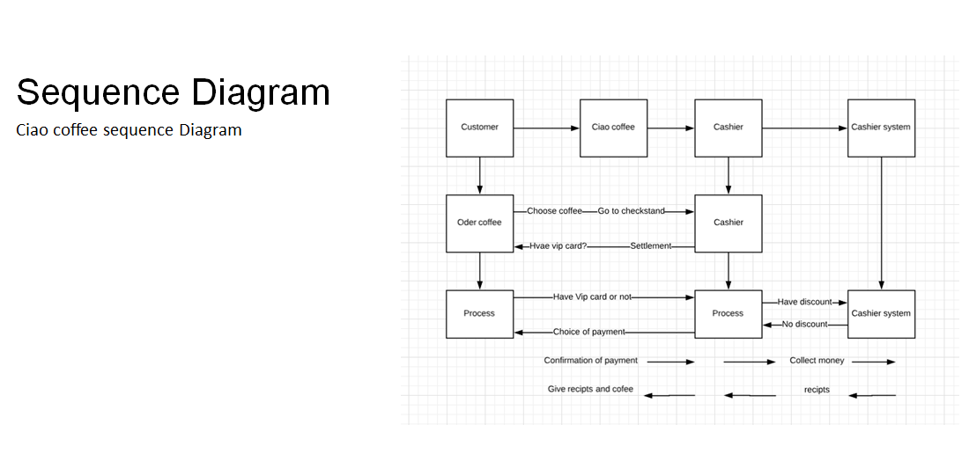
Sequence Diagram

Slide 23
Thank You

