Slide 1

Ciao Coffee
Presented By-
James Joy
Shallu Rana
Jessy Felix
Sandeep Kaur
Pinu Raja
Kevin

Slide 2


Slide 3
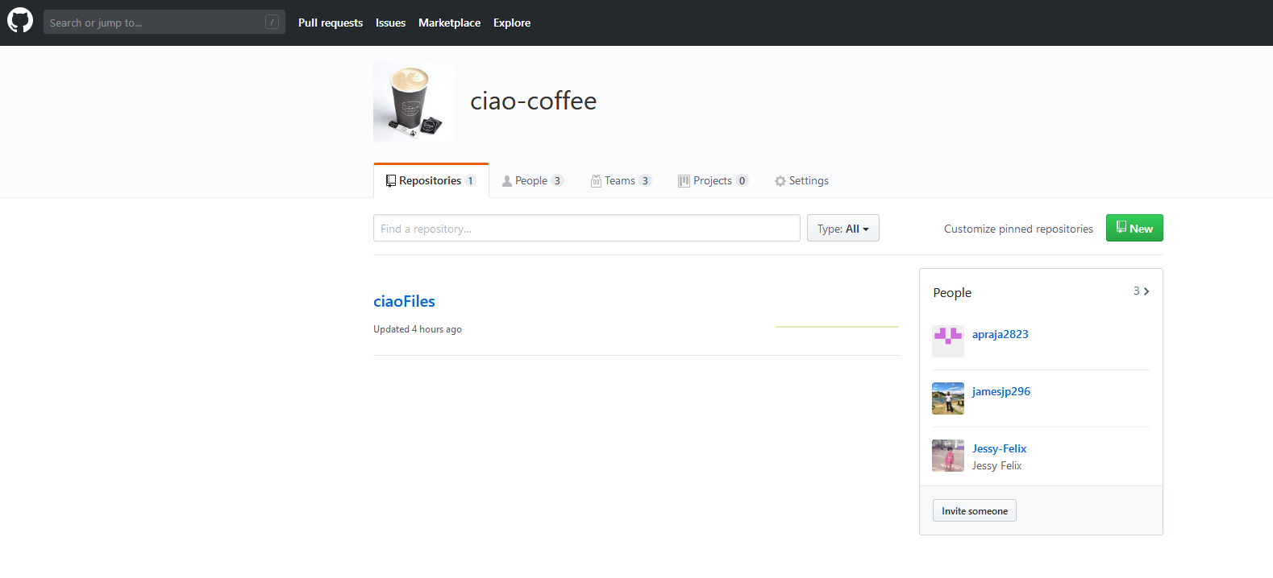

Slide 4
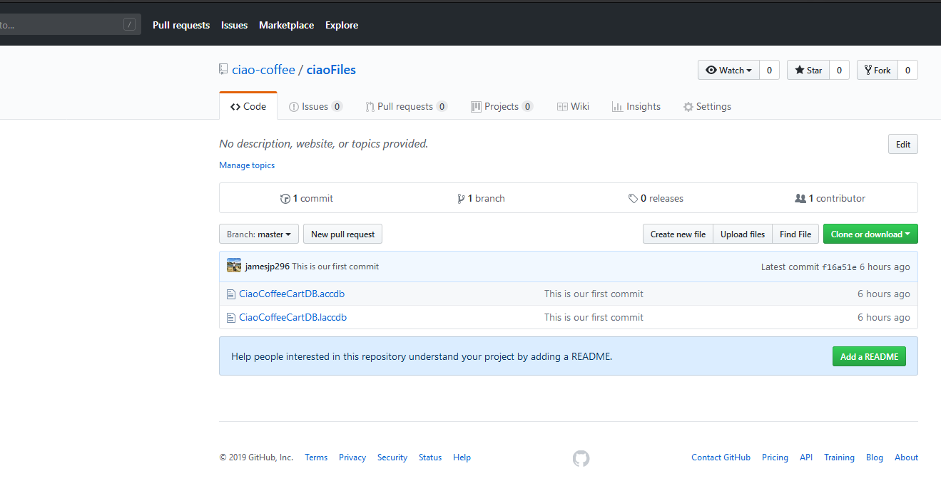

Slide 5
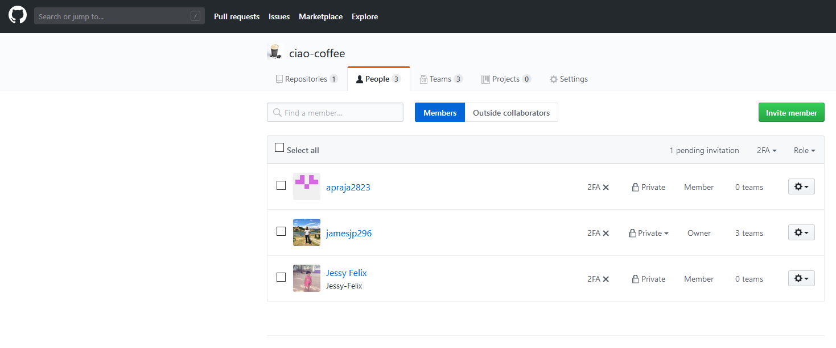

Slide 6
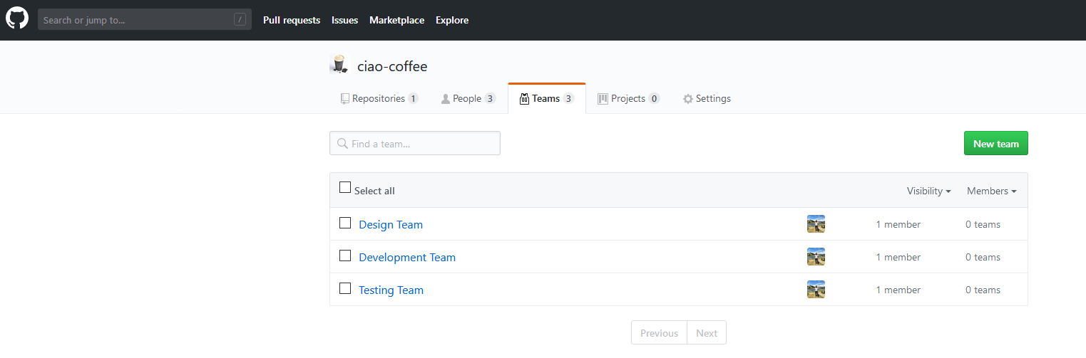

Slide 7
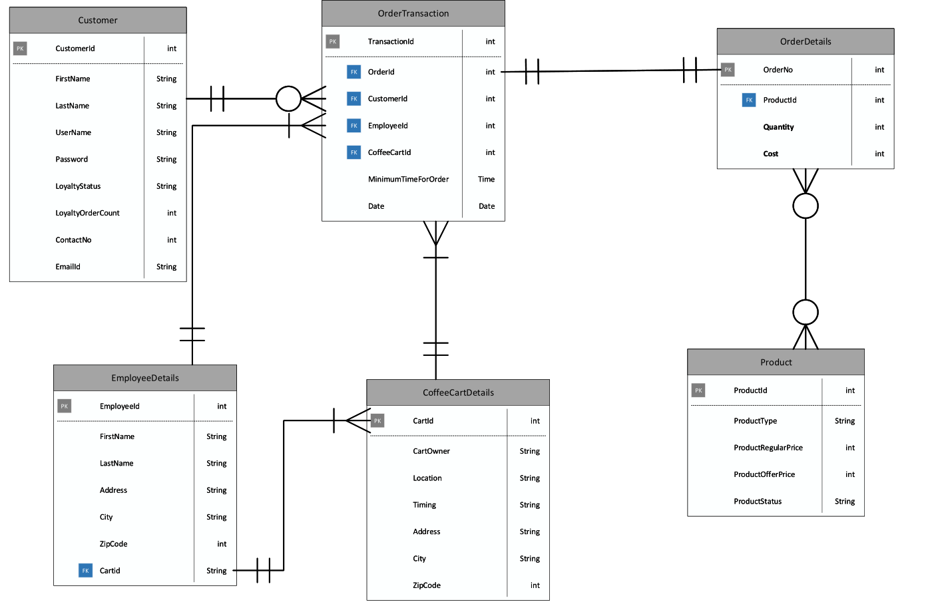

Slide 8
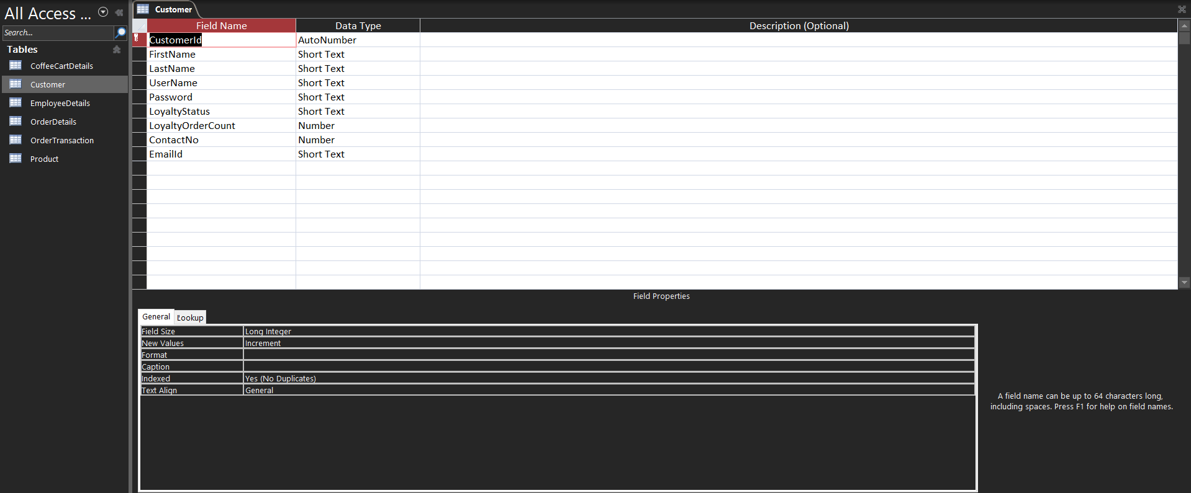
Customer Table

Slide 9
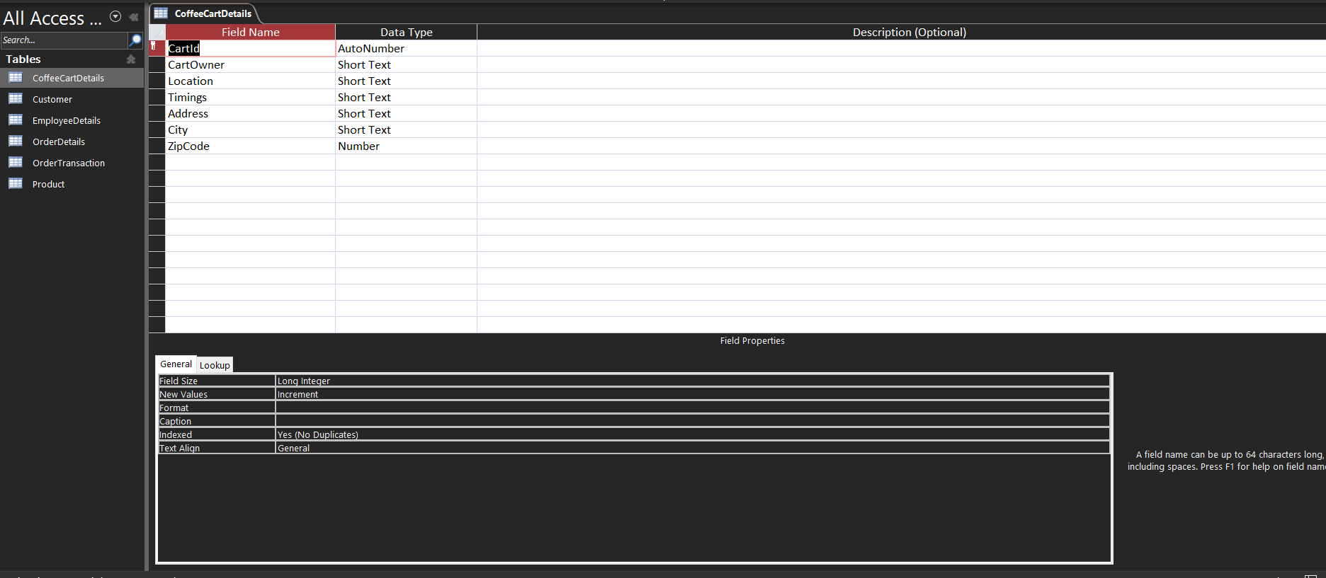
Ciao Coffee Cart Details Table

Slide 10
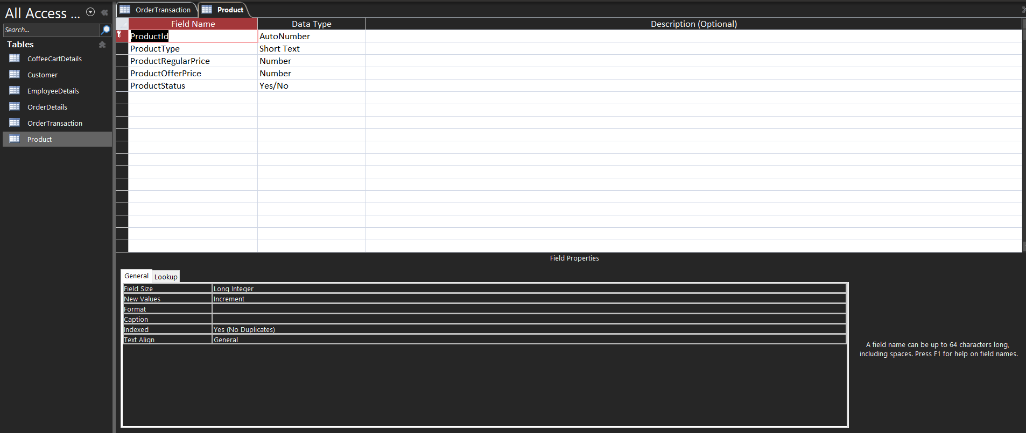
Product Table

Slide 11

Employee Table

Slide 12
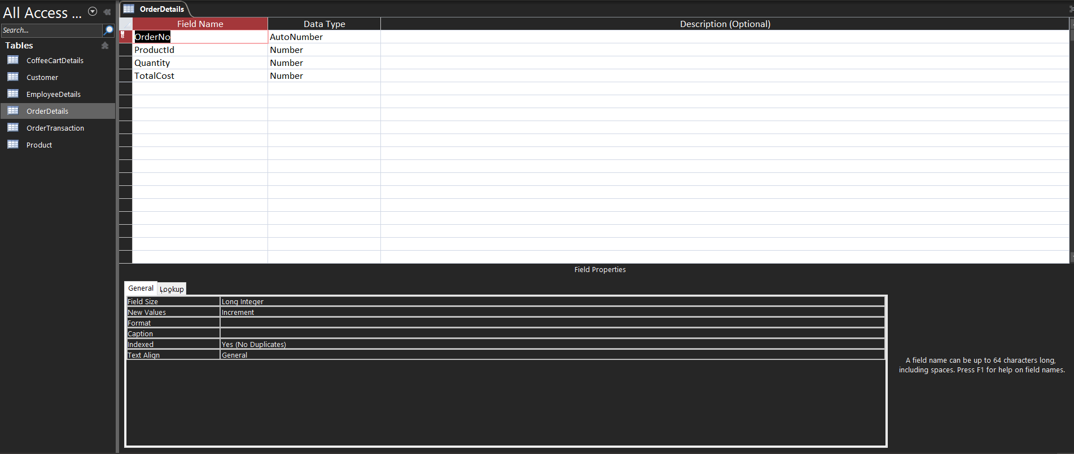
Order Details Table

Slide 13

Transaction Table

Slide 14
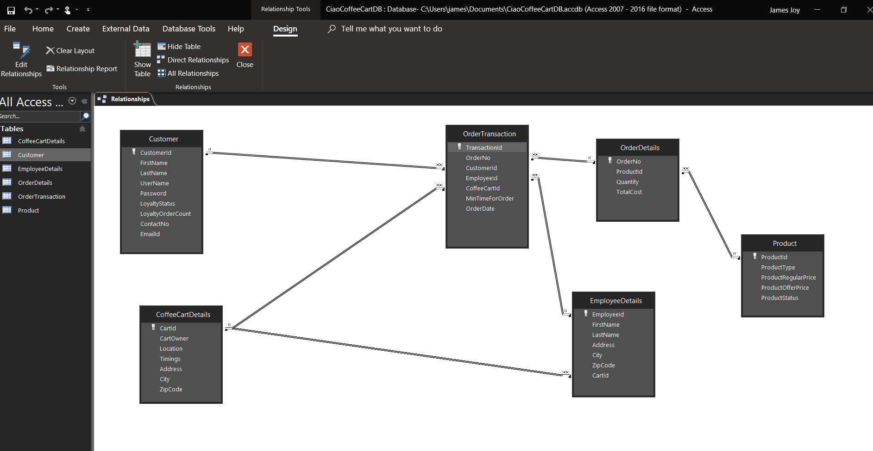
Relationship

