Slide 1
"Comprehensive Water Quality Assessment and Potability Prediction using Multi-parameter Analysis"
By Aprajita Pandey

Slide 2

DATA PROJECT ARCHITECTURE
Problem Statement
Data
EDA
Preprocessing
Modeling
F1 - Score
Conclusion

Slide 3

ABOUT THE PROJECT
The objective of this machine learning problem is to predict whether a given set of water quality parameters meets the potability criteria or not based on the provided features.

Slide 4
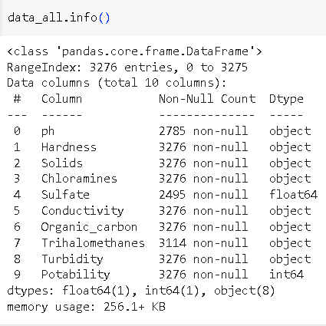
Data Information

Slide 5
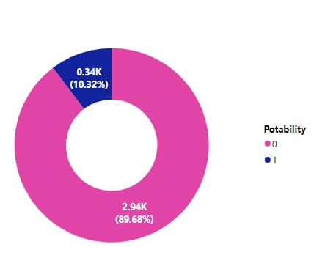
Potability Value Count
- The problem is binary classification
- This is univariate analysis of our target column.
- The data has class imbalance as the ratio of target column is 90 - 10.

Slide 6
SANITY CHECK
The following steps were taken for sanity check.
Data Sufficiency - This is the sample data given for the project
Type of problem - Binary Classification
Identify target column - Potability
Target Distribution - There is class imbalance of ratio 90 - 10.

Slide 7
Exploratory Data Analysis
The following analysis was derived from the data :
There are null values in the feature columns
The data value in the feature columns were incorrectly typed
Data has outliers for feature columns - Chloramines and Organic columns
There are skewness for some feature columns
The feature columns need to be scaled

Slide 8
Cleaning and PreProcessing
We have performed below steps to clean the data:
Correcting the data types of the columns
In the given data there were some special symbols/characters that were making each columns an object type
I have used regex to convert such values to there correct type
Treatment of Null Value
As the Data is numeric continuous so we treated the missing value with the mean of the data after checking the skewness.

Slide 9
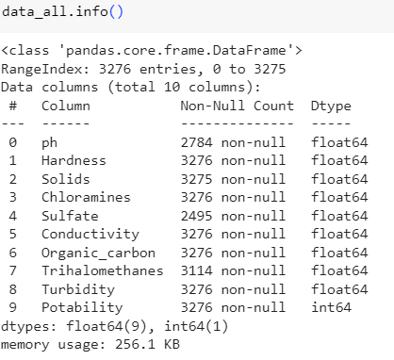
Data After Cleaning

Slide 10
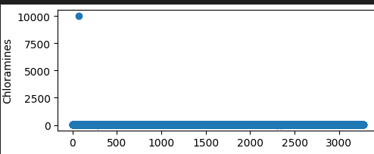
Outlier Treatment
- The data has 2 feature columns with the outlier - Chloramines and
Organic_carbon
- For chloramines the values are ranging between 0 to 10000 because of outlier
- We have treated the outliers for chloramines by capping it to 2000..

Slide 11
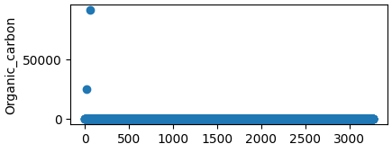
- We have outliers in organic_carbon as well
- For organic_carbon the values are ranging between 0 to more than 80,000 because of outliers
- We have treated the outliers for organic_carbons by capping it to 20000.

Slide 12
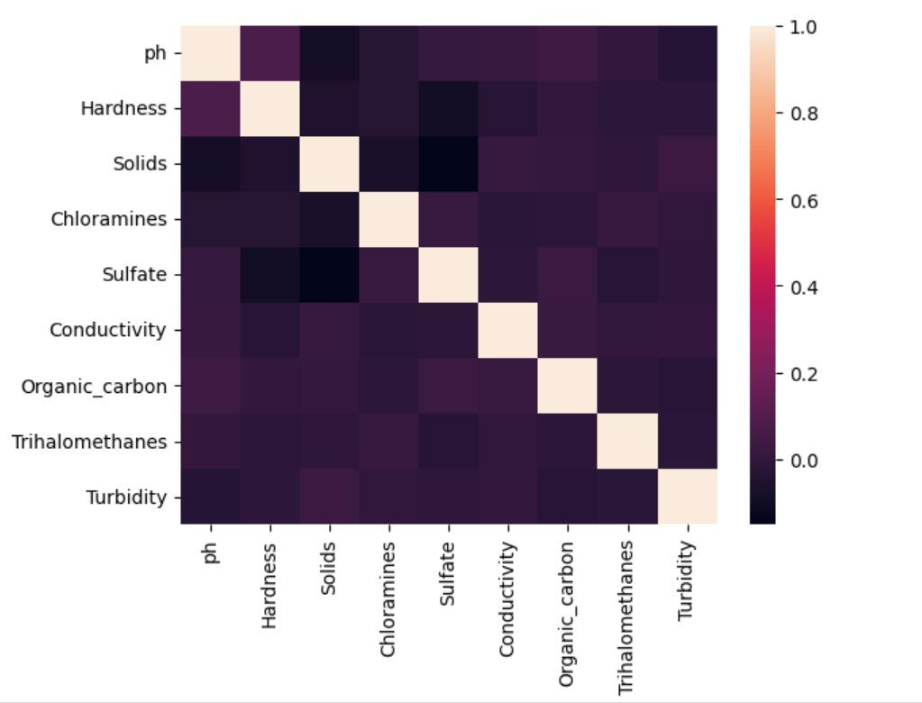
CORRELATION BETWEEN DATA

Slide 13
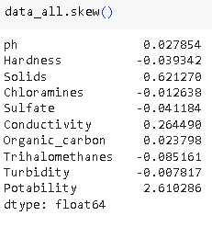
Skewness Treatment
- After doing all the treatments in the data we have found that there are skewness in the data.

Slide 14
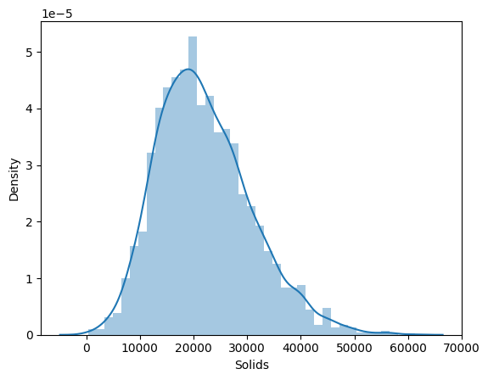
Skewness Treatment - SOLIDS
- A skewness of 0.6 for "Solids" suggests that the distribution of values for the "Solids" variable is positively skewed.
- This means that there is a longer tail on the right side of the distribution, and the bulk of the data is concentrated on the left side

Slide 15
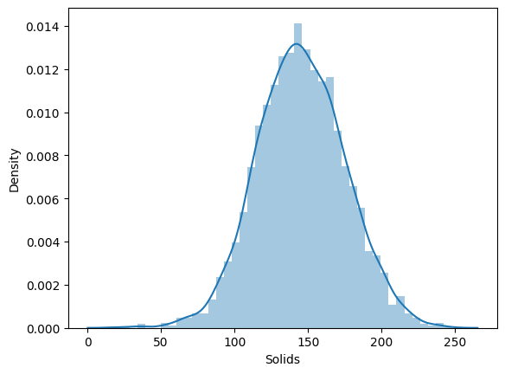
Skewness Treatment - SOLIDS
- Transforming data using the square root is one way to reduce skewness in a distribution, especially when dealing with right-skewed data
- I have used np.sqrt() to the SOLIDS column and it is applied element-wise to the specified columns.

Slide 16
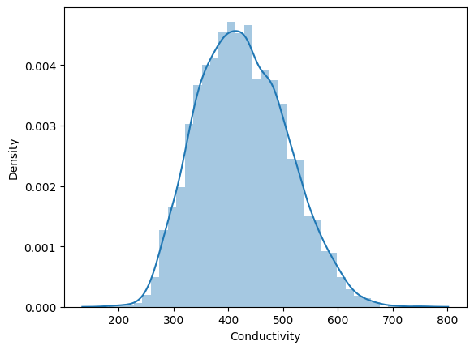
Skewness Treatment - CONDUCTIVITY
- A skewness of 0.2 for "conductivity" suggests a slight positive skewness
- This means that there is a longer tail on the right side of the distribution, and the bulk of the data is concentrated on the left side

Slide 17
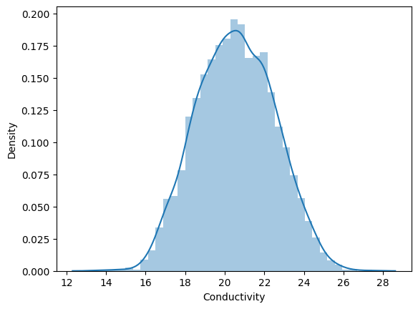
Skewness Treatment - CONDUCTIVITY
- I have used np.sqrt() to the CONDUCTIVITY column and it is applied element-wise to the specified columns.
- The skewness has reduced from 0.2 to 0.03 .

Slide 18
SCALING OF THE DATA
Upon completion of all the cleaning, our data has revealed a scaling problem.
Scales for the data range from 0 to 14 for PH to 0 to 60000 for Solids
This significant variation in scaling may affect the model's learning process.

Slide 19
SCALING OF THE DATA
To handle scaling, we have StandardScaler implemented.
StandardScaler() has been imported from the sklearn.preprocessing class.
The data is converted into identical scales using StandardScaler.

Slide 20
MODELLING
We used the class weight parameter to address the class imbalance and performed hyperparameter adjustment to ensure that each model produced the best prediction possible.
I've also used SMOTE on the training set and applied prediction on the validation set, but this is leading to overfitting.

Slide 21
MODELLING AND ACCURACY
19.9%
16.3%
43%
20%
40%
5%
Logistic Regression
Logistic Regression
TRAINING ACCURACY
VALIDATION ACCURACY
Decision Tree Classifier
Decision Tree Classifier
TRAINING ACCURACY
VALIDATION ACCURACY
Random Tree Classifier
Random Tree Classifier
TRAINING ACCURACY
VALIDATION ACCURACY

Slide 22
MODELLING AND ACCURACY( F1-Score)
56%
17%
72%
19.5%
Logistic Regression(SMOTE)
Logistic Regression(SMOTE)
TRAINING ACCURACY
VALIDATION ACCURACY
Decision Tree Classifier(SMOTE)
Decision Tree Classifier(SMOTE)
TRAINING ACCURACY
VALIDATION ACCURACY

Slide 23
CONCLUSION
The metrics used for the calculation of Accuracy is F1 - Score.
The model is moving towards overfitting as we are increasing the complexity of the data.
When SMOTE used for class imbalance has resulted in Overfitting .
Logistic Regression has giving the accurate result with very lesser difference between the F1 score of the training and the validation set , however overall performance of the model is underfitting

Slide 24
THANK YOU

