Slide 1


CropeePhy
Product Perspective The Smart Agriculture Platform integrates weather forecasting, crop advice, disease detection, and crop auctions. It empowers farmers with tailored guidance, allows advisors to manage availability, enables businessmen to participate in auctions.

Slide 2


Sign in/Sign up
CropeePhy
Home
Weather
Crop Recommendation
Disease Detection
Auction
Contact Us

Slide 3
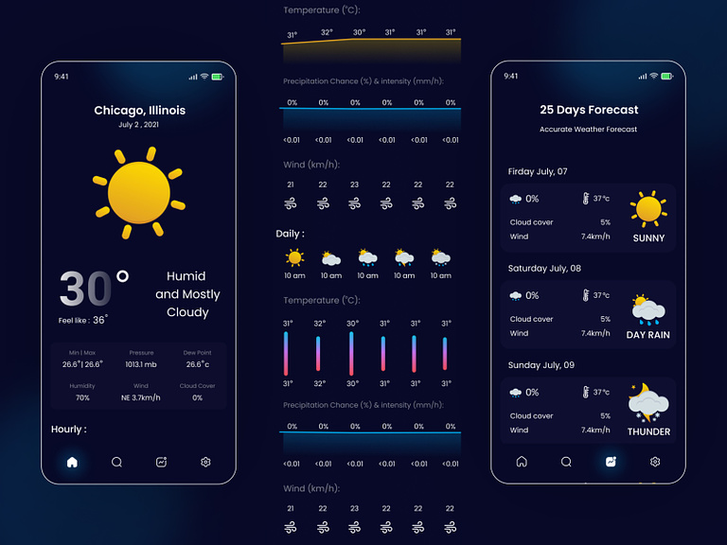
WEATHER REPORT

Slide 4

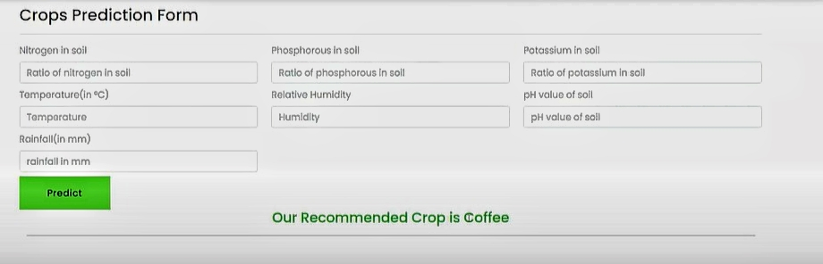
CROP RECOMMENDATION

Slide 5
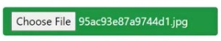
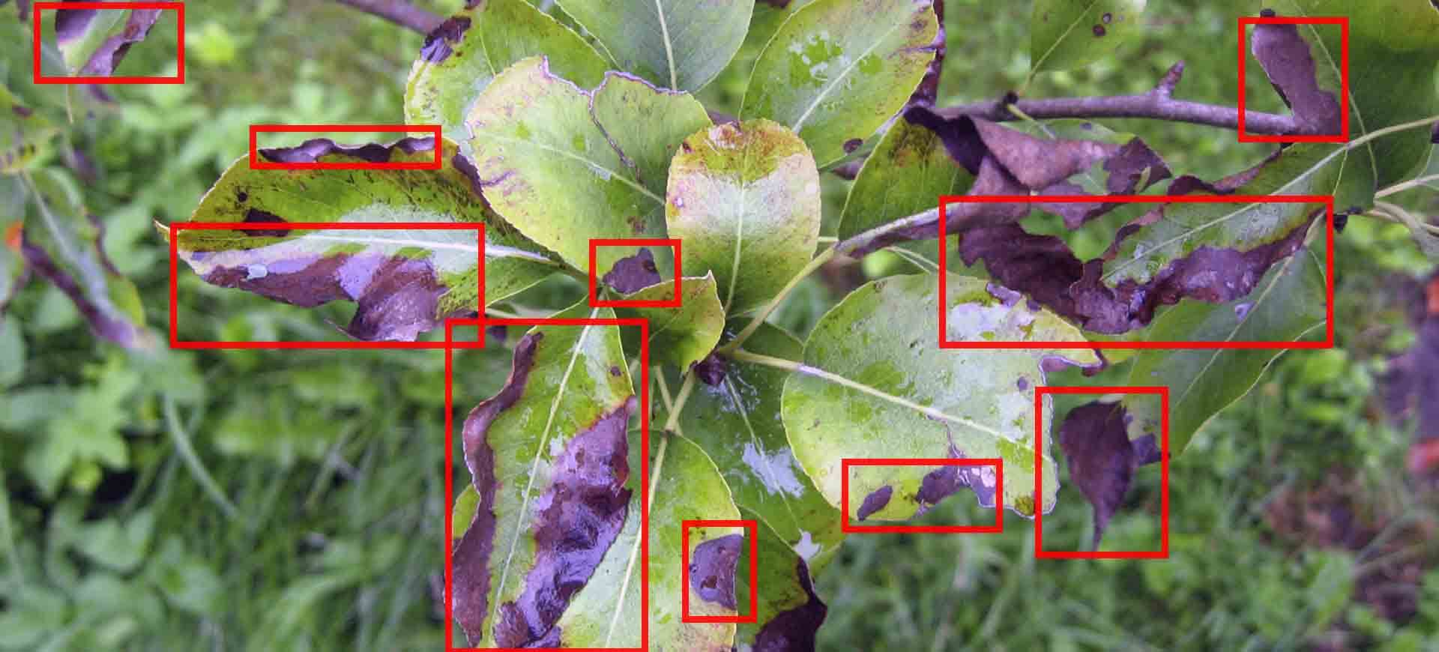
PLANT DISEASE DETECTION
Predict

Slide 6

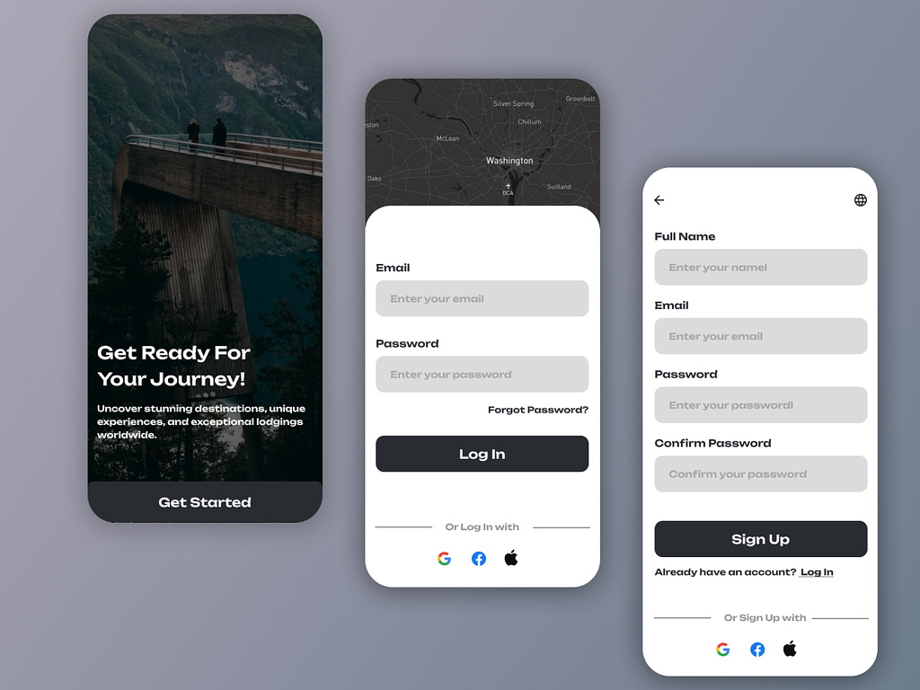
LOGIN & SIGN UP

Slide 7
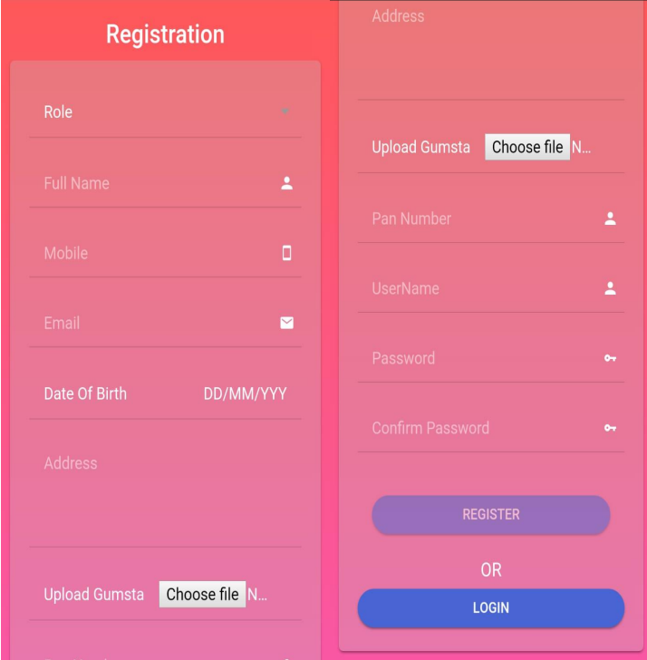
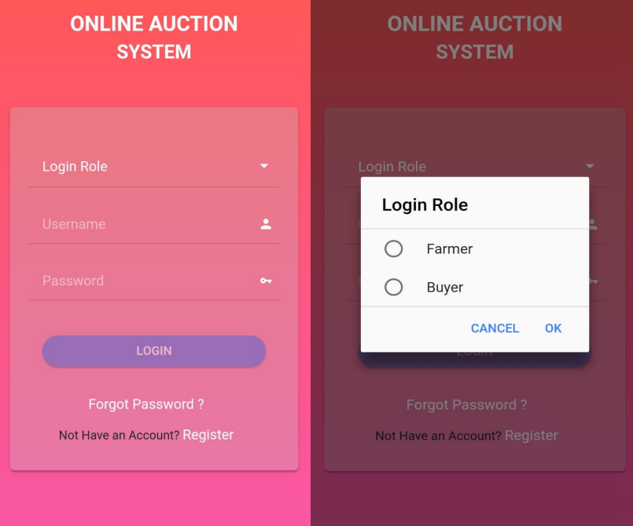
AUCTION SYSYTEM

Slide 8
THANK YOU…

