Slide 1
Transaction Management in the R* Distributed Database Management System

Slide 2
OUTLINE
INTRODUCTION
R* COMMIT PROTOCOL
Two-phase (2P)
Presumed Abort (PA)
Presumed Commit (PC).
Discussion
R* commit protocols
DEADLOCK MANAGEMENT IN R*

Slide 3
INTRODUCTION
Write
to buffer in volatile storage
Force-write
to buffer in volatile storage and flush immediately

Slide 4
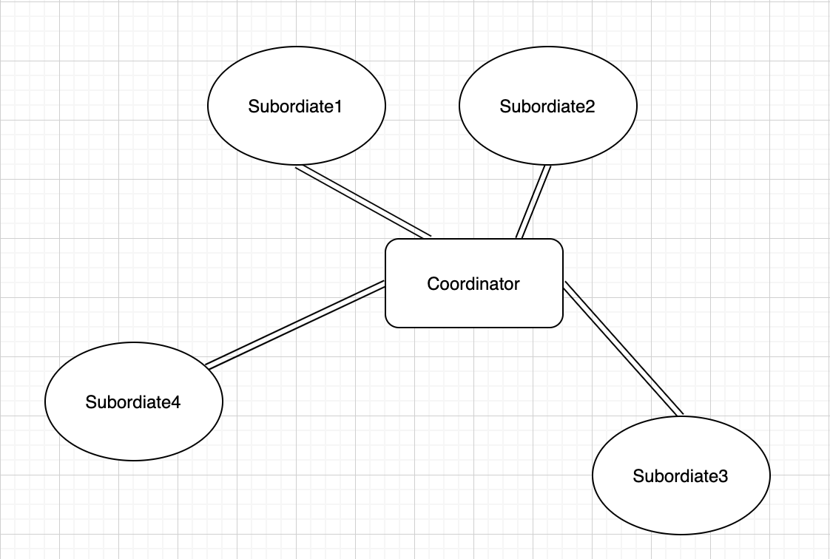
Two-phase commit protocol (2P)
Coordinator
Subordinates
user application and a set of other processes

Slide 5
2P Under Normal Operation
Phase 1
1. Coordinator receives a commit-transaction command from the user (Entering Phase 1).
2. Coordinator sends PREPARE to all subordinates.
3. Subordinates receive PREPARE and decide whether itself can conduct the commit and send coordinator YES/NO VOTE. If YES, move into prepare stage.
(YES: prepared state; NO: abort immediately)
4. Coordinator receive VOTEs.

Slide 6
2P Under Normal Operation
Phase 2
Coordinator sends COMMIT or ABORT based on VOTEs (Entering Phase 2)
COMMIT: All YES VOTEs. Coordinator moves into committing state by force-writing a commit record and sending COMMIT messages to all the subordinates. Subordinates move into committing stage.
ABORT: One or more NO VOTE. Moves to the aborting state by force-writing an abort record and sends ABORTs to (only) all the subordinates that are in the prepared state or have not responded to the PREPARE. Subordinates move into aborting stage.

Slide 7
2P Under Normal Operation
Phase 2
3.
COMMIT: Subordinates force-write a commit record and send coordinator ACK message. Then commit the transaction and “forget” it.
ABORT: Subordinates force-writes an abort record, sends an ACK to the coordinator, and then aborts the transaction and “forgets” it.

Slide 8
2P Under Normal Operation
Phase 2
4. The coordinator, after receiving the ACKs from all the subordinates that were sent a message in the second phase (remember that subordinates who voted NO do not get any ABORTS in the second phase), writes an end record and “forgets” the transaction.
Done!

Slide 9
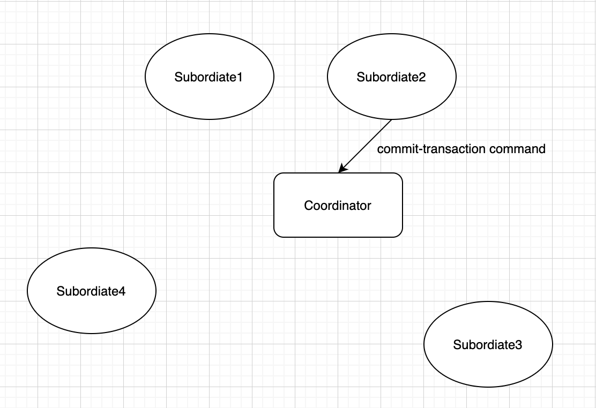
Phase 1

Slide 10
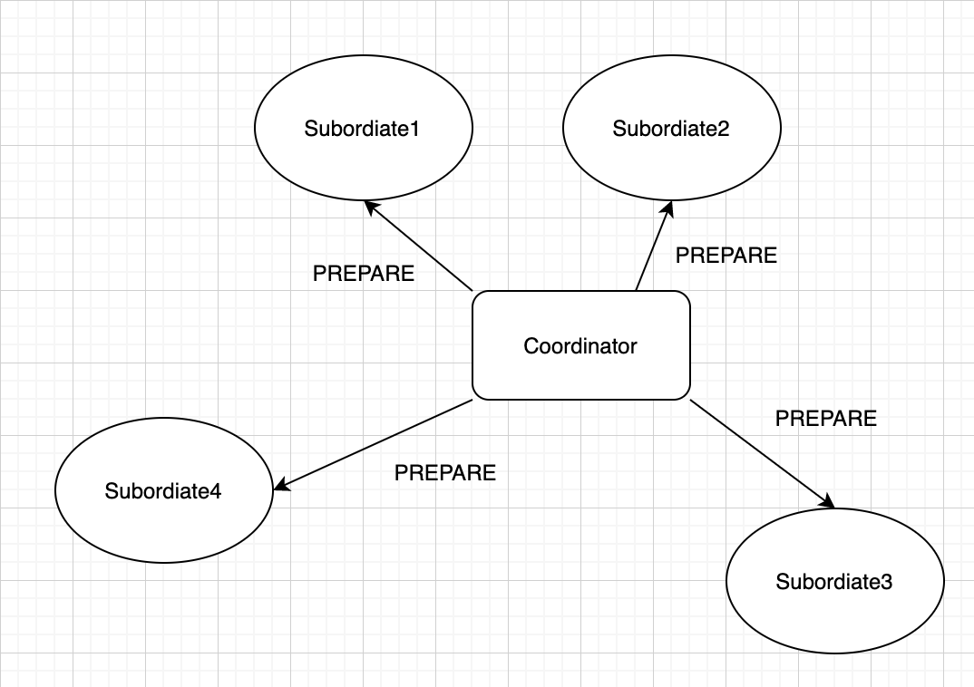
Phase 1

Slide 11
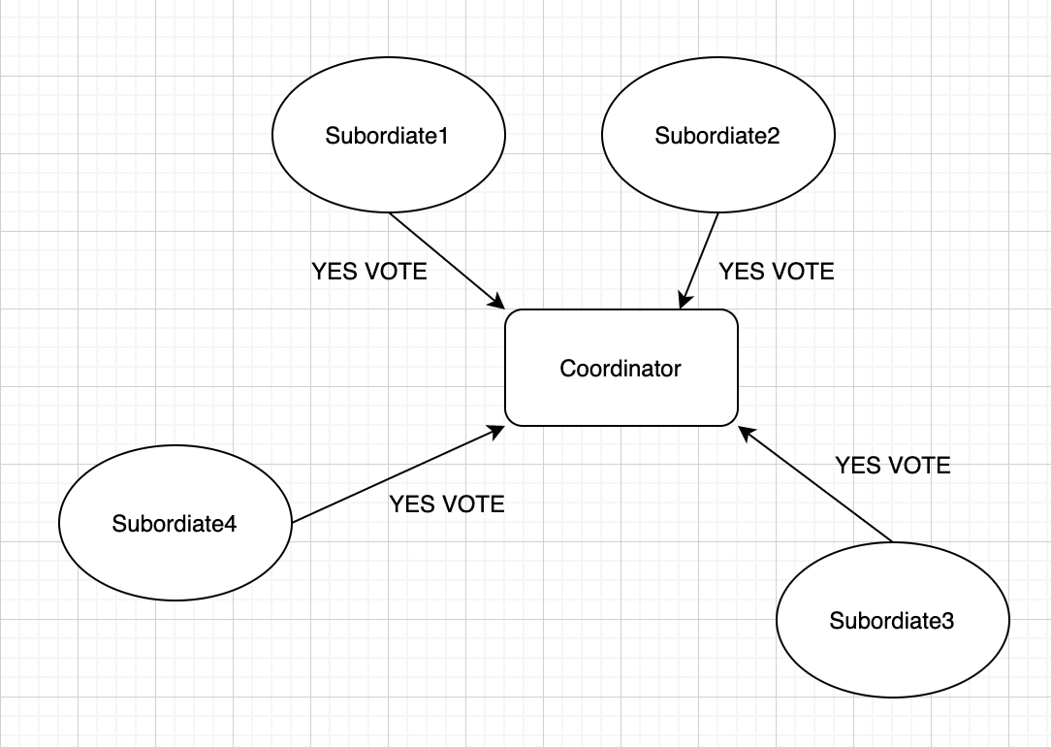
Phase 1

Slide 12
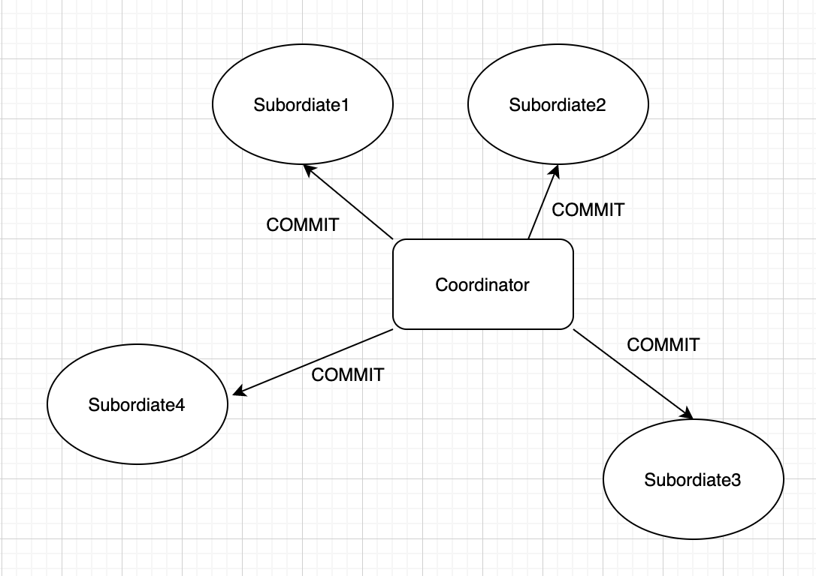
Phase 2

Slide 13
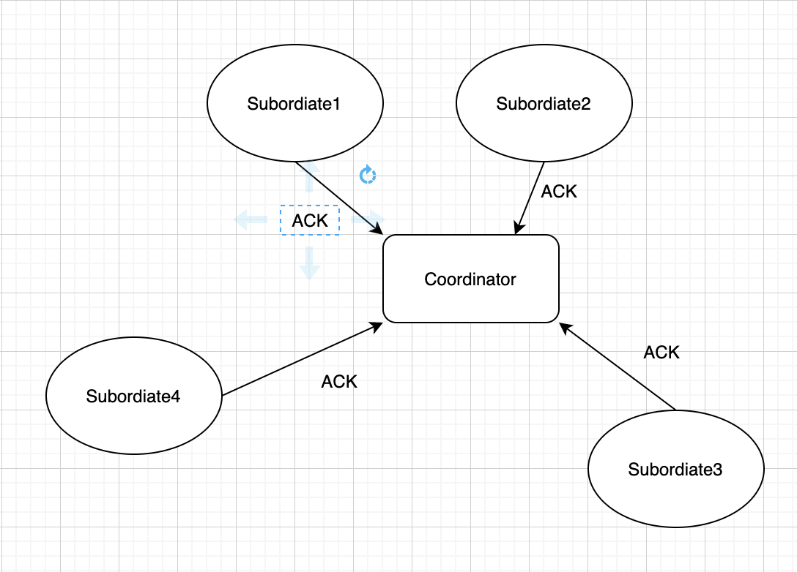
Phase 2

Slide 14
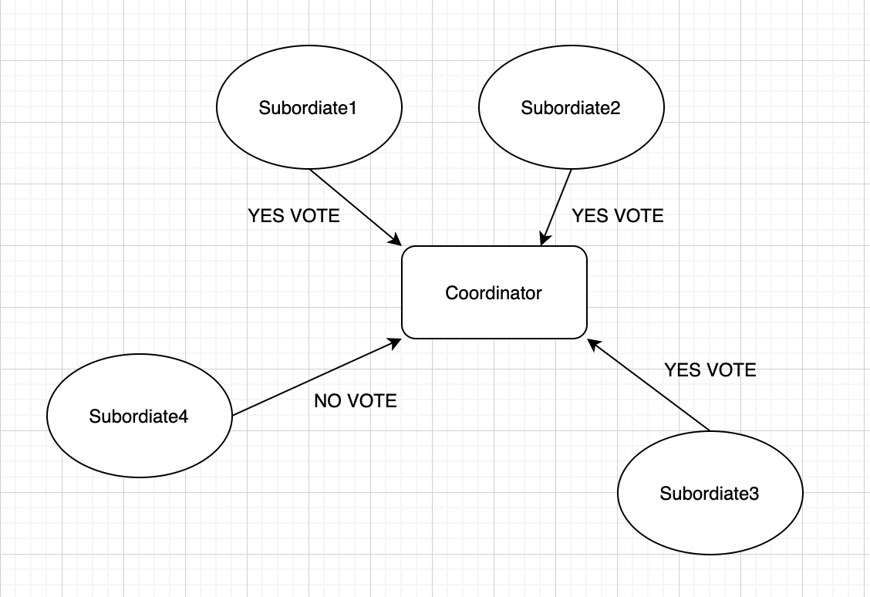
Phase 1 (NO)

Slide 15
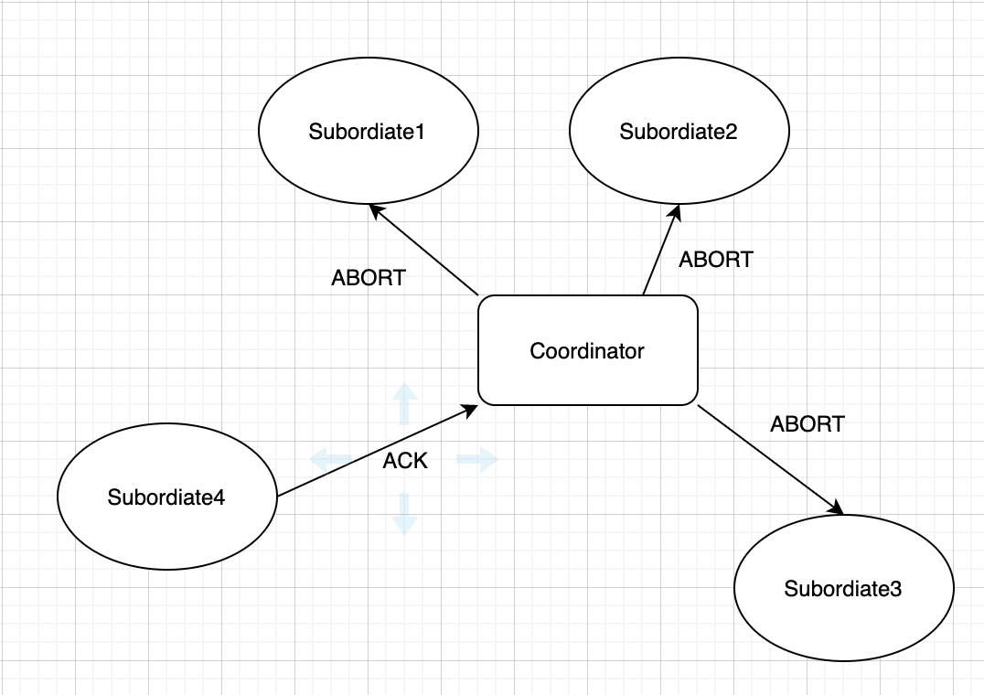
Phase 2 (NO)

Slide 16
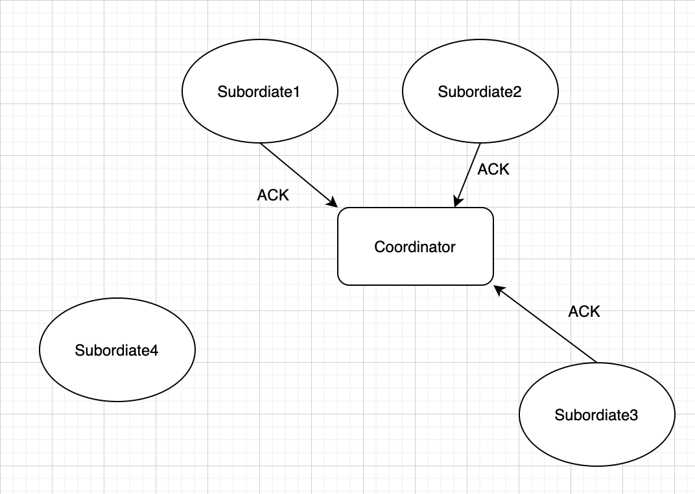
Phase 2 (NO)

Slide 17
2P and Failure
Each active site a recovery process exists and that it processes all messages from recovery processes at other sites and handles all the transactions that were executing the commit protocol at the time of the last failure of the site.

Slide 18
2P and Failure
Recovery process at the recovering site reads the log on stable storage and accumulates in virtual storage.

Slide 19
2P and Failure
Prepare Stage: Recovery process periodically tries to contact the coordinator site to find out how the transaction should be resolved. Resolve.
No Commit Protocol Log: Aborts that transaction by “undoing” its actions, if any, using the UNDO log records, writing an abort record, and “forgetting” it.
Committing/Aborting Stage: Periodically tries to send the COMMIT (ABORT) to all the subordinates that have not acknowledged and awaits their ACKs. ACKs are received, the recovery process writes the end record and “forgets” the transaction.

Slide 20
2P and Failure
If the coordinator process notices the failure of a subordinate while waiting for its vote, abort.
If the failure occurs when the coordinator is waiting to get an ACK, then the coordinator hands the transaction over to the recovery process.

Slide 21
2P and Failure
If a subordinate notices the failure of the coordinator before the former sent a YES VOTE and moved into the prepared state, then it aborts the transaction (this is called the unilateral abort feature).
If the failure occurs after the subordinate has moved into the prepared state, then the subordinate hands the transaction over to the recovery process.

Slide 22
Hierarchical 2P
Root process that is connected to the user/application acts only as a coordinator.
Leaf processes act only as subordinates.
Nonleaf, nonroot processes act as both coordinators (for their child processes) and subordinates(for their parent processes).

Slide 23
Hierarchical 2P
A nonroot, nonleaf process after receiving a PREPARE propagates it to its subordinates and only after receiving their votes does it send its combined (i.e., subtree) vote to its coordinator.

Slide 24
PRESUMED ABORT PROTOCOL (PA)
Coordinator “forget” a transaction immediately after it makes the decision to abort it (e.g., by receiving a NO VOTE) and to write an abort record.
Abort record need not be forced (both by the coordinator and each of the subordinates), and no ACKs need to be sent.
Coordinator need not record the names of the subordinates in the abort record or write an end record after an abort record.
If the coordinator notices the failure of a subordinate while attempting to send an ABORT to it, the coordinator does not need to hand the transaction over to the recovery process.

Slide 25
PRESUMED ABORT PROTOCOL (PA)
Completely or Partially Read-only
Leaf receives PREPARE and find out that it does not need any update, it sends a READ VOTE. releases its locks, and “forgets” the transaction and leave no log record.
Nonroot, nonleaf sends a READ VOTE only if its own vote and those of its subordinates’ are also READ VOTES
No second phase of the protocol if the root process is read only and it gets only READ VOTES, no log records

Slide 26
PRESUMED COMMIT PROTOCOL (PC)
Since most transactions are expected to commit, it is only natural to wonder if, by requiring ACKs for ABORTs, commits could be made cheaper by eliminating the ACKs for COMMITs.

Slide 27
PRESUMED COMMIT PROTOCOL (PC)
ABORTS be acknowledged, while COMMITS need not be.
Abort records be forced while commit records need not be by the subordinates
In the no information case, the recovery process responds with a COMMIT when a subordinate inquiries.

Slide 28
PRESUMED COMMIT PROTOCOL (PC)
PROBLEM!
when a root process has sent the PREPARES, and before the root process is able to collect all the votes and make a decision, the root process crashes. No commit log!
When the crashed root process’s site recovers, its recovery process will abort this transaction and “forget” it without informing anyone.
When the recovery process of the prepared subordinate’s site then inquires the root process’s site, the latter’s recovery process would respond with a COMMIT. Inconsistency!

Slide 29
PRESUMED COMMIT PROTOCOL (PC)
MODIFICATION
Each coordinator (i.e., nonleaf process) record the names of its subordinates safely before any of the latter could get into the prepared state.
When the coordinator site aborts on recovery from a crash that occurred after the sending of the PREPARES (but before the coordinator moved into the prepared state, in the case of the nonroot coordinators), the restart process will know who to inform (and get ACKs) about the abort.

Slide 30
DISCUSSION
Strength and weakness of PA and PC.
Choices could be made on a transaction-by-transaction basis
(instead of on a systemwide basis).
Blocking while subordinates in prepare stage and coordinator fails.

Slide 31
DISCUSSION
In R*, each site has one transaction manager (TM) and one or more database managers (DBMs).
TM manages the commit protocol, perform local and global deadlock detection, and assign transaction IDs to new transactions originating at that site.
The TM and DBMS each have their own log files.
TM incarnations communicate with each other.

Slide 32
DEADLOCK MANAGEMENT IN R*
No separate lock manager process. All locking related information is maintained in shared storage where it is accessible to the processes of transactions.
Deadlock detection instead of deadlock avoidance/prevention,
One deadlock detector (DD) at each site. The DDs at different sites operate asynchronously.
Each DD wakes up periodically and looks for deadlocks after gathering the wait-for information from the local DBMs and the communication manager.

Slide 33
DEADLOCK MANAGEMENT IN R*
information about Potential Global (i.e., multisite) Deadlock Cycles (PGDCs) received earlier from other sites is combined with the local information.
Choosing the victim for breaking the dead lock locally.

Slide 34
Thanks for watching!

