Slide 1
In search of an Understandable Consensus Algorithm
Yu Hsuan Tseng
Jonathan Rosenzweig

Slide 2
Outline
Section 1: The Introduction and the abstract of the paper
Section 2: The replicated state machine problem
Section 3: Strength and weakness of Paxos
Section 4: Describe approach of understandability
Section 5-7 : Raft consensus algorithm
Section 8: Evaluation of Raft
Section 9: Related work

Slide 3
Abstract
What is Raft ?
Raft is a consensus algorithm for managing a replicated log.
Includes new mechanism for changing the cluster membership-overlapping majority.
What are the same elements it shares with Paxos ?
It produces a result equivalent to (multi-)Paxos.
As efficient as Paxos.
What are the differences from Paxos ?
Structure is different from Paxos.
Better foundation for building practical system than Paxos.
Easier to understand and learn.

Slide 4
What’s wrong with Paxos
Exceptionally difficult to understand
Not a good foundation for building a practical system
Symmetric peer to peer approach

Slide 5
Raft’s novel features
Stronger leader:
Raft uses a stronger form of leadership than other consensus algorithm.
Leader is responsible for communicating with the clients and follower nodes
Leader election:
Randomized timers to elect leaders.
Membership changes:
New joint consensus approach where the majorities of two different configurations overlap during transition.

Slide 6
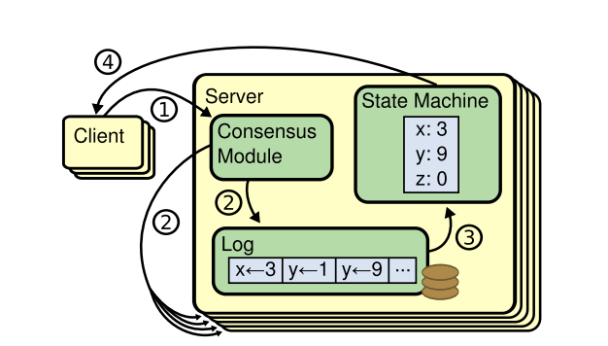
Replicated state machines
Definition:
Replicated state machines which on a collection of servers compute identical copies of the same state and can continue operating even if some of the servers are down.
*Note figure taken from In Search of an Understandable Consensus Algorithm. USENIX ATC'14

Slide 7
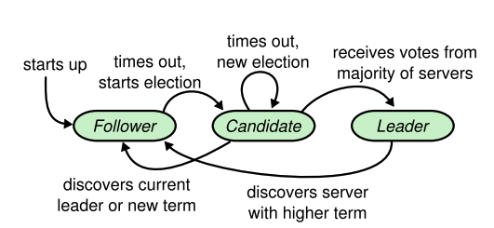
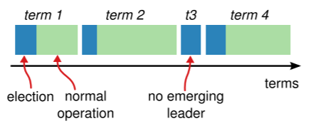
Leader election
Raft uses a “heartbeat mechanism” to trigger leader election.
*Note figure taken from In Search of an Understandable Consensus Algorithm. USENIX ATC'14

Slide 8
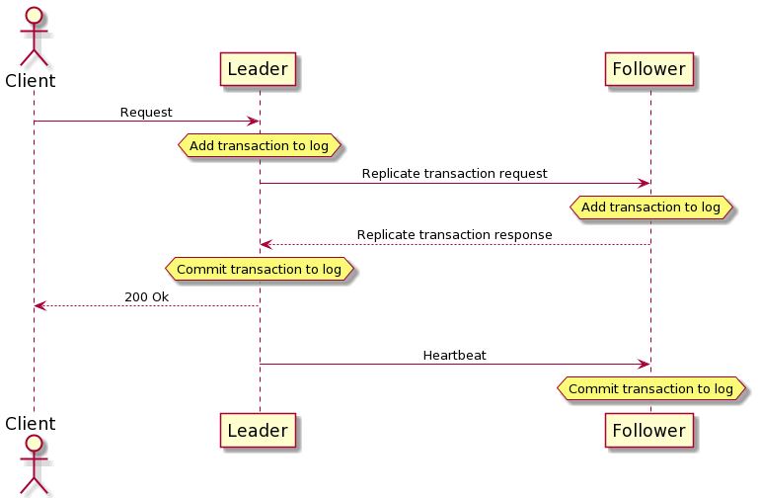
Log Replication

Slide 9
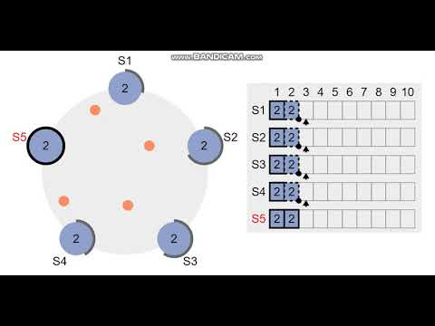

Slide 10
Log replication
Two properties:
If two entries in different logs have the same index and term, then they store the same command.
A leader creates at most one entry with a given log index in a given term, and log entries never change their position in the log.
If two entries in different logs have the same index and term, then the logs are identical in all preceding entries.
Consistency check

Slide 11
Election Restriction
A candidate must get a majority vote to be elected leader
Each node can only vote once per term
Follower will vote no if candidates log is shorter than its own
Follower will vote no if the term of the candidates last log entry is less than its own
Otherwise follower will vote yes
This ensures that the leader will be the most up to date

Slide 12
Ensuring Consistency
Inconsistencies can occur in the non committed log entries of various nodes
When this happens the follower will overwrite his uncommitted log entries with the leader’s
The leader is append only. It never modifies or deletes previous log entries
Inconsistencies can occur when a node is missing entries (not caught up with the leader)
Leader does a consistency check and backfills

Slide 13
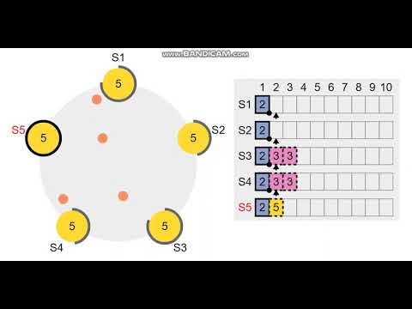

Slide 14
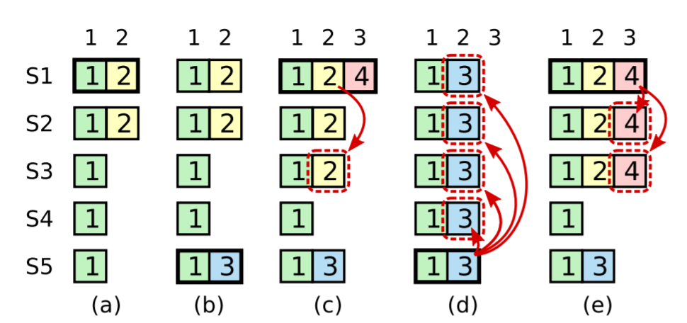
Committing Log Entries
Leader commits a log entry for their term when it has been replicated to a majority of nodes
Leader cannot commit entries from previous terms
Once the leader commits a log entry from their term all previous entries will be committed
*Note figure taken from In Search of an Understandable Consensus Algorithm. USENIX ATC'14

Slide 15
Timing
Raft uses randomized election timeouts
In order for Raft to elect and maintain a steady leader, the system must satisfy the following requirement
broadcastTime << electionTimeout << MTBF
broadcastTime = time it takes for leader to send a request to all of the nodes and get a response
MTBF = Mean Time Between Failures

Slide 16
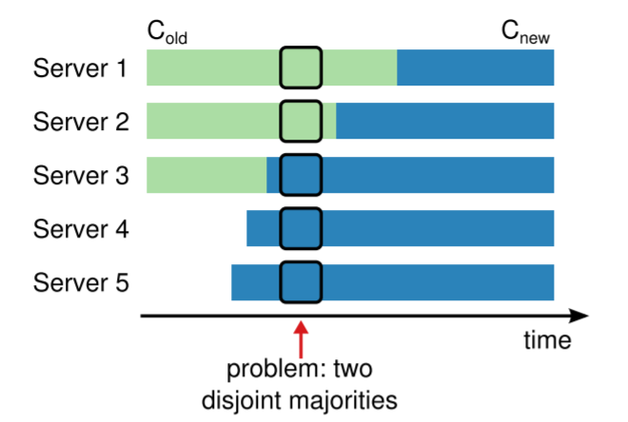
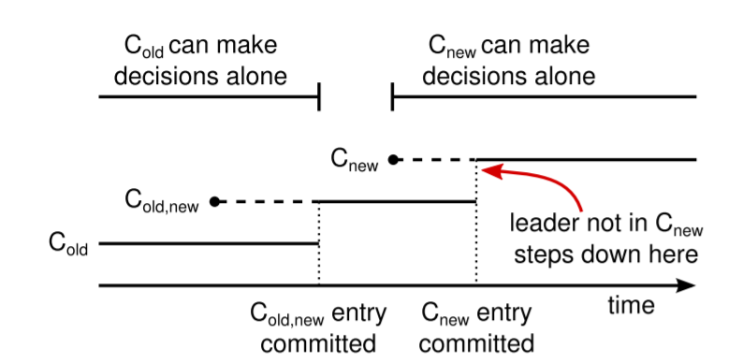
Membership Changes
Configuration changes to the system are sent as log entries
Period of joint consensus during transition
*Note figures taken from In Search of an Understandable Consensus Algorithm. USENIX ATC'14

Slide 17
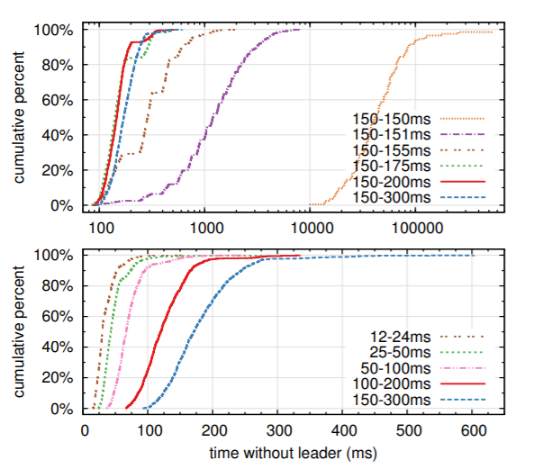
Performance
More randomness
Reduces probability of indecisive election
Raises the expected value of the timeout
Lower election timeout
Lowers the expected value of the timeout
Increases the probability of indecisive election
*Note figure taken from In Search of an Understandable Consensus Algorithm. USENIX ATC'14
Notes:
How does raft perform?
Availibility
Down time when there is no leader
Response time

