Slide 1
BaseDB
Milestone 3
Dillon Jackson, Hoai-An Ho, Max Gao, Hammud Haq, Gisselle Petty
Notes:
Dillon

Slide 2
Here’s a Quick Demo!
Notes:
Dillon

Slide 3
Objectives
Transaction Semantics
Concurrency Execution
Milestone 3 presents two new implementations to add onto our current L-store.
Notes:
An

Slide 4
Transaction Semantics

Slide 5
ACID Properties
Main Goal:
create a transaction consisting of a set of read and write operations where its execution adheres to the atomicity property
Atomicity
each transaction a “single unit", which is either a full success or total failure
Hard locking on operations that could have conflicts
Consistency
transactions make predictable changes, and data errors don’t destroy the integrity of the table
Atomicity
Consistency
Notes:
Gisselle

Slide 6
ACID Properties
Isolation
Concurrent execution should not have conflicting actions overlapping
QueCC concurrency control
Durability
Committed transactions remain so
open/close functions, previous milestone
Isolation
Durability
Notes:
Gisselle

Slide 7
Implementation
Transaction class
Just call run() and it should do the trick
QueCC concurrency execution takes care of most of the transaction functionality, so no commits or aborts necessary
Transaction Worker class is modified from the original implementation
add_query()
Transaction
Transaction
Worker
add_transaction()
run()
join()
__run()
Notes:
Dillon

Slide 8
2. Concurrent Execution

Slide 9
QueCC Basics
Phase 1
Phase 2
Implementing QueCC for our database concurrency protocols
2 Phases:
[1] Deterministic priority-based planning of transaction operations in parallel
[2] Priority driven execution of plans in parallel
Batching Client Transactions
Execution Threads
Planning Threads (predetermined priority)
Execution Queues
Main Memory
DB Storage
Index
Notes:
Hammud

Slide 10
QueCC - Phase 1
Step 1 - Split transactions into high vs low priority threads
Split based on read/write
Step 2 - Decide on the planning threads
Planning threads are running the process in parallel
Planning Thread #2
Planning Thread #2
w(b)
r(c)
Client Transactions
Client Transactions
w(b)
w(b)
w(b)
r(a)
w(b)
w(b)
r(d)
r(c)
r(a)
w(b)
r(d)
r(a)
Planning Thread #1
Planning Thread #1
r(a)
w(b)
Notes:
Hammud

Slide 11
QueCC - Phase 1
Priority Groups
Step 3 - Prioritized Execution Queues
Each section of the database gets its own high and low-priority queues
Place each sub-action of a transaction in the section queue it’s associated with
Low-priority queues
w(b)
w(b)
r(c)
r(d)
High-priority queues
r(a)
w(b)
r(a)
w(b)
Notes:
Hammud

Slide 12
QueCC - Phase 2
Step 4 - Execution threads
Execute high priority queue transactions first
Low priority transactions next, after high priority finishes
Sub-actions completed in stack order
Execution Thread #2
w(b)
w(b)
w(b)
w(b)
r(c)
r(d)
Committed Transactions
Execution Thread #1
r(a)
w(b)
r(a)
w(b)
r(a)
r(a)
Notes:
Hammud

Slide 13
QueCC - Phase 2
Main Memory
DB Storage
Step 5 - Committed Transactions
Transactions can be completed in any order
Sub-actions within them still adhere to an order though
Committed Transactions
a
b
w(b)
w(b)
w(b)
r(a)
c
r(d)
r(c)
r(a)
w(b)
d
Notes:
Hammud

Slide 14
Page Latches
Utilizes thread.Lock
When moving a page to/from the disk
We check the page latch when we try to read and write to a page
Wait for the page because we know it will be released once the page is moved
Prevents the chance for the page to copy itself with outdated data
Notes:
Max

Slide 15
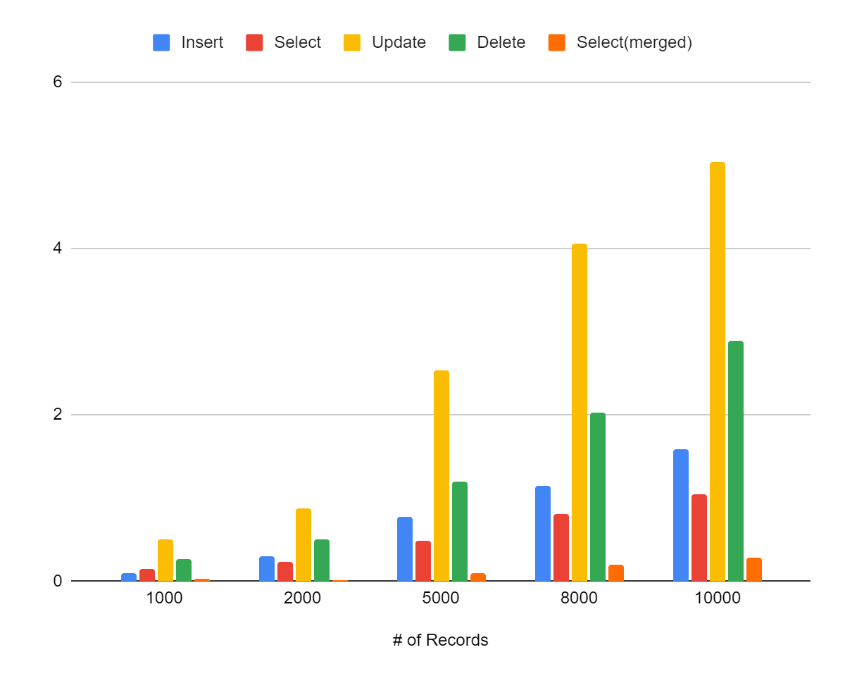
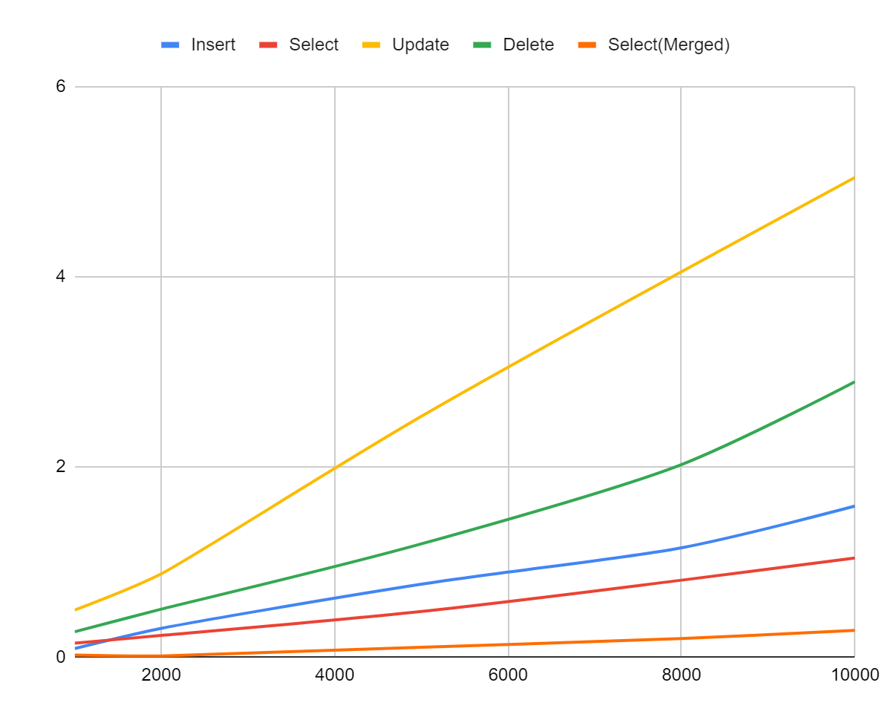
Performance Metrics
Notes:
Max

Slide 16
Thank You!

