Slide 1
Milestone 3
Multi-threaded, In-Memory & Durable L-Store Database
Patrick Chan | Sonya Gomez Enriquez |
Kevin Guan | Jai Malegaonkar |
Donna Moon
Notes:
Sonya
Hi again professor this is the presentation for our last milestone. We are group 19 Im sonya and in our team we have patrick, kevin, jai, and donna as well. This time our database will be multithreaded as well as in memory and durable.

Slide 2

Our Goals
Locks and Latches
Concurrency Control
Atomicity
Implement locks and latches to ensure data is safe while potentially being accessed by multiple threads
Allow multi-threaded transactions; Implement lock manager to help threads access data safely
Implement strict 2PL policy with a no-wait property; Will either full process and commit transaction or abort transaction and undo changes
Notes:
Jai

Slide 3
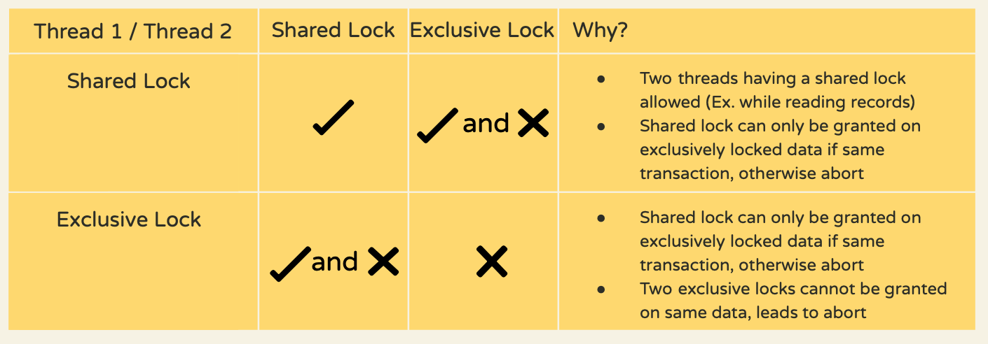
Locks and Latches: Design
Locking Rules
Latching:
In index
Bufferpool
RID generator
x
x
Notes:
Jai

Slide 4
Lock: Implementation
class LockManagerLock:
__slots__ = 'rid', 'locked_by', 'owned_by'
def __init__(self, rid):
def lock(self, tid):
def upgrade(self, tid):
def unlock(self, tid):
class LockManager:
__slots__ = 'latch', 'locks', 'tid'
def __init__(self):
def start(self):
def lock(self, tid, rid):
def unlock(self, tid, rid):
def upgrade(self, tid, rid):
Two-Phase Locking (2PL) with no wait: transaction immediately aborts if it is unable to obtain a lock
The LockManager class is implemented as an attribute of the Table class
We have a LockManagerDict(dict) class that maps record keys to Lock objects
Notes:
Jai

Slide 5
Multi-threading: Design
A transaction in a database must maintain these properties (ACID):
Atomicity: each transaction is treated as a single unit
Consistency: transaction will not violate data integrity constraints
Integrity: concurrent execution of transactions leaves database in the same state as if the transactions were executed sequentially
Durability: transaction will remain committed even in the case of system failure
Notes:
Donna
** Please dont include codes **
ACID + graph?

Slide 6
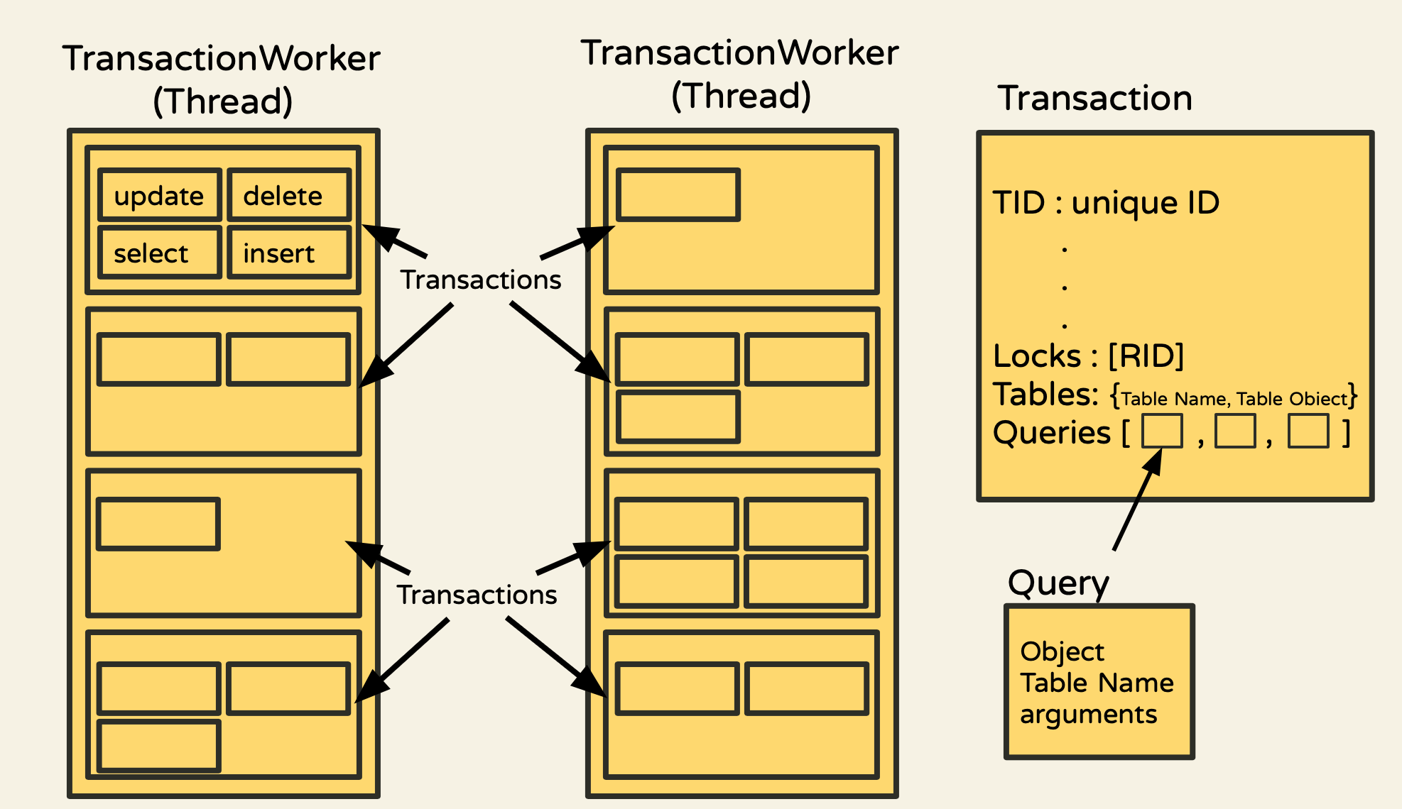
Threads/Transaction Worker: Visual
Notes:
Donna
Each transaction worker is a thread
It contains all the transactions we need to perform
Transaction contains info such as an unique Transaction ID
An array of locks it is holding right now
A dict that maps table name to table object
Array of queries object
And more…
When we run the transaction worker, we will run all the transaction in the ar

Slide 7
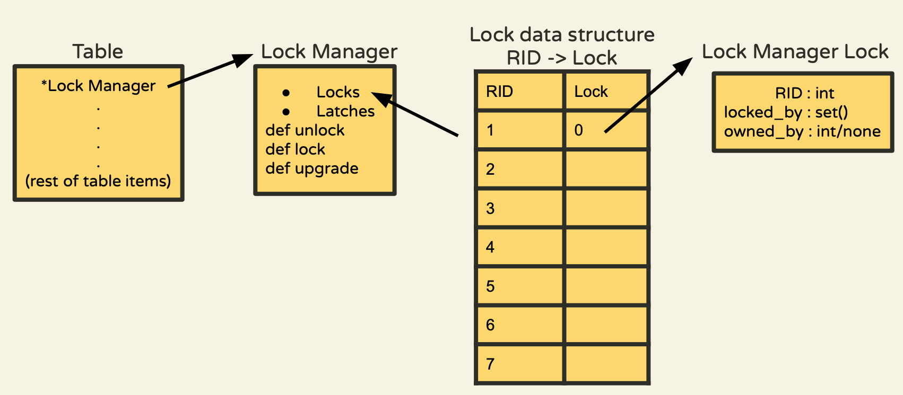
Lock and Lock Manager DS
Notes:
Sonya
Here I just wanted to discuss structures regarding locks and the lock manager. So instead of a global lock manager we opted for one lock manager per table to avoid mix ups with table RIDs. Each lock manager has its own locks n latches. The locks are held in a dictionary where each lock has a rid for simple access. The individual locks have their identifiers and potentially a locked_by if a shared lock and owned by if its an exclusive lock
For delete, we only truly delete as we commit to avoid prematurely deleting data
For insert, we actually insert but mark indirection to 2 if uncommitted so we know its invalid

Slide 8
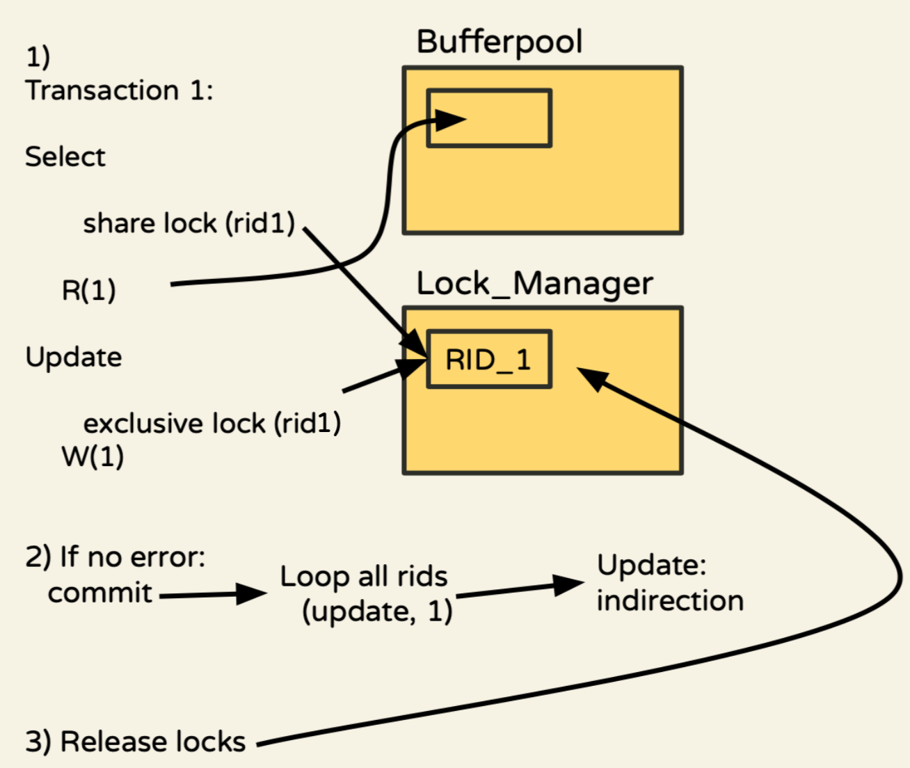
Atomicity: Commits
Notes:
Patrick
How a successful transaction looks like
Insert:
We change the timestamp to show the commit time
Timestamp = 0 is not committed
Update:
We change the indirection column to the latest tail record RID
Delete: We set the indirection column value is an invalid value
In Transactions We have 3 queries that will alter the database , insert, update and delete. The data that these queries manipulate will only persist if the whole transaction completes without failing . This is done by setting flags with in the records to indicate whether or not a record is committed and that flag is only changed when we decide to commit after the completion of the transaction. In addition to that we change the index after each query, which is done so queries have access to the most recent data. This indexing will be reversed in abort.

Slide 9
Atomicity: Aborts
We abort when a transaction cannot lock properly or when the query is invalid.
Then we go through an abort phase
We have the most recent change and the original data paired with the RID in the transaction
So during abort phase we can roll back through the modified index and point them back to the original data
Unlock all the holding locks
SID | GRADE 1 | GRADE 2 | GRADE 3
1 | 90 | 92 | 87
2 | 91 | 86 | 77
RID | TUPLE
010101 | [[][90,92],[92,87],[87,92]]
010102 | [[2,None][90,None],[92,None],[87,None]]
010103 | [[None,3][None,90],[None,92],[None,87]]
Notes:
Patrick
Abort when 2PL fails to acquire lock
Transaction cannot get the lock to read if we have a writer
Transaction cannot get the lock to write if we have >= 1 readers
During abort()
Invalid all the uncommitted records
Index rollback
Here we will abort when the Transaction fails to gain a lock, under the conditions which are described earlier in the slides. In aborts we must undo every query that has altered the database. We must invalidate any new record inserted by indicating it as deleted. Besides that we have to change the index back to the way we found it. We can do this because we have a dict that maps rid to the changes per column as seen. Where the left value is the original and the right value is the most recent update. None on the right represents a delete, in which we will reinsert and None on the left indicate a new base in which we will remove it from the index.

Slide 10
Merge Update
Fixed:
No more in place update, we will create a new base page file after each merge.
New: only merge stable data
Merge worker will ignore the base page if it contains uncommitted base record.
Merge worker will ignore all the tail records that are not committed. (i.e. base record indirection value is less than the RID of the tail record)
Notes:
KEVIN i will take this one

Slide 11
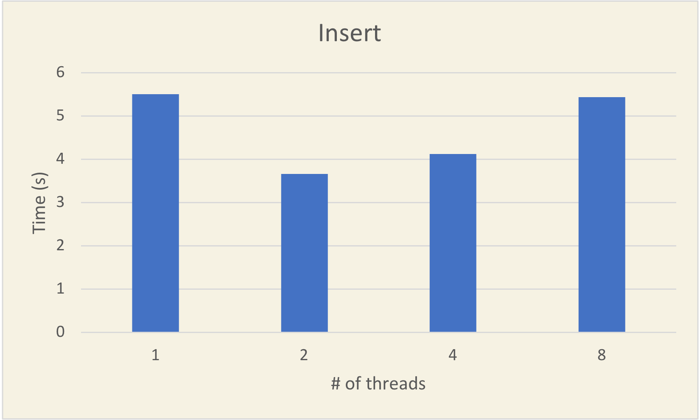
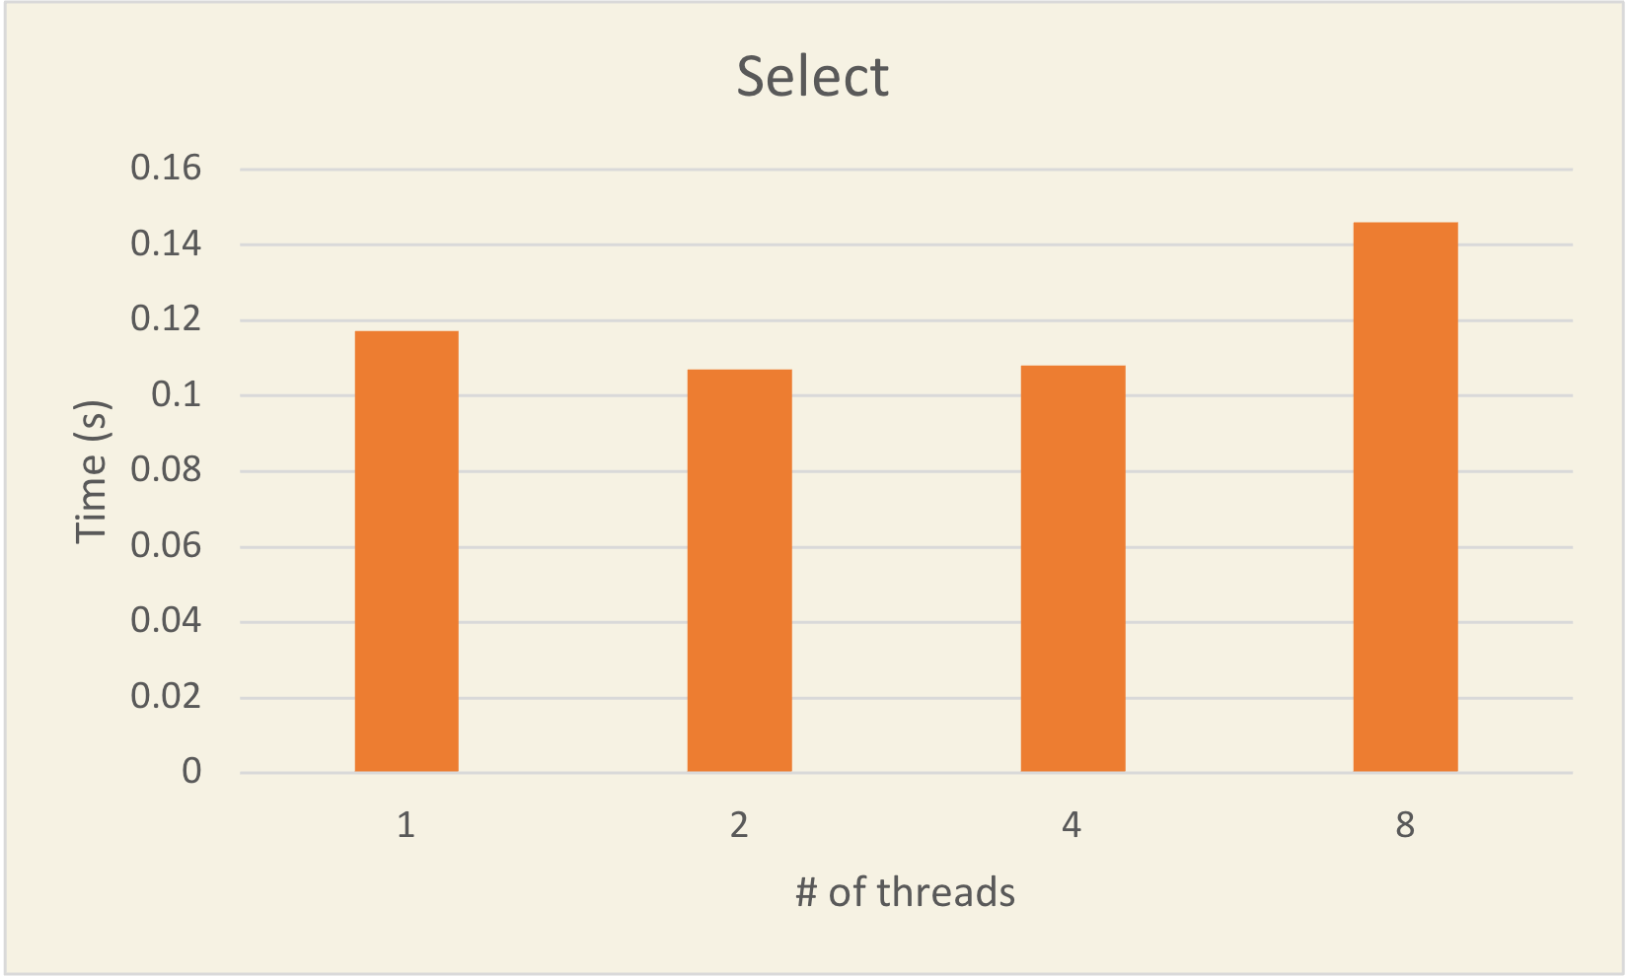
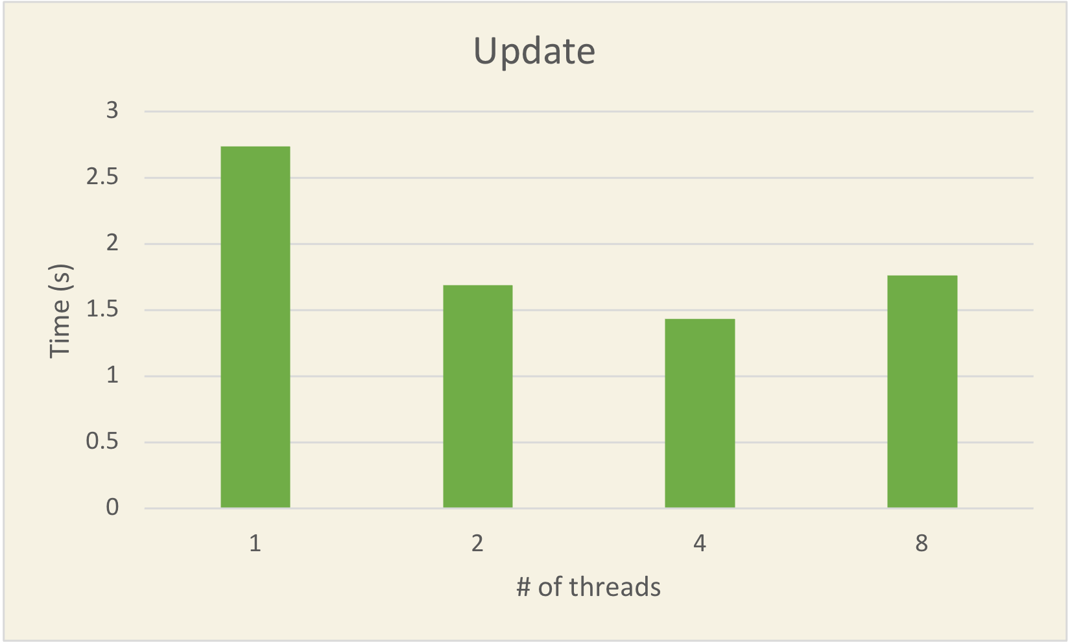
Performance
Machine Information: Apple M1 Pro CPU @ 3.22GHz, 10 cores 32 GB RAM 10k insert, select, and update using 1, 2, 4, and 8 threads
Results: - More threads != faster - For insert only transactions, we should use 2 threads. - For select and update only transactions, we should use 4 threads. - Potential explanation: Global Interpreter Lock
Notes:
KEVIN i will take this one

Slide 12
Final Thoughts
How can we improve?
Non-cumulative tail design - In real life, cumulative tail approach is impractical. - Non-cumulative tail makes merge more userful.
QueCC instead of 2PL - Don’t need to abort
Use multiprocessing instead of multithreading - Multiprocessing will utilize multiple cores
Notes:
KEVIN i will take this one

