Slide 1










Milestone 1 BLANK
Kai Janowicz, Bilal Pervaiz, Niraj Bangari, Andrew Lam, and Laura Ehrlich

Slide 2
Overview
Query Interface
Data Model
Select
Insert
Update
Sum
Database Storage
Base + Tail Pages
Page Range
1
3
Results
Speed
4
2
Bufferpool Management
Page Directory
Index Directory

Slide 3




Data Model
1

Slide 4
Storage
Column-based database
User Data
Metadata
Indirection, RID/TID, Timestamp, Schema Encoding, update count
Base + Tail Pages
Holds 512 records per page
A physical Page
# of columns + Metadata Count = # of physical pages
4096 kb
8 bytes per record

Slide 5
Page Range
Stores 8192 records
1 full page range
Base Pages
Tail Page
Holds 16 base pages
Unlimited Tail Pages to hold all updates

Slide 6


Bufferpool
Management
2

Slide 7
Page Directory
RID
1
Page Range
{RID, Page Range}
2
Base Page.
3

Slide 8
Index Directory
List of Dictionaries
One dict per column
Each data value maps to a list of Rids
User Data (key)
RID
[{},{},{},{}]
[Rid, Rid,Rid]

Slide 9
Query
Interface
3

Slide 10
Insert
Record
-Record input
-Calls table.insert
-increment RID
Query
-contains RID, primary key, columns
-PageRange for first insert
-add primary key to rid hashtable
-Checks for PageRange and BasePage space
-Creates data column to be inserted into physical pages of BasePage
If not
If there is still PageRange capacity, add BasePage
If there is not PageRange capacity, create a new PageRange
Table
If space
Index
Insert records into physical pages of BP
-calls create.index, which passes data column and rid to make hashtable for values

Slide 11
Select
Index
Index
Finds Location in Index
Returns the RID of every occurrence of the Inputted Key & the Column Index
Table
Query
Calls Separate Select
Input goes into query
Calls Select
Returns List of RIDS
Calls Internal Function “select_w_rid”
Returns Record
Table.select_w_rid
User Defined Page Range
pr.get / pr.get_uptodate
Finds most recent version of every record
Calculates where TID/RID is located in the data
Return Record

Slide 12
Sum
Table.select_for_me
User Defined Page Range
Query
Input Key Range and Column that is going to be summed
Checks if Key exists. Find location and return record holding specified column.
pr.get / pr.get_uptodate
Calculates where TID/RID is located in the data.
Calls Sum. Passes each Key in the range
Return Record

Slide 13
Update Cumulative
Calls to update a Record
Query
What to keep track of
Indirection Column
Update_Count Column
Col to update
Point Basepage to the Newest Version
Point newest to previous location
Table
Update Steps
Space in Tail page
Basepage Indirection Col
Indirection Col and Update_Count
Write to the Tail Page
Update the metadata in the Tail page
Make the New Indexes
Index

Slide 14
Select_Version & Sum_Version
Draw Backs:
Only works with Primary keys
Visual Representation:
I want version -1 of rid 0
Base
My Assumptions
If requested version is larger than the update number then return the first entry.
ind | RID | val
3 | 0 | 5
0 | 1 | 6
0 | 2 | 4
My Implementation:
Jumping to versions through the indirection column
Tail
ind | TID | val
0 | 1 | 8
1 | 2 | 6
2 | 3 | 4

Slide 15
Delete
Calls to delete on a certain Record
Gives Key and what to update
Query
What to do:
Update the index
Change Rid to -1 to signal a delete
Finds the Rid using the Index
Calls delete and places -1 in the Rid Col
Table
Remove deleted data mappings in the Index
Index

Slide 16
Results
4

Slide 17
BIG 0 RESULTS FOR QUERY OPERATIONS
INSERT: INSERT NEW TABLE or NEED TO UPDATE/ADD PAGERANGE AND BASE PAGE
Inserting a record & setup index:
BIG-O: O(2N); N = COLUMN NUMBERS
NEW BASE PAGES AND PAGE RANGE: O(1)
O(2N) (WORST CASE)
SELECT: SELECT FROM DATABASE BASED ON GIVEN CRITERIA
LOOKING FOR ALL COLUMNS
O(N) (WORST CASE)
DELETE: DELETE A RECORD FROM THE DATABASE
THIS DELETES THE BASE PAGE FROM THE PAGE RANGE
REMOVES THE RECORD FROM THE INDEX
BIG-O: O(N). N IS NUMBER OF COLUMNS

Slide 18
BIG O RESULTS FOR QUERY OPERATIONS: CONTINUED
SUM: CONSTANT TIME
ARITHMETIC; SUMMING FROM A TO B
O(1)
UPDATE: UPDATING A RECORD. EACH UPDATES COLUMN WILL HAVE THEIR OWN TAIL PAGE
EACH ADDITIONAL UPDATED GETS THEIR OWN TAIL PAGE
UPDATE BOTH THE INDEX AND ADD THE PAGE RANGE WITH THE TAIL PAGES AS NEEDED
WORST CASE: ALL COLUMNS NEED A NEW TAIL PAGE
O(N), N IS THE COLUMN NUMBER

Slide 19
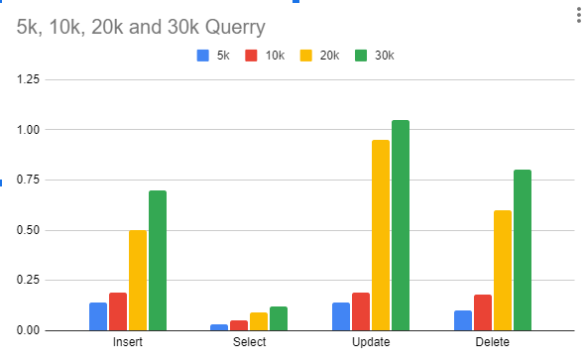
Results
Specs
-Ram 16gb ddr4
-i5-12400 2.5ghz

Slide 20

Thanks!

