Slide 1
Distributed Database Systems (ECS - 265)
Staring into the Abyss : An Evaluation of Concurrency Control with One Thousand Cores
Presented By
Sanjat Mishra
10.09.2018

Slide 2
Road Map
What this paper is about?
What problems does it address?
What methods does this paper use to draw its conclusions?
What criteria does this paper consider while drawing the conclusion?

Slide 3
What’s this paper about?
States the problems that todays Database Management System will face when paired with with a ‘many-core’ system.

Slide 4
Why are we talking about a thousand core system?
Right now, Multi Core systems are the only way of increasing the computing power required to carry out large scale operations!

Slide 5

What’s a Concurrency Control Problem?
It is the coordination of the simultaneous executions of transactions in a multi user database.
Problems that emerge without concurrency control:
Lost Update
Uncommitted Data
Inconsistent Retrieval

Slide 6
Methodology Adopted in the paper
Chooses workloads or test databases. (OLTP in this case)
Performs an evaluation of 7 concurrency control schemes.
Uses a simulator to benchmark performances on a ‘many-core’ machine and then scales it to a thousand core machine.

Slide 7
Online Transaction Processing (OLTP)
The OLTP system supports that part of an application that interacts with the end users.
Features of OLTP Transactions :
They are short lived
They touch only a small subset of data during index look ups
They are repetitive

Slide 8
ACID Properties
Atomicity – Either the entire transaction takes place at once or doesn’t happen at all.
Consistency – The integrity constraints of a DB must be me so that the DB is consistent before and after a transaction.
Isolation – Ensures multiple transactions can occur concurrently without leading to inconsistency.
Durability – Ensures that once transaction is done, the updates are stored and written to the disk and persist even when system fails.

Slide 9
Concurrency Control Schemes
Two Phase Locking (2PL)
DL_DETECT
NO_WAIT
WAIT_DIE
Timestamp Ordering (T/O)
TIMESTAMP
MVCC
OCC
H-STORE

Slide 10

Two Phase Locking (2PL)
Transactions have to acquire locks for an element in the DB before they are allowed to execute a read or write on that element.
The Database maintains the lock for each tuple or a higher logical level.
Ownership of locks is governed by the following rules;
Different transactions can’t simultaneously hold conflicting locks.
Once a transaction surrenders ownership of a lock, it can never obtain new locks.

Slide 11
Phases of 2PL
Growing
Growing Phase
The Transaction can acquire as many locks as it wants to without releasing locks.
Shrinking
Shrinking Phase
The Transaction enters the shrinking phase after it releases locks. Here, it is prohibited from obtaining more locks.

Slide 12
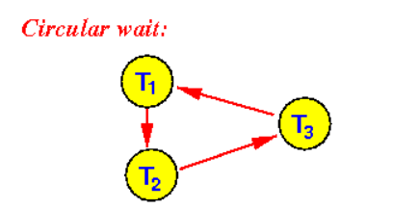
Types of Two Phase Locking
2PL with Deadlock Detection (DL_DETECT)
The DBMS monitors a waits-for graph for cycles.
If a cycle is detected, this means there’s a deadlock between those processes.
When a deadlock is found, the system must choose which transaction to abort.
Usually a transaction with lesser number of resources is aborted first.

Slide 13

Types of Two Phase Locking
2PL with Non-Waiting Deadlock Prevention (NO_WAIT)
This scheme aborts a transaction if a deadlock is suspected.
When a lock request is denied, the scheduler automatically aborts the transaction requesting the lock.

Slide 14

Types of Two Phase Locking
2PL with Waiting Deadlock Prevention (WAIT_DIE)
This is a non pre-emptive variation of the NO_WAIT scheme.
Here, each transaction needs to acquire a timestamp before execution.
The execution is based on timestamp ordering and helps prevent deadlocks.
In case of a deadlock, the younger of the transactions is aborted.

Slide 15
Timestamp Ordering (T/O)
Assigns a time stamp to every transaction and generates a serialization order a priori . The DBMS then enforces this order.
DBMS solves conflicts in the proper order of timestamp.
Broad way of categorizing the various schemes under T/O :
How the DBMS checks for conflicts?
When the DBMS checks for conflicts?

Slide 16
Basic T/O (TIMESTAMP)
Every time a transaction updates a tuple in the database, it checks the timestamp of the previous operation on the same tuple.
If the timestamp of the new operation is lower than the timestamp of the previous operation on the same tuple, then the new operation has to be aborted.
In this method, the read operation always creates a copy of the tuple before it reads and only reads the copy.

Slide 17

Multi version Concurrency Control (MVCC)
In this scheme, every write operation creates a new version of the tuple in the database.
Each version of the tuple is tagged with the timestamp and transaction id of the transaction that created it.
The DBMS maintains an internal list of the versions of an element.
For a Read operation, the DBMS determines which version of the element is to be accessed by checking the timestamp.

Slide 18

Optimistic Concurrency Control (OCC)
In this scheme, the DBMS tracks the read/write sets of each transaction and stores all of the “write” operations in a separate workspace.
When a transaction commits, the system checks and determines whether the transactions read set overlaps with any operation in the write set.

Slide 19
T/O with Partition Level Locking (H-STORE)
In this scheme, the database is divided into disjoint sets of memory called partitions.
Each partition is protected by a lock and is assigned a single threaded execution engine that has exclusive access to the partition.
A transaction needs to have all the locks of all the partitions that it needs to access before it is allowed to start running.
Hence, the DBMS needs to know before hand about which transactions access which partitions.

Slide 20
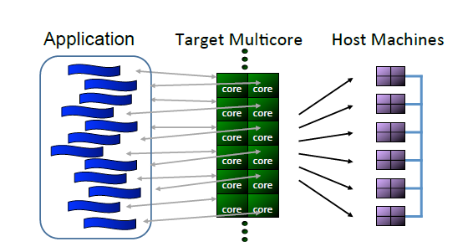
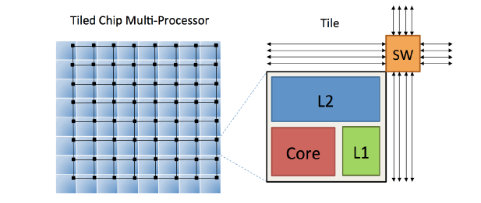
Test Set up
Graphite Simulator
Simulator for large scale multi core systems.
Can scale to 1024 cores.
The target architecture is a tiled chip multi processor where each tile contains a low power in order processing core.
Custom DBMS
Custom lightweight DB.
Number of worker threads = Number of cores , where each thread is mapped to a separate core.

Slide 21

Some Useful Terms
USEFUL WORK : The time that the transaction is actually executing application logic and operating on tuples.
ABORT : Overhead incurred when DBMS rolls back all of the changes made by a transaction.
TS ALLOCATION : Time taken to allocate the timestamp from centralized allocator.
INDEX : The time that the transaction spends in hash index for tables.
WAIT : The total amount of time the transaction has to wait (either for a lock or for a value that’s not ready yet)
MANAGER : The time that the transaction spends in lock manager or the timestamp. (Excludes wait time)

Slide 22

Workloads
Yahoo Cloud Serving Benchmark (YCSB)
Collection of workloads that are representative of large scale services
20GB YCSB database containing one table and 20 million records.
Single primary key column and DBMS creates a single hash index for the primary key.
Each transaction by default access 16 records at a time. (Read or Write)
Uses a term theta to determine level of contention
When Theta = 0, all tuples are accessed with same frequency.
When Theta = 0.6, a hotspot of 10% of tuples are accessed by 40% of the transactions.
When Theta = 0.8, a hotspot of 10% of tuples are accessed by 60% of the transactions.

Slide 23
Workloads
TPC-C
Current industry standard for evaluating performance of OLTP systems
Consists of 9 tables that simulate a warehouse centric order processing application.
Has 5 different types of transactions (only New Order and Payment are modeled in this paper)

Slide 24
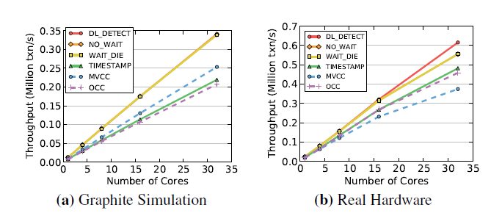
Simulator vs Real Hardware
The graph shows that the simulator generates results that are comparable to the Real Hardware.
The trends of MVCC , TIMESTAMP and OCC are a bit different.
After 32 cores, the both T/O based and WAIT_DIE schemes drop due to cross-core communication and timestamp allocation overhead.

Slide 25
General Optimizations
Memory Allocation
While scaling DBMS to large core counts, DBMS spends most of the time in waiting for memory allocation.
Hence a new malloc function was developed which assigns each thread its own memory pool and then resizes the pool according to the workload.
Lock Table
This is a key contention point in DBMS. Instead of having a centralized lock table or timestamp manager, each transaction latches on to the tuple it needs.
Mutexes
Accessing a mutex lock is expensive and requires several messages to be sent across the chip. Reduces scalability.

Slide 26
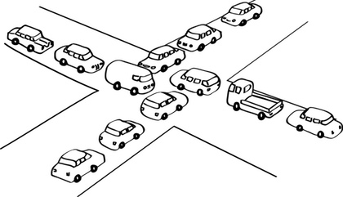
Scalable Two Phase Locking
Deadlock Detection
The main bottle neck occurs when multiple threads compete to understand their waits-for graph and detect cycles.
By partitioning the data structures across cores and making the deadlock detector lock free , each core has its own local copy and doesn’t need to wait.
Lock Thrashing
Even with improved detection, the DL_DETECT doesn’t scale due to thrashing. This occurs when a transaction holds its lock until it commits, blocking all other concurrent transactions that need the same lock.
This becomes a bottleneck in most 2PL schemes.

Slide 27
Solution to Lock Thrashing
Lock thrashing can be solved by aborting some transaction that are waiting to acquire locks.
This can reduce the number of active transaction at a particular time.
Ideally, setting a timeout helps the system run at optimal throughput. The timeout threshold varies cases to case.
Restarting a transaction is relatively faster than rolling back and performing the changes again.
Trade off between performance and transaction abort rate.

Slide 28
Scalable Timestamp Ordering
Timestamp Allocation
Using mutexes for timestamp allocation increases the duration and decreases scalability.
One solution is to use atomic addition operation to advance a global timestamp. This requires fewer instructions and is faster since the critical sector is locked down for a smaller period.
But this is still insufficient for a 1000-core CPU.
Other methods that can work:
Atomic Addition with batching.
CPU Clocks
Hardware Counters

Slide 29
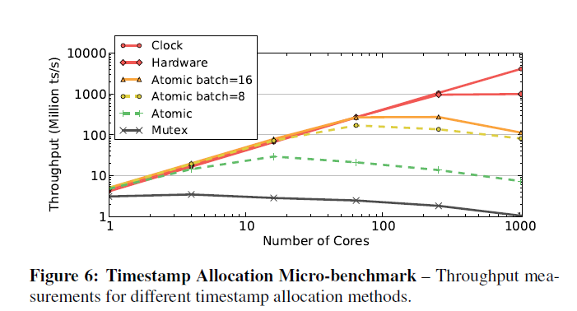
Comparing Timestamp Allocation Methods
Mutex performs the worst.
Throughput of atomic addition reduces with increasing number of cores.
Batching suffers from contention after a point.
CPU Clock is the ideal candidate as its decentralized.

Slide 30
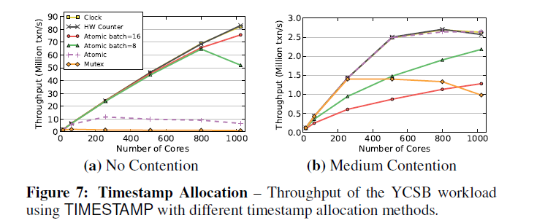
Comparing Timestamp Allocation Methods on Workload
When there’s no contention, the results are almost similar.
When there’s contention, transaction have to restart and hence performance depreciates.

Slide 31
Distributed Validation
This is specifically meant for OCC where there is a critical section after the read phase.
Normally, mutexes are used to protect the critical section but this decreases scalability.
Instead, using per tuple validation that breaks the operation into smaller fragments is faster.

Slide 32
Local Partitions
This scheme is meant for H-STORE . By enhancing H-STORE to use the shared memory effectively, scalability is achievable.
By giving direct data access to transactions for remote partitions, overhead decreases .
The read only tables don’t create additional copies and hence reduces memory footprint.

Slide 33
Experimental Analysis
The experiment done can be grouped into 2 categories:
Based on Scalability
Based on Sensitivity to Data changes
Scalability experiment tells us how well the model performs when the number of cores increases.
The Sensitivity experiment tells us how well the model handles changes to data or more complicated transaction scenarios.

Slide 34
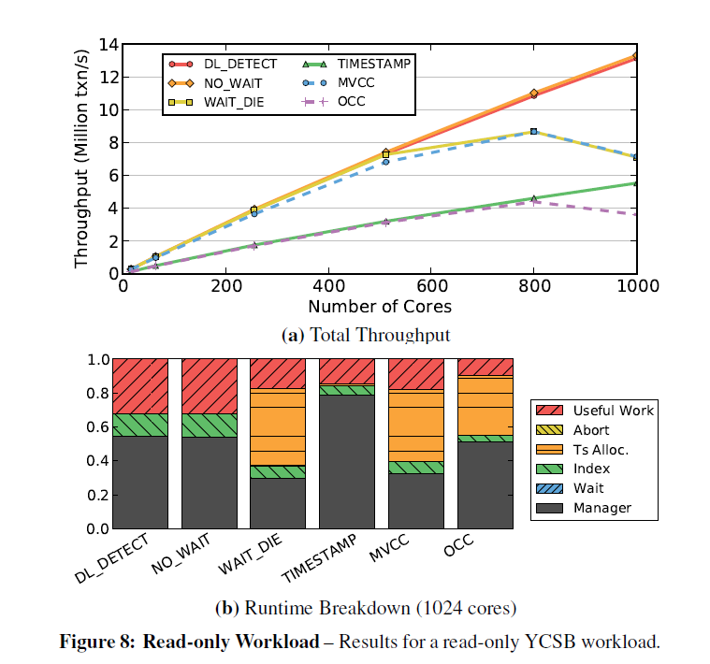
Read Only Workload
The Read only arrangement provides a benchmark before moving to more complex arrangements.
In a perfectly scalable case, linear increase should be present.
Timestamp allocation bottle necks the related schemes.
OCC and TIMESTAMP waste cycles while making copies of data to be read.

Slide 35
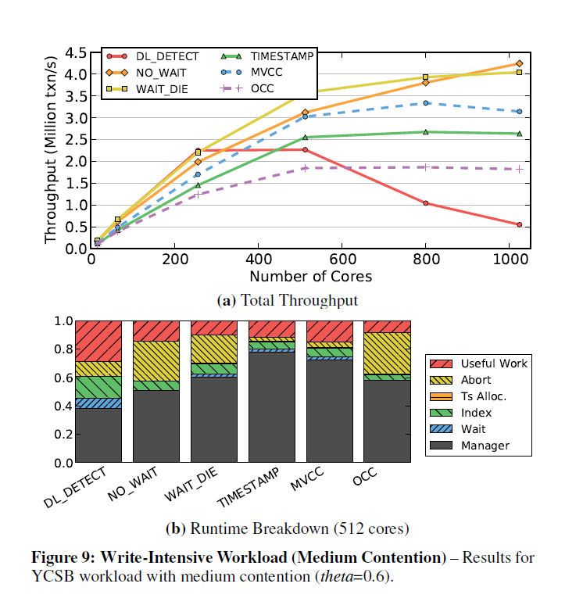
Write Intensive Workload (Medium Contention)
Large size of the workload means contention can vary and may be less.
Hence, we introduce the “theta” factor to reflect real world data which has high contention chances.
NO_WAIT and WAIT_DIE alone scale past 512 cores.
DL_DETECT spends most time in waiting.
OCC spends large portion in aborting.
MVCC and TIMESTAMP perform good as they overlap operations and reduce waiting time.

Slide 36
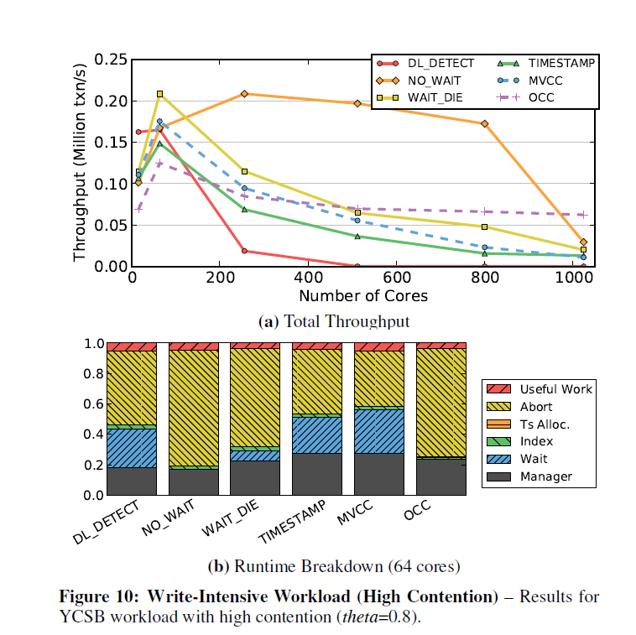
Write Intensive Workload (High Contention)
When high contention, all of the schemes fail to scale.
Due to higher number of conflicts, most of the time is spent in aborting transactions or waiting for lock release.

Slide 37
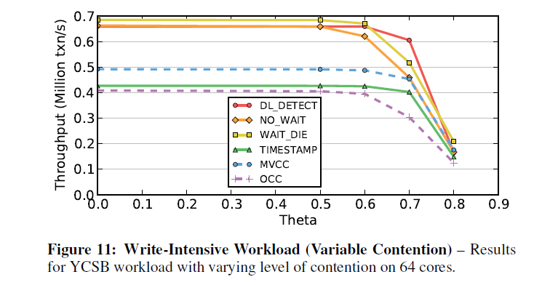
Sensitivity to Contention
With increase in theta value, the schemes virtually become non-scalable.
Increase in the number of cores stops to matter.

Slide 38
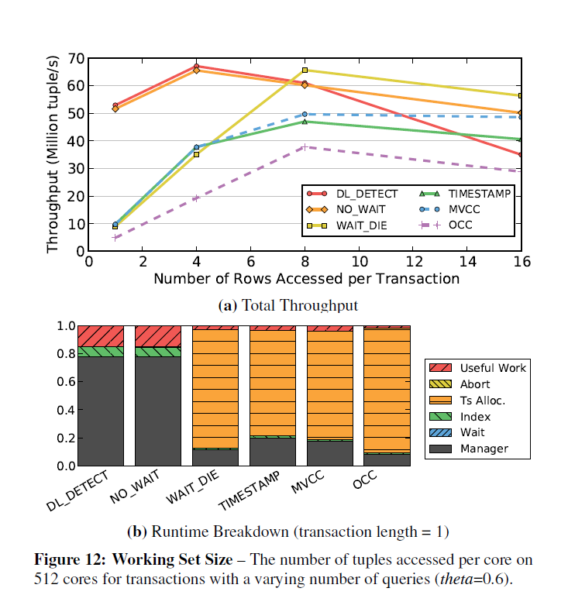
Working Set Size
Working set is the number of records the transactions need to access.
When the working set size increases, the chances of contention also increase.
Shorter Transactions lead to higher through put as contention chances decrease.
When short transactions, DL_DETECT and NO_WAIT have best throughputs.
With increase in size, thrashing also increases.
When transactions are small, T/O schemes suffer because cost of timestamp is high.
This later gets amortized and they scale better.

Slide 39
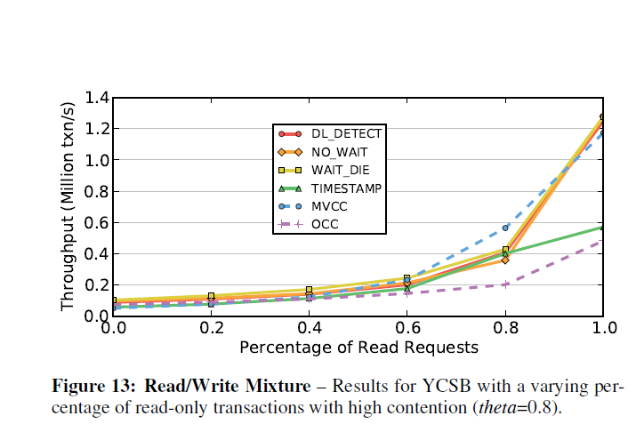
Read/Write Mixture
MVCC performs best consistently.
TIMESTAMP suffers due to copy overhead.

Slide 40
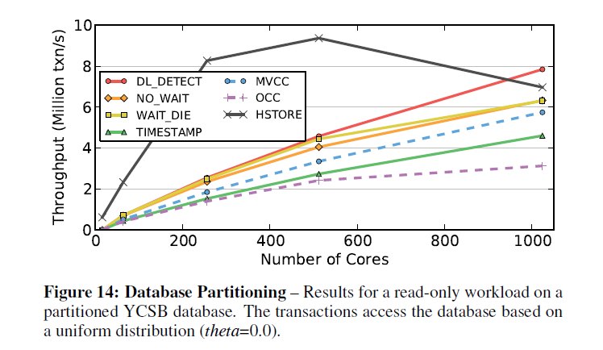
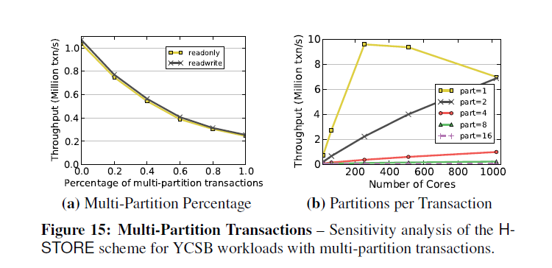
Database Partitioning
When the database is partitioned and cores are assigned, H-STORE initially performs the best.
This approach is best when the data to be accessed is split across less number of partitions.
With increase in number of partitions, every scheme suffers.

Slide 41
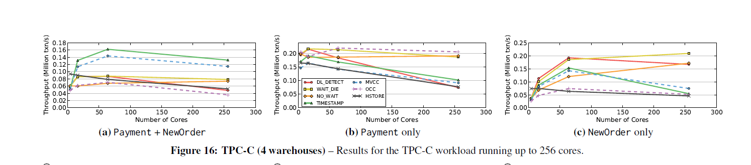
TPC-C Workload (4- Warehouses)
More worker threads than warehouses.
Cross core communication takes place.
All schemes fail to scale when there are few warehouses than cores.
H-STORE isn’t optimal as data is scattered across multiple partitions.
2PL schemes suffer from thrashing.
T/O experiences high abort rates but outperforms others as Reads aren’t blocked by Writes.

Slide 42
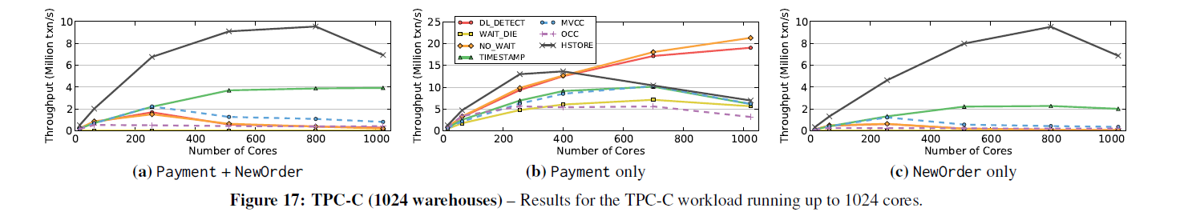
TPC-C Workload (1024 Warehouses)
Here, number of warehouses = number of cores.
Even if there is no contention, bottleneck is maintaining and assigning locks and Timestamp Allocation.
MVCC suffers from write overheads.
OCC suffers from acquiring latches.
Performance only better in Payment as bottle neck is eliminated.

Slide 43
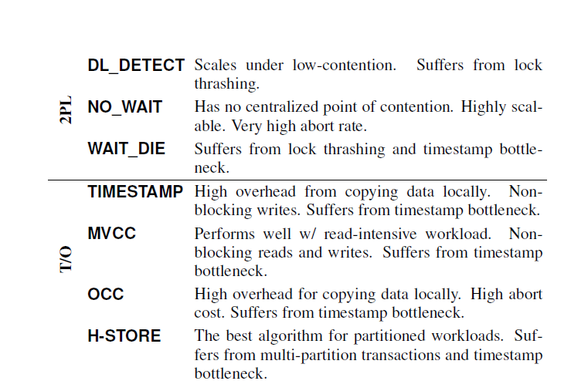
Conclusion
Every scheme suffers from bottle necks under different scenarios.
No scheme is ideal for real world application when number of cores are high.
Extra cores are never utilized to their full potential.

