Slide 1
Dissecting BFT Consensus: In Trusted Components we Trust!
Presented by Tarun Tiwari, Akshit Parmar, Devashree Kataria, Sofiya Shaikh

Slide 2
MINBFT
Typical BFT protocols require at least 3f+1 replicas
Why 3f+1? Why not 2f+1?
More replicas = more cost
A solution: make equivocation impossible
Can guarantee safety of a BFT protocol in just 2f+1 replicas!
Monotonic counters/Append only logs -> We trust you! (Well, kinda)

Slide 3
Approaches....
Trusted Logs
Trusted Counters
q
A set of ‘q’ monotonically increasing counters
Only APPEND (q, k_{new} , x ) function, no LOOKUP
k
k+1
k+2
…
q+1
k
k+1
k+2
…
.
.
.
.
Append only logs
Offers the following API
APPEND ( q, k_{new} , x )
LOOKUP ( q, k )

Slide 4
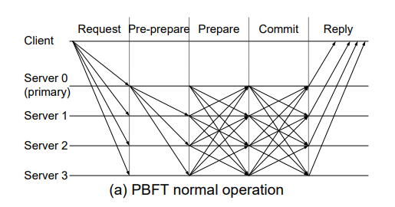
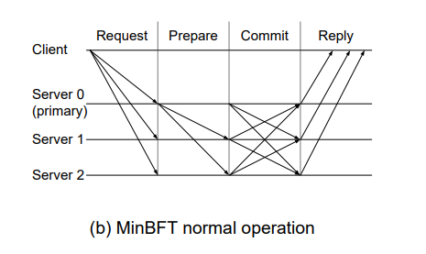
PBFT – f replicas = MINBFT + trusted components
Pre-prepare
Prepare

Slide 5
ZYZZYVA
Fast case:
Application
3f+1
Request
Prepare
Reply
Client
Primary
Replica 1
Replica 2
Replica 3
Two phase case:
Application
2f+1
2f+1
Request
Prepare
Reply
Commit
Local Commit
Client
Primary
Replica 1
Replica 2
Replica 3

Slide 6
MINZYZZYVA
Application
Fast case:
2f+1
Request
Prepare
Reply
Client
Primary
Replica 1
Replica 2
Two phase case:
Application
f+1
f+1
Request
Prepare
Reply
Commit
Local Commit
Client
Primary
Replica 1
Replica 2

Slide 7
Consensus vs Replicated State Machine (RSM)
Consensus is agreement among the replicas for a particular transaction
RSM is agreement for a specific/correct ordering of transactions
Liveness
Safety
Liveness
Safety
If one honest replica executes a txn, all honest replicas eventually also execute the same txn
If a honest replica executes a txn as kth txn, then all honest replicas also execute the same txn as kth txn
A client receives a response for its request
All client transactions are executed in a correct order

Slide 8
Observed challenges of using Trust Components
Weak Quorums
Relies on Data Persistence
Enforces Sequential Order

Slide 9
Weak Quorums
Restricted Responsiveness Issue:
Trust-based BFT protocols lack guaranteed client responsiveness.
Replicated State Machine (RSM) liveness (client responsiveness) is as vital as consensus liveness.
Protocols can't ensure clients receive f+1 identical responses from distinct replicas.
Inadequate Quorums:
Trust-BFT protocols use smaller quorums (f+1) leading to responsiveness issues.

Slide 10
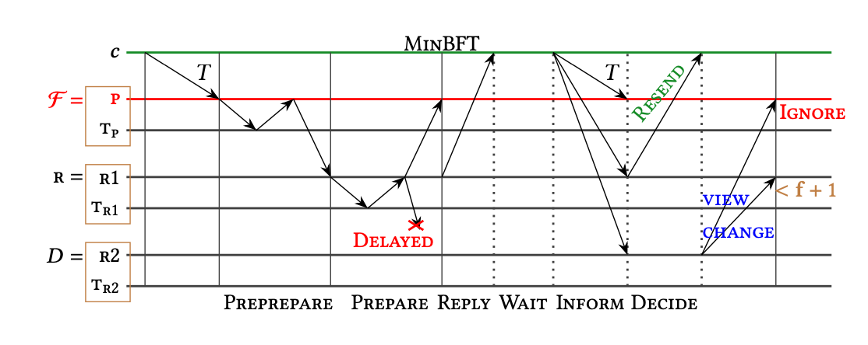
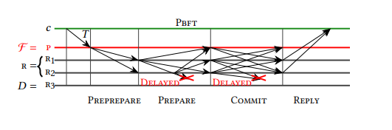
Disruption in service in MinBFT protocol due to weak quorums in comparison to the Pbft protocol
Protocols can be modified, but at an additional cost involving techniques like checkpointing, added latency, or broadcasting.

Slide 11
Data Persistence
Necessity of Persistent State:
Trust-based BFT protocols rely on persistent state in trusted hardware to ensure safety.
Popular platforms like Intel SGX face vulnerabilities like power failures and rollbacks.
Safety Violation Example (MinBFT):
Illustrative scenario: Byzantine primary (p) initiates transactions (𝑇, 𝑇′) and rolls back its trusted component's state.
Result: Conflicting transactions executed at the same sequence number (𝑇 and 𝑇′).
Safety compromised as replicas execute different transactions at the same sequence number.

Slide 12
Enforces Sequential Order
Lack of Parallelism in Trust-BFT Protocols:
Trust-BFT protocols are inherently sequential.
They process client requests one at a time and lack parallel consensus invocations.
Pipelining helps, but it doesn't address the core problem.
In contrast, traditional BFT protocols are parallel and have throughput bound by system resources.
Example: Running Two Consensus Instances in Parallel (MinBFT):
Assume parallel execution of transactions Ti and Tj (i<j).
Replica r receives Tj before Ti and updates its state.
When Ti arrives, r can't process it, stalling progress.

Slide 13
FlexiTrust Claims and Properties
Claim:
2f+1 is not enough
Trusted Components are still beneficial for BFT
Properties:
Parallel Consensus
Minimal Trusted Component Use
No Trusted Logging

Slide 14
Designing FlexiTrust
Change in Append Functionality
1
Only the leaders need to invoke the Trusted Counter
2
Increase the quorum size to 2f+1
3

Slide 15
Append Function
AppendF(𝑞, 𝑥): This function is used to associate a specific message 𝑥 with a counter value 𝑘, which is the 𝑞-th counter of a trusted component (tr). The modification entails incrementing the counter value 𝑘 by one to 𝑘 + 1 and binding it to message 𝑥. An attestation ⟨Attest(𝑞, 𝑘, 𝑥)⟩tr is generated as proof of this binding.
Purpose: The reason for this modification is to efficiently support parallel consensus instances. While the system allows multiple transactions to be ordered in parallel, the execution of these transactions must still follow a sequence number order to maintain correctness.
Rationale: The existing "Append" functionality allows a Byzantine replica to disrupt the system's progress in two ways: by stalling the system or by issuing a sequence number that is far into the future. This can exhaust the defined range of sequence numbers. When this happens, honest replicas are forced to trigger view changes to fill the gap with "no-op" operations. These "no-op" operations are essentially dummy transactions that fill the gap in the sequence, preventing Byzantine replicas from exploiting it.

Slide 16

Create Function
Create(𝑘): This function is designed to create a new counter with an identifier 𝑞 and an initial counter value 𝑘. It is essential that no previous counter has the same identifier 𝑞. The function also returns an attestation ⟨Attest(𝑞, 𝑘)⟩tr as proof of the creation of this new counter.
Purpose: The "Create" function is used to establish new counters. It plays a crucial role in allowing the new primary (after a view change) to restart consensus on previously proposed requests.
Certificate for New Counters: For each new counter created by a replica, a certificate (attestation) is required to prove the counter's newness. This certificate ensures that the counter is genuinely new and not a duplicate of any existing counter.

Slide 17
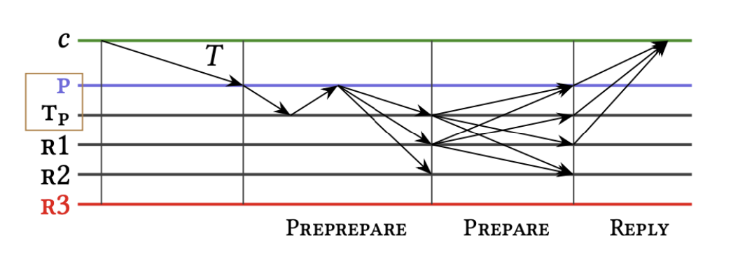
FlexiBFT Protocol
(a) FlexiBFT

Slide 18
FlexiZZ
Client Submission: A client submits a new transaction 𝑇 by sending a signed message ⟨𝑇 ⟩𝑐 to the primary (leader) p.
AppendF Function: The primary invokes the AppendF(𝑞,𝑚) function to bind the transaction 𝑇 to a specific counter value 𝑘. This action prevents the primary from assigning the same sequence number 𝑘 to two conflicting messages 𝑚 and 𝑚′.
Attestation: After invoking AppendF, the primary returns an attestation ⟨Attest(𝑞, 𝑘,𝑚)⟩tp as proof of the valid binding between the transaction and the counter value. This attestation is crucial to maintaining the sequence order and preventing conflicts.
Transaction Forwarding: The primary forwards the attestation and the transaction to all replicas.
Replica Execution: Replicas, upon receiving this message, execute the transaction in sequence order. If a replica has already executed the transaction, it directly sends a response. The client marks the transaction as complete when it receives responses from 2f + 1 replicas in matching views.

Slide 19
Evaluation
(1) How do our FlexiTrust protocol perform and scale?
(2) What is the impact of failures?
(3) How will these protocols behave as hardware technology evolves?

