Slide 1
ECS 265: ByShard: Sharding in a Byzantine Environment
By Jelle Hellings and Mohammad Sadoghi
Presented by Aditya Parab, Abhishek Gokhale, Naveen Kanuri & Maanas Vohra

Slide 2
Current Data Distribution
D
D
D
D
D
D
D
D
D
Notes:
So we’re gonna talk about how Sharding works in Distributed database systems. So, this is how a traditional database system looks like.
As u can see, all the replicas (shown in grey) are exactly the same. They all carry the burden of same data D.
If sharding were included in the system...

Slide 3
Data Distribution after Sharding
D/3
D/3
D/3
D/3
D/3
D/3
D/3
D/3
D/3
S1
S2
S3
Notes:
Each shard is a cluster/group of replicas, but now each replica within a shard only carries the burden of a subset of the data.
Each subset of data is highly similar to one another. So for example if the data was of people liking the color purple, then all of them would be grouped together in S1.
As each replica within each shard now only carries a subset of the burden of the entire data, sharding helps with storage scalability.
Sharding (horizontal) vs vertical scaling: a network of smaller, cheaper servers may be more cost effective in the long term than maintaining one big server: Expanding the capacity of the deployment only requires adding additional servers as needed, which can be a lower overall cost than high-end hardware for a single machine. The trade off is increased complexity in infrastructure and maintenance for the deployment
sharding can potentially alleviate the impact of unplanned outages. During downtime, all the data in an unsharded database is inaccessible, which can be disruptive or downright disastrous. When done right, sharding can ensure high availability: even if one or two nodes hosting a few shards are down, the rest of the database is still available for read/write operations as long as the other nodes (hosting the remaining shards) run in different failure domains

Slide 4
Client
IncrementA to A+1
A
B
C
A
B
C
A
B
C
A
B
C
A
B
C
A
B
C
A
B
C
A
B
C
A
B
C

Slide 5
Client
Increment A to A+1
Affected = All replicas
A+1
B
C
A+1
B
C
A+1
B
C
A+1
B
C
A+1
B
C
A+1
B
C
A+1
B
C
A+1
B
C
A+1
B
C
Notes:
In case client requests to increment a part of the data, then all the replicas are affected as they all are holding the same data and they must all increment that part of the data

Slide 6
Client
Increment A to A+1
A
B
C
A
B
C
A
B
C

Slide 7
Client
Increment A to A+1
Affected = a subset of replicas (1 shard)
A+1
B
C
A+1
B
C
A+1
B
C
Notes:
In case of sharding and client requests incrementing a part of the data, then only the shard with replicas having that data will be affected
So this will help in processing scalability as the other shards are free to start working on another execution

Slide 8
R
R
R
R
R
R
R
R
Shard 1
Shard 2
R
R
Light arrows = local decisions by consensus
Dark arrows = multi-shard communication using cluster-sending
N_{s} > 3F_{s}
_{Within each shard}
R
R
Shard 3
Notes:
Each shard is a cluster of replicas
Local Decisions within a Shard are made by Consensus. Any consensus protocol can be used.
Decisions requiring Multi-Shard Communication are made via Cluster-sending
Challenge? How to provide flexible multi-shard transactions capabilities in a Byzantine environment.

Slide 9
𝜏 → A,B,C,D,E,F
R
R
R
R
R
A
B
C
D
E
F
A
B
C
D
E
F
A
B
C
D
E
F
A
B
C
D
E
F
A
B
C
D
E
F
A
B
C
D
E
F
Notes:
In a sharded system, per-shard replication of 𝜏 only yields a local linearizable replication order within that shard, however. As distinct shards can replicate transactions locally in different orders, the local replication order does not necessary determine a conflict-free execution order for 𝜏 across shards (e.g., serializable execution [5, 6, 29])

Slide 10
𝜏 → A,B,C,D,E,F
Different replication order across shards
A
B
C
D
E
F
A
C
B
F
D
E
F
B
C
D
E
A
A
B
D
C
E
F
Notes:
In a sharded system, per-shard replication of 𝜏 only yields a local linearizable replication order within that shard, however. As distinct shards can replicate transactions locally in different orders, the local replication order does not necessary determine a conflict-free execution order for 𝜏 across shards (e.g., serializable execution [5, 6, 29])

Slide 11
𝜏 → A,B,C,D,E,F
R
R
R
R
R
R
R
R
R
R
A
B
C
D
E
F
A
B
C
D
E
F
F
B
C
D
E
A
F
B
C
D
E
A
F
B
C
D
E
A
F
B
C
D
E
A
F
B
C
D
E
A
A
B
C
D
E
F
A
B
C
D
E
F
A
B
C
D
E
F
A
B
C
D
E
F
F
B
C
D
E
A
Notes:
In a sharded system, per-shard replication of 𝜏 only yields a local linearizable replication order within that shard, however. As distinct shards can replicate transactions locally in different orders, the local replication order does not necessary determine a conflict-free execution order for 𝜏 across shards (e.g., serializable execution [5, 6, 29])
Also, Within traditional systems, individual replicas can independently execute transactions and update their state accordingly as each replica holds a full copy of all data. This no longer holds for multi-shard transaction:
each replica only holds a copy of the data in its shard. Hence, for the execution of 𝜏, replicas in the involved shards need to exchange any necessary state. This exchange is complicated by the presence of Byzantine replicas in each of
the involved shards and, hence, requires additional coordination to assure that all necessary state is reliably exchanged.
The above para just means that a shard may depend on the data from another shard. Just like yesterday’s RingBFT paper said.
This is why we might need multishard txn,
Sharding has been introduced in AHL, CAPER but optimization for txns that don’t contend for the same resources and other systems are optimized for single-sharded traditional resilient distributed systems

Slide 12
MultiShard Communication (Orchestrate Execute Model)
Multi-Shard transactions are processed through the Orchestrate - Execute Model
The processing is done in the form of Shard Steps
Each Shard step has only one consensus step
Shard steps can be either Vote, Commit or Abort
Notes:
This is where we introduce ByShard, a framework which is a formalization of sharded resilient systems, and shows how traditional distributed database principles like 2phase commit and 2phase locking can be implemented in a sharded distributed db system which helps in consistency of multishard txn.
To do this Byshard uses OEM.
Orchestration implements 2phase commit while execution executes 2phase locking

Slide 13
Types of ShardSteps
Vote Step
Commit Step
Abort Step
Notes:
Vote, Commit, Abort steps are done via consensus within the shard
Shards with Vote steps can result in commit or abort vote
Shards with Commit steps have capability to commit the transaction and send success to client
Shards with Abort step has capability to say Abort the txn and roll back changes

Slide 14
Types of Orchestration
Linear
Centralized
Distributed

Slide 15
Types of Orchestration
Consecutive consensus steps: n_{v} + 1
Consensus steps = n_{v} + n_{c}
Cluster-sending steps = n_{v} - 1 + n_{c}
Linear (Commit)
S1
Vote steps: S1, S2, S3, S4 Commit steps: S2, S5, S6
Abort Steps: S3
S2
S3
S4
S5
S6
Vote
Vote
Vote
Vote
Commit
Notes:
If committed:
Consecutive consensus steps: n_{v} + 1 (Refer to the previous slide) -> Here for S_{n} we have a commit vote.

Slide 16
Types of Orchestration
Consecutive consensus steps: At most n_{v} + 1
Consensus steps = At most n_{v} + n_{a}
Cluster-sending steps = At most n_{v} - 1 + n_{a}
Linear (Abort)
S1
Vote steps: S1, S2, S3, S4 Commit steps: S2, S5, S6
Abort Steps: S3
S2
S3
S4
S5
S6
Vote
Vote
Vote
Vote
Abort
Notes:
If committed:
Consecutive consensus steps: n_{v} + 1 (Refer to the previous slide) -> Here for S_{n} we have a commit vote.

Slide 17
Digression: Why consensus takes time
δ = 10 ms
δ = 10 ms
δ = 10 ms
P
R1
R2
R3
PrePrepare
Prepare
Commit
Accept τ
PBFT
Notes:
Consensus step: The steps of reliable replication among replicas and deciding an order for execution

Slide 18
Types of Orchestration
Consecutive consensus steps: 4
Consensus steps = 1 + (n_{v} - 1) + 1 + n_{c}= n_{v} + n_{c} + 1
Cluster-sending steps = (n_{v} - 1) + (n_{v} - 1) + n_{c} = 2(n_{v} - 1) + n_{c}
Centralized (Commit)
(root) S1
Vote steps: S1, S2, S3, S4 Commit steps: S2, S5, S6
Abort Steps: S3
S2
S3
S4
S5
S6
Root Vote
Vote
Decide
Commit
Notes:
If committed:
Consecutive consensus steps: 4 (Refer to the previous slide) -> Here for S_{n} we have a commit vote.

Slide 19
Types of Orchestration
Consecutive consensus steps: 4
Consensus steps = 1 + (n_{v} - 1) + 1 + n_{a}= n_{v} + n_{a} + 1
Cluster-sending steps = (n_{v} - 1) + (n_{v} - 1) + n_{a} = 2(n_{v} - 1) + n_{a}
Centralized (Abort)
(root) S1
Vote steps: S1, S2, S3, S4 Commit steps: S2, S5, S6
Abort Steps: S3
S2
S3
S4
S5
S6
Root Vote
Vote
Decide
Abort
Notes:
If committed:
Consecutive consensus steps: 4 (Refer to the previous slide) -> Here for S_{n} we have a commit vote.

Slide 20
Types of Orchestration
Consecutive consensus steps: 3
Consensus steps = 1 + (n_{v} - 1) + n_{c} = n_{v} + n_{c}
Cluster-sending steps = (n_{v} - 1) + (n_{a} + n_{c}) + (n_{v} - 1) * (n_{a} + n_{c}) = (n_{v}- 1) + (n_{a}+ n_{c})n_{v}
Distributed
(root) S1
Vote steps: S1, S2, S3, S4 Commit steps: S2, S5, S6
Abort Steps: S3
S2
S3
S4
S5
S6
Root Vote
Vote
Commit
Notes:
If committed:
Consecutive consensus steps: 3 (Refer to the previous slide) -> Here for S_{n} we have a commit vote.

Slide 21
Types of Orchestration
Consecutive consensus steps: 3
Consensus steps = 1 + (n_{v} - 1) + n_{a} = n_{v} + n_{a}
Cluster-sending steps = (n_{v} - 1) + (n_{a} + n_{c}) + (n_{v} - 1) * (n_{a} + n_{c}) = (n_{v}- 1) + (n_{a}+ n_{c})n_{v}
Distributed
(root) S1
Vote steps: S1, S2, S3, S4 Commit steps: S2, S5, S6
Abort Steps: S3
S2
S3
S4
S5
S6
Root Vote
Vote
Abort
Notes:
If committed:
Consecutive consensus steps: 3 (Refer to the previous slide) -> Here for S_{n} we have a commit vote.
In distributed, the shards with commit steps get a wait msg, so that they are told to ‘wait’ for n_{v} -1 commit votes. If they receive any less, they must wait before committing.
However In centralized, this is not the case, as the shards with commit steps dont have to wait for more than 1 commit/abort vote. If they receive even 1 at any point, they will commit/abort. So wait msg is not required

Slide 22
Account Transfer Data & Transaction Model
Con(X,y) = “the balance of X is at least y”
Mod(X,y) = “add value of y to the balance of X”
Notes:
Important: The paper doesn’t consider interactive transactions that require back-and-forth communication between client and system. This is termed as ill-suited for resilient systems because this transaction’s processing would require high cost of individual consensus steps to process each back and forth transaction.
Each transaction is a pair (C, M) C(S), M(S): Affects accounts maintained by S

Slide 23
Account Transfer Data & Transaction Model
Con(X,y) = “the balance of X is at least y”
Mod(X,y) = “add value of y to the balance of X”
A system commits to 𝜏 only if constraints C hold, in which case modifications M are applied.

Slide 24
Degrees of Isolation
Isolation free (degree 0 isolation)
Read uncommitted execution (degree 1 isolation)
Read committed execution (degree 2 isolation)
Serializability (degree 3 isolation)
Notes:
Disadvantage of Read Committed: -> Releasing locks immediately after reading D, can lead to non-repeatable reads in a txn.
Disadvantage of Read Uncommitted: -> We are doing dirty reads (reading D which is not yet committed)
Read committed execution (degree 2 isolation): Read locks are released directly after reading D
Read uncommitted execution (degree 1 isolation): No read locks obtained on any data item -> Reducing contention for read-heavy workloads
Waiting by failing: When lock can’t be obtained by the transaction 𝜏, 𝜏 aborts. -> Cost of aborted transactions that can be executed.

Slide 25
Isolation Free Direct Execution
degree 0 isolation
τ = (C, M)
S = shards(τ)
Vote step
Only mod. and no constraints?
Abort vote
no
Constraints
valid?
Commit vote
Abort step
yes
Commit step
Rollback
Optimistic Execution

Slide 26
A
$100
A
$500
A
$200
𝜏1 , S𝑎
𝜏2 , S𝑎
B
$300
B
$300
B
$300
Con(A,100)
Mod(A,400)
Con(A,500)
Mod(A,-300)
E
$0
E
$0
E
$0
A
$-200
A
$200
𝜏1 , Sb
𝜏1 , S𝑎
B
$300
B
$300
E
$0
Mod(A,-400)
ABORT
E
$0
Con(B,700)
decide ABORT
A
$-200
𝜏2 , Se
B
$300
Mod(E,300)
E
$300
𝜏1 = Con(A, 100), Con(B, 700), Mod(A, 400), Mod(B, -400);
𝜏2 = Con(A, 500), Mod(A, -300), Mod(E, 300)

Slide 27
A
$100
A
$500
A
$200
𝜏1 , S𝑎
𝜏2 , S𝑎
B
$300
B
$300
B
$300
Con(A,100)
Mod(A,400)
Con(A,500)
Mod(A,-300)
E
$0
E
$0
E
$0
A
$-200
A
$200
𝜏1 , Sb
𝜏1 , S𝑎
B
$300
B
$300
E
$0
Mod(A,-400)
ABORT
E
$0
Con(B,700)
decide ABORT
A
$-200
𝜏2 , Se
B
$300
Mod(E,300)
E
$300
𝜏1 = Con(A, 100), Con(B, 700), Mod(A, 400), Mod(B, -400);
𝜏2 = Con(A, 500), Mod(A, -300), Mod(E, 300)

Slide 28
A
$100
A
$500
A
$200
𝜏1 , S𝑎
𝜏2 , S𝑎
B
$300
B
$300
B
$300
Con(A,100)
Mod(A,400)
Con(A,500)
Mod(A,-300)
E
$0
E
$0
E
$0
A
$-200
A
$200
𝜏1 , Sb
𝜏1 , S𝑎
B
$300
B
$300
E
$0
Mod(A,-400)
ABORT
E
$0
Con(B,700)
decide ABORT
A
$-200
𝜏2 , Se
B
$300
Mod(E,300)
E
$300
𝜏1 = Con(A, 100), Con(B, 700), Mod(A, 400), Mod(B, -400);
𝜏2 = Con(A, 500), Mod(A, -300), Mod(E, 300)

Slide 29
A
$100
A
$500
A
$200
𝜏1 , S𝑎
𝜏2 , S𝑎
B
$300
B
$300
B
$300
Con(A,100)
Mod(A,400)
Con(A,500)
Mod(A,-300)
E
$0
E
$0
E
$0
A
$-200
A
$200
𝜏1 , Sb
𝜏1 , S𝑎
B
$300
B
$300
E
$0
Mod(A,-400)
ABORT
E
$0
Con(B,700)
decide ABORT
A
$-200
𝜏2 , Se
B
$300
Mod(E,300)
E
$300
𝜏1 = Con(A, 100), Con(B, 700), Mod(A, 400), Mod(B, -400);
𝜏2 = Con(A, 500), Mod(A, -300), Mod(E, 300)

Slide 30
A
$100
A
$500
A
$200
𝜏1 , S𝑎
𝜏2 , S𝑎
B
$300
B
$300
B
$300
Con(A,100)
Mod(A,400)
Con(A,500)
Mod(A,-300)
E
$0
E
$0
E
$0
A
$-200
A
$200
𝜏1 , Sb
𝜏1 , S𝑎
B
$300
B
$300
E
$0
Mod(A,-400)
ABORT
E
$0
Con(B,700)
decide ABORT
A
$-200
𝜏2 , Se
B
$300
Mod(E,300)
E
$300
𝜏1 = Con(A, 100), Con(B, 700), Mod(A, 400), Mod(B, -400);
𝜏2 = Con(A, 500), Mod(A, -300), Mod(E, 300)

Slide 31
“Safe Transaction”
X
X
Con(X, 50) Mod(X, -200)
-200
199
-1
Balance can’t be negative, so rollback
X
X
Rollback
Mod(X,+200)
+200
-1
199
Notes:
Explain safe transaction -> Executed together in a vote step
Checking the constraints and removing of balance: locking of available resource
Rollback: release of unused resources

Slide 32
“Unsafe Transaction”
X
Mod(X,200) for 𝛕₁
+200
0
200
X
-5
Expenditure 𝛕₂
200
195
Rollback due to 𝛕₁ constraint failure:
Mod(X, -200)
X
-200
195
-5
Notes:
2. [DONE] Rollback for multi shard: safe and unsafe operation
If there is a constraint failure for tau1, due to which we abort, we will rollback all operations associated with all shards corresponding to the transaction tau1.
Explain unsafe transactions
These will not violate constraints when doing in the end (commit step).
Each affected shard performs two steps:
Vote step: Check constraints and do safe modifications
Commit steps: Performs unsafe modifications

Slide 33
Lock-Based Execution
Multiple transactions can hold a read-lock on D at the same time.
Write locks on D are exclusive.
Serializability
Avoid deadlocks
Linear Orchestration
Notes:
3. [DONE, Slide 32] Locks on centralized and decentralized
This is not possible because we want to obtain locks in a particular order. Doing this in centralized would remove parallelism of the vote steps and thus reduces the advantage of centralized orchestration
To minimize the shard steps, fixed order on shards and data items within shards.
This will require linear orchestration
Since each transaction locks data in exact same order, we help resolve the previous issue we mentioned where different shards have different replication order
𝜏 needs to obtain a read lock on each data item D before it reads D and a write lock before it writes D
Multiple transactions can hold a read-lock on D at the same time.
Write locks on D are exclusive.
Serializability: 𝜏 is barred from obtaining new locks after releasing any locks
Avoid deadlocks: each transaction locks data in the exact same order.
To minimize the shard steps, order is fixed on shards and data items within shards. This will require linear orchestration.

Slide 34
Lock Based Execution
Vote Step: Success
Acquire lock; check constraint
X₁
τ = (C, M)
S’ = shards(τ)
X_{i} 𝛜 ACCOUNTS(S)
X₂
S
X₃
X₄
X₅
Vote commit
Notes:
τ = (C, M)
S = shards(τ)
VOTE(S): acquire lock LOCK(X) for every account X in ACCOUNTS(S) in some order
While acquiring lock, check for CON(X, y) in C(S).
If constraint violation, then vote abort and release all locks in S
If all constraints satisfied, then vote commit.

Slide 35
Lock Based Execution
Vote Step: Failure
Acquire lock; check constraint
X₁
τ = (C, M)
S’ = shards(τ)
X_{i} 𝛜 ACCOUNTS(S)
X₂
S
X₃
X₄
X₅
Vote abort; release locks

Slide 36
Lock Based Execution
Abort Step
Acquire lock; check constraint
X₁
τ = (C, M)
S’ = shards(τ)
X_{i} 𝛜 ACCOUNTS(S)
X₂
S
X₃
X₄
X₅
released locks

Slide 37
Lock Based Execution
Commit Step
X₁
τ = (C, M)
S’ = shards(τ)
X_{i} 𝛜 ACCOUNTS(S)
Modifications
X₂
S
X₃
X₄
X₅
Release locks
Notes:
τ = (C, M)
S = shards(τ)
3. COMMIT(S): Performs all modifications M(S)
After that perform RELEASE(X) to release the locks
4. ABORT(S): Performs RELEASE(X) to release all locks for X in ACCOUNTS(S)

Slide 38
Lock Based Execution
Commit Step
X₁
τ = (C, M)
S’ = shards(τ)
X_{i} 𝛜 ACCOUNTS(S)
Modifications
X₂
S
X₃
X₄
X₅
Released locks

Slide 39
A
$100
A
$500
𝜏1 , S𝑎
B
$300
B
$300
Con(A,100)
Mod(A,400)
E
$0
E
$0
 | Access to A
𝜏1 | write
𝜏2
𝜏1 = Con(A, 100), Con(B, 700), Mod(A, 400), Mod(B, -400);

Slide 40
 | A
𝜏1 | write
𝜏2
A
$500
A
$200
𝜏2 , S𝑎
B
$300
B
$300
Con(A,500)
Mod(A,-300)
E
$0
E
$0
𝜏1 = Con(A, 100), Con(B, 700), Mod(A, 400), Mod(B, -400);
𝜏2 = Con(A, 500), Mod(A, -300), Mod(E, 300)

Slide 41
Lock Based Execution
𝜏 with n = |shards(𝜏)|
S1
S2
S3
S4
Vote
Vote
Vote
Vote
Commit/Abort
Consensus Steps = n + (n - 1) = 2n - 1 Cluster-sending Steps = (n - 1) + (n - 1) = 2n - 2
Notes:
𝜏 with n = |shards(𝜏)|
Total vote steps = n (To get all locks)
Total commit steps = n - 1 (For M(S) and RELEASE(X) for all X in ACCOUNTS(S))
OR
Total abort steps = n - 1 (For RELEASE(X) for all X in ACCOUNTS(S))
Consensus steps = n for vote steps + (n - 1) for commit steps = 2n - 1 Cluster sending = (n - 1) for vote steps + (n - 1) for commit steps = 2n - 2

Slide 42
Lock Based Execution
VOTE(S) = {..., LOCK(X), …}
Can obtain LOCK(X)?
No
Wait VOTE(S)
Yes
Add to wait queue for each R_{i}
Continue VOTE(S)
Q_{R1}(X) = [..., (𝜏, VOTE(S))]
R1
R6
R2
R5
R3
R4
Notes:
VOTE(S) = {..., LOCK(X), …}
Either lock obtained, and execution of VOTE(S) continues.
Else, execution waits till LOCK(X) obtained. In this case, each replica R in S puts (𝜏, VOTE(S)) on a wait-queue Q_{R}(X)

Slide 43
Lock Based Execution
𝜎 = {..., RELEASE(X), …} for 𝜏’
Write Lock
Wake up 𝜏_{read1} and 𝜏_{read2}
𝜏’
X
R1
R6
𝜏_{read1}
R2
R5
X
R3
R4
𝜏_{read2}
Q_{R1}(X) = [(𝜏_{read1}, VOTE(S)), …, (𝜏_{read2}, VOTE(S)), ...]
Read lock
Notes:
Let 𝜎 = {..., RELEASE(X), …} be the commit/abort step for 𝜏’ != 𝜏. When lock is not obtained:
If next txn in Q_{R}(X) requires a read lock, and 𝜏’ held a write lock on X. Then wake up all transactions in Q_{R}(X) that require a read lock on X.
If next txn in Q_{R}(X) requires a write lock, and 𝜏’ was the last transaction holding any lock on X, then we can wake up the last transaction.
The wake up operations are done by queues in a deterministic manner. Therefore, no consensus is required to check which transaction to be executed next and its initiation.

Slide 44
Lock Based Execution
𝜎 = {..., RELEASE(X), …} for 𝜏’
Last Lock (Read/Write)
Wake up 𝜏_{write}
𝜏’
X
R1
R6
R2
R5
𝜏_{write}
X
R3
R4
Write lock
Q_{R1}(X) = [(𝜏_{write}, VOTE(S)), ... ]
Notes:
Let 𝜎 = {..., RELEASE(X), …} be the commit/abort step for 𝜏’ != 𝜏. When lock is not obtained:
If next txn in Q_{R}(X) requires a read lock, and 𝜏’ held a write lock on X. Then wake up all transactions in Q_{R}(X) that require a read lock on X.
If next txn in Q_{R}(X) requires a write lock, and 𝜏’ was the last transaction holding any lock on X, then we can wake up the last transaction.
The wake up operations are done by queues in a deterministic manner. Therefore, no consensus is required to check which transaction to be executed next and its initiation.

Slide 45
Lock Based Execution
D1
D2
D3
D4
D5
D6
D7
D8
D9
D10
𝜏₁ = writes to data items D1, ... , D10
𝜏₁ performs m consecutive consensus steps, which will take at least 300ms before 𝜏₂ can get the write lock.
Large txn processing latencies in high contention
𝜏₂ = writes to data items D1
Consensus step takes 30ms

Slide 46
Performance Evaluation
Notes:
Q1. How are the accounts chosen?
Ans> Binomial distribution where n = 1000 and p = 0.5
Q2. What exactly is the message delay?
Ans> Delay between the two replicas. In this case, we have simulated this. We have only implemented the orchestration and execution.
Workload = 5000 transactions
Impact per transaction: 16 distinct accounts per shard
Initial balance: 2000
Putting constraints on 8 accounts: Read op
Removing balance from 4 accounts: Write op (500 value)
Adding balance to 4 accounts: Write op (500 value)
Accounts per shard = 128
Shard count = 64
Message delay = 10ms
Consensus time = 30ms
Decisions per second per shard = 1000

Slide 47
Experiments
Scalability
Contention
Factor-Scalability

Slide 48
Setup
No. of Shards = 64
Active accounts per shard = 128. Total Accounts = 8192
Message Delay = 10ms
Consensus Time = 30ms
Decisions per shard per sec = 1000

Slide 49
Workload
Total transactions = 5000
Each transaction affects 16 distinct accounts
These 16 are chosen uniformly at random
Out of these 16, 8 have read and 8 have write operations

Slide 50
Measurements
Total Runtime
Cumulative Duration
Average Throughput
Average Committed Throughput
Median Shard Steps

Slide 51
Scalability: Impact of sharding on the system
Behavior of system = f(number of shards) parameters constant.
Increase in shard count
parallel processing power
Decrease in accounts per shard
Increase in multi-shard txns. Increase in average number of shards affected per txn.
Notes:
Parameters: Workload of 5000 txns and initial dataset
Behavior of system as a function of the number of shards while keeping other parameters constant.
Increase in shard count while keeping other parameters same.
-> Increase in parallel processing power
Decrease in accounts per shard (to keep parameters same)
-> Increase in multi-shard txns.
-> Increase in average number of shards affected per txn.

Slide 52
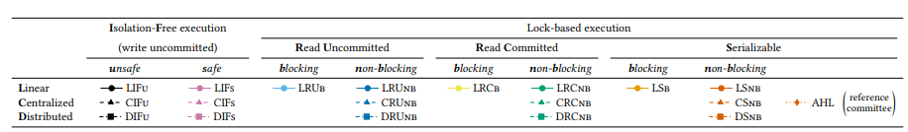
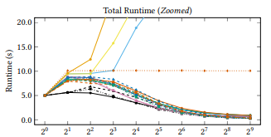
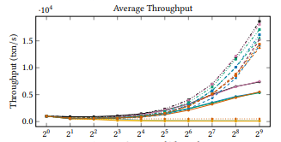
Performance Evaluation: Results: Scalability
AA/shard
8192, 4096, 2048, 1024, 512, 256, 128, 64, 32, 16
AA/shard
8192, 4096, 2048, 1024, 512, 256, 128, 64, 32, 16
Notes:
The noticeable part is the three lines that shoot up: orange, yellow, blue. For a particular shard count, higher the isolation level, higher is the runtime.
Blocking locks can give good runtimes only when the contention is low.
Important things to note:
The same argument in 1) applies to orange, yellow, and blue.
The two lines purple and black correspond to linear orchestration and isolation free execution. In this case, the high runtime is because of more number of consecutive consensus steps, the implementation of isolation-free execution, and a combination of increasing contention (due to decrease in accounts per shard) and increasing parallelism (due to increase in shards)
Important things to note:
The same argument in 1) applies to orange, yellow, and blue.
Distributed and centralized orchestration have higher throughput due to parallelism of consensus. Higher throughput offsets the negative impact by increased contention (eg. due to higher rates of constraint failures)

Slide 53
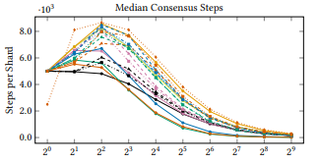
Performance Evaluation: Results: Scalability

Slide 54
Contention
Behavior of system = f(number of active accounts per shard)
Generation of appropriate workloads = f(overall number of active accounts in the system)
Increase in number of Active accounts => Decrease in probability that two transactions affect the same account => Decrease in contention
Notes:
In computer science, resource contention is a conflict over access to a shared resource such as random access memory, disk storage, cache memory, internal buses or external network devices. A resource experiencing ongoing contention can be described as oversubscribed.
Q1. Why we use active accounts per shard?
Ans> Increase in active accounts -> Decrease in probability that two transactions affect the same account -> decreasing contention. (We are using lock-based execution here)
Q2. Anything mentioned about appropriate workloads?
Ans> Nothing in the paper

Slide 55
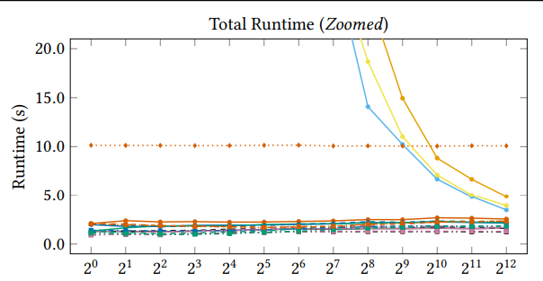
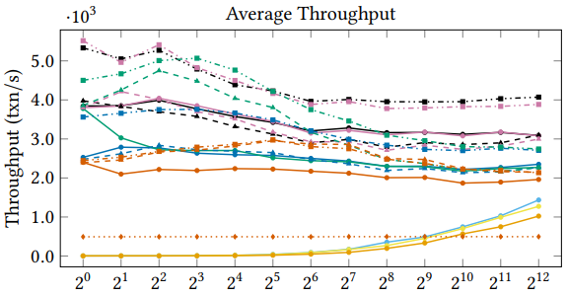
Performance Evaluation: Results: Contention

Slide 56
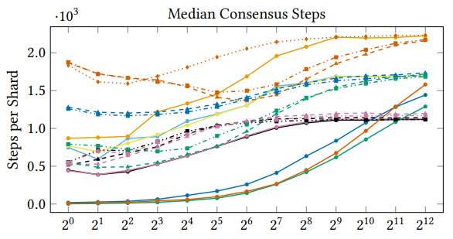
Performance Evaluation: Results: Contention

Slide 57
Factor-Scalability: Impact of scaling the system
Behavior of system = f(number of shards)
with number of active accounts per shard constant (128)
Generation of appropriate workloads as a function of the overall number of active accounts in the system.
Scalability: shard count => parallel processing power
Contention: total active accounts => contention
Notes:
Q1. What is the difference between Scalability and Factor-Scalability Experiment?
Ans> In scalability we have to keep all the other parameters same. Thus, we had to reduce the number of accounts per shard.

Slide 58
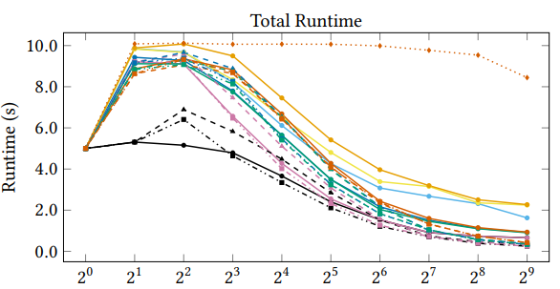
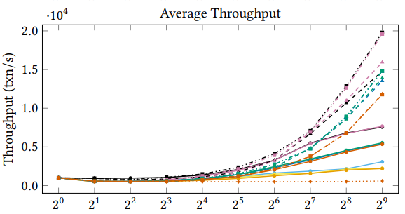
Performance Evaluation: Results: Factor-Scalability

Slide 59
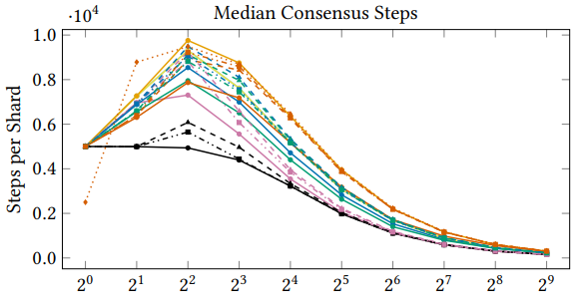
Performance Evaluation: Results: Factor-Scalability

Slide 60
THANK YOU!

