Slide 1
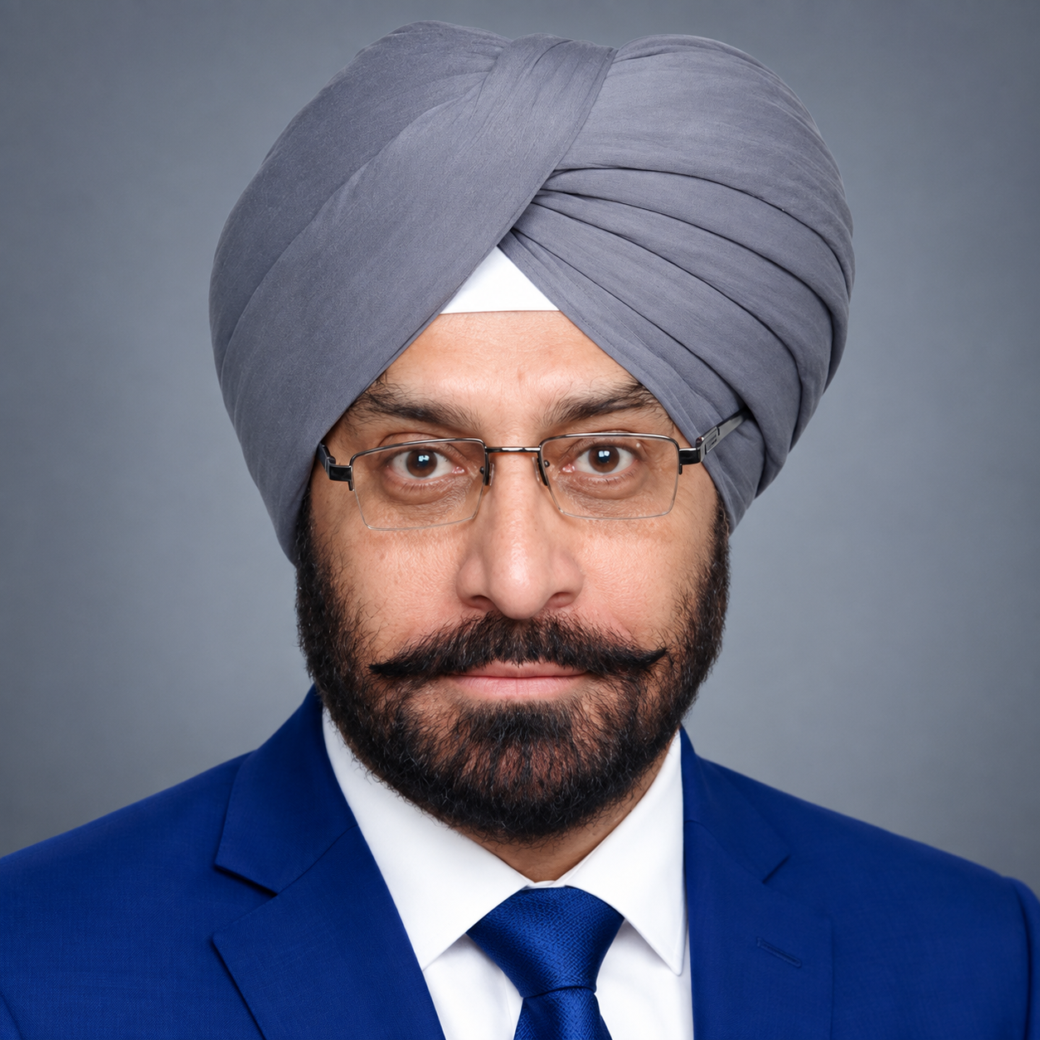
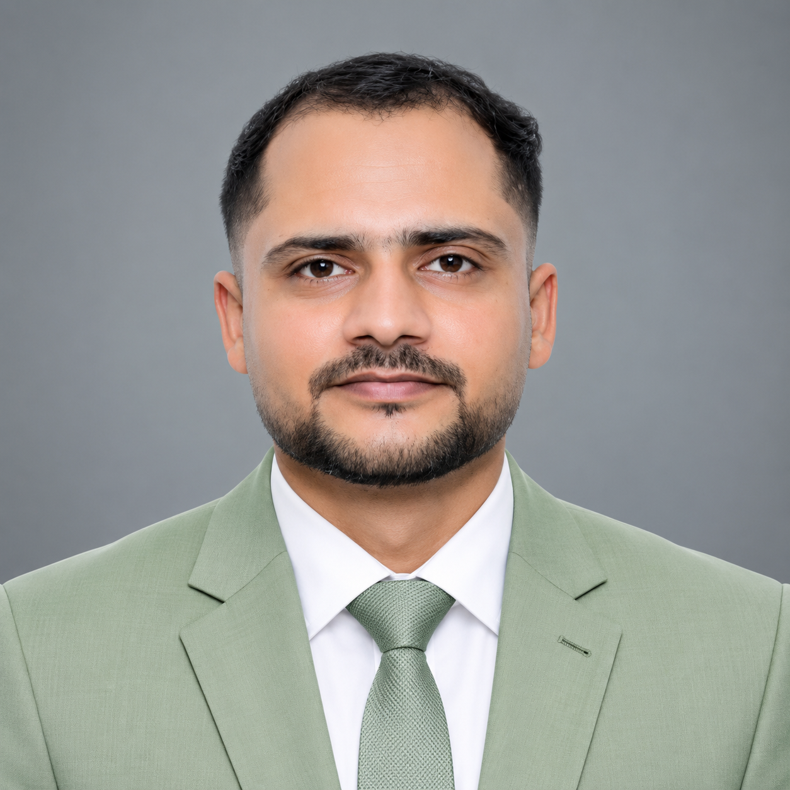
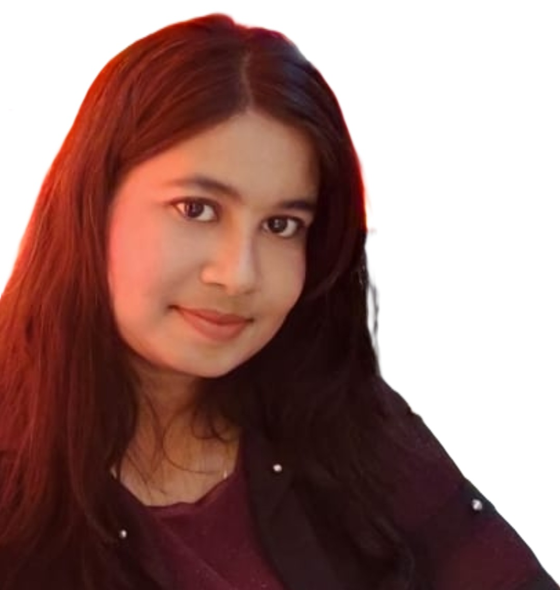
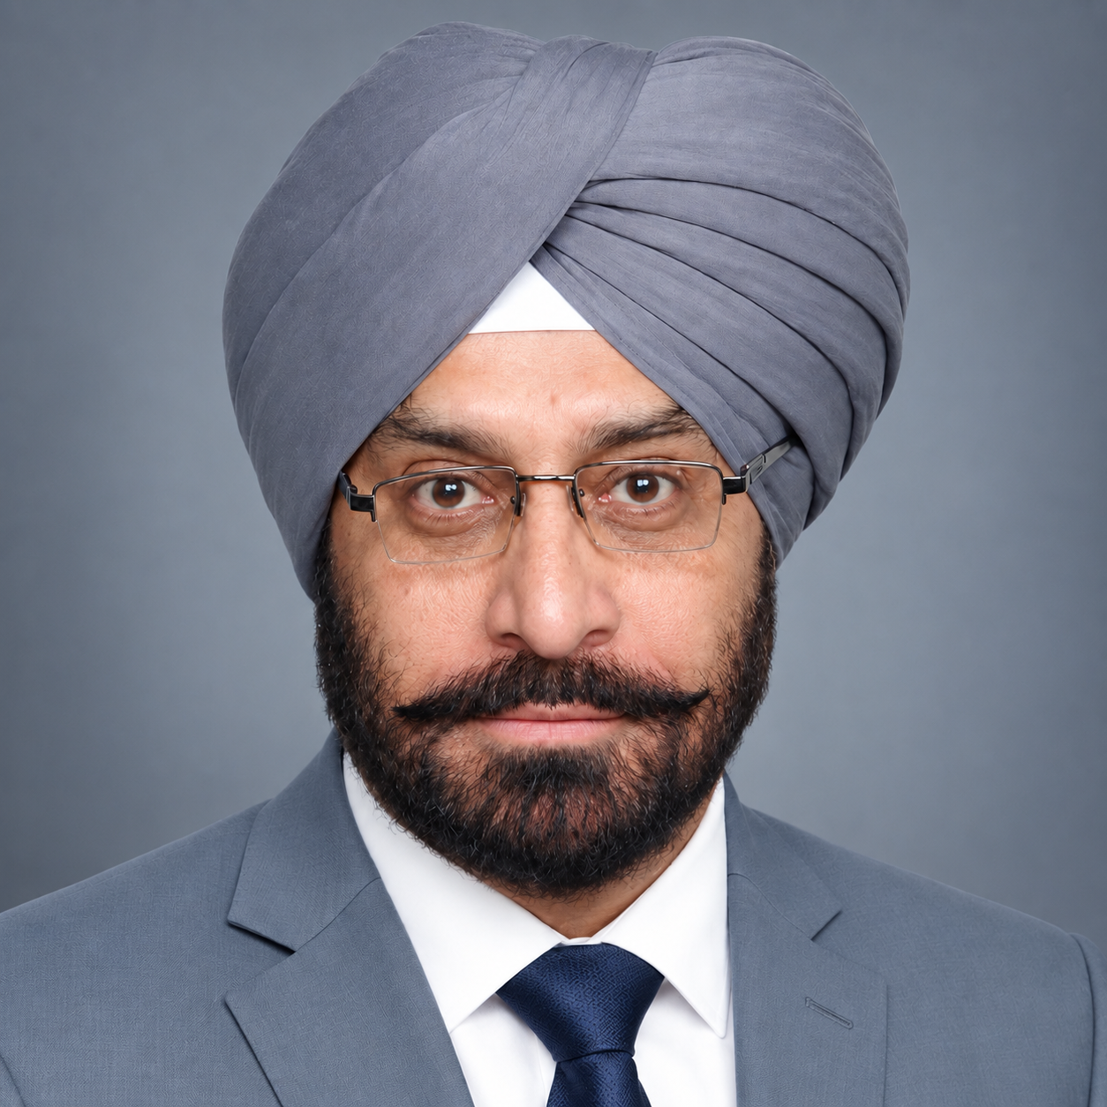
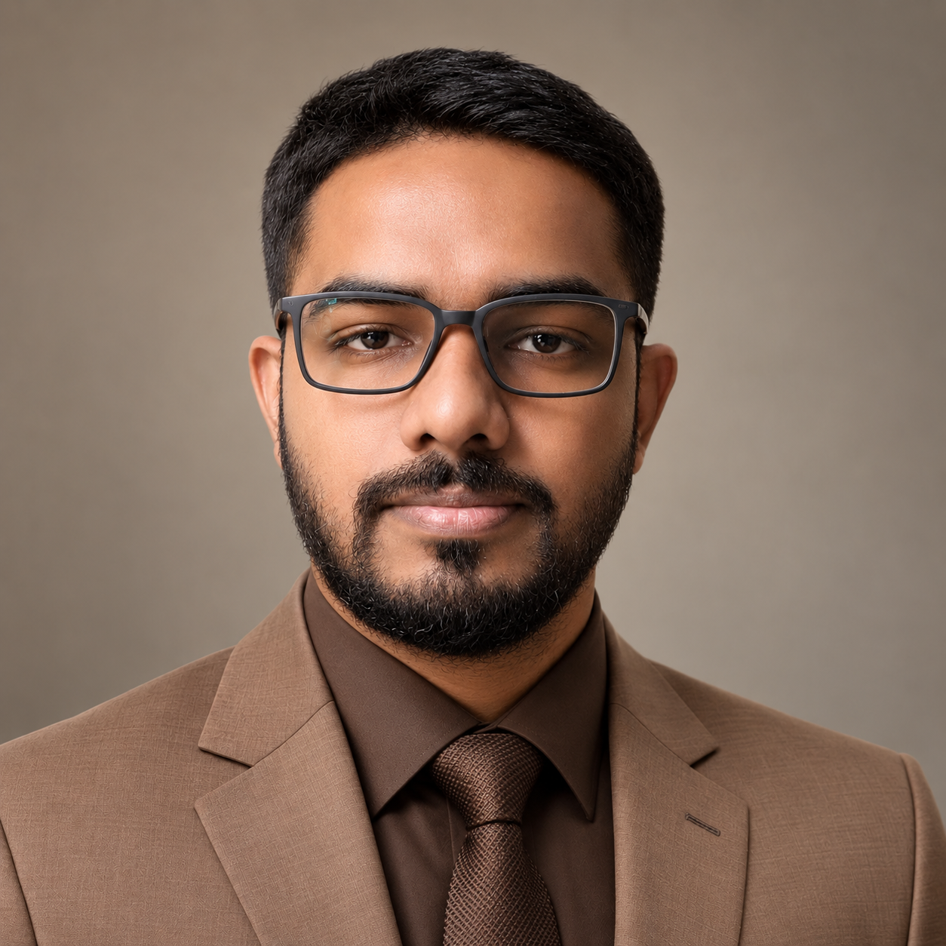
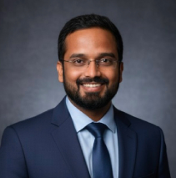
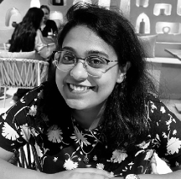
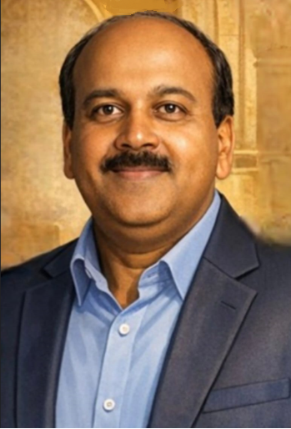
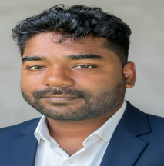
Team
TM
BillionTests.AI
COFOUNDERS AND CXOs
MS
Maninder Pal Singh Sethi
Co-founder & CBO
Contact:
Mob:+91 94170 29446
Email: mpsethi@billiontests.com
AK
Alok Kulshrestha
Co-founder & COO
Contact:
Mob: +91 9839715130
Email: alok.Kulshrestha@billiontests.ai
AC
Abhishek Chaturvedi
CPO
Contact:
Mob: +91 63872 54206
Email:abhishek.chaturvedi@billiontests.ai
SR
Priyanka Priyadarshini
CGO
44 years of experience in Business Development of technologies in Pharma, Packaging & Agri. 10 years dedicated to AI enabled and Lab Testing Solution
Led Operations in Deeptech and AI companies – Visotonics and Ocenip over five years. Postgraduate from IET Lucknow.
5 years of experience in production dev and deployment of AI products and pharmaceutical. Postgraduate in Biochemistry.
Headed growth operations in anti-counterfeiting tech for 4 years. Expertise in scaling the deep-tech products. LLB from North Odisha University
DEVELOPMENT TEAM
PA
Pranav Asthana
Co-Inventor & Platform Head
RM
Ritu Mishra
Co-Inventor & Head of Innovation
PP
Pramod Prasad
RevOps Leader
MB
Mohini Behera
Co-Inventor & Chief Scientist
Cofounded visotonics, Checko, Upjao, $25M exit. 20+ research papers, 10+ patents. Ex-Intel, IIT Kanpur
Cofounded visotonics, Upjao. 8 years in building deep tech products. Ex-researcher at NCFlexe, IIT Kanpur.
Cofounded visotonics, 30+ years of technology business leadership | Built $150M+ business portfolios |. Ex-Cisco | Motorola | Ericsson
Cofounded visotonics, Upjao. Developed 10+ AI products for large enterprises. IIT Jodhpur, NIT Rourkela

Slide 2
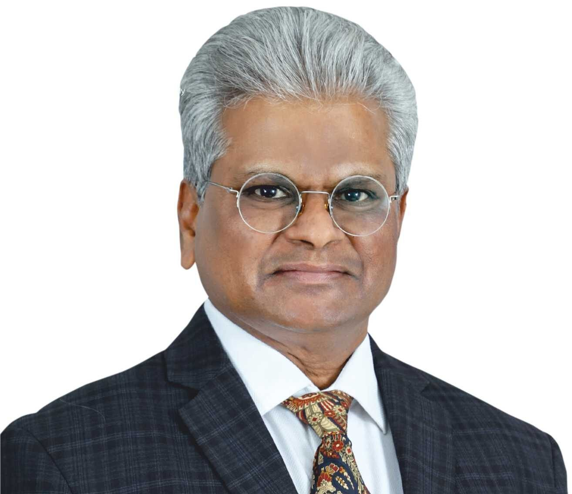
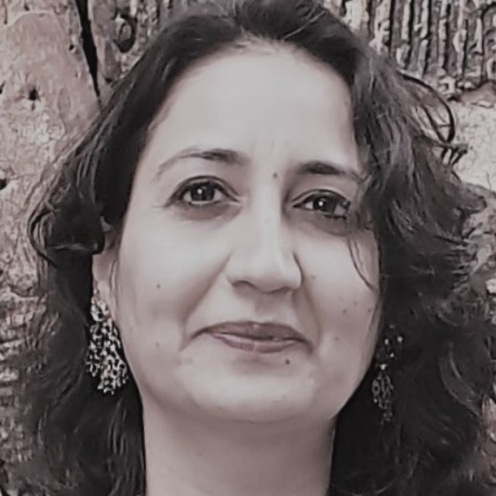
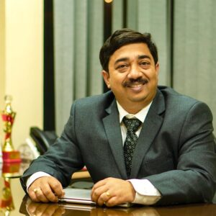
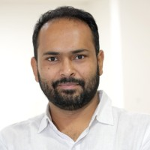
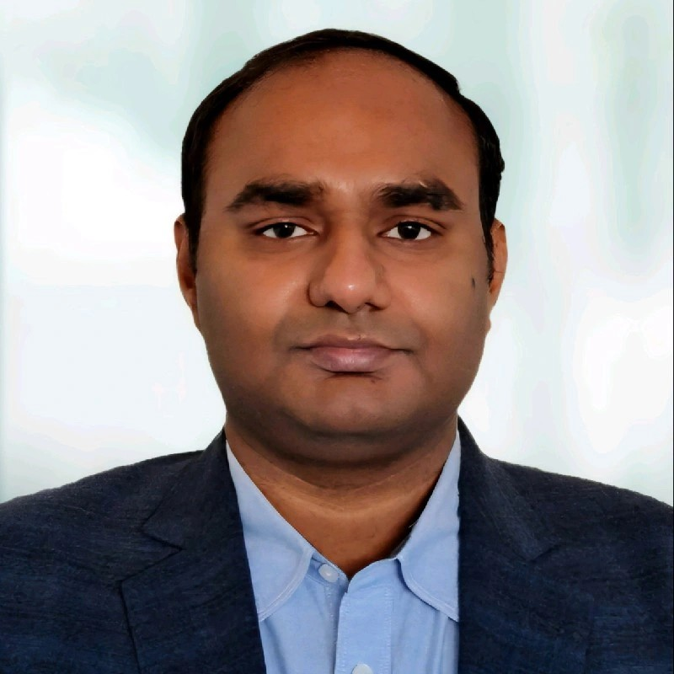
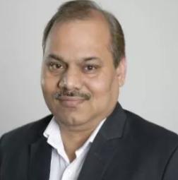
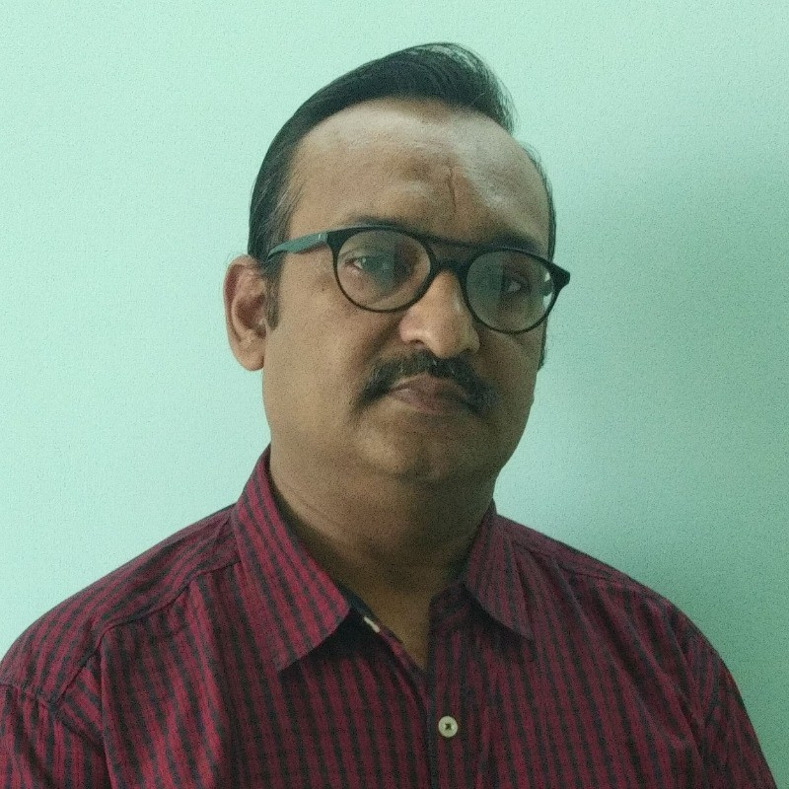
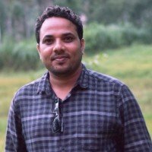
Team: Mentors and employees
TM
BillionTests.AI
Dr. Sudhindra Tatti
CEO of Prompt Innovations
Ph.D. (University of Texas, Austin)
Dr. Shikha Dhawan
Founder, Biozazen
Ph.D. (Delhi University)
Prof. Amitabha Bandyopadhyay
BSBE, IIT Kanpur
Ex-Harvard Medical School
Prof. Sandeep Kumar
EE, IIT Delhi
Ph.D. (IIT Kanpur)
Dr. RAVI VEDURURU
PhD Exec. MBA , Clinical Dx & Medical device Consultant
Dr. Sudheer Kumar
COO (NCFlexe, IIT Kanpur)
Ph.D. (NPL)
Neeraj Garg
Partner, SBM Advisors
Ex-CTO AMUL, NDDB
Prof. Vinod Kurmi
EE, IISER
Ph.D. (IIT Kanpur)

