Slide 1
BillionTests.AI
TM
AI Platform. Developed in India. Built for India

Slide 2
The Healthcare Crisis
TM
BillionTests.AI
Every year in India, preventable diseases claim hundreds of thousands of lives simply because screening happens too late—or not at all!
Condition | % of Indian Population | Annual Testing | Annual Deaths in India | Avoidable with Early Screening
Diabetes | ~8-8.3% adults | 20-25% | ~1,000,000 | 400,000-600,000
Chronic Kidney Disease | ~11-16% adults | <5% | ~175,000+ | 150,000-250,000
UTI | ~24% (adult women) | Variable | Not precisely recorded | 100,000-150,000
Liver Disease with bilirubinuria | NAFLD 9-32% (serious disease much lower) | <5% | ~268,000 | 10,000-30,000
TOTAL |  |  | >1.4 million | 670,000-1,080,000
DALYs (Disability-Adjusted Life Years) Lost: 10-20 million annual loss DALYs due to late detection of screen-able diseases

Slide 3
Strip based analysis
TM
BillionTests.AI
Strip-based analysis is one of the simplest, fastest, and most cost-effective ways to get a preliminary diagnosis of critical health parameters. Yet, despite its potential for scale, current approaches are riddled with challenges that prevent widespread adoption and reliable use, whether for humans, livestock, or pets.
Challenges with Current Approaches:
1: Manual Reading
Error-prone (depends on lighting, colour perception, human judgment)
Slow (requires reading strips carefully at precise intervals)
Requires trained personnel (not scalable for home/field use)
Not scalable for mass screening programs
2: Imported Machines
Expensive (₹1-2 lakh per analyser)
Dominated by foreign brands (Siemens, Roche, Abbott, Menarini)
Usually single-purpose (proprietary strip dependency)
Lab-bound (require electricity, stable environment)
3: Lab-Based Testing
Infrastructure-dependent
24-48 hour delays for results
Centralized data (no real-time health visibility)
High costs for patients
Impact:
Patients, farmers, and pet owners end up paying more, waiting longer, and health systems lose the chance for real-time, scalable diagnostics.

Slide 4
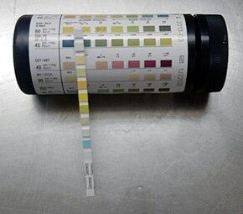
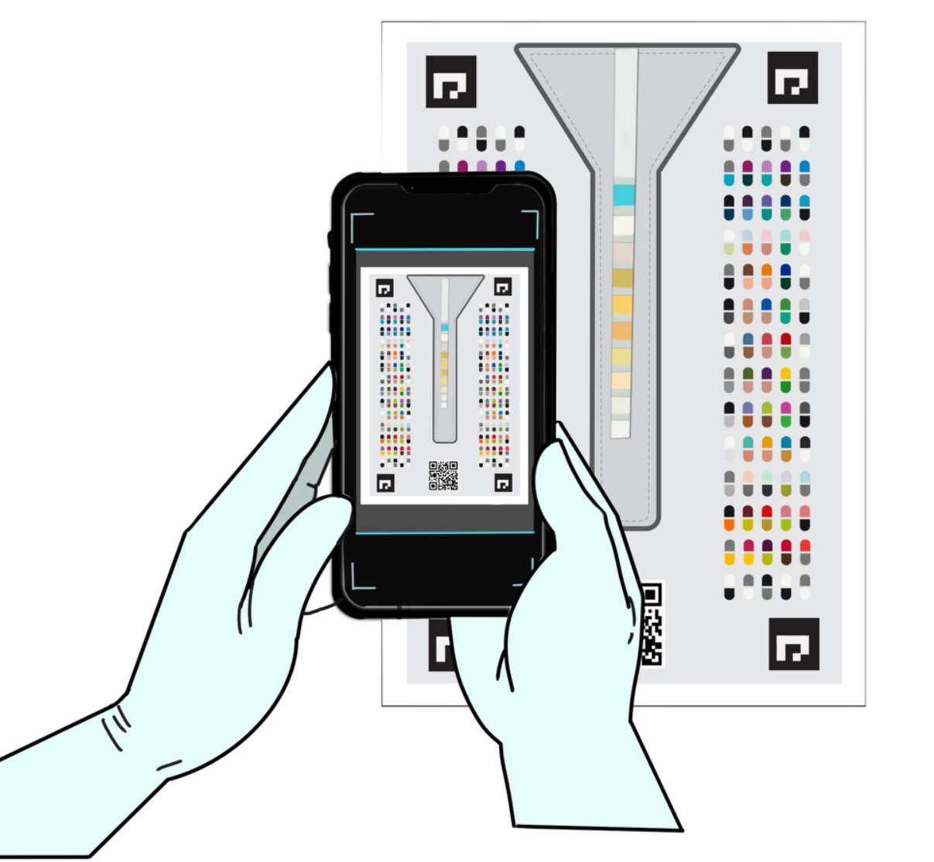

BillionTests: Introduction
BillionTests.AI
TM
BillionTests.AI is India's first universal, AI-powered automated test-strip reading platform that combines:
Computer Vision AI + classical image processing – Trained on 100,000+ images for 98%+ accuracy
IoT Connectivity – Real-time data sync with health systems
Blockchain Security – Tamper-proof, verifiable test records
Transformation of strip based testing
Manual and error-prone
assessment
to
Automated and accurate Assessment

Slide 5
BillionTests.AI: Introduction
TM
BillionTests.AI
Key Differentiators:
Works with all standard urine test strips licensed under CDSCO
98% accuracy through AI-powered image analysis
Low cost scan (mobile app) or ₹1,999 portable device (vs ₹40k–₹2L imported analysers)
Completely Made in India
Portable, offline-capable, electricity-free operation, field ready
Blockchain-secured, tamper-proof results for data trust
Compatible with all govt.- approved strips
The platform delivers lab-grade accuracy at field-level affordability, addressing critical gaps in India's preventive healthcare infrastructure.
Why Urine-Based Screening Is Powerful in India
  Low cost, non-invasive
  No lab dependency
  Results in 1–2 minutes
  Ideal for rural areas, elderly care, mass screening
No education needed – single click operation
5

Slide 6
Blockchain & Data Privacy
TM
BillionTests.AI
Tamper-Proof Results
Each test result is securely linked to time, device ID, and strip type, ensuring full traceability.
User-Centric Data Privacy
Patients retain ownership of their health data:
  Results are encrypted & stored privately.
  Sharing is consent-based → only doctors, labs, or insurers chosen by the user can access.
Immutable Blockchain Ledger
Test records are permanently stored on the blockchain, making them fraud-proof and verifiable for:
  Insurance claims (no fake reports)
  CSR/NGO programs (impact validation)
  Regulatory compliance (auditable history)

Slide 7
Innovation and novelty
TM
BillionTests.AI
1. Radically Affordable
100x lower cost than standard diagnostic labs
Truly universal - works with ALL govt-approved strips—no vendor lock-in
Leverages mature supply chains instead of reinventing hardware
2. AI-Powered Accuracy
98% accuracy validated on 200+ samples
Trained on 100,000+ diverse images
Eliminates human reading errors and subjective interpretation
Continuous learning from real-world data
3. Zero-Friction Testing
Single-click smartphone app (Android/iOS)
BT Cards handle lighting/environmental variations automatically
No medical training required
Works anywhere—home, clinic, or remote village
Lean-by-design architecture – Uses existing strips, smartphones, and mature supply chains instead of reinventing hardware, enabling massive cost reduction and rapid scale.
The Bottom Line: Lab-grade diagnostics at 1% of the cost, accessible to anyone with a smartphone
7

Slide 8
Quick Health Clues from Urine Test Parameters
TM
BillionTests.AI
Parameter | Indicates Possible
Protein | Urinary Tract Infections(UTI), Kidney disease, Kidney Stones, diabetes, dehydration and liver or bile duct problems
Leukocytes (WBC) | Infection, UTI, kidney stones
Ketones | Low-carb diet, diabetes
Glucose | Diabetes (if >180 mg/dL)
Nitrites | Bacterial infection (E. coli, Gonorrhea)
Blood | UTI, intense exercise, kidney stones
Urobilinogen | Liver disease, cirrhosis, hepatitis, liver damage
pH (6.7–7.5) | Uric acid stones, excess protein intake
Specific Gravity | Dehydration, urine concentration issues
Bilirubin | Early liver disease, blocked bile duct

Slide 9
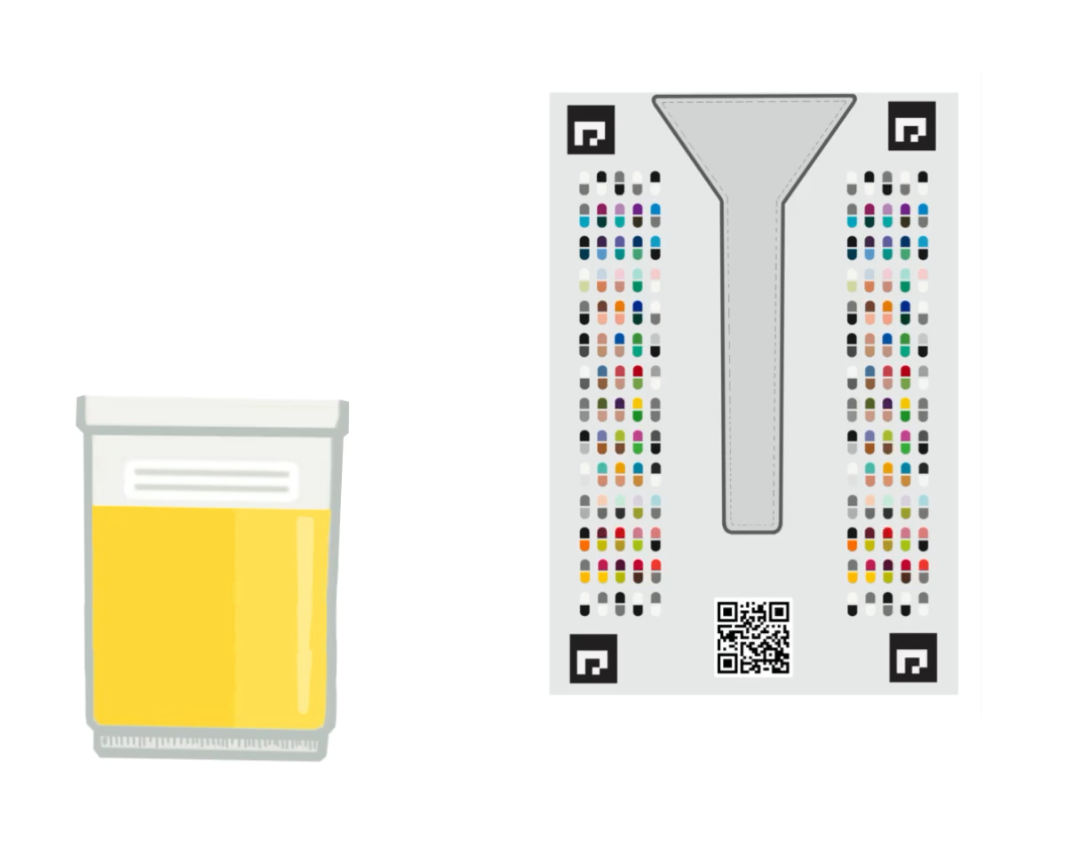
Solution 1 - Mobile App
TM
BillionTests.AI
Our cutting-edge AI technology simplifies the diagnostic process into three streamlined steps :
Scan
Use our intuitive mobile app to guide users in performing the test correctly.
2. Analyze:
Our sophisticated AI software instantly generates accurate test results within 20 seconds.
3. Action:
Get easy to interpret results and contacts of medical experts for further action via digital platform.
Click above to play the animation

Slide 10

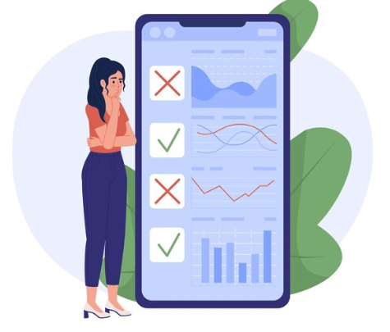
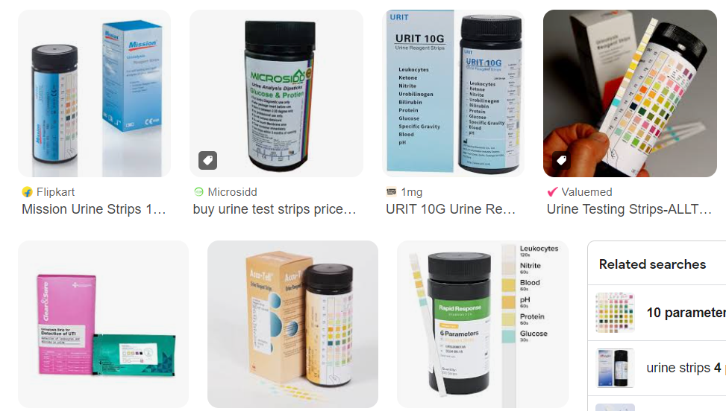
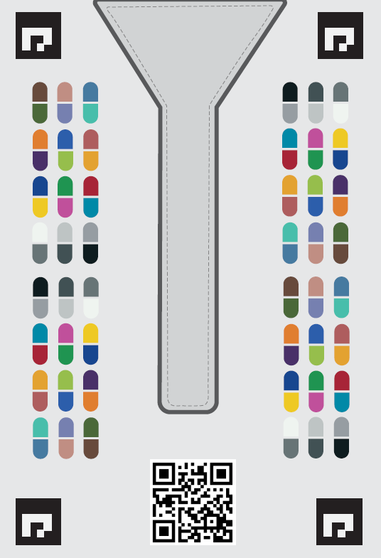


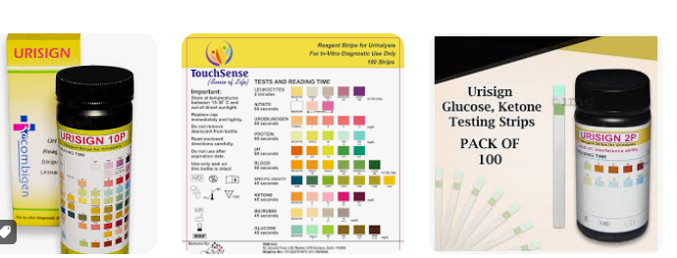

Logistics Snap
TM
BillionTests.AI
BTCARDX
Mobile Scan App
Online Assessment
TM
Diagnostic test strips
Cloud
Artificial Intelligence
Online Reports
Ready made and well-established diagnostic strips
BillionTests.AI
Technology Layer
User does self assessment
at home and gets reports in
~20 seconds

Slide 11
Solution 2 – Edge Device
BillionTests.AI
TM
The BillionTests.AI Edge Device is a smart, plug-and-play urinalysis scanner built for mass testing at scale.
It delivers instant, AI-powered results for kidney, blood sugar, UTI + 7 more parameters. and generates tamper-proof blockchain reports for trusted diagnostics.
How It Works
Insert strip → Place the urine test strip into the device.
Automatic scan → Built-in optics capture and calibrate under controlled lighting.
AI analysis → Device interprets kidney, blood sugar, UTI + 7 more parameters in under 20 seconds.
Instant report → Results shown on connected mobile/desktop app.
Blockchain record → Secured for verification, sharing, and compliance.
Key Advantages
Unlimited testing → One-time cost, no recurring scan charges.
Offline-first → Works without internet; syncs later when connected.
Multi-strip compatible → Not restricted to proprietary strips like Siemens/Roche.
Portable & durable → Lightweight, reliable for field and community use.
11

Slide 12
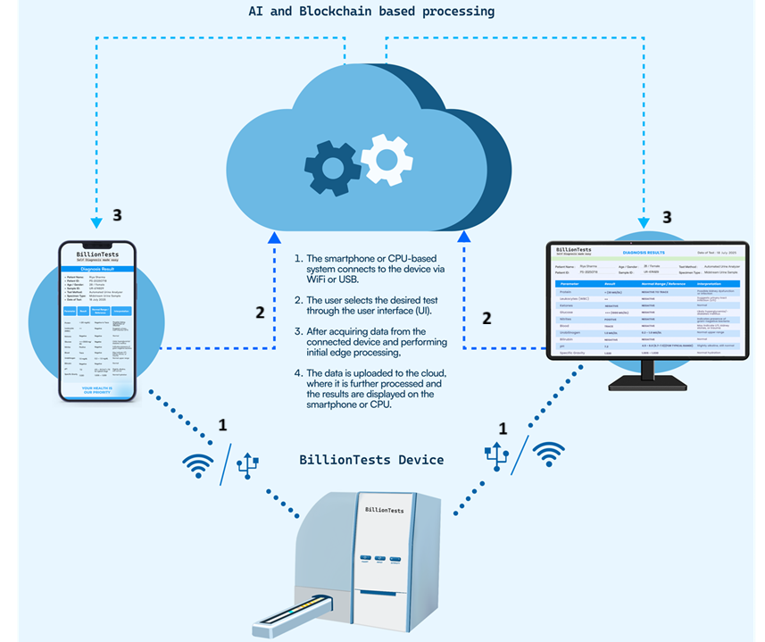
How it Works?
BillionTests.AI
TM
User inserts the test strip into the BillionTests.AI device.
The device is connected to a smartphone or CPU machine via Wi-Fi/ Bluetooth/ USB.
User selects the test to be performed.
The device acquires the data from the strip.
Basic edge processing is done on the device.
The processed data is transferred to the cloud for further analysis.
The final processed results are displayed on the connected smartphone or CPU machine.
1
2
3
4
5
6
7

Slide 13
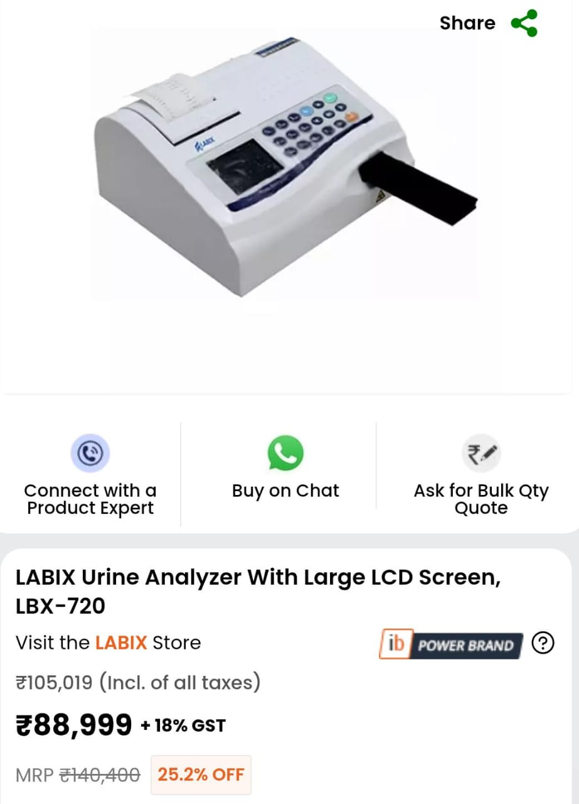
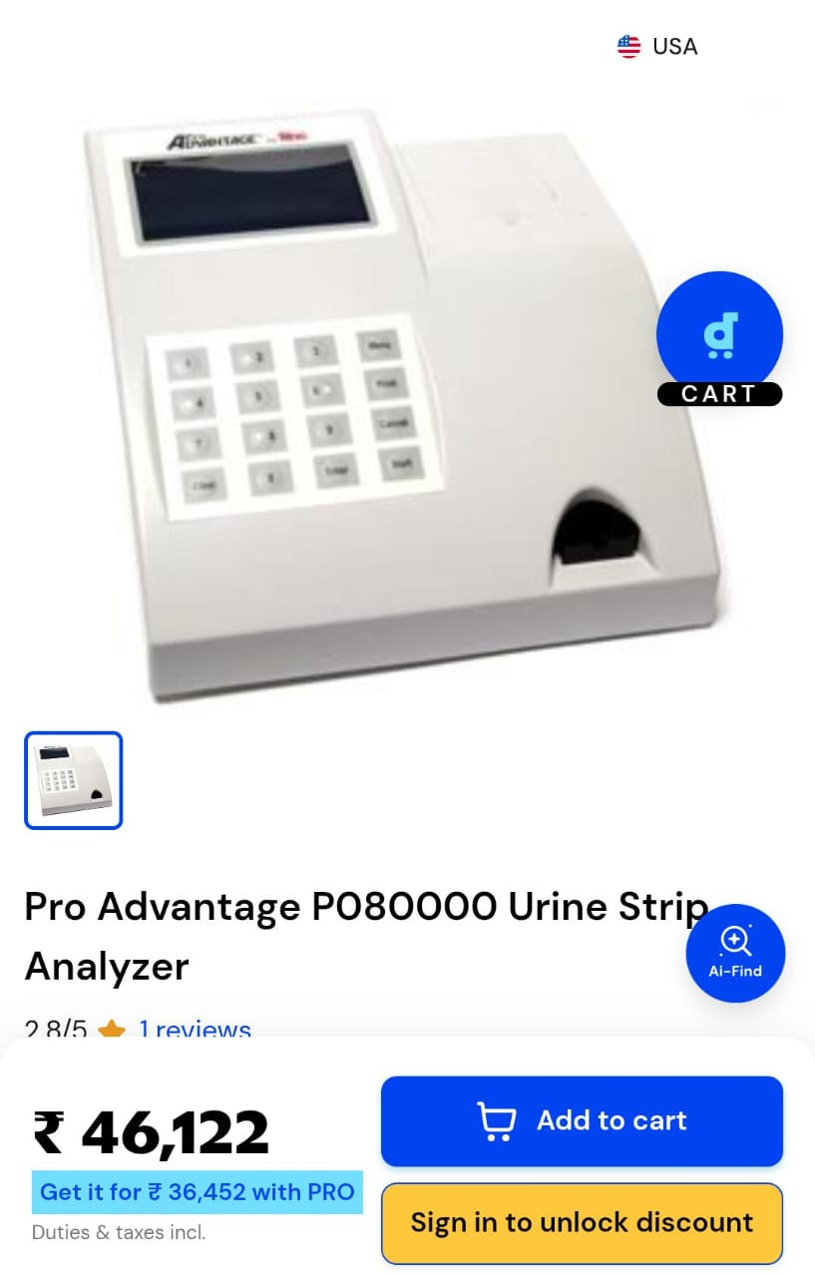
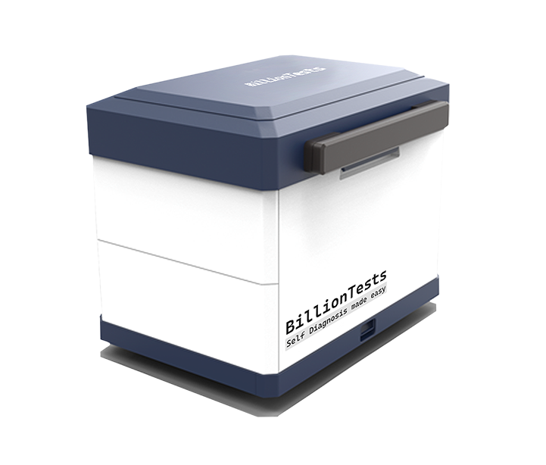
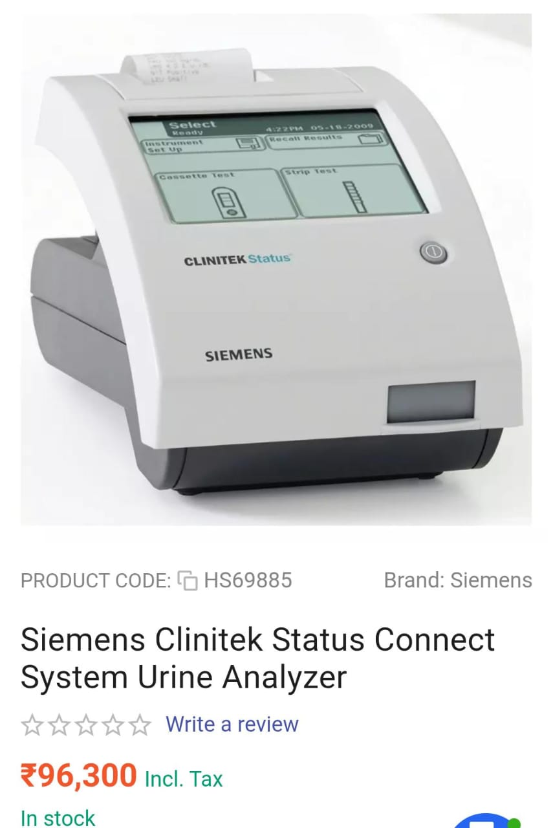
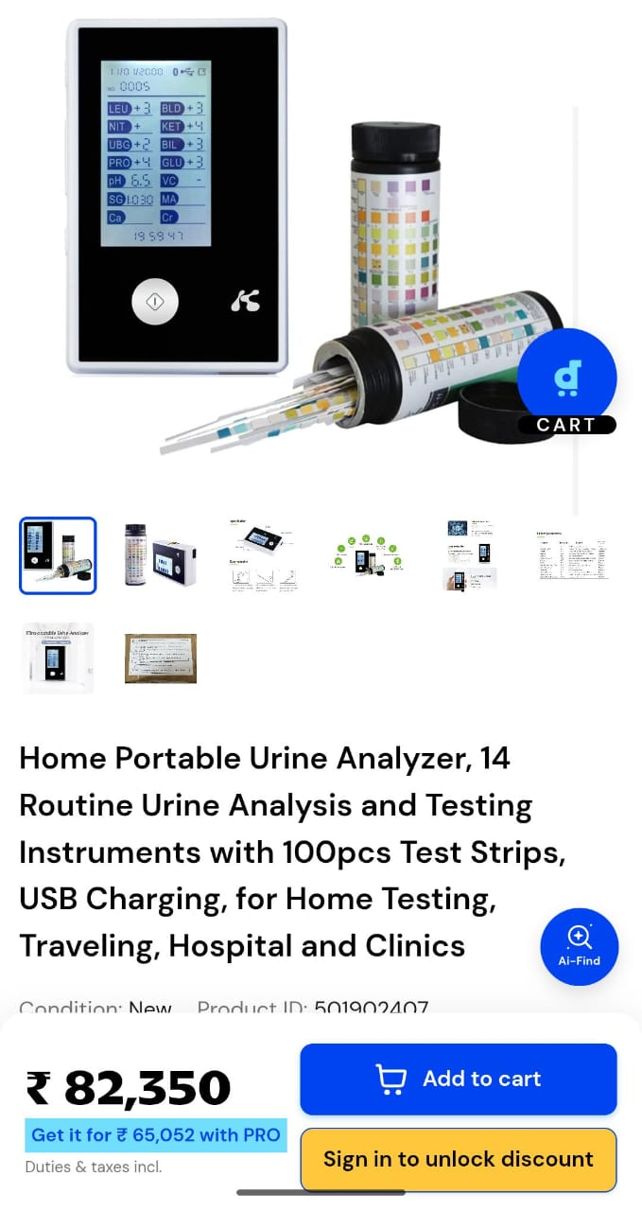
Competition Scenario
TM
BillionTests.AI
  BillionTests
₹1999/-

Slide 14
COMPETITIVE ADVANTAGES
TM
BillionTests.AI
1 vs. Imported Analyzers
90% lower cost
Universal strip compatibility
Portable & field-deployable
No electricity requirement
Indigenous manufacturing
2 vs. Manual Reading
Eliminates human error
Standardized results
Digital records & traceability
No expertise required
Faster turnaround
3 vs. Lab-Based Testing
Point-of-care results
10x lower cost
No sample transport
Immediate clinical decision support
Higher compliance & follow-up
Patent Filed: Core AI-based strip interpretation and calibration methodology under patent protection.

Slide 15
SOCIAL & PUBLIC HEALTH IMPACT
BillionTests.AI
TM
Key Benefits
Early Disease Detection:
Identifies at-risk individuals before symptoms develop
Enables timely intervention and treatment
Reduces progression to severe complications
Reduced Healthcare System Load:
Decreases tertiary hospital admissions
Enables preventive care at primary level
Optimizes resource allocation
Community Health Data:
Real-time population health monitoring
Data-driven policy decisions
Epidemic/outbreak early warning
Health Equity:
Brings diagnostics to underserved populations
Bridges urban-rural healthcare gap
Empowers community health workers
2. Alignment with National Goals
SDG 3: Good Health and Well-being
Ayushman Bharat: Preventive healthcare mission
National Health Mission: Universal health coverage
Digital India: Healthcare digitization
Skill India: Empowers workers with technology
3. Global Impact Potential
According to Lancet Commission:
47% of global population lacks access to early diagnostics
BillionTests.AI addresses this through:
  Ultra-low cost
  No infrastructure requirement
  Simple operation (single click)
  Scalable deployment model

Slide 16
Summary of technology validations
TM
BillionTests.AI
Phase | Focus Area | Activities Performed | Outcome
Phase 1 – Core Tech Validation | Mobile Apps | Functional, UI/UX, stress testing across Android & iOS | Done
 | Hardware | Optical calibration, durability, lighting variation tests | Done
 | Connectivity & Location | Local, internet connectivity, GPS validation, secure data transfer | Done
Phase 2 – System Reliability | Blockchain | API integration, transaction stress test, audit validation | Done
 | Cloud Infrastructure | Load testing, auto-scaling, encryption & compliance checks | Done
 | AI Technology | Model training on thousands of strip images, benchmarking vs. experts | Done
Phase 3 – Controlled Testing | Synthetic Urine | Controlled testing with chemical variations of pH, glucose, salt, etc. | Done
 | Reference Validation | Expert card-based reading vs. AI reading comparison | Done
Phase 4 – Field Trials | Local Lab Trials | Multi-city validation in diagnostic labs with real strips | Done
 | User Feedback | Ease of use, speed, adoption study | Done
Phase 5 – Clinical Validation | Institutional Trials | Process started at A. City Imaging (Delhi) and B. GIMS (Greater Noida) | Completed at A
 | Regulatory Prep | Data collection for compliance standards from MedTech Mitra, GIMS (Greater Noida) & COE-AI, IIT Kanpur | In Progress

Slide 17
Future Expansion
TM
BillionTests.AI
BillionTests.AI is not limited to urine analysis — the same AI + IoT + Blockchain platform can power a universal diagnostic ecosystem:
Blood Tests → Hemoglobin, cholesterol, malaria, and rapid test kits.
Glucose Monitoring → Affordable, at-home diabetes management.
Pregnancy & Fertility Tests → hCG, ovulation strips.
Infectious Disease Strips → Malaria, dengue, COVID-19 antigen/antibody kits.
Veterinary Diagnostics → Affordable tests for livestock and pets.
Other Colorimetric Strips → Adaptable to any standard generic test strip variant across human health diagnostics licensed under CDSCO.
Vision: From a urine-based gateway test to a comprehensive, low-cost diagnostic platform serving billions.

Slide 18
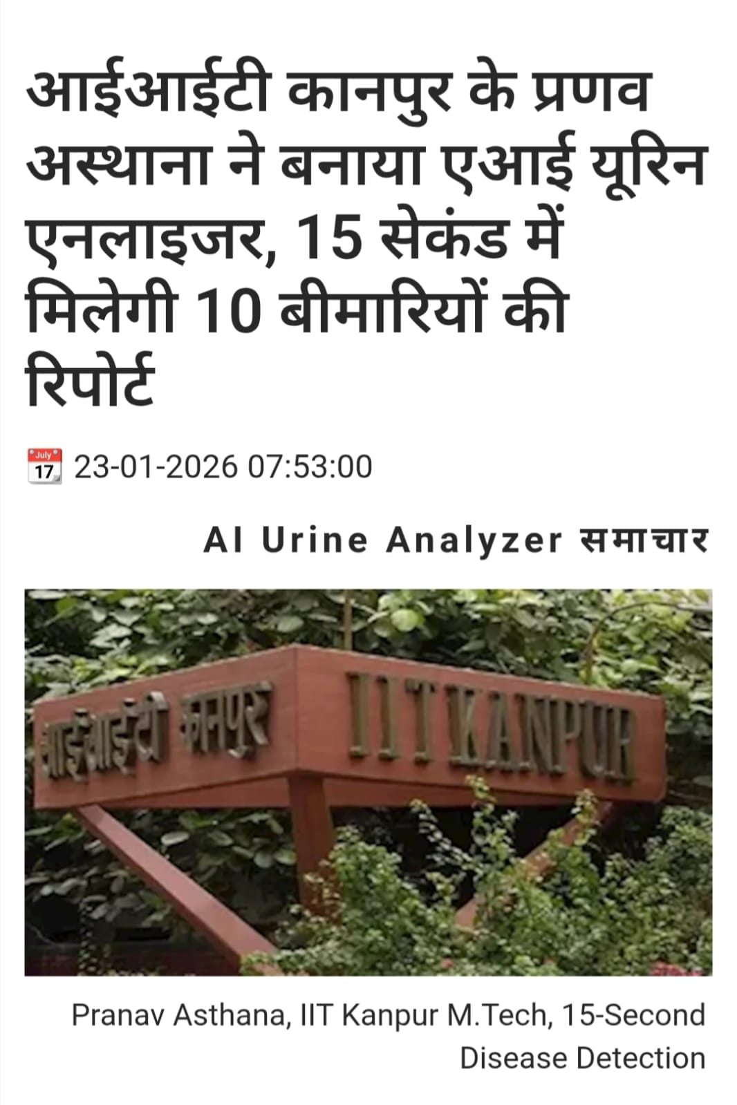
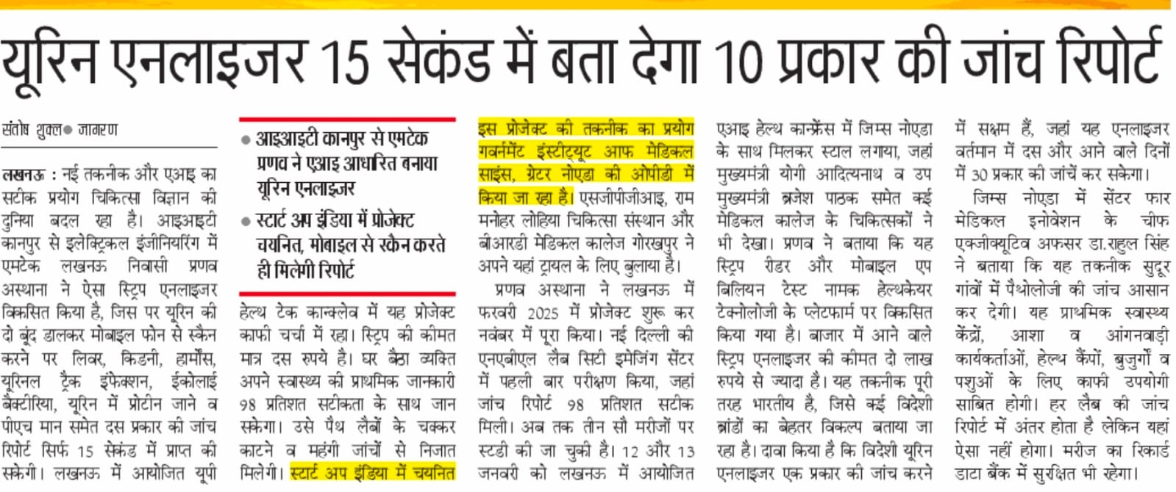
BillionTests.AI in news
TM
BillionTests.AI

Slide 19
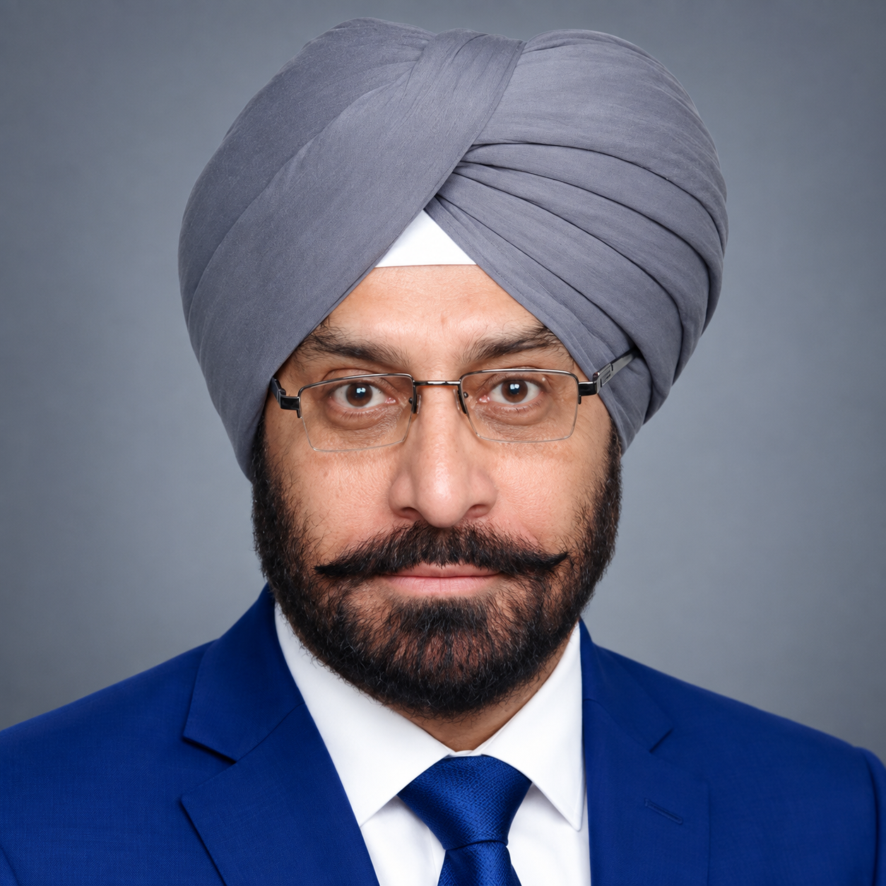
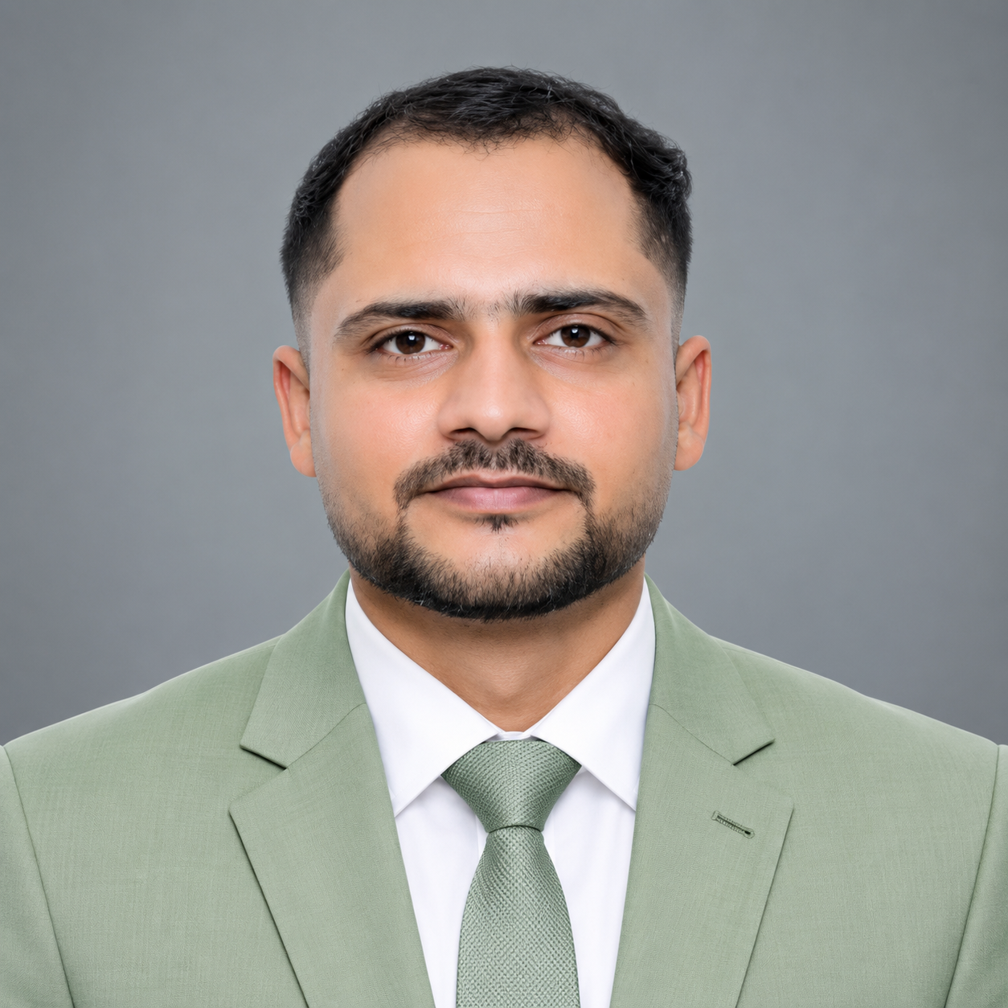

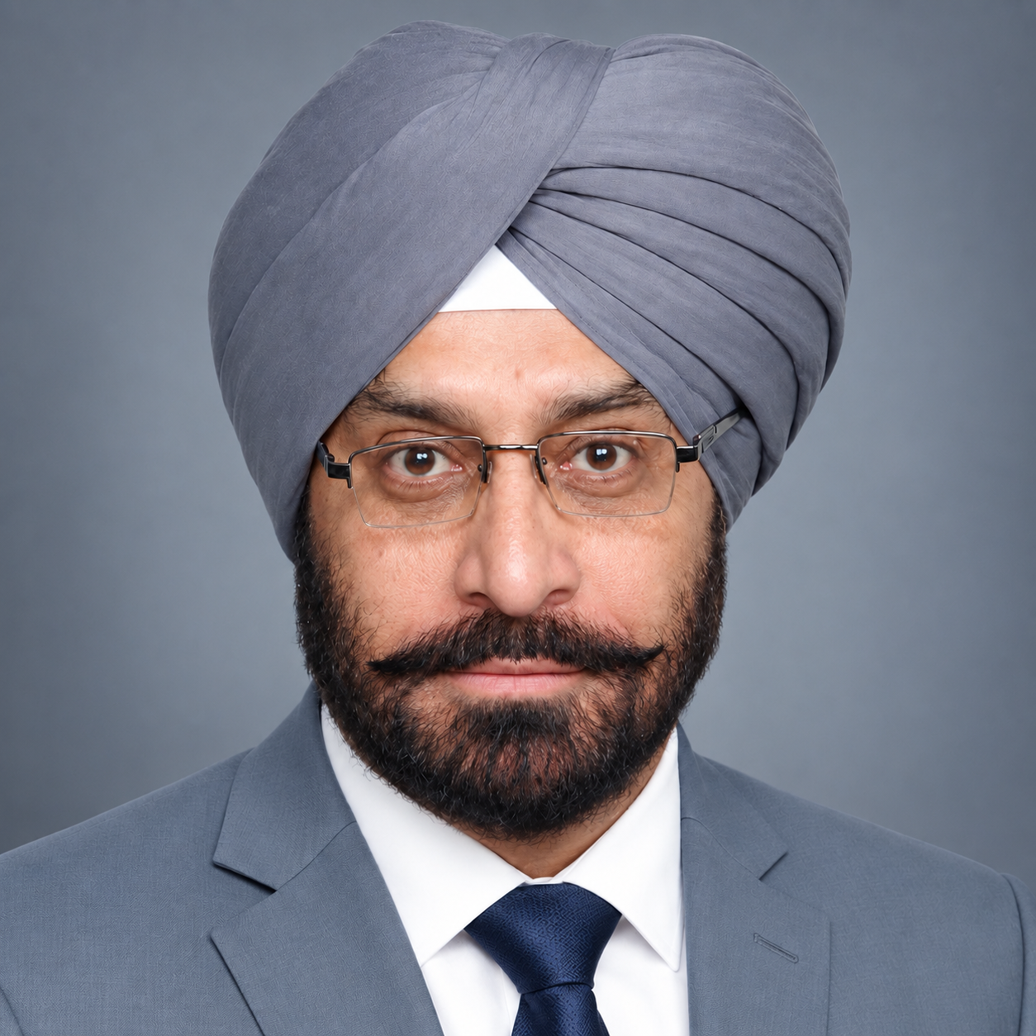



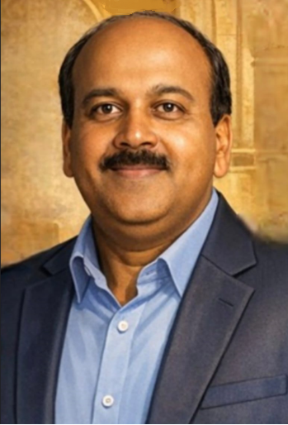

Team
TM
BillionTests.AI
COFOUNDERS AND CXOs
MS
Maninder Pal Singh Sethi
Co-founder & CBO
Contact:
Mob:+91 94170 29446
Email: mpsethi@billiontests.com
AK
Alok Kulshrestha
Co-founder & COO
Contact:
Mob: +91 9839715130
Email: alok.Kulshrestha@billiontests.ai
AC
Abhishek Chaturvedi
CPO
Contact:
Mob: +91 63872 54206
Email:abhishek.chaturvedi@billiontests.ai
SR
Priyanka Priyadarshini
CGO
Post Graduate in Chemistry (Hons School) from Punjab University Chandigarh. Having rich experience of 44 years in Business Development of capital goods. 10 years dedicated to AI enabled and Lab Testing Solution
Postgraduate from IET Lucknow. Having over five years of experience in technical sales.
Postgraduate in Biochemistry and have a total of 5 years of professional experience, including AI based product development and pharmaceutical sales.
B.Tech., VJTI Mumbai. Founded – Ocenip, Vedicraft
DEVELOPMENT TEAM
PA
Pranav Asthana
Co-Inventor & Platform Head
RM
Ritu Mishra
Co-Inventor & Head of Innovation
PP
Pramod Prasad
RevOps Leader
MB
Mohini Behera
Co-Inventor & Chief Scientist
Cofounded visotonics, Checko, Upjao, $25M exit. 20+ research papers, 10+ patents. Ex-Intel, IIT Kanpur
Cofounded visotonics, Upjao. 8 years in building deep tech products. Ex-researcher at NCFlexe, IIT Kanpur.
Cofounded visotonics, 30+ years of technology business leadership | Built $150M+ business portfolios | Scaling AI-led innovation. Ex-Cisco | Motorola | Ericsson | IIFT
Cofounded visotonics, Upjao. Developed 10+ AI products for large enterprises. IIT Jodhpur, NIT Rourkela

Slide 20





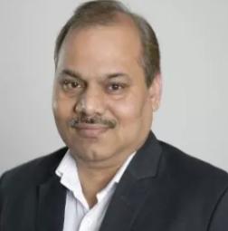
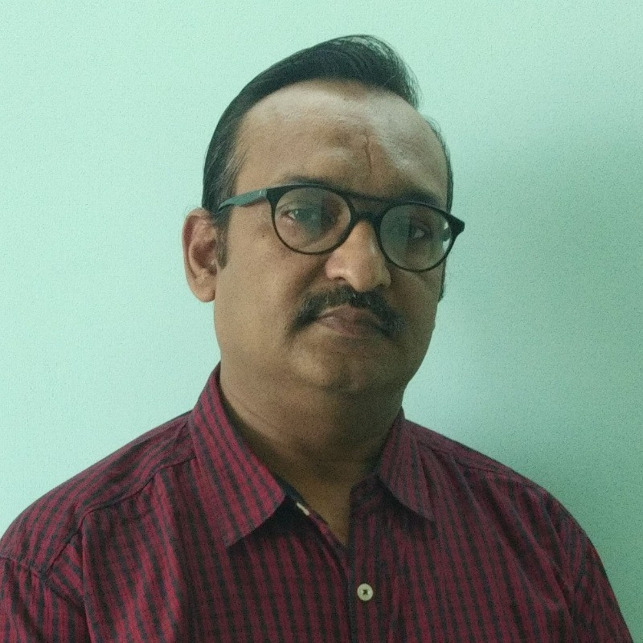

Team: Mentors and employees
TM
BillionTests.AI
Dr. Sudhindra Tatti
CEO of Prompt Innovations
Ph.D. (University of Texas, Austin)
Dr. Shikha Dhawan
Founder, Biozazen
Ph.D. (Delhi University)
Prof. Amitabha Bandyopadhyay
BSBE, IIT Kanpur
Ex-Harvard Medical School
Prof. Sandeep Kumar
EE, IIT Delhi
Ph.D. (IIT Kanpur)
Dr. RAVI VEDURURU
PhD Exec. MBA , Clinical Dx & Medical device Consultant
Dr. Sudheer Kumar
COO (NCFlexe, IIT Kanpur)
Ph.D. (NPL)
Neeraj Garg
Partner, SBM Advisors
Ex-CTO AMUL, NDDB
Prof. Vinod Kurmi
EE, IISER
Ph.D. (IIT Kanpur)

Slide 21
Credibility & Validation
BillionTests.AI
TM
Academic & Technical Credibility
Patent Filed for AI-based strip interpretation and calibration methodology
COE-AI, IIT Kanpur – Technical validation of AI models and system architecture
Core technology developed by IIT Kanpur alumni.
Clinical & Field Validation
Validated at NABL-accredited lab (City Imaging)
98% accuracy benchmarked against lab reference analyzers
Multiple strip brands and real-world lighting conditions tested
Incubation & Regulatory Support
GIMS Greater Noida Incubation Center
  Clinical trials execution
  Compliance and CDSCO navigation
MedTech Mitra: Regulatory guidance & standards compliance
Strategic Deployment Partnerships - Prompt Dairy Tech
  Access to 70,000+ villages for cattle health check
  Devices placed at various centers; strips distributed via health workers
  Home-based scanning enabled through smartphones already present in households
21

Slide 22
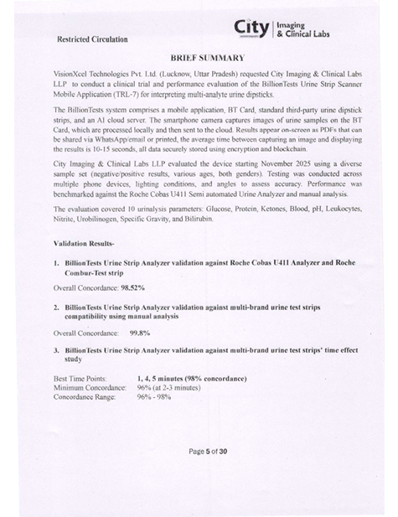
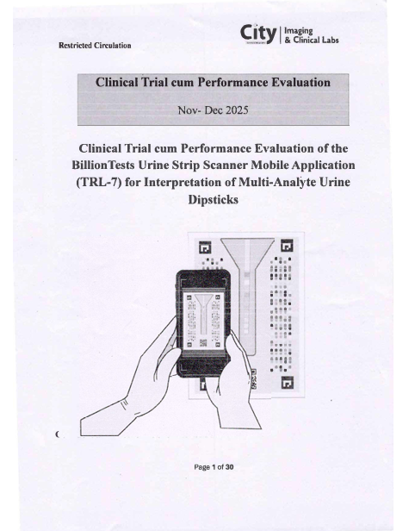
Accreditation Status at City Imaging
TM
BillionTests.AI
Validated at City Imaging and Clinical Labs(NABL Accredited).

Slide 23
Thanks
Pranav Asthana
+91 9651891556
pranav@excl.ai

