Slide 1

A MAJOR PROJECT (PRC – 3)
On
DEEP FAKE VIDEO DETECTION USING CNN
BACHELOR OF TECHNOLOGY
IN
CSE- AI & ML
BY
A.PREETHAM - 21VE5A6607
B. SHIVA SAI - 21VE5A6608
D. SHABHARISH - 21VE5A6609
B. RAVI TEJA - 20VE1A6670
Under the Guidance of
Dr. K. Madan Mohan – Associate Professor
ACADEMIC YEAR: (2023-2024)

Slide 2
CONTENTS
DEEP FAKE VIDEO DETECTION USING CNN
Abstract
Proposed System
Literature Survey
System Architecture
Modules
Software and Hardware Requirements
UML Diagrams
Usecase Diagram
Sequence Diagram
Class Diagram
Activity Diagram
Component Diagram
Modules Description
Conclusion
References
Queries

Slide 3
ABSTRACT
Techniques for creating and manipulating multimedia information have progressed to the point where they can now ensure a high degree of realism. Deep Fake is a generative deep learning algorithm that creates or modifies face features in a super realistic form, in which it is difficult to distinguish between real and fake features.
This technology has greatly advanced and promoted a wide range of applications in TV channels, video game industries, and cinema, such as improving visual effects in movies and a variety of criminal activities, such as misinformation generation by mimicking famous people.
To identify and classify Deep-Fakes, research in Deep Fake detection using deep neural networks (DNNs) has attracted increased interest. Basically, Deep Fake is the regenerated media by injecting or replacing some information within the CNN model.

Slide 4
PROPOSED SYSTEM
As the field of deep-fake video detection continues to evolve, researchers are proposing new systems that aim to improve upon existing methods. The proposed system is a deep learning based approach that uses a convolutional neural network (CNN) to analyze video frames and detect any signs of manipulation.
The CNN is trained on a large dataset of both real and fake videos, allowing it to learn the unique features of deep-fakes. The motion magnification technique is particularly effective at detecting deep-fakes that have been generated using Generative Adversarial Networks (GANs), which are often difficult to detect using traditional methods.
In summary, the proposed system for deep-fake video detection uses a combination of motion magnification and deep learning-based approaches to analyze video frames and detect any signs of manipulation. This approach has the potential to be more effective than existing methods and could help mitigate the risks associated with the spread of deep-fake videos.
Advantages: It will provide a very high accuracy on real time data.

Slide 5
LITERATURE SURVEY
• Title: A Survey on Deepfake Video Detection
Author : P Yu, Z Xia, J Fei, Y Lu
Description: An in-depth exploration of methodologies and technologies aimed at detecting deepfake videos, addressing the growing concern of misinformation and manipulation in multimedia content.
Year of Publishing: 2023
•.Title: Deepfake Detection: A Systematic Literature Review
Author: MS Rana, MN Nobi, B Murali, AH Sung
Description: This comprehensive review examines various methodologies, algorithms, and technologies utilized in detecting deepfake content across different media platforms.
Year of Publishing: 2022
• Title: Analysis Survey on Deepfake Detection and Recognition with Convolutional Neural Networks
Author: SR Ahmed, E Sonuç, MR Ahmed
Description: This comprehensive survey explores the landscape of deepfake detection and recognition techniques, focusing particularly on the application of convolutional neural networks (CNNs).
Year of Publishing: 2022

Slide 6
LITERATURE SURVEY
• Title: Deepfake: An Overview
Author: A Chadha, V Kumar, S Kashyap, M Gupta
Description: This comprehensive overview delves into the realm of deepfake technology, exploring its origins, evolution, applications, controversies, and potential impacts on society. It discusses the underlying techniques used to create deepfake media, such as machine learning algorithms and neural networks, and examines their implications for various sectors including politics, entertainment, and cybersecurity.
Year of Publishing: 2021
• Title: Deepfakes and the Threat to National Security
Authors: B. Wang, N. Singh, J. Patel
Description: This paper investigates the emerging threat of deepfakes to national security. It explores how deepfakes can be used for disinformation campaigns, foreign interference in elections, and the manipulation of public opinion. The authors propose potential mitigation strategies and emphasize the need for international collaboration to address this growing challenge.
Year of Publishing: 2020

Slide 7
LITERATURE SURVEY
• Title: Detecting Deepfakes with Facial Landmark Analysis
Authors: S. Liu, M. Gareth, Q. Li
Description: This research paper examines the use of facial landmark analysis for deepfake detection. Facial landmarks refer to specific points on a face, such as the corners of the eyes or the tip of the nose. The authors explore how analyzing changes in these landmarks across video frames can reveal inconsistencies indicative of deepfakes.
Year of Publishing: 2019
• Title: Deepfakes: A Legal and Ethical Challenge
Authors: D. Jones, A. Garcia
Description: This paper delves into the legal and ethical issues surrounding deepfakes. It explores the challenges of regulating deepfake creation and use, discusses potential legal ramifications for creating and disseminating deepfakes, and raises ethical concerns about the misuse of this technology.
Year of Publishing: 2019
• Title: On the Use of Generative Adversarial Networks (GANs) for Deepfake Creation
Authors: T. Edwards, L. Denton, A. Lucas
Description: This paper focuses on the technical aspects of deepfake creation, specifically the use of Generative Adversarial Networks (GANs). GANs are a type of deep learning model that can be used to generate realistic images and videos. The authors explore the different GAN architectures used for deepfakes and analyze the advancements in this field.
Year of Publishing: 2018

Slide 8
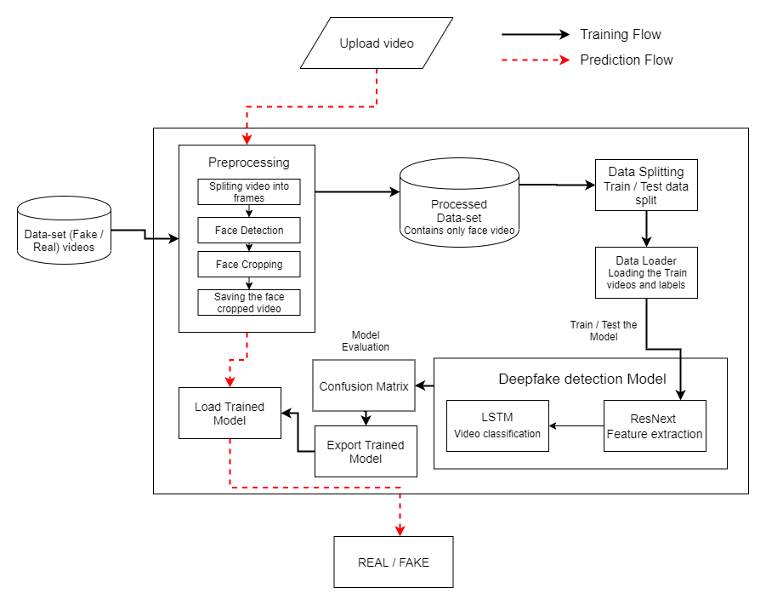
SYSTEM ARCHITECHTURE

Slide 9
MODULES
Preprocessing Module: This module handles the initial steps of preparing the video data for analysis. It likely includes functions for splitting videos into frames, detecting faces within those frames, and cropping them for further processing.
Feature Extraction Module: This module utilizes a ResNext convolutional neural network (CNN) to extract distinctive characteristics from the preprocessed facial frames. These characteristics, called features, might capture patterns in color, shape, and texture that can reveal inconsistencies in deepfakes.
Video Classification Module: This module employs a long short-term memory (LSTM) network. The LSTM analyzes the sequence of features extracted from each frame over time (the video). By looking at these temporal features, the LSTM aims to identify inconsistencies that might arise during deepfake creation, such as unnatural blinking patterns or subtle differences in facial movement across frames.
Training and Evaluation Module: This module manages the training process for the entire deepfake detection model. It ensures the model learns effectively from the provided video datasets (likely containing real and deepfake examples) and evaluates the model's performance on separate testing datasets.
Deepfake Detection Module: After training and evaluation, this final module embodies the complete deepfake detection system. It incorporates all the previous modules and takes a new video as input. The system then analyzes the video using the feature extraction and video classification modules and outputs a classification - real or deepfake.

Slide 10
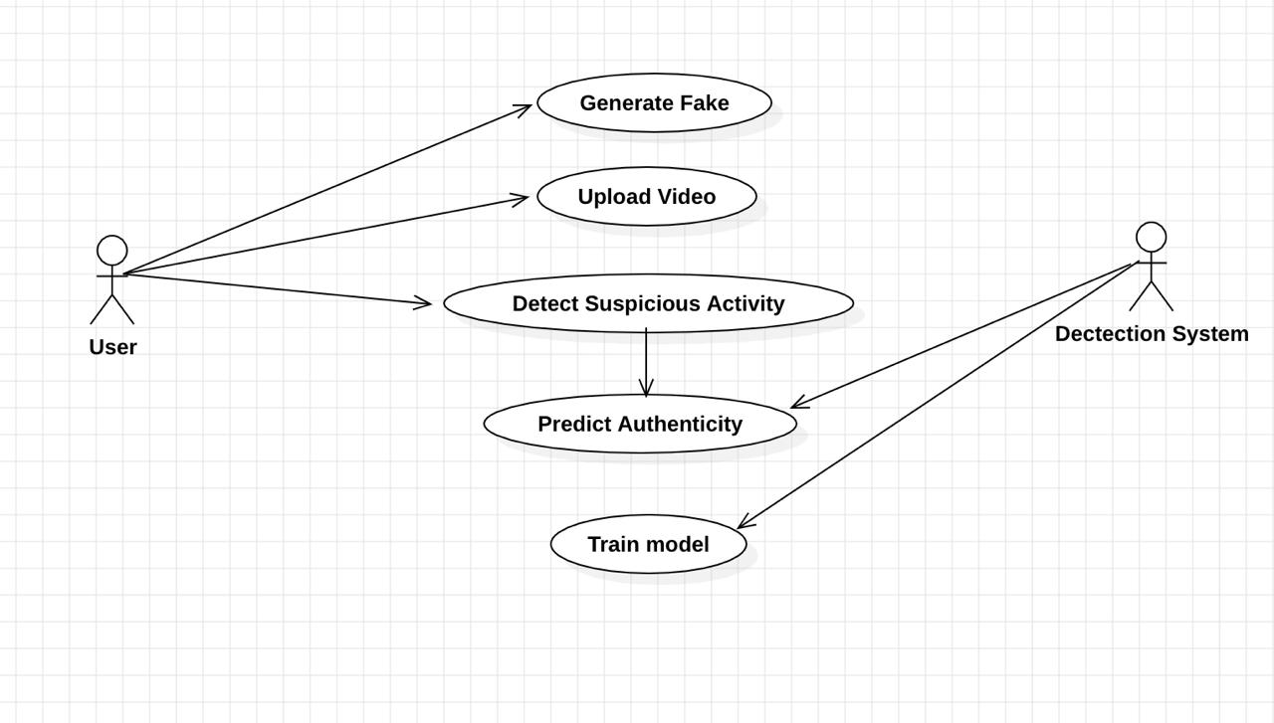
UML Diagram – Use-Case Diagram

Slide 11
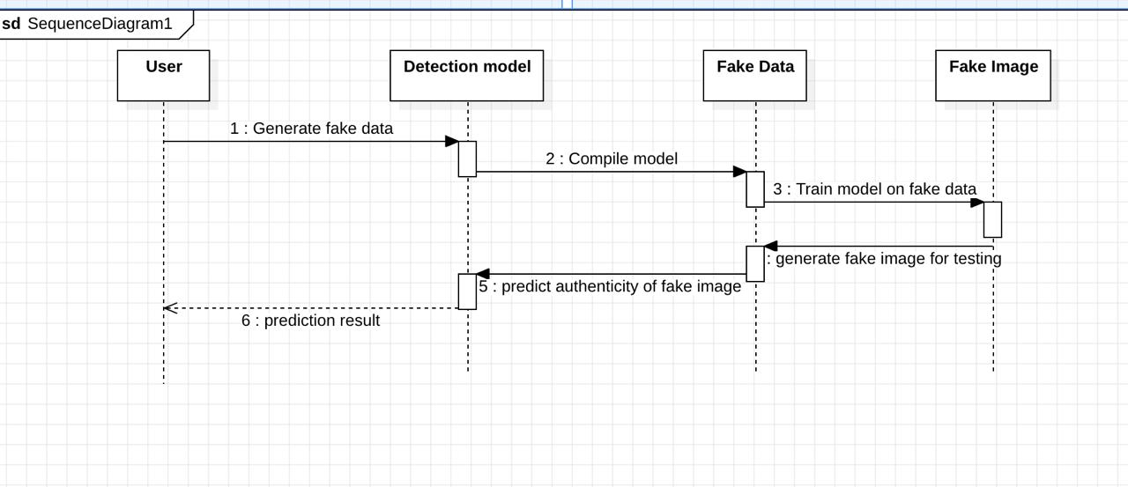
Sequence Diagram

Slide 12
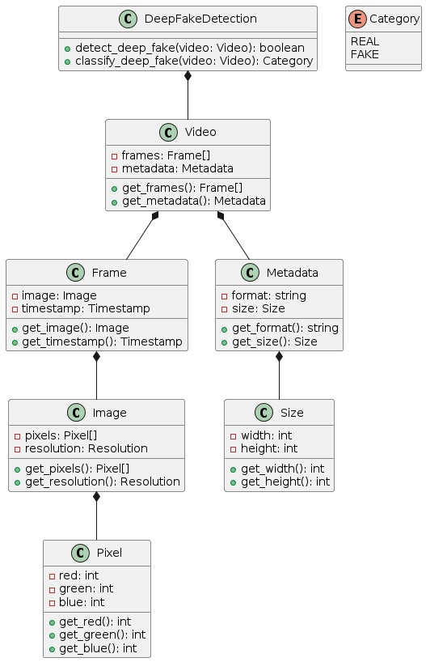
Class Diagram

Slide 13
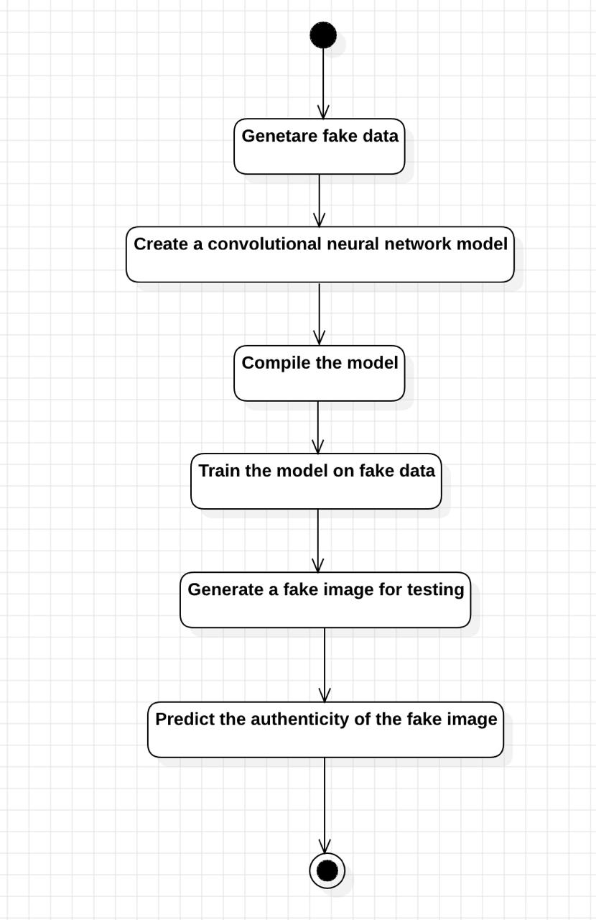
Activity Diagram

Slide 14
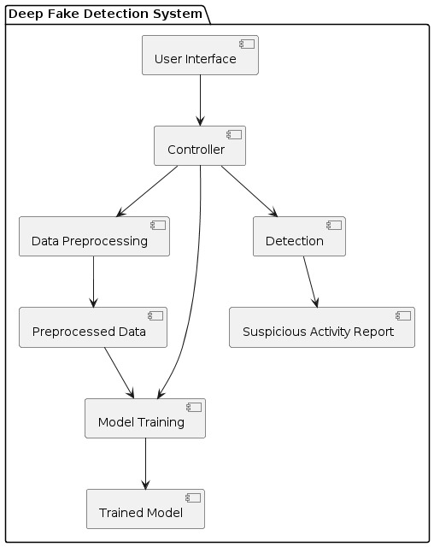
Component Diagram

Slide 15
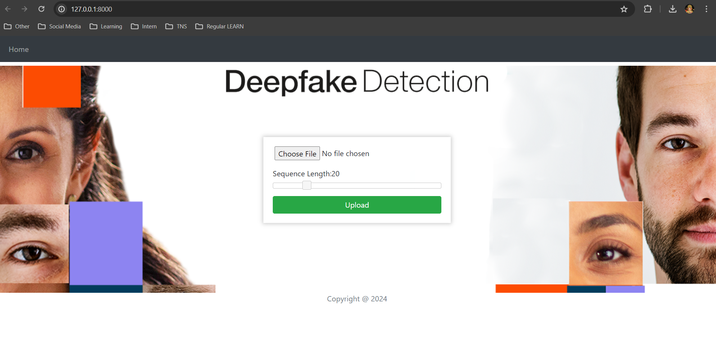
Result

Slide 16
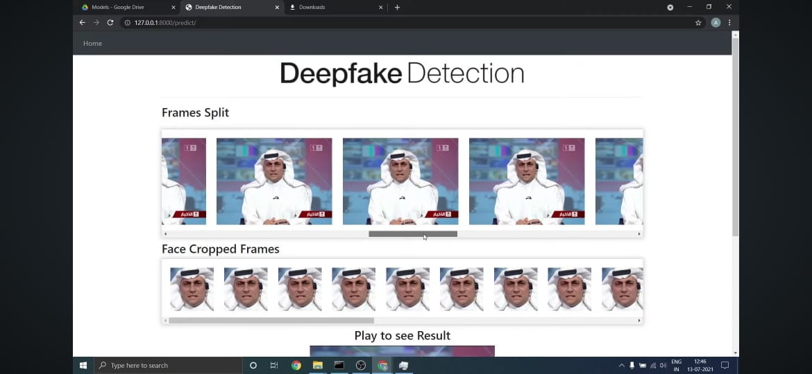
Result

Slide 17
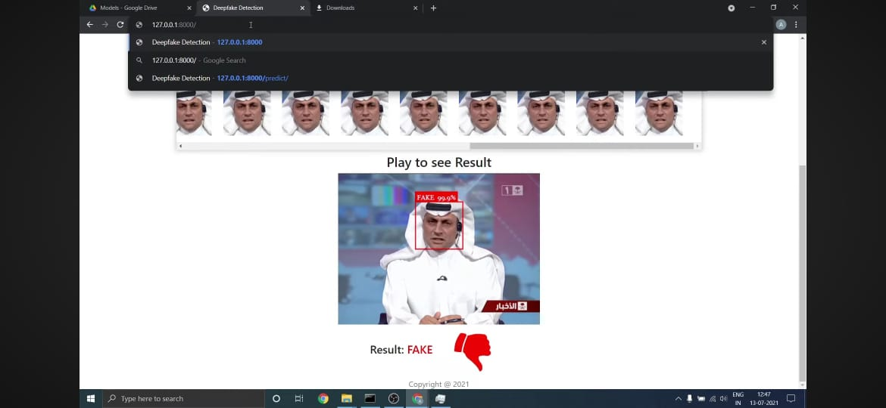
Result

Slide 18
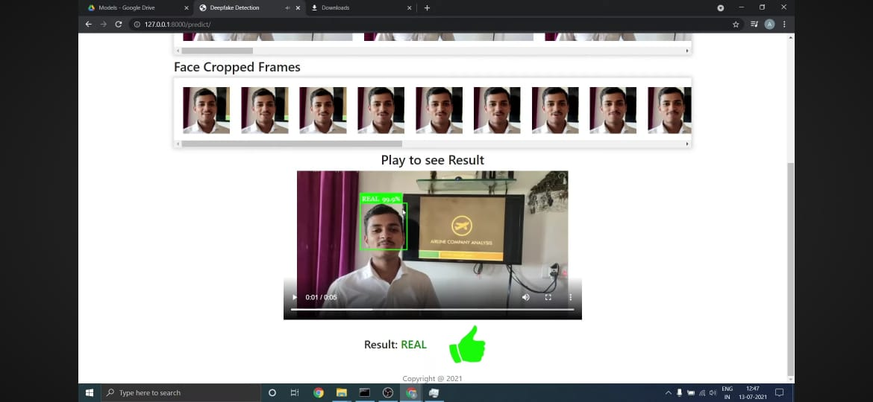
Result

Slide 19
SOFTWARE AND HARDWARE REQUIREMENTS
The software required for the system are:
Microsoft Windows 7 Above.
Python (main programming language)
Django – Framework
Matplotlib or Seaborn (for data visualization)
MySQL (for database management, if needed)
Excel or CSV files (for storing and manipulating datasets)
The Hardware required for the system are:
Processor – intel i5 or Above
Hard Disk – 50 GB
Memory – 4 GB RAM or Above
Graphic Card : nvidia GTx 1650 or above

Slide 20
Modules Description
1. Data Collection and Preprocessing:
The module begins by collecting a diverse dataset of both authentic and deepfake videos. These videos are preprocessed to extract frames and prepare them for feature extraction.
2. Feature Extraction with CNNs:
Convolutional Neural Networks (CNNs) are employed to extract high-level features from individual frames of the videos. These features capture spatial information and patterns within each frame.
3. Temporal Analysis with RNNs:
The extracted features from CNNs are fed into a Recurrent Neural Network (RNN) architecture, which performs temporal analysis across frames. The RNN learns to detect temporal inconsistencies introduced by deepfake manipulation, such as unnatural facial movements or inconsistent lighting.

Slide 21
Modules Description
4. Training and Evaluation:
The module trains the CNN and RNN components using a labeled dataset containing both authentic and deepfake videos. Training involves optimizing the network parameters to minimize classification errors. The performance of the model is evaluated using standard metrics such as accuracy, precision, recall, and F1 score.
5. Integration and Deployment:
Once trained and evaluated, the deepfake detection model is integrated into an application or system where it can analyze incoming videos in real-time or batch mode. Deployment considerations include scalability, efficiency, and compatibility with existing infrastructure.
6. Continuous Improvement:
The module includes provisions for continuous improvement, such as retraining the model with additional data to adapt to evolving deepfake techniques. Regular updates and enhancements ensure the effectiveness and reliability of the detection system over time.

Slide 22
REFERENCES
[1] Y. Li, M. C. Chang, and S. Lyu, “In Ictu Oculi: Exposing AI created fake videos by detecting eye blinking,” in 10th IEEE International Workshop on Information Forensics and Security, WIFS 2021, 2022.
[2] H. Li, B. Li, S. Tan, and J. Huang, “Detection of Deep Network Generated Images Using Disparities in Color Components,” Aug. 2021.
[3] Y. Li and S. Lyu, “Exposing Deep Fake Videos By Detecting Face Warping Artifacts.”
[4] D. Guera and E. J. Delp, “Deepfake Video Detection Using Recurrent Neural Networks,” in Proceedings of AVSS 2018 - 2018 15th IEEE International Conference on Advanced Video and Signal-Based Surveillance, 2019.
[5] X. Yang, Y. Li, and S. Lyu, “Exposing Deep Fakes Using Inconsistent Head Poses,” in ICASSP, IEEE International Conference on Acoustics, Speech and Signal Processing - Proceedings, 2019.
[6] K. He, X. Zhang, S. Ren, and J. Sun, “Deep residual learning for image recognition,” in Proceedings of the IEEE Computer Society Conference on Computer Vision and Pattern Recognition, 2020, vol. 2016-Decem, pp. 770–778.
[7] D. E. King, “Dlib-ml: A machine learning toolkit,” J. Mach. Learn. Res., 2009.
[8] Adam Geitgey, “Machine Learning is Fun! Part 4: Modern Face Recognition with Deep Learning,” Medium, 2016.
[9] G. Bradski, “The OpenCV Library,” Dr Dobbs J. Softw. Tools, 2010.
[10] Hastie, T., Tibshirani, R., & Friedman, J. (2009). “The elements of statistical learning: data mining, inference, and prediction.” Springer Science & Business Media.

Slide 23
REFERENCES
[11] Oscar Schwartz. 12 November 2018. You thought fake news was awful, right? “The death place of the truth is in deep fakes”. a Guardian.
[12] Sik-Ho Tsang, “Review: Inception-v3 1st Runner Up (Image Classification) in ILSVRC 2015.
[13] MesoNet: a Compact Facial Video Forgery Detection Network", by Darius Afchar, Vincent Nozick, Junichi Yamagishi, and Isao Echizen, arXiv:1809.00888v1 [cs.CV] 4 Sep 2018.
[14] Deepfake Video Detection Using Recurrent Neural Networks", 2018 15th IEEE International Conference on Advanced Video and Signal Based Surveillance (AVSS). David Güera and Edward J. Delp.
[15] Brian Dolhansky, Russ Howes, Ben Pflaum, Nicole Baram, Cristian Canton Ferrer, “The Deepfake Detection Challenge (DFDC) Preview Dataset”, arXiv:1910.08854 [cs.CV], 19 Oct 2019.
[16] PavelKorshunov and Sebastien Marcel, “Vulnerability assessment and detection of Deepfake videos”, IAPR International Conference 2019.
[17] ThanhThi Nguyen, Cuong M. Nguyen, Dung Tien Nguyen, DucThanh Nguyen, SaeidNahavandi, “Deep Learning for Deepfakes Creation and Detection”, arXiv:1909.11573 [cs.CV], 25 Sep 2019.
[18] Chesney, Robert and Citron, Danielle Keats, Deep Fakes: A Looming Challenge for Privacy, Democracy, and National Security (July 14, 2018). 107 California Law Review (2019, Forthcoming); U of Texas Law, Public Law Research Paper No. 692; U of Maryland Legal Studies Research Paper No. 2018-21.
[19] Francesco Marra,Diego Gragnaniello, Davide Cozzolino,Luisa Verdoliva, “Detection of GANGenerated Fake Images over Social Networks”, IEEE Conference on Multimedia Information Processing and Retrieval (MIPR), 10-12 April 2018.
[20] Shubhangi Tirpude1 , Naman Vidyabhanu2 , Hashir Sheikh3 ShoebPathan 4 , Zeeshan Ali syed5 , Shivam Singh, “Abnormal X-Ray Detection System using Convolution Neural Network”, International Journal of Advanced Trends in Computer Science and Engineering, ISSN 2278-3091, Volume 9, No. 1, JanuaryFebruary 2020.

Slide 24
CONCLUSION
We presented a neural network-based approach to classify the video as deep fake or real, along with the confidence of proposed model. The proposed method is inspired by the way the deep fakes are created by the GANs with the help of Autoencoders. Our method does the frame level detection using ResNext CNN and video classification using RNN along with LSTM. The proposed method is capable of detecting the video as a deep fake or real based on the listed parameters in paper. We believe that, it will provide a very high accuracy on real time data.

Slide 25
ANY QUERYS

Slide 26
THANK YOU

