Slide 1

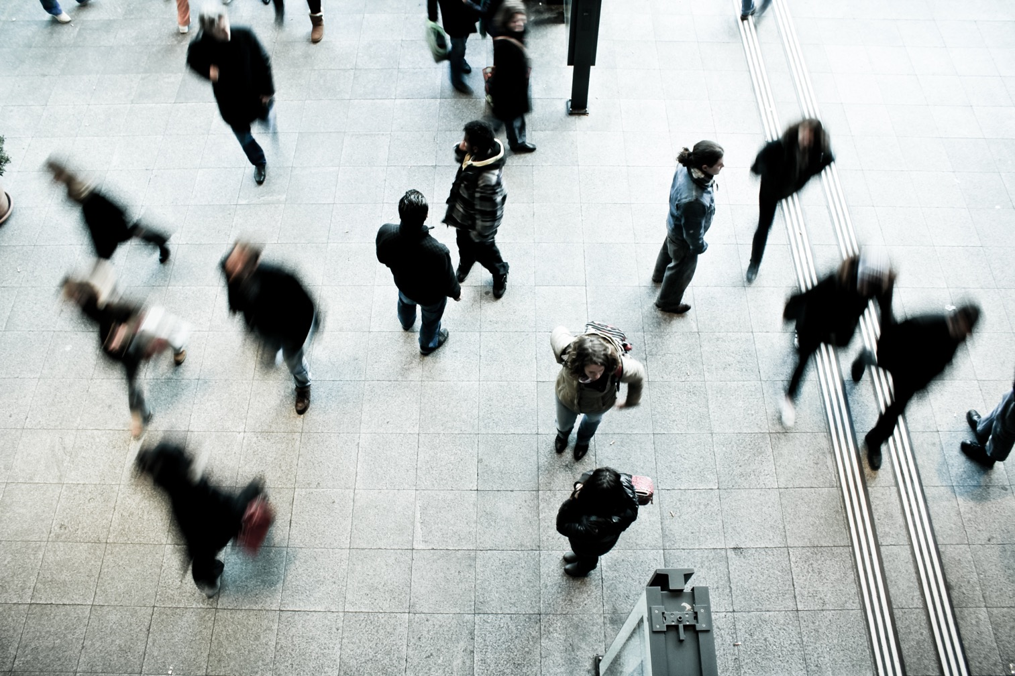
Title heading for two lines
Subheading
Instructions to replace the photo
There are 2 layers on this slide.
To change the photo please right click anywhere on the page and use option Send to back to select the photo.
Delete the photo and insert a new image by clicking from the toolbar or tab Insert, click on Picture and select from Picture from file. Position the image within the clear area of the graphic device (right handside) window and repeat the first step by right clicking on the new image and Send to back.
Delete this note once you’ve finished reading.

Slide 2
Title heading for two lines
Subheading

Slide 3

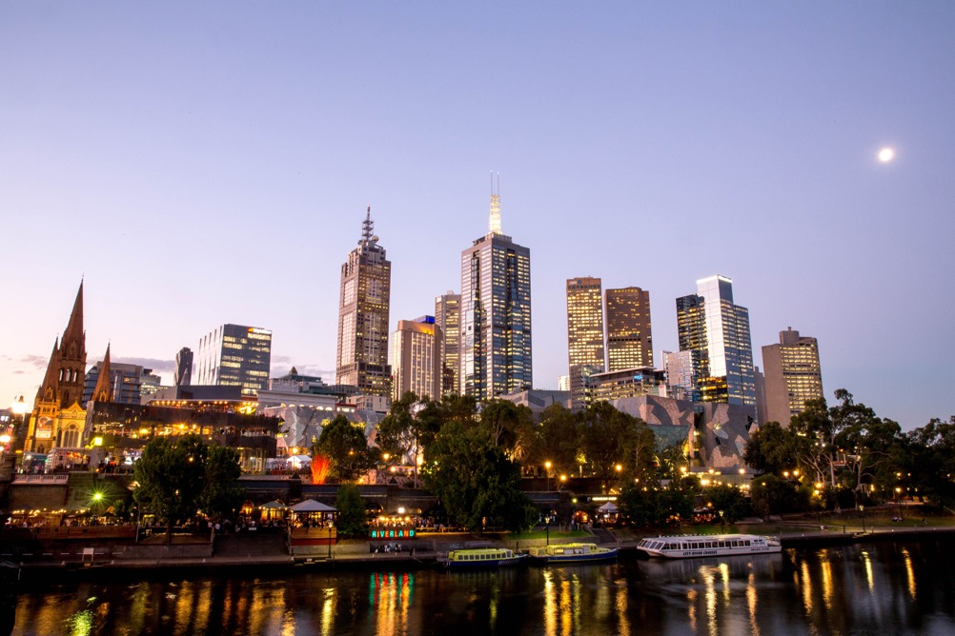
Heading 1 with two lines
Body copy
Bullet 1
Bullet 2
Bullet 3
Instructions to replace the photo
There are 2 layers on this slide.
To change the photo please right click anywhere on the page and use option Send to back to select the photo.
Delete the photo and insert a new image by clicking from the toolbar or tab Insert, click on Picture and select from Picture from file. Position the image within the clear area of the graphic device (right handside) window and repeat the first step by right clicking on the new image and Send to back.
Ensure the images are both behind the text boxes
Delete this note once you’ve finished reading.

Slide 4
Heading 1 with two lines
Body copy
Bullet 1
Bullet 2
Bullet 3

Slide 5
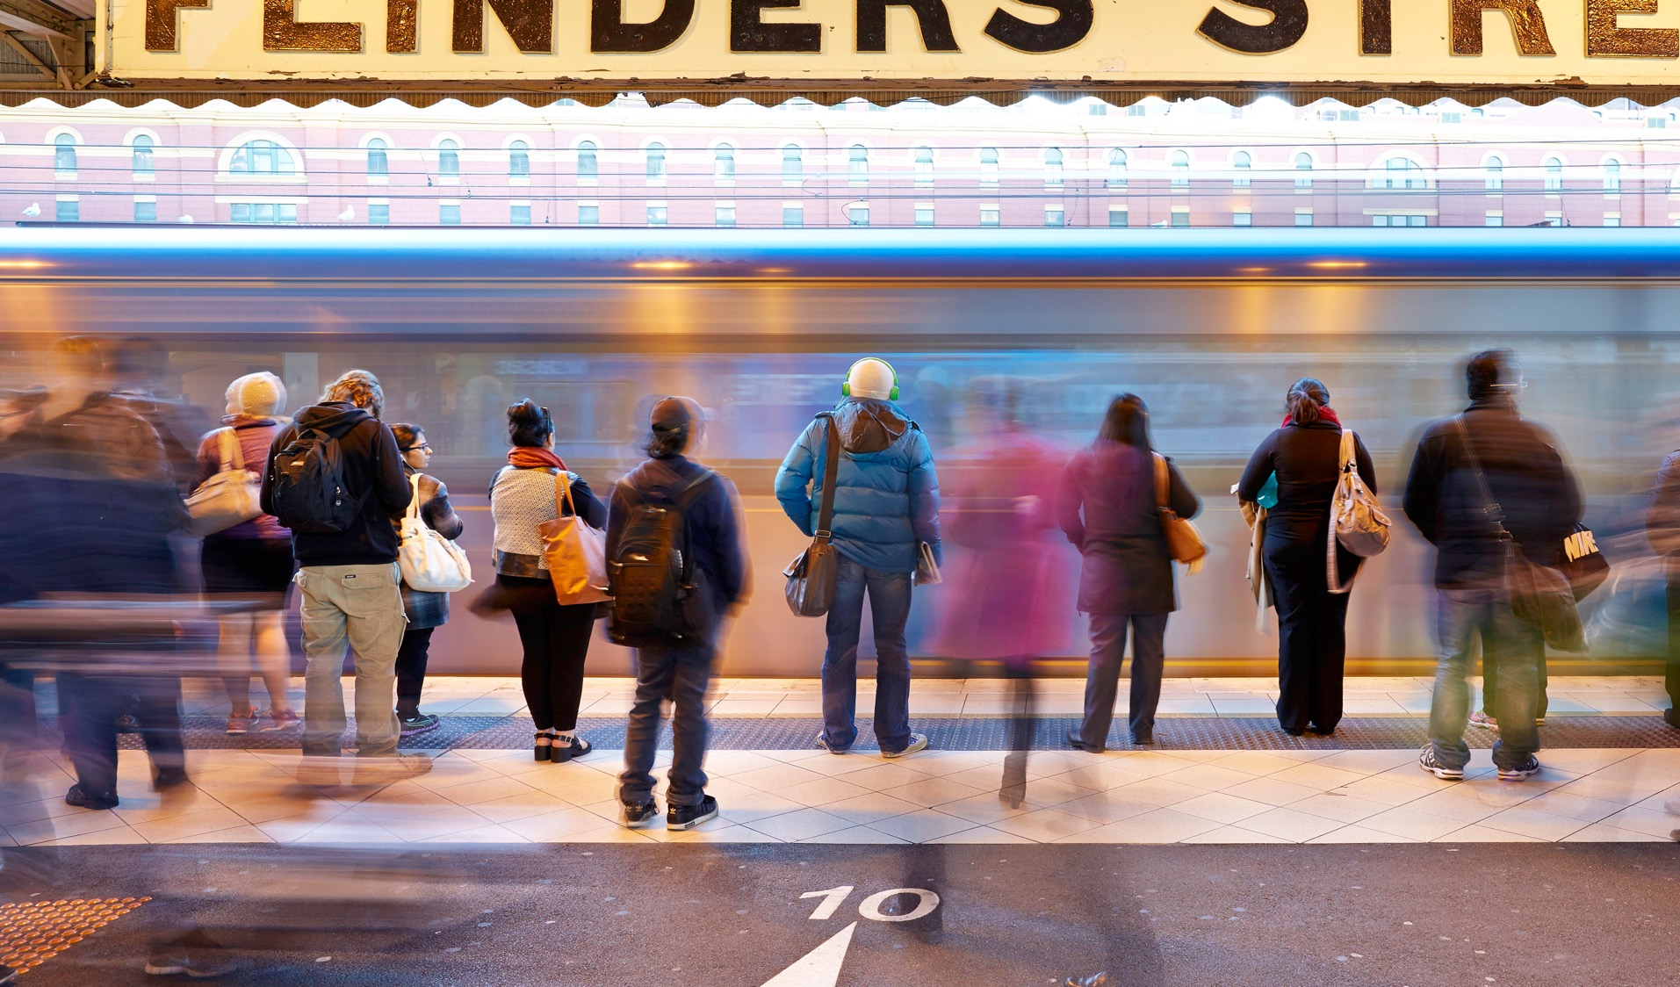

Heading 1 with two lines
Body copy
Bullet 1
Bullet 2
Bullet 3
Instructions to replace the photo
There are 2 layers on this slide.
To change the photo please right click anywhere on the page and use option Send to back to select the photo.
Delete the photo and insert a new image by clicking from the toolbar or tab Insert, click on Picture and select from Picture from file. Position the image within the clear area of the graphic device (right handside) window and repeat the first step by right clicking on the new image and Send to back.
Ensure the images are both behind the text boxes
Delete this note once you’ve finished reading.
For highlight text or quotes aut ommodis ad quundescieni cullaborpor alis maximus.

Slide 6


Heading 1 with two lines
Body copy
Bullet 1
Bullet 2
Bullet 3
Instructions to replace the photo
There are 2 layers on this slide.
To change the photo please right click anywhere on the page and use option Send to back to select the photo.
Delete the photo and insert a new image by clicking from the toolbar or tab Insert, click on Picture and select from Picture from file. Position the image within the clear area of the graphic device (right handside) window and repeat the first step by right clicking on the new image and Send to back.
Ensure the images are both behind the text boxes
Delete this note once you’ve finished reading.
For highlight text or quotes aut ommodis ad quundescieni cullaborpor alis maximus.

Slide 7
Main heading here two lines
Heading 2 to accommodate two lines
Heading 2 to accommodate two lines
Body text omni diore pelita cum harit expe cus solor ad magnihil isque sandae sim ium ra cum et faccabo rumendam que estotate voluptate estiisciis quam, te cum eum alitati debitibus inist praecerunt
Bullet 1
Bullet 2
Bullet 3
Body text omni diore pelita cum harit expe cus solor ad magnihil isque sandae sim ium ra cum et faccabo rumendam que estotate voluptate estiisciis quam, te cum eum alitati debitibus inist praecerunt.
For highlight text or quotes aut ommodis ad quundescieni cullaborpor alis maximus.

Slide 8
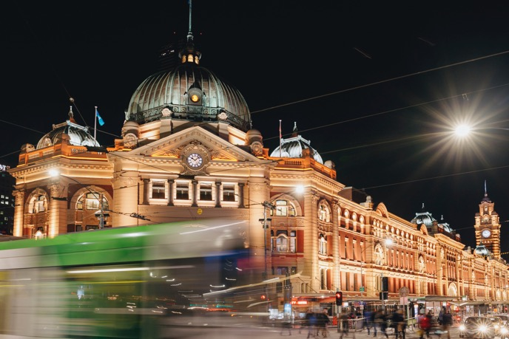
Main heading here two lines
Body text omni diore pelita cum harit expe cus solor ad magnihil isque sandae sim ium ra cum et faccabo rumendam que estotate voluptate estiisciis quam, te cum eum alitati debitibus inist praecerunt
Bullet 1
Bullet 2
Bullet 3
For highlight text or quotes aut ommodis ad quundescieni cullaborpor alis maximus.

Slide 9
Main heading here two lines
Body text omni diore pelita cum harit expe cus solor ad magnihil isque sandae sim ium ra cum et faccabo rumendam que estotate voluptate estiisciis quam, te cum eum alitati debitibus inist praecerunt
Bullet 1
Bullet 2
Bullet 3
Table title | Table title | Table title | Table title | Table title | Table title
table copy | 100 | 100 | 100 | 100 | 100
table copy | 100 | 100 | 100 | 100 | 100
table copy | 100 | 100 | 100 | 100 | 100
table copy | 100 | 100 | 100 | 100 | 100

Slide 10
Main heading here two lines
Body text omni diore pelita cum harit expe cus solor ad magnihil isque sandae sim ium ra cum et faccabo rumendam que estotate voluptate estiisciis quam, te cum eum alitati debitibus inist praecerunt
Bullet 1
Bullet 2
Bullet 3
Table title | Table title | Table title
table copy | 100 | 100
table copy | 100 | 100
table copy | 100 | 100
table copy | 100 | 100
table copy | 100 | 100
table copy | 100 | 100

Slide 11


Section 1
Section break slides are available to use in 4 colours. These can be used in rotation if there are more than 4 sections.
Instructions to replace the photo
There are 2 layers on this slide.
To change the photo please right click anywhere on the page and use option Send to back to select the photo.
Delete the photo and insert a new image by clicking from the toolbar or tab Insert, click on Picture and select from Picture from file. Position the image within the clear area of the graphic device (right handside) window and repeat the first step by right clicking on the new image and Send to back.
Delete this note once you’ve finished reading.
Sub heading

Slide 12

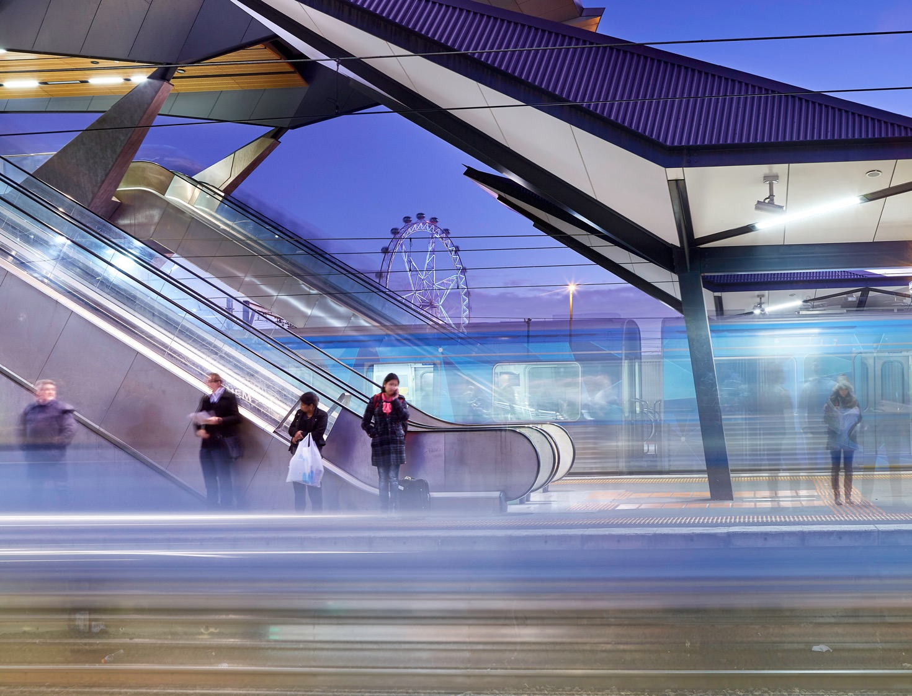
Section 2
Section break slides are available to use in 4 colours. These can be used in rotation if there are more than 4 sections.
Instructions to replace the photo
There are 2 layers on this slide.
To change the photo please right click anywhere on the page and use option Send to back to select the photo.
Delete the photo and insert a new image by clicking from the toolbar or tab Insert, click on Picture and select from Picture from file. Position the image within the clear area of the graphic device (right handside) window and repeat the first step by right clicking on the new image and Send to back.
Delete this note once you’ve finished reading.
Sub heading

Slide 13

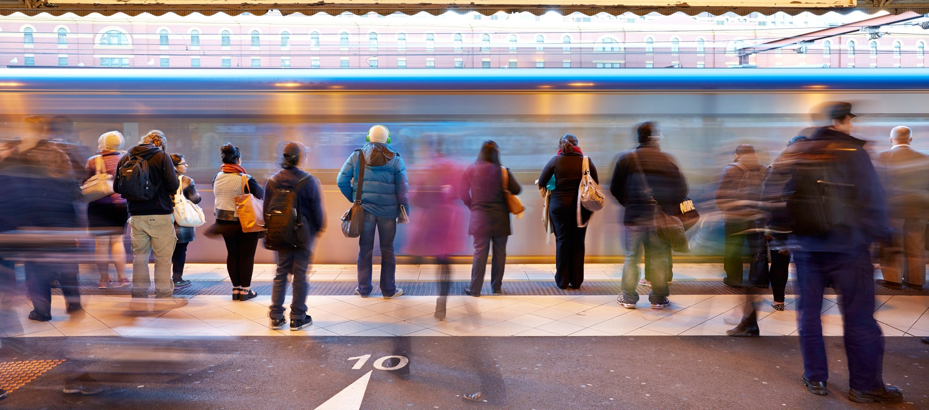
Section 3
Section break slides are available to use in 4 colours. These can be used in rotation if there are more than 4 sections.
Instructions to replace the photo
There are 2 layers on this slide.
To change the photo please right click anywhere on the page and use option Send to back to select the photo.
Delete the photo and insert a new image by clicking from the toolbar or tab Insert, click on Picture and select from Picture from file. Position the image within the clear area of the graphic device (right handside) window and repeat the first step by right clicking on the new image and Send to back.
Delete this note once you’ve finished reading.
Sub heading

Slide 14

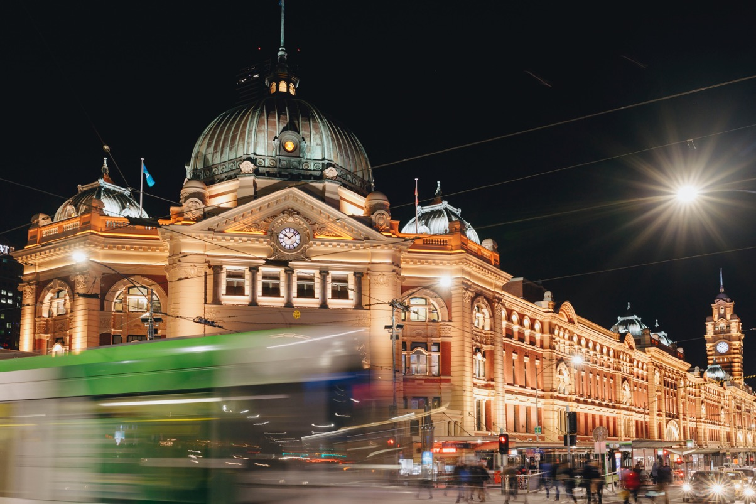
Section 4
Section break slides are available to use in 4 colours. These can be used in rotation if there are more than 4 sections.
Instructions to replace the photo
There are 2 layers on this slide.
To change the photo please right click anywhere on the page and use option Send to back to select the photo.
Delete the photo and insert a new image by clicking from the toolbar or tab Insert, click on Picture and select from Picture from file. Position the image within the clear area of the graphic device (right handside) window and repeat the first step by right clicking on the new image and Send to back.
Delete this note once you’ve finished reading.
Sub heading

Slide 15
Section 1
Sub heading

Slide 16
Section 2
Sub heading

Slide 17
Section 3
Sub heading

Slide 18
Section 4
Sub heading

