Slide 1
Texas Housing Prices: powerpoint_presentation
Alison Hill

Slide 2
Packages and data
The txhousing data is available when you install and load the ggplot2 package.
library(tidyverse) txsamp <- txhousing %>% filter(city %in% c("Houston", "Fort Worth", "San Antonio", "Dallas", "Austin"))

Slide 3
Austin is expensive
ggplot(data = txsamp, aes(x = sales, y = median)) + geom_point(aes(colour = city)) + scale_colour_viridis_d("City\nCenter", option = params$viridis_palette)

Slide 4
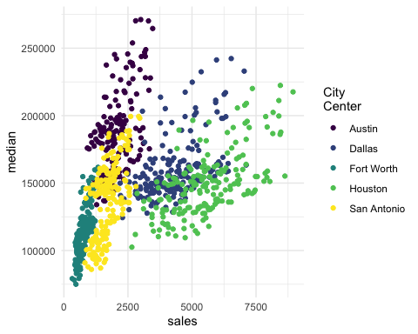

Slide 5
Austin prices on the rise
ggplot(data = filter(txsamp, city == "Austin"), aes(x = sales, y = median)) + geom_point(aes(colour = year)) + scale_colour_viridis_c("Austin by year", option = params$viridis_palette, direction = -1)

Slide 6
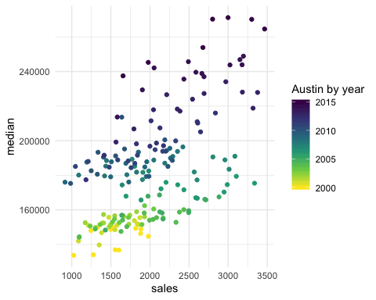

Slide 7
Fort Worth has more affordable housing
library(scales) # to make y-axis in non-scientific notation ggplot(txsamp, aes(x = median, fill = city)) + geom_histogram(aes(weight = sales), position = "dodge", binwidth = 15000) + scale_fill_viridis_d(option = params$viridis_palette)+ scale_y_continuous(labels = comma)

Slide 8
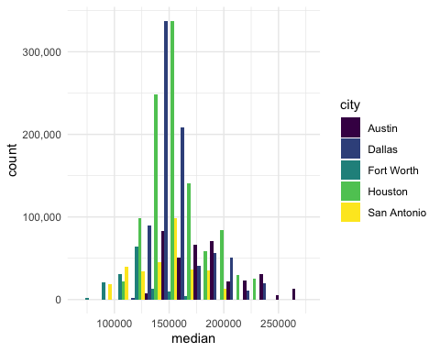

Slide 9
The current pace of sales is fast
“Months inventory”: amount of time it would take to sell all current listings at current pace of sales.
ggplot(data = txsamp, aes(x = year, y = inventory, colour = city)) + geom_point() + geom_smooth(se = FALSE) + scale_colour_viridis_d("City\nCenter", option = params$viridis_palette)

Slide 10
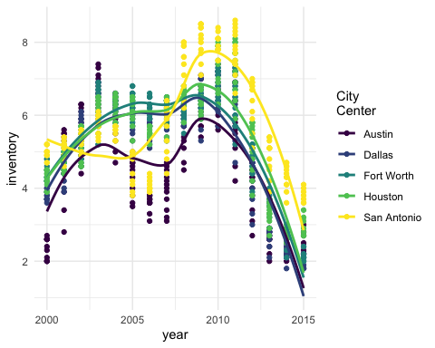

Slide 11
Thanks to…
Jennifer Thompson: https://github.com/jenniferthompson/ParamRmdExample
Garrett Grolemund: https://rmarkdown.rstudio.com/lesson-6.html

