Slide 1
Visualizing Texas: powerpoint_presentation

Slide 2
Packages
We’ll use ggplot2 for visualization, and some light dplyr for data wrangling.
library(ggplot2) # plotting library(dplyr) # wrangling

Slide 3
Texas housing data
This data is loaded for you when you install and load the ggplot2 package.
txsamp <- txhousing %>% filter(city %in% c("Houston", "Fort Worth", "San Antonio", "Dallas", "Austin")) glimpse(txsamp)
## Observations: 935 ## Variables: 9 ## $ city <chr> "Austin", "Austin", "Austin", "Austin", "Austin", "Aus… ## $ year <int> 2000, 2000, 2000, 2000, 2000, 2000, 2000, 2000, 2000, … ## $ month <int> 1, 2, 3, 4, 5, 6, 7, 8, 9, 10, 11, 12, 1, 2, 3, 4, 5, … ## $ sales <dbl> 1025, 1277, 1603, 1556, 1980, 1885, 1818, 1880, 1498, … ## $ volume <dbl> 173053635, 226038438, 298557656, 289197960, 393073774,… ## $ median <dbl> 133700, 134000, 136700, 136900, 144700, 148800, 149300… ## $ listings <dbl> 3084, 2989, 3042, 3192, 3617, 3799, 3944, 3948, 4058, … ## $ inventory <dbl> 2.0, 2.0, 2.0, 2.1, 2.3, 2.4, 2.6, 2.6, 2.6, 2.6, 2.7,… ## $ date <dbl> 2000.000, 2000.083, 2000.167, 2000.250, 2000.333, 2000…

Slide 4
Our data is monthly
Here is just a sample of rows from one city to show that we have data for each of the 12 months for each year, except for 2015.
txsamp %>% filter(city == "Austin") %>% count(year)
## # A tibble: 16 x 2 ## year n ## <int> <int> ## 1 2000 12 ## 2 2001 12 ## 3 2002 12 ## 4 2003 12 ## 5 2004 12 ## 6 2005 12 ## 7 2006 12 ## 8 2007 12 ## 9 2008 12 ## 10 2009 12 ## 11 2010 12 ## 12 2011 12 ## 13 2012 12 ## 14 2013 12 ## 15 2014 12 ## 16 2015 7

Slide 5
Austin is expensive
ggplot(data = txsamp, aes(x = sales, y = median)) + geom_point(aes(colour = city)) + scale_colour_viridis_d("City\nCenter", option = params$viridis_palette)

Slide 6
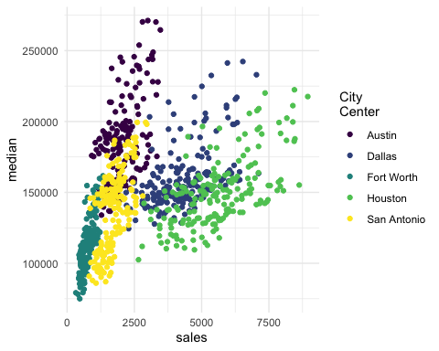

Slide 7
Austin prices on the rise
ggplot(data = filter(txsamp, city == "Austin"), aes(x = sales, y = median)) + geom_point(aes(colour = year)) + scale_colour_viridis_c("Austin by year", option = params$viridis_palette, direction = -1)

Slide 8
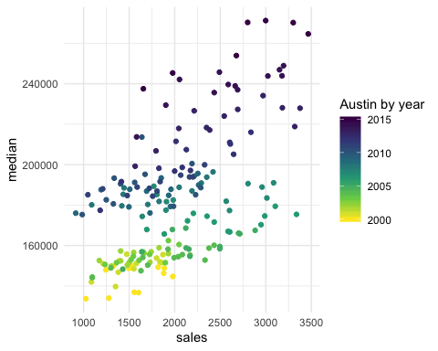

Slide 9
Fort Worth has more affordable housing
library(scales) # to make y-axis in non-scientific notation ggplot(txsamp, aes(x = median, fill = city)) + geom_histogram(aes(weight = sales), position = "dodge", binwidth = 15000) + scale_fill_viridis_d(option = params$viridis_palette)+ scale_y_continuous(labels = comma)

Slide 10
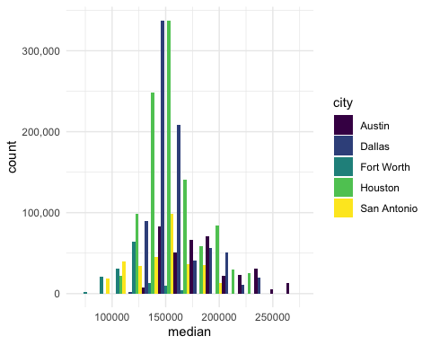

Slide 11
The current pace of sales is fast
“Months inventory”: amount of time it would take to sell all current listings at current pace of sales.
ggplot(data = txsamp, aes(x = year, y = inventory, colour = city)) + geom_point() + geom_smooth(se = FALSE) + scale_colour_viridis_d("City\nCenter", option = params$viridis_palette)

Slide 12
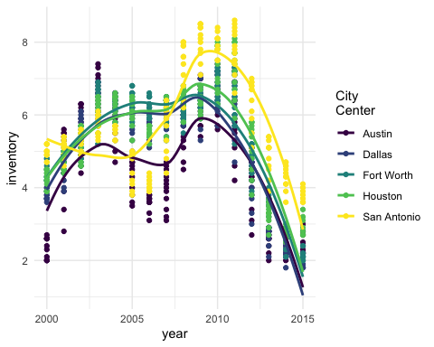

Slide 13
Thanks to…
Jennifer Thompson: https://github.com/jenniferthompson/ParamRmdExample
Garrett Grolemund: https://rmarkdown.rstudio.com/lesson-6.html

