Slide 1
Texas Housing Prices: powerpoint_presentation
Alison Hill

Slide 2
Packages and data
We’ll use ggplot2 for visualization, and some light dplyr for data wrangling. The txhousing data is loaded for you when you install and load the ggplot2 package.
library(ggplot2) # plotting library(dplyr) # wrangling txsamp <- txhousing %>% filter(city %in% c("Houston", "Fort Worth", "San Antonio", "Dallas", "Austin"))

Slide 3
Austin is expensive
ggplot(data = txsamp, aes(x = sales, y = median)) + geom_point(aes(colour = city)) + scale_colour_viridis_d("City\nCenter", option = params$viridis_palette)

Slide 4
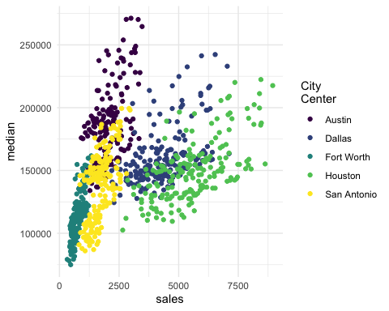

Slide 5
Austin prices on the rise
ggplot(data = filter(txsamp, city == "Austin"), aes(x = sales, y = median)) + geom_point(aes(colour = year)) + scale_colour_viridis_c("Austin by year", option = params$viridis_palette, direction = -1)

Slide 6
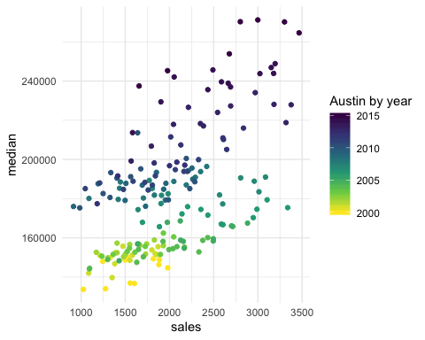

Slide 7
Fort Worth has more affordable housing
library(scales) # to make y-axis in non-scientific notation ggplot(txsamp, aes(x = median, fill = city)) + geom_histogram(aes(weight = sales), position = "dodge", binwidth = 15000) + scale_fill_viridis_d(option = params$viridis_palette)+ scale_y_continuous(labels = comma)

Slide 8
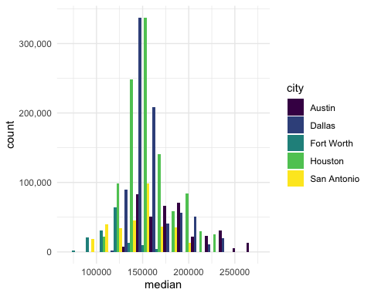

Slide 9
The current pace of sales is fast
“Months inventory”: amount of time it would take to sell all current listings at current pace of sales.
ggplot(data = txsamp, aes(x = year, y = inventory, colour = city)) + geom_point() + geom_smooth(se = FALSE) + scale_colour_viridis_d("City\nCenter", option = params$viridis_palette)

Slide 10
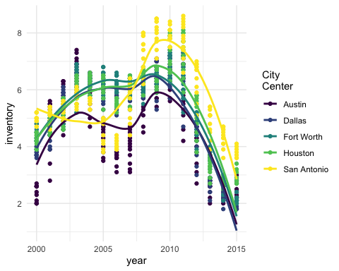

Slide 11
Thanks to…
Jennifer Thompson: https://github.com/jenniferthompson/ParamRmdExample
Garrett Grolemund: https://rmarkdown.rstudio.com/lesson-6.html

