Slide 1
Texas Housing Prices: powerpoint_presentation
Alison Hill

Slide 2
Packages and data
The txhousing data is available when you install and load the ggplot2 package.

Slide 3
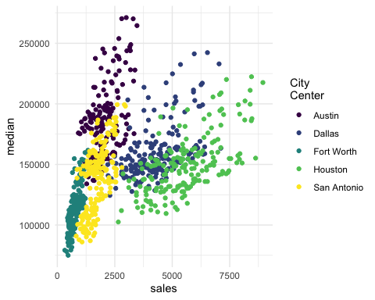
Austin is expensive

Slide 4
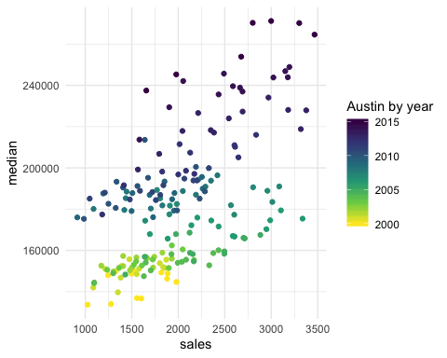
Austin prices on the rise

Slide 5
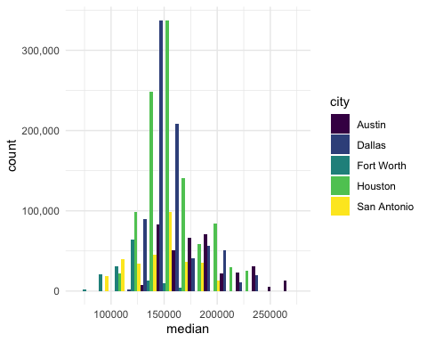
Fort Worth has more affordable housing

Slide 6
The current pace of sales is fast
“Months inventory”: amount of time it would take to sell all current listings at current pace of sales.

Slide 7
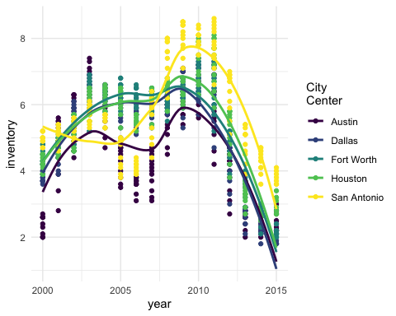

Slide 8
Thanks to…
Jennifer Thompson: https://github.com/jenniferthompson/ParamRmdExample
Garrett Grolemund: https://rmarkdown.rstudio.com/lesson-6.html

