Slide 1
Powerpoint penguins
Alison Hill

Slide 2
Table of Contents
Stacked histogram (wrong)
Dodged histogram (better)
Do you teach literate programming?
Testing
Surprised that warnings/messages push plots to next slide?
Penguin party!
Teaching in Production
The output format
Using markdown
Observations
Speaker notes?
Columns
So two column won’t work, huh?
from a blog post
why???
Reading in the figure manually
OK how about a style template?
Side-by-side code + plot
More observations
Slide templates
Pain points
Pain points (continued)
Seeing my layout options
Try kable instead

Slide 3
head(penguins, 4)
## # A tibble: 4 x 8 ## species island bill_length_mm bill_depth_mm flipper_length_… body_mass_g sex ## <fct> <fct> <dbl> <dbl> <int> <int> <fct> ## 1 Adelie Torge… 39.1 18.7 181 3750 male ## 2 Adelie Torge… 39.5 17.4 186 3800 fema… ## 3 Adelie Torge… 40.3 18 195 3250 fema… ## 4 Adelie Torge… NA NA NA NA <NA> ## # … with 1 more variable: year <int>

Slide 4
Stacked histogram (wrong)
# Histogram example: flipper length by species ggplot(data = penguins, aes(x = flipper_length_mm)) + geom_histogram( aes(fill = species), alpha = 0.5) + scale_fill_manual(values = c("darkorange","darkorchid","cyan4"))

Slide 5
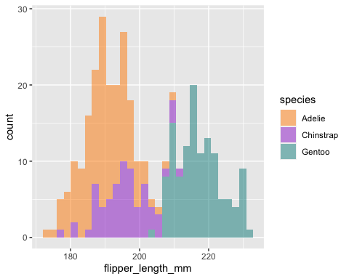

Slide 6
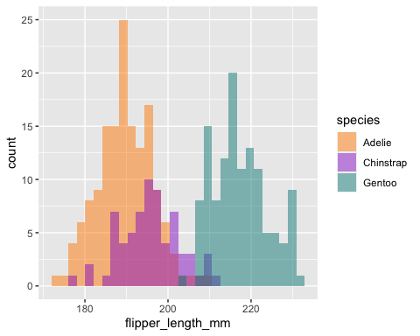
Dodged histogram (better)

Slide 7
Do you teach literate programming?

Slide 8
Testing
## Warning: Removed 2 rows containing missing values (geom_point).

Slide 9
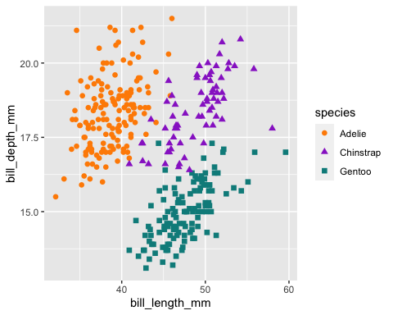

Slide 10
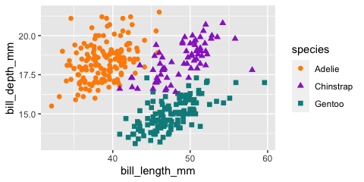
Surprised that warnings/messages push plots to next slide?

Slide 11

Penguin party!

Slide 12
Teaching in Production
. . .
Tip #1: Use R Markdown to make slides with xaringan
. . .
Tip #2: Use R Markdown to make a shareable site with distill
. . .
Q & A

Slide 13
I don’t get it
https://pandoc.org/MANUAL.html#inserting-pauses
Oh: “Note: this feature is not yet implemented for PowerPoint output.”
so no incremental slides

Slide 14
The output format
--- output: xaringan::moon_reader ---

Slide 15
Using markdown
Fair game:
headers (#, etc.)
bold
italics
lists (like this one!)

Slide 16
PowerPoint
Templates included with Microsoft PowerPoint 2013 (either with .pptx or .potx extension) are known to work, as are most templates derived from these. The specific requirement is that the template should begin with the following first four layouts: Title Slide Title and Content Section Header Two Content All templates included with a recent version of MS PowerPoint will fit these criteria. (You can click on Layout under the Home menu to check.) You can also modify the default reference.pptx: first run pandoc -o custom-reference.pptx --print-default-data-file reference.pptx, and then modify custom-reference.pptx in MS PowerPoint (pandoc will use the first four layout slides, as mentioned above).

Slide 17
Observations
Code looks like crap, and I cannot do anything about it?
The reference template looks like crap?
My plots look like crap? Why is the resolution so poor?

Slide 18
Speaker notes?
wow that works- very neat 🎉
ooh and emojis work too 🏆
Notes:
you shouldn’t be reading this right now

Slide 19
Columns
This syntax is insane

Slide 20
left
right somehow, these columns end up on a different slide? oh right, because I tried to use words above, see: “This syntax is insane”

Slide 21
So two column won’t work, huh?
Cool cool.
I just copy pasted from here: https://pandoc.org/MANUAL.html#columns
Note: this ended up working (I think) after going into visual editor mode then back.

Slide 22
from a blog post
https://stymied.medium.com/what-slides-from-markdown-5239ed31e7ac

Slide 23
Left column:
Bullet
Bullet
Bullet

Slide 24
why???
Left column:
Bullet
Bullet
Bullet
## `stat_bin()` using `bins = 30`. Pick better value with `binwidth`.
## Warning: Removed 2 rows containing non-finite values (stat_bin).

Slide 25
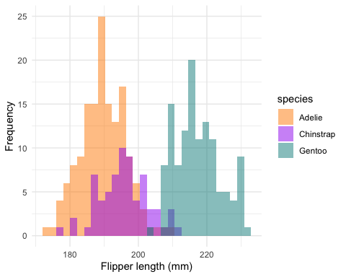
Reading in the figure manually
Left column at width='10%'?:
This
is
a
hack

Slide 26
OK how about a style template?
Womp womp.
output file: slides.knit.md Could not find shape for Powerpoint content Error: pandoc document conversion failed with error 63 In addition: Warning messages: 1: Removed 2 rows containing non-finite values (stat_bin). 2: Removed 2 rows containing non-finite values (stat_bin). Execution halted

Slide 27
https://ljupcho.com/blog/powerpoint
The template slides need to be made as slide masters, not actual slides.

Slide 28
PRO-TIP:
Power up R Markdown and knitr (this should be on same slide as PRO-TIP)

Slide 29
Side-by-side code + plot
Why? Don’t repeat yourself!
Code first, plot second
Chunk 1: {r plot-last, fig.show = 'hide'}
Chunk 2: {r ref.label = 'plot-last', echo = FALSE}
Plot first, code second
Chunk 1: {r plot-first, echo = FALSE}
Chunk 2: {r ref.label = 'plot-first', fig.show = 'hide'}

Slide 30
More observations
The default 4:3 looks super-dated, and hard to know that you must change the reference template
turning on visual editor made all my --- slide separators turn into full lines? That is not pleasant. Three is “just enough” visually for an HR?
BUT it changed all my insane div syntax to :::- much better!
It took me awhile to figure out how slide separators and heading levels started new slides

Slide 31
Slide templates
Making the reference slide template well is kind of a game changer- sharing some good templates might be very welcome.
Setting them up the right way is a huge gotcha.
Most powerpoint users are given a template- only advanced PPT users make their own slide templates, or have others make a real template for them.
We’ll need to teach “PPT for R Markdown users”

Slide 32
Also, there are lots of slide layouts in there, but I have no idea how to use them?
Pandoc says:
The specific requirement is that the template should begin with the following first four layouts:
Title Slide
Title and Content
Section Header
Two Content
From Pandoc:
You can also modify the default reference.pptx: first run pandoc -o custom-reference.pptx –print-default-data-file reference.pptx, and then modify custom-reference.pptx in MS PowerPoint (pandoc will use the first four layout slides, as mentioned above).

Slide 33
Pain points
no model reference slide template provided, and no easy way to make one that fits pandoc’s weird needs (can we wrap the pandoc function?)
no R output in two column slides- huge bummer.
no ANYTHING else on two columns slides- just the slide title and the columns.
in two column slides, width appears to do nothing?

Slide 34
Pain points (continued)
no way to control code overflow. With HTML you can work with CSS, but it feels impossible this way other than manually in PPT?
monofont in YAML is namechecked by pandoc, but doesn’t work? https://rmarkdown.rstudio.com/docs/reference/powerpoint_presentation.html
my template has a footer with date, slide number, etc.- where is that?
no background images, or even inverse slides

Slide 35
Seeing my layout options
This is handy, officer::layout_summary()
## layout master ## 1 Title Slide Office Theme ## 2 Title and Vertical Text Office Theme ## 3 Vertical Title and Text Office Theme ## 4 Title and Content Office Theme ## 5 Section Header Office Theme ## 6 Two Content Office Theme ## 7 Comparison Office Theme ## 8 Title Only Office Theme ## 9 Blank Office Theme ## 10 Content with Caption Office Theme ## 11 Picture with Caption Office Theme

Slide 36
Try kable instead
layout | master
Title Slide | Office Theme
Title and Vertical Text | Office Theme
Vertical Title and Text | Office Theme
Title and Content | Office Theme
Section Header | Office Theme
Two Content | Office Theme
Comparison | Office Theme
Title Only | Office Theme
Blank | Office Theme
Content with Caption | Office Theme
Picture with Caption | Office Theme

