Slide 1
Alt text
Alison Hill

Slide 2
Alt text does not work with urls
![look a puffin](https://upload.wikimedia.org/wikipedia/commons/9/94/Puffin_Mrkoww.jpg "Title: A proper puffin"){fig.alt="alt text: it is a very cute puffin."}

Slide 3
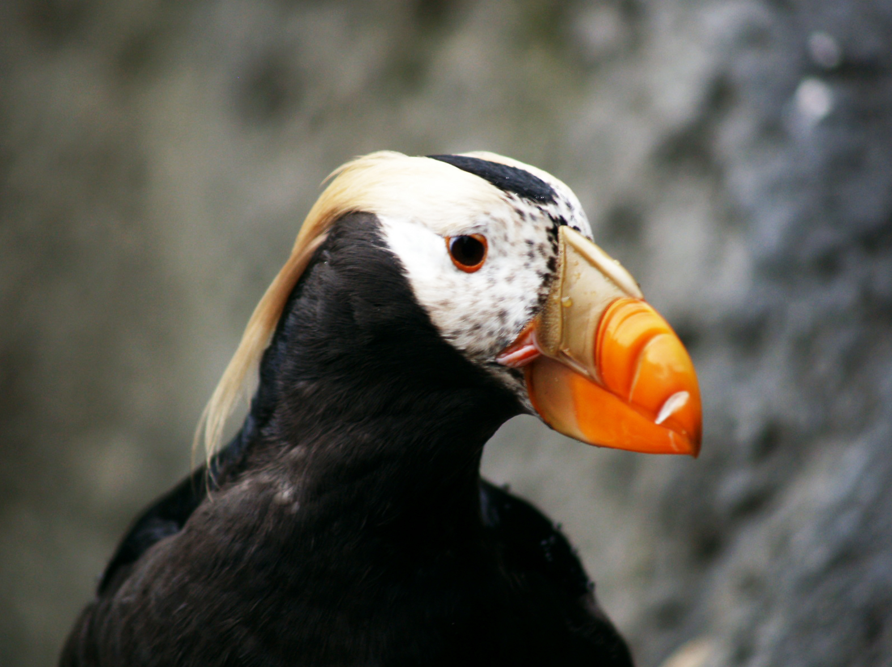
look a puffin

Slide 4
Alt text does not work with local images either
![look a puffin](../images/Puffin_Mrkoww.jpg "Title: A proper puffin"){fig.alt="alt text: it is a very cute puffin."}

Slide 5
look a puffin

