Slide 1
Spaceless
Alison Hill

Slide 2
Img + spaceless text
Some opening remarks with no space look a puffin
With no space, there is no puffin :(

Slide 3
Img + spaced out text
Some opening remarks with a space

Slide 4
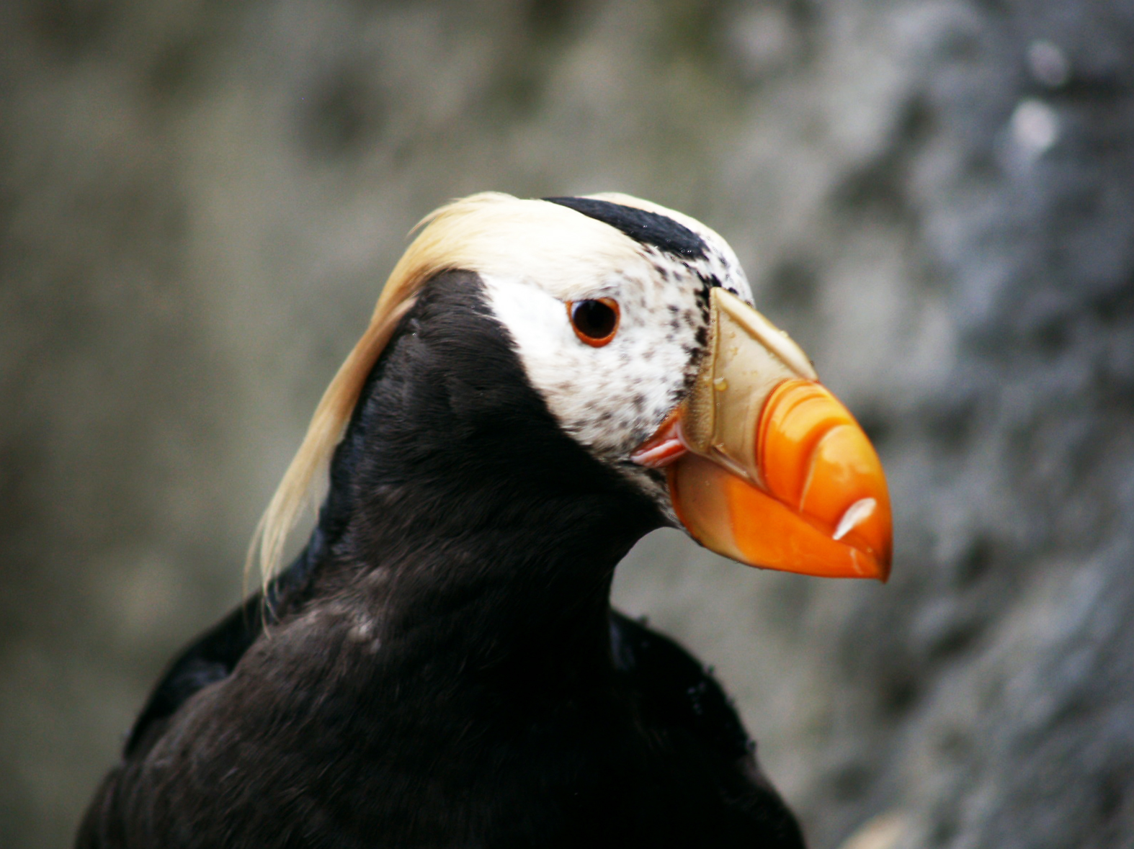
look a puffin

Slide 5
With a space, we have puffin (but of course, on its own slide)

