Slide 1
Powerpoint penguins
Alison Hill

Slide 2
Table of Contents
hi
one
two
am I header
test
test
l1 above me, but I’m on a new slide
test
l2
Alt text does not work with urls
Alt text does not work with local images either
Resizing images with out.width does not work
Where does the code go?
Where does the h2 go?
Where does the teeny tiny plot go?
But this works
Hello- I’d like to not be on a new slide
Code forces plot on new slide …
this works
Do you teach literate programming?
Testing
Surprised that warnings/messages push plots to next slide?
Penguin party!
Teaching in Production
The output format
Using markdown
Observations
Speaker notes?
Columns
So two column won’t work, huh?
from a blog post
why???
Reading in the figure manually
Testing officedown
ggplot in right column
OK how about a style template?
Side-by-side code + plot
Notes

Slide 3
hello

Slide 4
hi

Slide 5
Just some normal text on this slide please

Slide 6
if slide level is 1, I cannot use section slides

Slide 7
one
two

Slide 8
three
four

Slide 9
am I header

Slide 10
test
l1 above me, but I’m on a new slide

Slide 11
test
l1 above me, but I’m on a new slide

Slide 12
test

Slide 13
l2 above me

Slide 14
l2
l3

Slide 15
Alt text does not work with urls

Slide 16
![look a puffin](https://upload.wikimedia.org/wikipedia/commons/9/94/Puffin_Mrkoww.jpg "Title: A proper puffin"){fig.alt="alt text: it is a very cute puffin."}

Slide 17
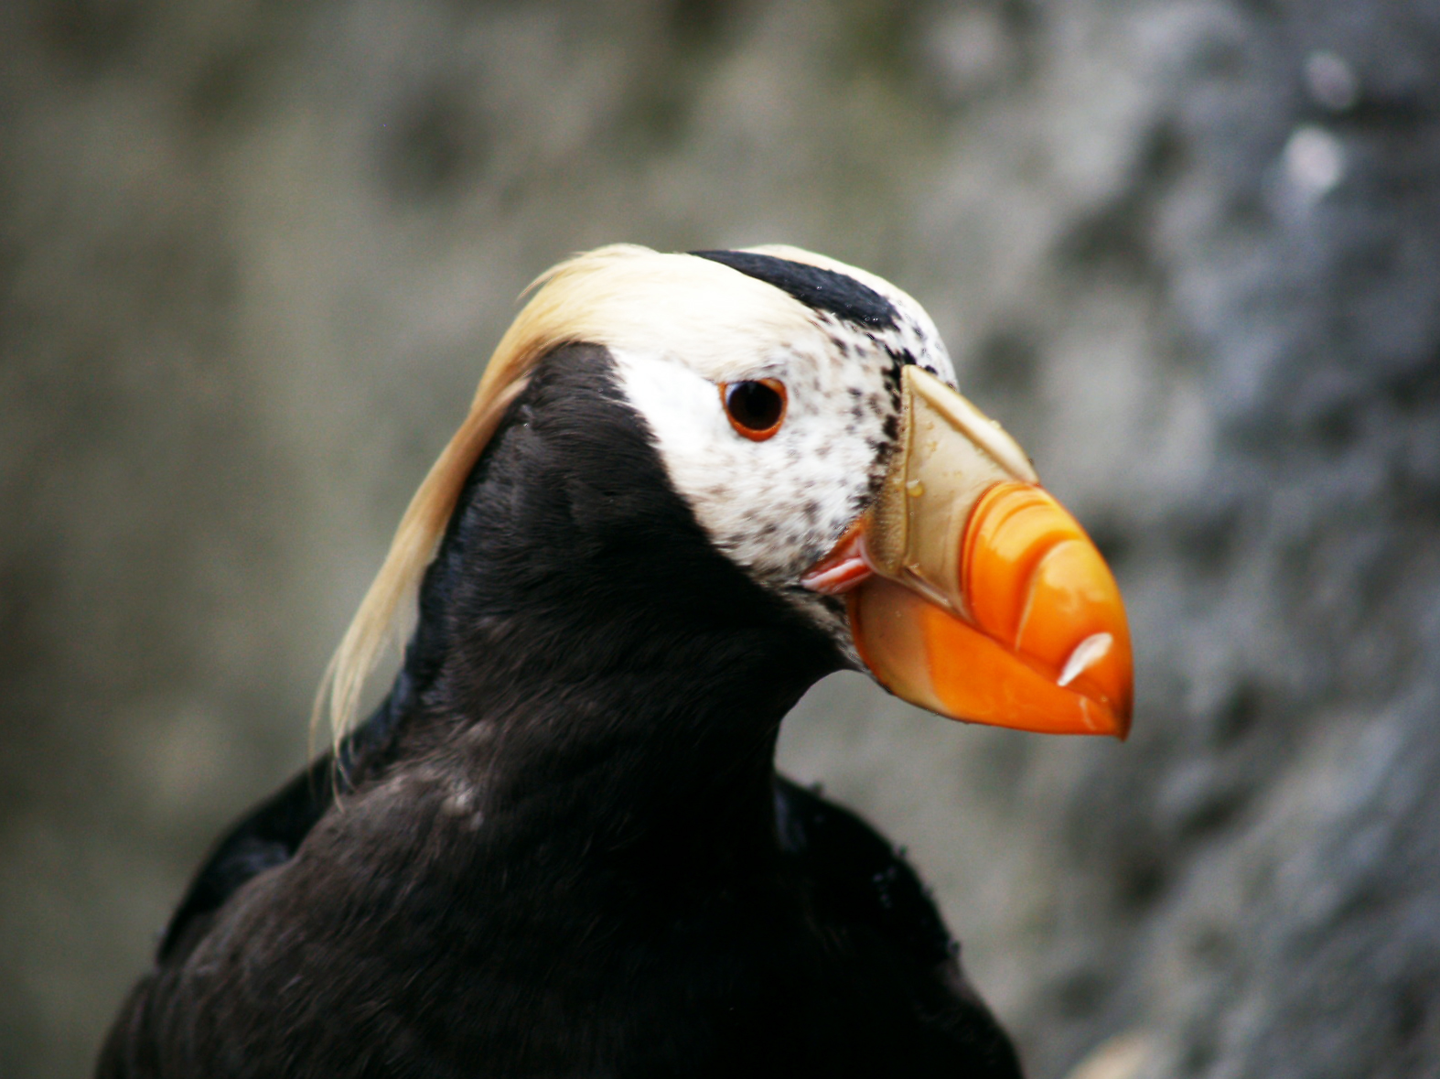
look a puffin

Slide 18
Alt text does not work with local images either
![look a puffin](images/Puffin_Mrkoww.jpg "Title: A proper puffin"){fig.alt="alt text: it is a very cute puffin."}

Slide 19
look a puffin

Slide 20
Resizing images with out.width does not work
plot(cars)

Slide 21
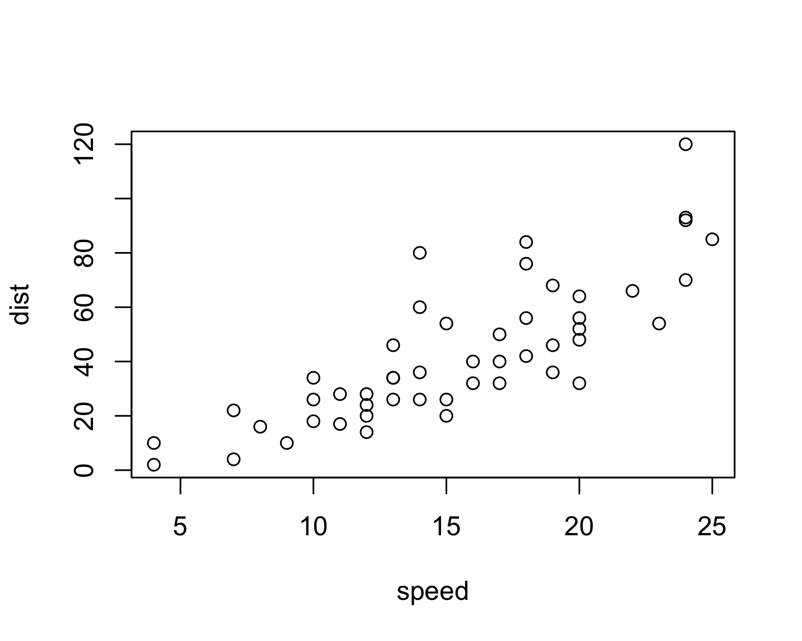

Slide 22
https://github.com/jgm/pandoc/issues/4586

Slide 23
Where does the code go?
head(penguins, 4)
## # A tibble: 4 x 8 ## species island bill_length_mm bill_depth_mm flipper_length_… body_mass_g sex ## <fct> <fct> <dbl> <dbl> <int> <int> <fct> ## 1 Adelie Torge… 39.1 18.7 181 3750 male ## 2 Adelie Torge… 39.5 17.4 186 3800 fema… ## 3 Adelie Torge… 40.3 18 195 3250 fema… ## 4 Adelie Torge… NA NA NA NA <NA> ## # … with 1 more variable: year <int>

Slide 24
Where does the h2 go?
head(penguins, 4)
## # A tibble: 4 x 8 ## species island bill_length_mm bill_depth_mm flipper_length_… body_mass_g sex ## <fct> <fct> <dbl> <dbl> <int> <int> <fct> ## 1 Adelie Torge… 39.1 18.7 181 3750 male ## 2 Adelie Torge… 39.5 17.4 186 3800 fema… ## 3 Adelie Torge… 40.3 18 195 3250 fema… ## 4 Adelie Torge… NA NA NA NA <NA> ## # … with 1 more variable: year <int>

Slide 25
Where does the teeny tiny plot go?
plot(cars)

Slide 27
But this works
Adelie
Chinstrap 4
Gentoo
2 + 2
## [1] 4

Slide 28
I’m unlisted

Slide 29
Hello- I’d like to not be on a new slide
https://github.com/rstudio/rmarkdown/issues/1625

Slide 30
Code forces plot on new slide …
# Histogram example: flipper length by species ggplot(data = penguins, aes(x = flipper_length_mm)) + geom_histogram( aes(fill = species), alpha = 0.5) + scale_fill_manual(values = c("darkorange","darkorchid","cyan4"))

Slide 31
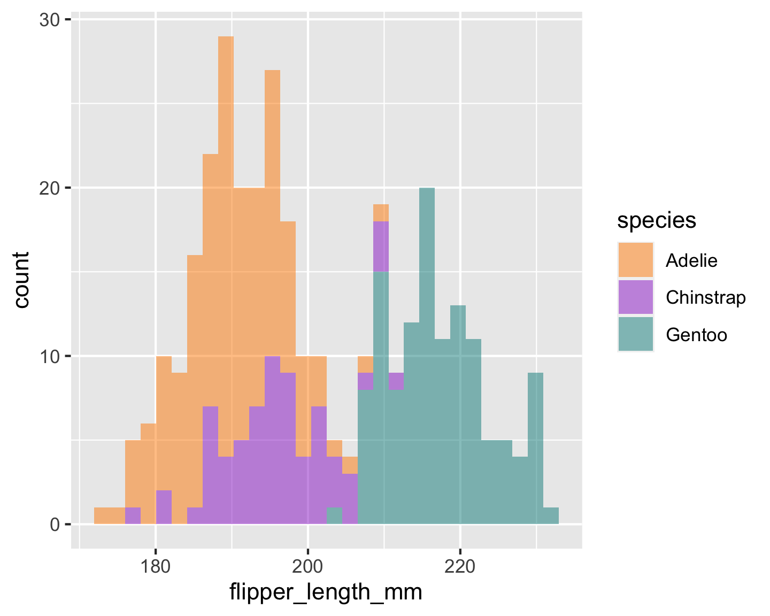

Slide 32
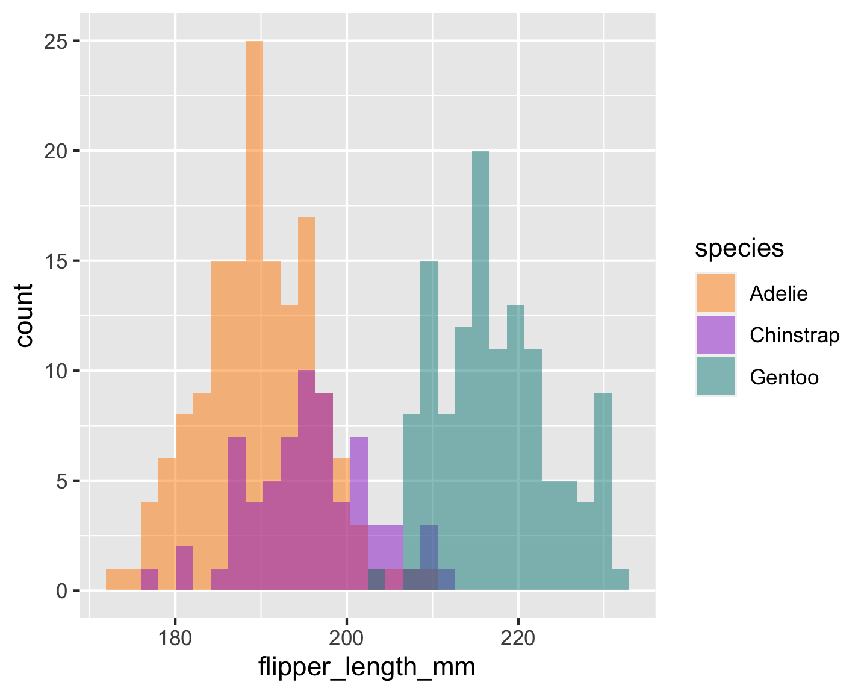
this works

Slide 33
Do you teach literate programming?

Slide 34
Testing
## Warning: Removed 2 rows containing missing values (geom_point).

Slide 35
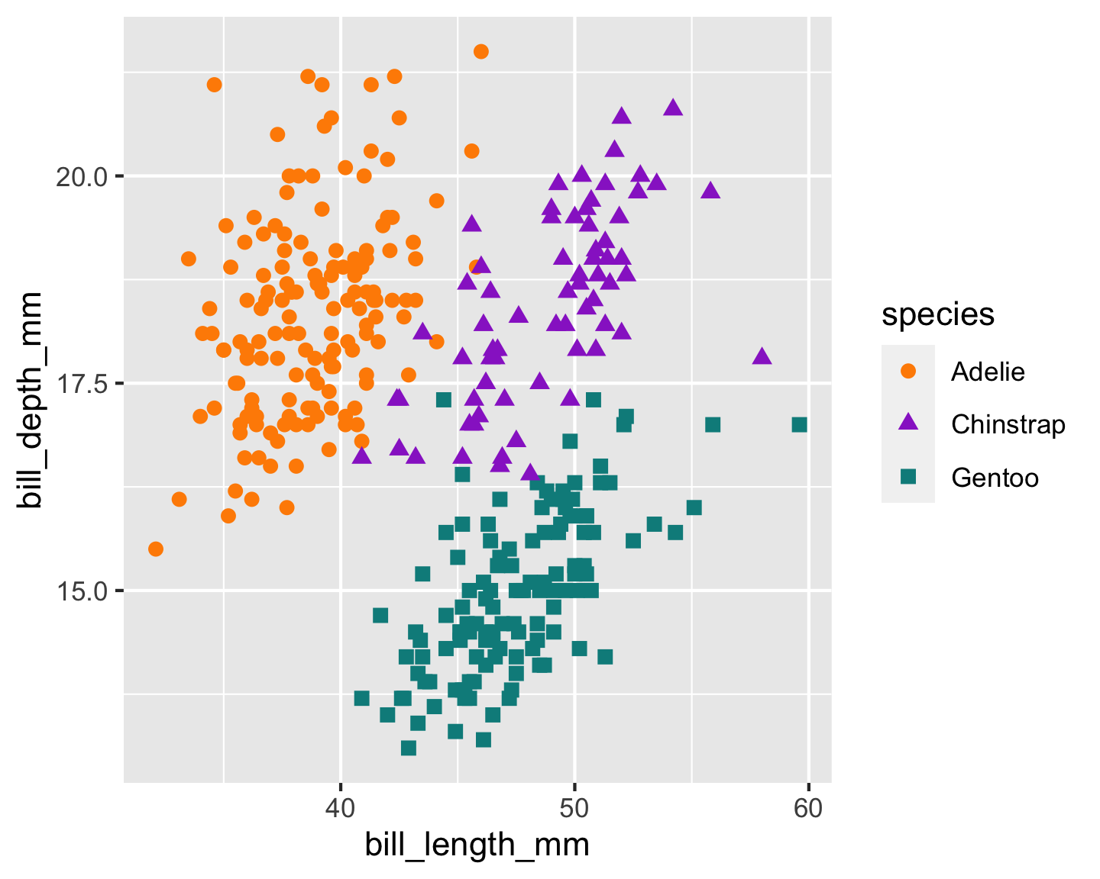

Slide 36
Surprised that warnings/messages push plots to next slide?

Slide 37
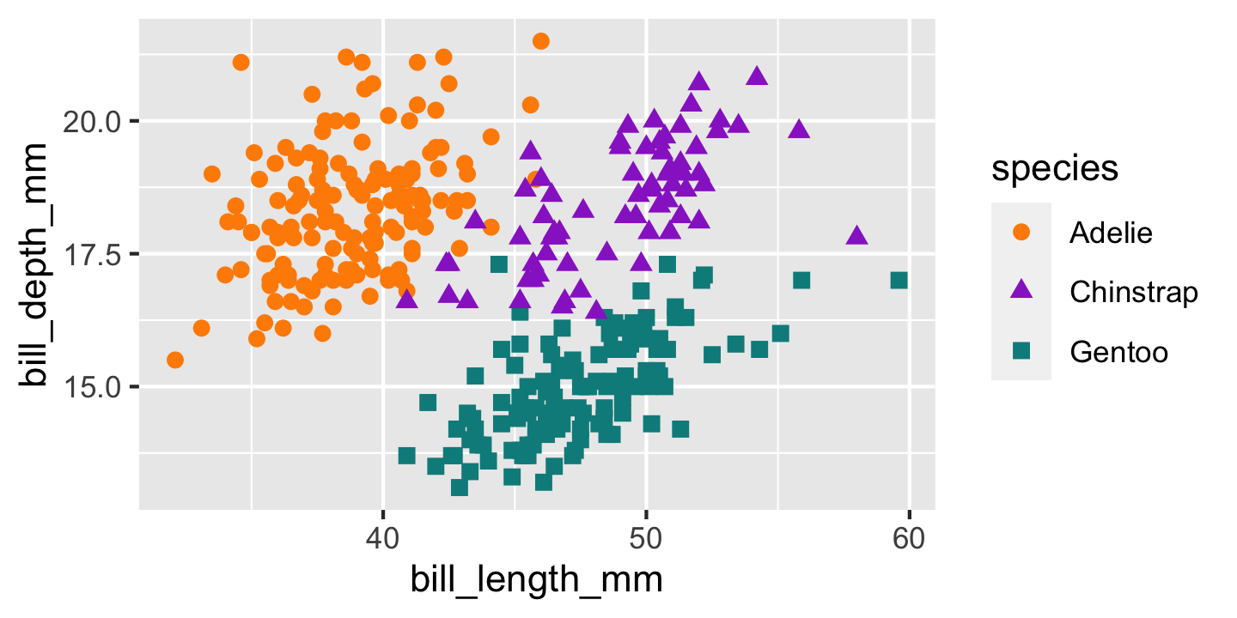

Slide 38
Penguin party!

Slide 39


Slide 40
Teaching in Production
. . .
Tip #1: Use R Markdown to make slides with xaringan
. . .
Tip #2: Use R Markdown to make a shareable site with distill
. . .
Q & A

Slide 41
I don’t get it
https://pandoc.org/MANUAL.html#inserting-pauses
Oh: “Note: this feature is not yet implemented for PowerPoint output.”
so no incremental slides

Slide 42
The output format
--- output: xaringan::moon_reader ---

Slide 43
Using markdown
Fair game:
headers (#, etc.)
bold
italics
lists (like this one!)
You can include Knit markdown as normal¹.²

Slide 44
PowerPoint
Templates included with Microsoft PowerPoint 2013 (either with .pptx or .potx extension) are known to work, as are most templates derived from these. The specific requirement is that the template should begin with the following first four layouts: Title Slide Title and Content Section Header Two Content All templates included with a recent version of MS PowerPoint will fit these criteria. (You can click on Layout under the Home menu to check.) You can also modify the default reference.pptx: first run pandoc -o custom-reference.pptx --print-default-data-file reference.pptx, and then modify custom-reference.pptx in MS PowerPoint (pandoc will use the first four layout slides, as mentioned above).

Slide 45
Observations
Code looks like crap, and I cannot do anything about it?
The reference template looks like crap?
My plots look like crap? Why is the resolution so poor?

Slide 46
Speaker notes?
wow that works- very neat 🎉
ooh and emojis work too 🏆
Notes:
you shouldn’t be reading this right now

Slide 47
Columns
This syntax is insane

Slide 48
left
right somehow, these columns end up on a different slide? oh right, because I tried to use words above, see: “This syntax is insane”

Slide 49
So two column won’t work, huh?
Cool cool.
I just copy pasted from here: https://pandoc.org/MANUAL.html#columns
Note: this ended up working (I think) after going into visual editor mode then back.

Slide 50
from a blog post
https://stymied.medium.com/what-slides-from-markdown-5239ed31e7ac

Slide 51
Left column:
Bullet
Bullet
Bullet

Slide 52
why???

Slide 53
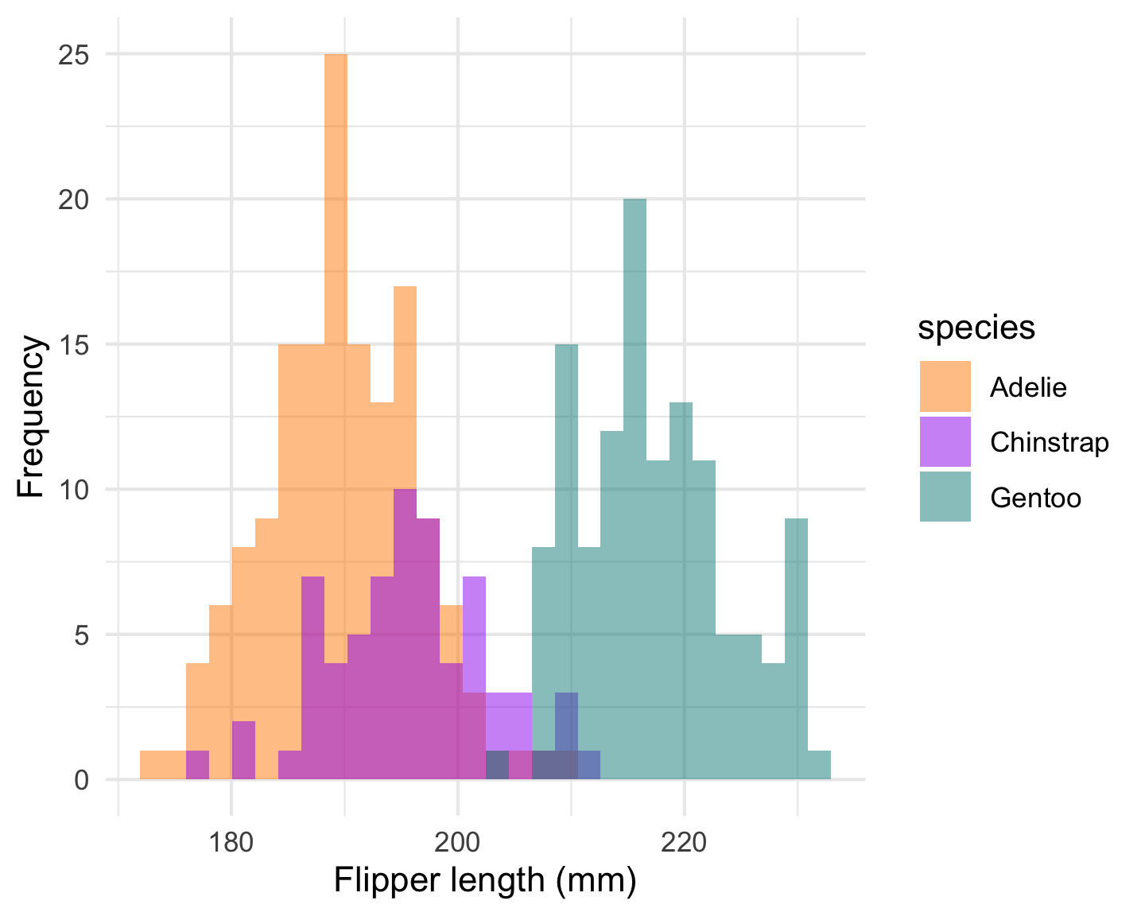
Left column:
Bullet
Bullet
Bullet
Yes caption!

Slide 54
Reading in the figure manually

Slide 55
Left column at width='10%'?:
This
is
a
hack

Slide 56
Testing officedown
## $code ## <quosure> ## expr: ^ ## env: empty ## ## $ggobj

Slide 58
## ## $bg ## [1] "white" ## ## $fonts ## list() ## ## $pointsize ## [1] 12 ## ## $editable ## [1] TRUE ## ## attr(,"class") ## [1] "dml"

Slide 60
ggplot in right column
Some
Bullets
## $code ## <quosure> ## expr: ^ ## env: empty ## ## $ggobj

Slide 62
## ## $bg ## [1] "white" ## ## $fonts ## list() ## ## $pointsize ## [1] 12 ## ## $editable ## [1] TRUE ## ## attr(,"class") ## [1] "dml"

Slide 63
OK how about a style template?
Womp womp.
output file: slides.knit.md Could not find shape for Powerpoint content Error: pandoc document conversion failed with error 63 In addition: Warning messages: 1: Removed 2 rows containing non-finite values (stat_bin). 2: Removed 2 rows containing non-finite values (stat_bin). Execution halted

Slide 64
https://ljupcho.com/blog/powerpoint
The template slides need to be made as slide masters, not actual slides.

Slide 65
PRO-TIP:
Power up R Markdown and knitr (this should be on same slide as PRO-TIP)

Slide 66
Side-by-side code + plot
Why? Don’t repeat yourself!
Code first, plot second
Chunk 1: {r plot-last, fig.show = 'hide'}
Chunk 2: {r ref.label = 'plot-last', echo = FALSE}
Plot first, code second
Chunk 1: {r plot-first, echo = FALSE}
Chunk 2: {r ref.label = 'plot-first', fig.show = 'hide'}

Slide 67
Notes
1. A footnote
2. does this work?

