Slide 1
Introduction to
Web Services

Slide 2
About me
Paul Cordero
Software Developer
B.S Chemsitry/Biology, B.S. Computer Science, M.S. Chemsitry, MBA
Development in Education, Insurance, Municipalities and Asset Management
Member of the Operations / Infrsctructure Team
ERP, Phsycial Infrastructure, Forecasting, Architecture
.Net / C#, Java, PowerShell

Slide 3
Topics
APIs
What is REST
Why use REST
REST vs SOAP
HTTP Status Codes
HTTP Methods / Verbs
HTTP Request
HTTP Response
XML or JSON
Resource Best Practices
Browser Tools
Example
Documentation

Slide 4
APIs
What is an API?
set of subroutine definitions, protocols, and tools for building application software.
Defines how software objects interact.
It is how applications talk to each other.
Consistency, Standard, Contract.
Web APIs
Google Maps
Facebook
Uber
Dropbox
…
Notes:
Standards of development
Connection of disparent systems
SAAS solutions
Mobile Applications on iOs and Android use APIs
Seperation of UI and Business and Services and Data

Slide 5
What is REST
2000 Roy Fielding doctoral dissertation at UC Irving
“Architectural Styles and the Design of Network-based Software Architectures”
Used REST to design HTTP 1.1 and Uniform Resource Identifiers (URIs)
Representational State Transfer (REST)
Architecture style
Client-Server
Stateless
Cacheable
Layered System
Code on Demand
Uniform Interface
Notes:
Client-Server
Seperation of concerns. Scalability.
Stateless
Each session request contains everything necessary for the request.
Session can be transferred to another service.
Cacheable
Response are cachable
Layered System
Load balancing, N-tier, multiple data storage
Code on Demand
Javascript, Angular
Uniform Interface
Fundamantal to REST. Layer architecture.
Primarily used for Web Services
Services based on the REST principal are RESTful services

Slide 6
Why use REST
Performance
Scalability
Detach Client / Server
UI code updates separate from server updates
* Uniform Interface
Objects are simple JSON
Notes:
Performance: forces business into a service layer
Scability: load balancing / N Servers / DEV Scale
Uniform Interface: use electrical grid in US example, House waterhose example, cars example
Google example of XML and JSON

Slide 7
REST vs SOAP
SOAP
Simple Object Access Protocol
Been around a while, many existing application still use it
Is a protocol
Clients are tightly coupled to the server
Rigid contract between client and server
If either client or server code changes, everything breaks
XML format
REST
Is an architectural style
Less coupling
Client can have zero knowledge of the API
JSON, XML, Text, RSS formats
Designed simular to other web technologies

Slide 8
HTTP Status Codes
3 digit HTTP Response return codes
1xx Informational responses
2xx Success
3xx Redirection
4xx Client errors
5xx Server errors
*200 OK
*201 Created
*204 No Content
*400 Bad Request
401 Unauthorized
403 Forbidden
*404 Not Found
500 Internal Server Error
550 Permission denied

Slide 9
HTTP Methods / Verbs
GET 200/404
List / Read a record by Id or all records.
PATCH 200, 204/404
Update / Replace a record(s) by Id(s)
Only properties that have changed
PUT 200, 204/404
Update / Modify a record(s) by Id(s)
The entire object, all properties
POST 201/404, 409
Create a record
DELETE 200/404
Removes a record(s) by Id(s)

Slide 10
HTTP Request
HTTP Method: GET, PATCH, PUT, POST, DELETE
URI: API URI for resource
HTTP Version: HTTP v1.1
Request Header: Metadata header info. Key-value pairs.
Request Body: Message content
HTTP Method | URI | HTTP Version
Request Header
Request Body
Notes:
Header contains: content type, length, authentication, session information

Slide 11
HTTP Response
HTTP Version: HTTP v1.1
Response Code: 3 digit HTTP Response code
Request Header: Metadata header info. Key-value pairs.
Request Body: Message content
HTTP Method | Response Code
Request Header
Request Body

Slide 12
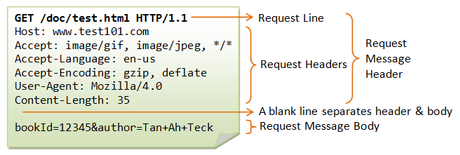
HTTP Request/Response
Notes:
Header contains: content type, length, authentication, session information

Slide 13
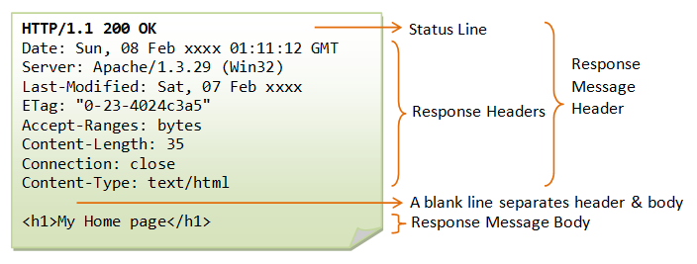
HTTP Request/Response
Notes:
Header contains: content type, length, authentication, session information

Slide 14
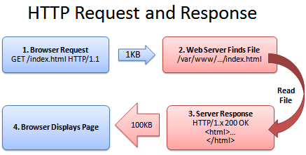
HTTP Request/Response
Notes:
Header contains: content type, length, authentication, session information

Slide 15
XML or JSON
Extensible Markup Language
http://www.freeformatter.com/xml-formatter.html
<user>
<first>Paul</first>
<last>Cordero</last>
<company>Truno</company>
<email>pcordero@truno.com</email>
<phone>1.800.657.7108</phone>
<project>
<name>Architecture</name>
</project>
<project>
<name>Forecasting</name>
</project>
</user>
Javascript Object Notation
http://jsonlint.com/
{
"first": "Paul",
"last": "Cordero",
"company": "Truno",
"email": "pcordero@truno.com",
"phone": "1.800.657.7108",
"project": [
{
"name": "Architecture"
},
{
"name": "Forecasting"
}
]
}

Slide 16
Resource Best Practices
1-1 relationship between resource and URI
Use plural nouns when naming resources
URI should not say anything about the action / operation
Avoid verbs when naming resources
http://api.example.com/FetchUser/3
http://api.example.com/DeleteUser/1
HTTP Methods determine the action / operation
http://api.example.com/User/3 GET
http://api.example.com/User/1 DELETE
Resources objects can contain links to other resources
Notes:
Services layer should also be 1-1 with the resource
Repository layer can be 1-1 with the resource or use case based

Slide 17


Browser Tools
POSTMAN
https://www.getpostman.com/
Local application install
Chrome extension
Used to call APIs
Fiddler
https://www.telerik.com/download/fiddler
Local application install
Used to debug APIs

Slide 18
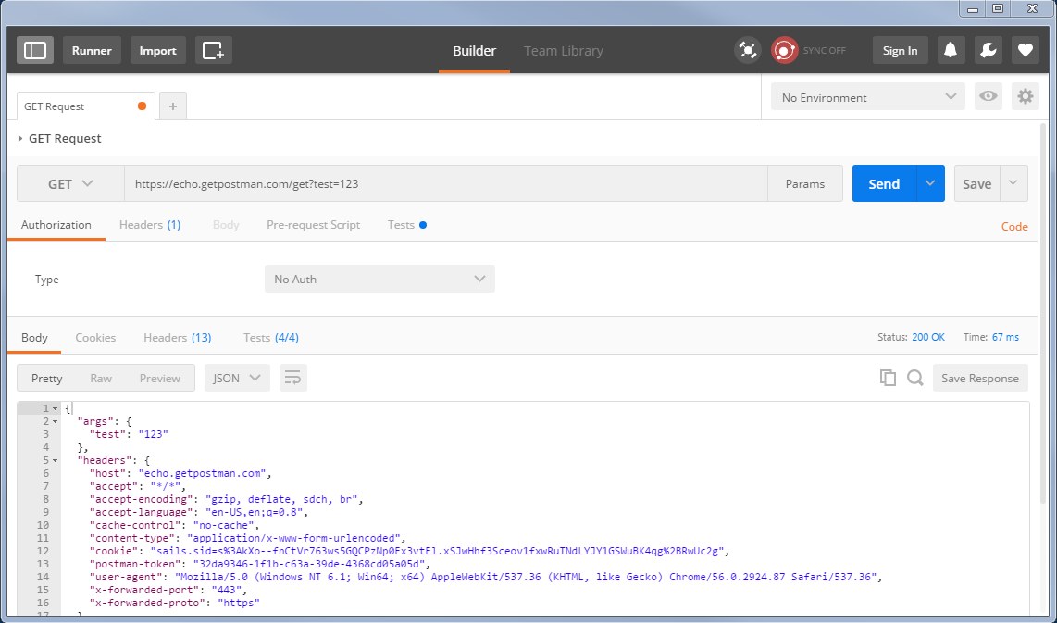
Browser Tools - Postman

Slide 19
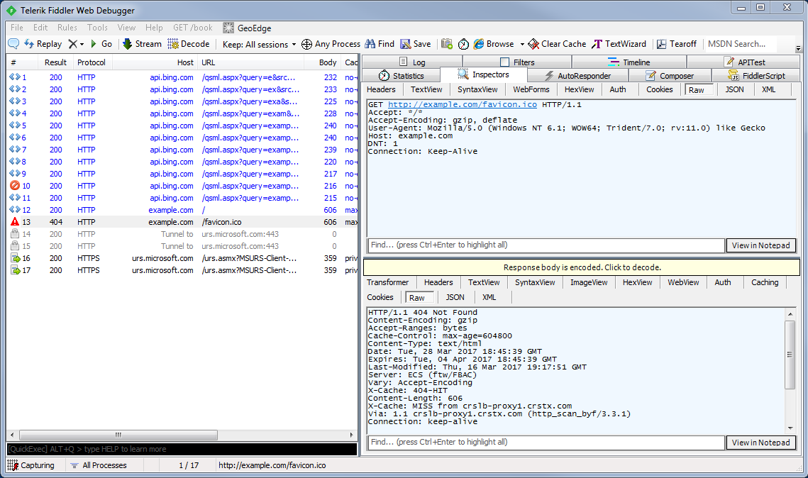
Browser Tools - Fiddler

Slide 20
Example
RESTExample local project
.Net, C#, WEB API
Will be checked into the GitHub repo
User APIs

Slide 21
Documentation
REST APIs should be documented prior to release
Manually document the following for each API:
URL
Methods
URL Parameters (Required/optional)
Data Parameters (PUT/POST/PATCH)
Success Response (Code and Data Object)
Error Response (Code and Data Object)
Example Calling Code
Use a tool
http://swagger.io/

Slide 22
Resources
https://en.wikipedia.org/wiki/Representational_state_transfer
https://www.ntu.edu.sg/home/ehchua/programming/webprogramming/HTTP_Basics.html
http://www.drdobbs.com/web-development/restful-web-services-a-tutorial/240169069
https://www.getpostman.com/
https://www.telerik.com/download/fiddler/
http://swagger.io/

