Slide 1
Introduction to
SQL and SQLite

Slide 2
About us
People who sat behind those same desks
Computer Systems Business Analyst
Yash - Bachelor in Mechanical Engineering, Masters in MIS - TTU
Jainam - Bachelor in Electronics and Telecommunication, Master in MIS - TTU
Now working on Data analysis, Reporting and System administration at TRUNO
Tools R, YellowFin, PSQL, UNIX Bash scripting, SALT (NOT taught in class!)

Slide 3
Topics
Database basics
What are objects, attributes, and relationship
What is a table, database and schema?
SQL basics
What is SQL, query, standards, uses?
Need to learn SQL, and where it is used?
SQLite basics
Need of SQLite and applications
Installing and setup SQLite
Accessing SQlite - DB browser for SQlite

Slide 4
Structured Query Language
We use SQL to communicate with database
It is the standard language for relational database management systems
Some common relational database management systems that use SQL are: Oracle, Sybase, Microsoft SQL Server, Access, SQLite etc
Standard SQL commands such as "Select", "Insert", "Update", "Delete", "Create", and "Drop" can be used to across all RDBMS
It is the world's most widely used database language, developed in the mid-1970s by Chamberlin and Raymond Boyce.
SQL itself is not a programming language, but its standard allows creating procedural extensions for it, which extend it to functionality of a mature programming language.
SQL is considered a fourth-generation language (4GL), whereas Java and C++ are third-generation languages (3GLs).
Notes:
Fourth-generation languages are programming languages that are closer to human language than high-level languages like Java. These 4GLs are often used to access databases, such as SQL, where humanlike syntax is used to retrieve and manipulate data.

Slide 5
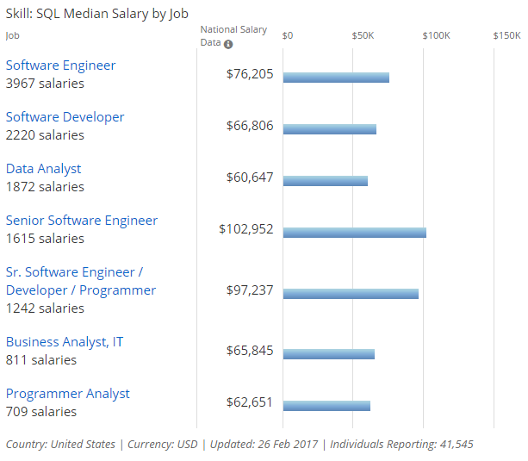
Notes:
Business Insider : 9 tech skills that pay over $120,000 and are in demand. 8th Skill is SQL !

Slide 6








SQLite
SQLite is an in-process library that implements a self-contained, serverless, zero-configuration, transactional SQL database engine
SQLite is public domain and is thus free for use for any purpose, commercial or private
SQLite is used to improve application speed by having database on client side e.g. Apple, Android, Adobe lite
It is also used to store logs, error, state and multimedia files client side e.g. DropBox, Airbus, GM, Nissan
Facebook uses SQLite as the SQL database engine in their osquery product
Expensify uses SQLite as a server-side database engine for their enterprise-scale expense reporting software
Notes:
SQLite is also used in iTunes, even on non-Apple hardware.
Bosch uses SQLite in the multimedia systems install on GM, Nissan, and Suzuki automobiles.
Airbus confirms that SQLite is being used in the flight software for the A350 XWB family of aircraft.
Dropbox file archiving and synchronization service is reported to use SQLite as the primary data store on the client side.
Expensify uses SQLite as a server-side database engine for their enterprise-scale expense reporting software.
Facebook uses SQLite as the SQL database engine in their osquery product.
Presumably GE is using SQLite in something that they are exporting.
Intuit apparently uses SQLite in QuickBooks and in TurboTax to judge from some error reports from users seen here and here.

Slide 7
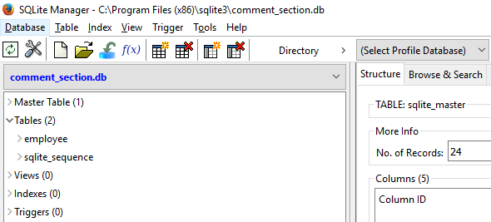

Installing SQLite
A database in SQLite is a single disk file, we can use SQLite browsers to view this file.
The browser we will be trying in SQLite studio - Windows, Mac and UNIX
For Mac - System Preferences > Security & Privacy > General > Allow apps - Anywhere
You can also access SQLite database file from browser
Chrome : SQLite Viewer with Google Drive
FireFox : SQLite Manager
You can also access SQLite database file from command line CLI
To access SQLite from command line - change directory where sqlite3.exe is installed
Notes:
https://sqlitestudio.pl/index.rvt?act=download
https://www.sqlite.org/download.html
sqlite-tools-win32-x86-3170000.zip

Slide 8
SQLite3 commands
cd C:\Program Files (x86)\sqlite3\sqlite3.exe
.quit .databases .tables .show
CREATE TABLE
INSERT INTO
UPDATE
DELETE FROM
Use tool sqldiff.exe comment_section.db comment_section1.db --schema
Backup your database - .backup backup_file.sq3
Another way - sqlite3 sample.db .dump > sample.bak
SQLite replication - http://litereplica.io/
Use CASE - SELECT CASE WHEN 1=2 THEN ‘FALSE’ ELSE ‘TRUE’;
Notes:
CREATE TABLE employee(post_id INTEGER NOT NULL PRIMARY KEY AUTOINCREMENT, name TEXT NOT NULL, email TEXT NOT NULL, website_url TEXT NULL, comment TEXT NOT NULL );
INSERT INTO employee ( name, email, website_url, comment ) VALUES ( 'Shivam Mamgain', 'xyz@gmail.com','shivammg.blogspot.com', 'Great tutorial for beginners.' );
SELECT * FROM employee;
UPDATE employee SET email = 'zyx@email.com' WHERE name = 'Shivam Mamgain';
DELETE FROM employee WHERE post_id = 9;

Slide 9
Reference and Citation
SQLite3 Introduction - https://www.sqlite.org/about.html
What is SQL - http://www.sqlcourse.com/intro.html
SQLite - https://www.sqlite.org/
SQL Job - http://www.payscale.com
Business Insider - http://www.businessinsider.com/

