Slide 1
SQL Part II

Slide 2
What we learnt so far
What is a Database
What are objects, attributes, relationships and schema
How to install and run SQLite
CREATE, INSERT, SELECT, CASE, COUNT, FROM, WHERE, DELETE

Slide 3
Moving forward...
We will talk about Data types, Keys, Joins, etc.
Let’s install PostgreSQL - most widely used open source enterprise DB
https://www.postgresql.org/
Grab a sample database to work with
http://www.postgresqltutorial.com/postgresql-sample-database/

Slide 4
Data Types
Computer doesn’t understand the difference between 12, 12.0, abcd
Data types are crucial in any programming language including SQL
Some of the basic data types for everyday use are:
Int - Integer
Numeric (Float) - Decimal
Char - Textual data
VarChar - Textual as well as numeric data
Timestamp - Date and time combined
https://www.w3schools.com/sql/sql_datatypes.asp
https://www.postgresql.org/docs/current/static/datatype.html

Slide 5
Keys
Two important key types
- Primary Key
- Foreign Key
Primary Key: Unique value which acts an identifier for each row in a table
Mostly a numeric ID
Cannot be null
Address (address_id, address_line1, address_line2, city, state)
Foreign Key: Refers to the primary key for a different table
Cannot be null
Customer (customer_id, first_name, last_name, address_id)

Slide 6
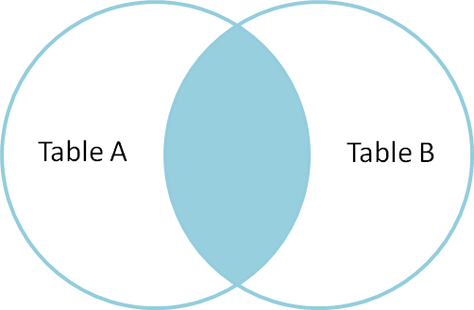
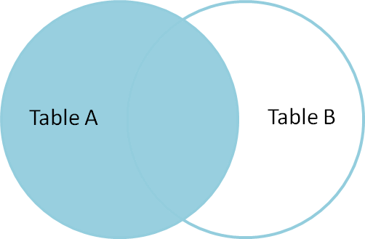
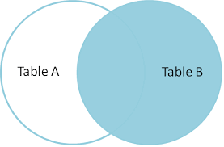
JOINS
INNER JOIN: Joins two tables on common values and retrieves common results between the two tables.
LEFT OUTER JOIN: Joins two tables on common values and retrieves ALL results from left table and matching results from the other table.
RIGHT OUTER JOIN: Joins two tables on common values and retrieves ALL results from right table and matching results from the other table.

Slide 7
GROUP BY / HAVING
SQL allows several aggregation functions such as SUM, AVG, MAX, MIN, COUNT
https://www.postgresql.org/docs/current/static/functions-aggregate.html
Aggregation is achieved by grouping other columns.
Columns present in the SELECT list NEED to go in the GROUP BY for aggregation.
Columns which are not present in the SELECT can still be included in the GROUP BY
WHERE clause lets us specify conditions. HAVING clause lets us specify conditions on the aggregated columns unlike WHERE clause.

Slide 8
PostgreSQL backup
There are three fundamentally different approaches to backing up PostgreSQL data
SQL dump
File system level backup
Continuous archiving
Link to PostgreSQL GUI tools - http://wiki.postgresql.org/

Slide 9
SQL dump
pg_dump is also the only method that will work when transferring a database to a different machine architecture, such as going from a 32-bit to a 64-bit server.
Advantage of SQL dump is, generally be re-loaded into newer versions of PostgreSQL, whereas file-level backups and continuous archiving are both extremely server-version-specific.
Another advantage is pg_dump does not block other operations on the database while it is working.
For large database you compress the dump or split in smaller file size
pg_dump dbname > outfile
psql dbname < infile
pg_dump -h host1 dbname | psql -h host2 dbname
pg_dump dbname | gzip > filename.gz VS gunzip -c filename.gz | psql dbname
pg_dump dbname | split -b 1m - filename VS cat filename* | psql dbname

Slide 10
File System level backup
An alternative backup strategy is to directly copy the files that PostgreSQL uses to store the data in the database
Two disadvantage of this method
The database server must be shut down in order to get a usable backup. Half-way measures such as disallowing all connections will not work
You cannot backup individual tables or databases from their respective files or directories.
Note that a file system backup will typically be larger than an SQL dump.
pg_dump does not need to dump the contents of indexes for example, just the commands to recreate them.
However, taking a file system backup might be faster.
tar -cf backup.tar /usr/local/pgsql/data

Slide 11
Continuous Archiving
At all times, PostgreSQL maintains a write ahead log (WAL) in the pg_xlog/ subdirectory of the cluster's data directory.
The log records every change made to the database's data files.
This log exists primarily for crash-safety purposes: if the system crashes, the database can be restored to consistency by "replaying" the log entries made since the last checkpoint.
Advantages
We do not need a perfectly consistent file system backup as the starting point. Any internal inconsistency in the backup will be corrected by log replay
Continuous backup can be achieved simply by continuing to archive the WAL files. This is particularly valuable for large databases, where it might not be convenient to take a full backup frequently.
It is possible to restore the database to its state at any time since your base backup was taken.
If we continuously feed the series of WAL files to another machine that has been loaded with the same base backup file, we have a warm standby system: at any point we can bring up the second machine and it will have a nearly-current copy of the database.

Slide 12
Reference and Citation
PostgreSQL backup - https://www.postgresql.org/docs/9.1/static/backup.html
Sample PostgreSQL DB - http://www.postgresqltutorial.com/postgresql-sample-database/
PostgreSQL website - http://www.postgresqltutorial.com/postgresql-sample-database/

