Slide 1
What College Doesn’t Teach You
(And How to learn even more)

Slide 2
Who Am I?
Practically, nobody
Manage software teams on 3 continents
Owned 4 software companies
Sit on the CS Academy Board
IE, help influence curriculum across the CS and engineering department
Grown / managed companies from $0 to $65M / ARR
Note that makes me ALMOST a unicorn in the software space

Slide 3
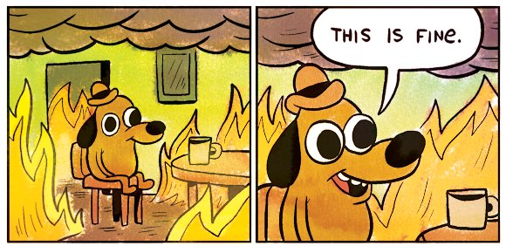
Purpose of the Class
Things TTU doesn’t teach
The difference between higher ed and vocation
The missing link
Mentors / Apprenticeships
Who can come to the class?
Is it accredited? Is it useful?

Slide 4
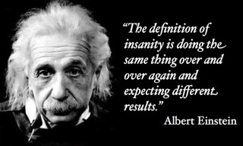
Discussion of What We’re Doing
Group learning
Taught by industry experts
Folks who know “stuff”
Wide range of IT exposure
Go home and study, just like a normal class
This is a class for “meat eaters”

Slide 5

Introductions
Go ahead, introduce yourselves.
What’s your name?
What’s your major?
Why are you here?

Slide 6

Software Tools We’ll Use
Microsoft Excel
SQLite
PostgreSQL
R / RStudio
Visual Studio / C#
SaltStack
GitHub
StackExchange
CodeFights

Slide 7

Modern Skillsets
What’s the number one thing that TTU is teaching you?
How do you learn best?
What else do you need to learn?
How do you get a job? An internship?
What’s the purpose of an internship?

Slide 8

Web Survey Break
https://www.surveymonkey.com/r/DGD32JY
Or
goo.gl/paxGQx
How to reach me:
Anthony@TimeForge.com
https://www.linkedin.com/in/apresley/
@AntonePresley

Slide 9
Class Schedule, Slide 1
Week 1
- 2/28: Kick Off Meeting, Discussion of the Program, Goals, Modern Skillsets, What we'll be using in the class (Anthony)
Week 2
- 3/7: Using SQLite - Download and install, set up, access, SQL insertion, backups, tools, and resources (Yash / Jainam)
- 3/9: Download and use PostgreSQL - Download, install, set up, access, SQL insertion, backups, tools, and resources (Yash / Jainam)
[SPRING BREAK]

Slide 10
Class Schedule, Slide 2
Week 3
- 3/21: MVP Development, Target Audience Identification, Finding a Mentor, Failing Fast (Kimberly Gramm)
- 3/23: Code Academy 101, What you can do in 10 weeks of dedicated learning (Charles @ CodeIversity)
Week 4
- 3/28: Web Services, Grails and .NET (Dunno)
- 3/30: Web Services, Grails and .NET (Dunno)
Week 5
- 4/1: Crunching Data in Excel Quickly (Trent)
- 4/6: Crunching Data in Excel Quickly (Trent)

Slide 11
Class Schedule, Slide 3
Week 6
- 4/11: Mobile Apps / AngularJS / Ionic (Bobby)
- 4/13: Mobile Apps / AngularJS / Ionic (Bobby)
Week 7
- 4/18: Machine Learning / Visualization (Jainam / Deepti)
- 4/20: Machine Learning / Visualization (Jainam / Deepti)
Week 8
- 4/25: DevOps and SaltStack, Making Things Repeatable (Erik / Yash)
- 4/27: DevOps and SaltStack, Making Things Repeatable (Erik / Yash)

Slide 12
Class Schedule, Slide 4
Week 9
- 5/2: Creating Windows Services and Programs Part 1 (Zach)
- 5/4: Prototypes, MVP, Alpha, Beta Code (Todd)
Week 11
- 5/9: Creating Windows Services and Programs Part 2 (Zach)
- 5/11: Wrap Up, Summer Projects, Keep It Going, Next Semester (Anthony)

