Slide 1
DATA SCIENCE/British Airways
Ilhama Novruzova

Slide 2
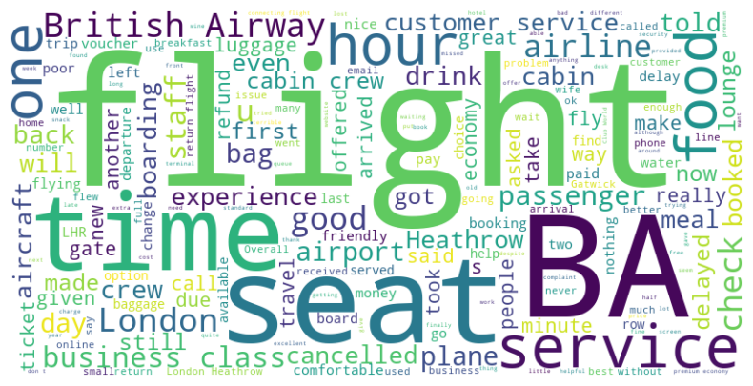
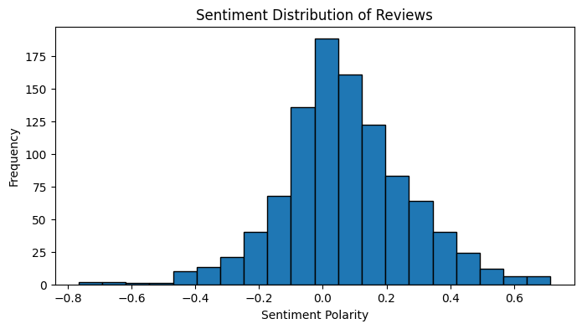
Initial Insights
We can see that the categories of the reviews are flight, time, seat, service, food, and other related domains.
From the negative side, we see problems with canceled flights, delays, and changes. This is mainly about flight and time issues.
From the positive side, factors such as good experience, friendly staff, and great meals have the potential to exist.
0.0 was the most frequent sentiment polarity.
The polarity is more skewed towards negativity; however, in different parts positive frequency height seems to be higher.
Overall, the reviews that the users give are not the best ones, they appear to be neutral which could be a balance of negative and positive views above.

