Slide 1
Depth and Tag Fusion

Slide 2
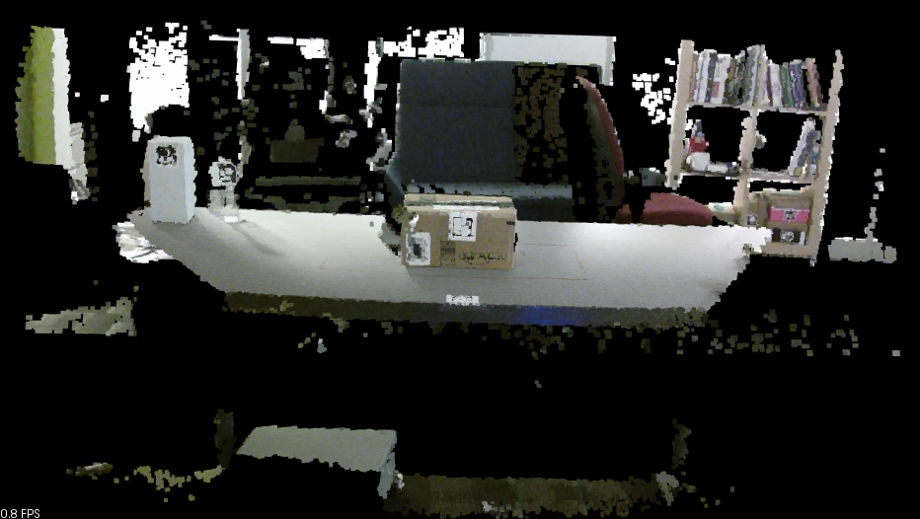
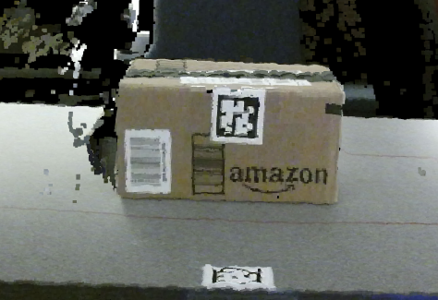

Slide 3
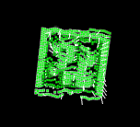
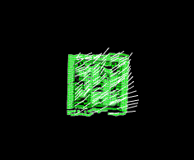
Tag in range image.
In green is the result from plane fitting from RANSAC
Model Coefficients:
0.0109732
-0.524886
0.851102
-0.775971

Slide 4
XYZ of centroid : x: -0.0345814 , y: 0.00127834 , z: 0.917 . XYZ apriltags : x: -0.034327 , y: 0.00194878 , z: 0.922739 .
ori apriltags : x: 0.970942 , y: 0.0229656 , z: -0.0227476 , w: -0.237124 .

