Slide 1
Simulate Kinematics
Forward & Inverse Kinematic in javascript

Slide 2
Kinematics
Motion within, not affected by outside world forces
Motion starts from part of the kinematic object
Motion pass through and bring effects to other part of the kinematic object
Base Point & Free Point
Forward Kinematic
Inverse Kinematic

Slide 3
Forward Kinematics
Motion starts from Base Point
Motion passed to Free Point
Example:
Walk

Slide 4
Inverse Kinematics
Motion starts from Free Point, driven by certain purpose
Base Point is driven by Free Point
Example:
Fetch something with arms
Dragged by something

Slide 5
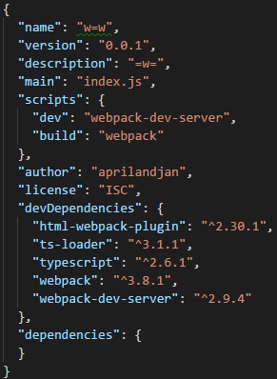
Simulation Enviroment
Canvas in HTML
Vanilla Javascript (Typescript)
Webpack for development and final bundle
No other frameworks or dependencies

Slide 6
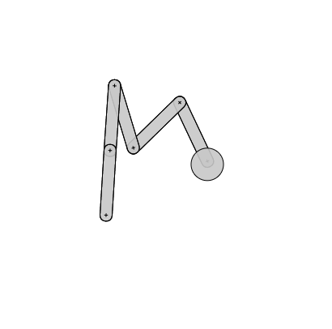
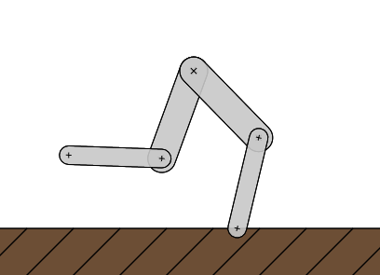
Simulation Target
Walk with legs!
Fetch with arms!

Slide 7
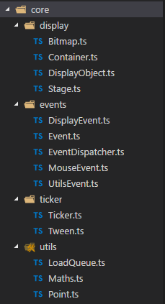
Create A Simple Canvas Framework
Ticker
requestAnimationFrame
register
Display
DisplayObject
Container
Events
Event
EventDispatcher
Stage
unregister

Slide 8
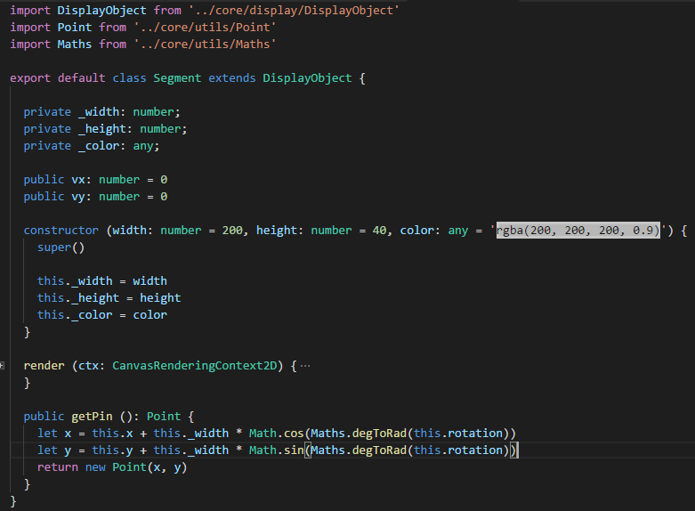
DisplayObject: Segment
Base Point (x, y)
dx = x + Math.cos(r)
Axis X
Rotation (r)
dy = y + w * Math.sin(r)
AxisY
Free Point: Pin Point

Slide 9

Chained Segment
1. Sub segment position is decided by end point of parent segment
2. Parent segment Pass rotation To sub segment

Slide 10
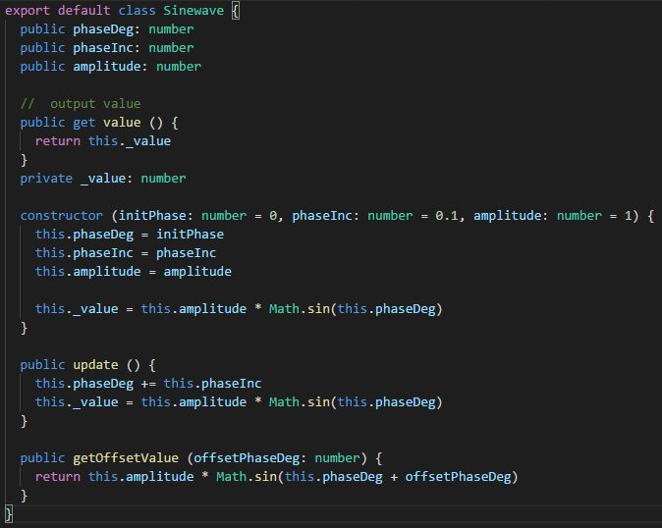
Sinewave
Any numeric value mapped to [-1, 1]
Nature and periodic curve
Can be delayed or advanced via Phase offset
Ease to create with Math.sin(rad)

Slide 11
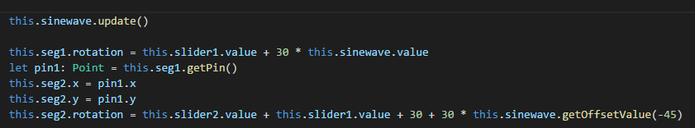
One Leg

Slide 12
Two Legs
Create Another Leg
Sinewave Phase offset = Math.PI / 2

Slide 13
Walk
Space with Gravity
vx, vy, vy += gravity
Step on the Ground and bounce back
If (seg.y > ground.y) then bounce back
Move forward
When on the ground, record the move distance as vx, vy
Stage edge detect
When overcome the stage edge, move to another side of the edge

Slide 14
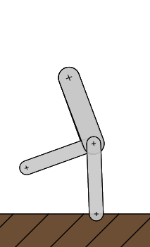
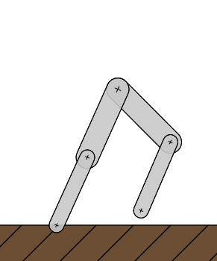
Completed: Walk with legs!
* Chapter 5 in the demo program

Slide 15
Fetch with arms!
* Chapter 6 in the demo program

Slide 16
Thanks for watching!

