Slide 1
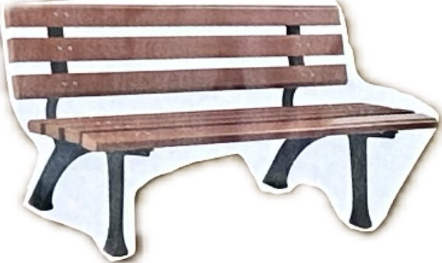
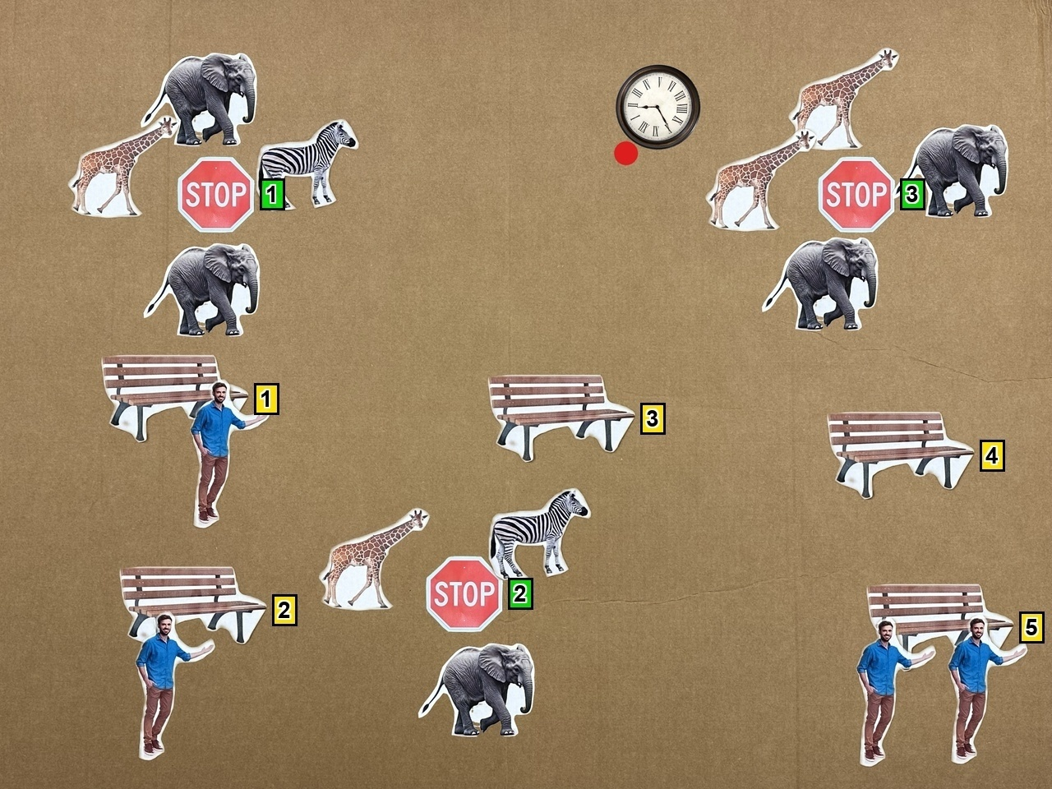
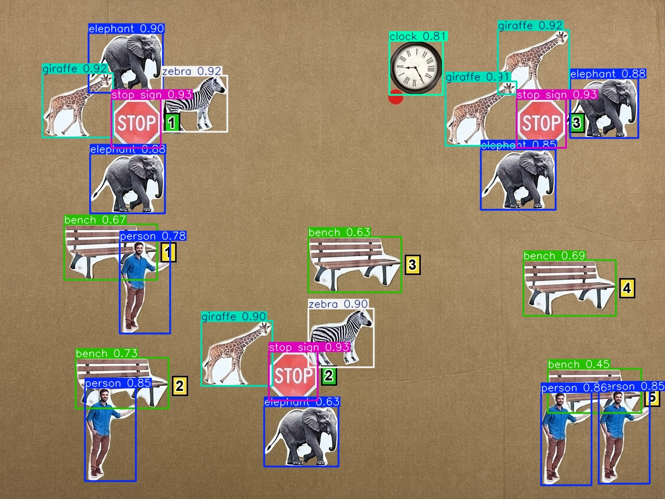
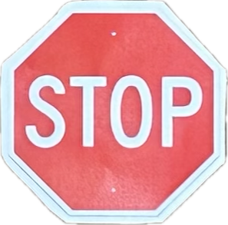
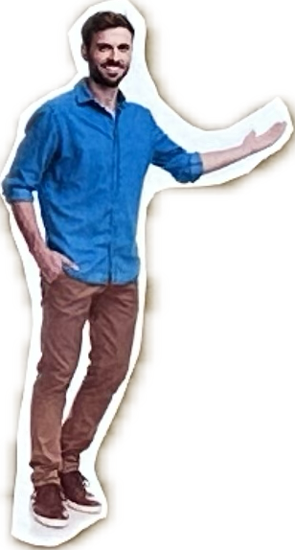
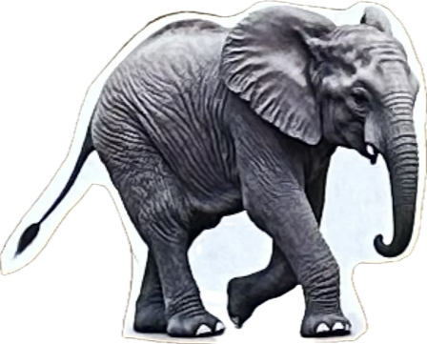
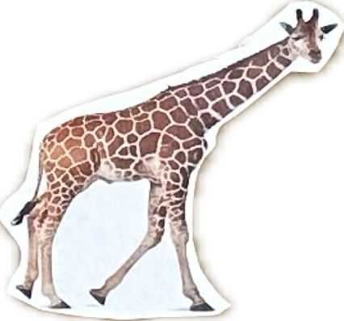
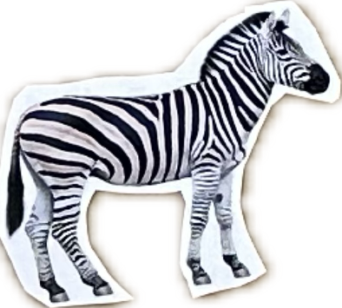
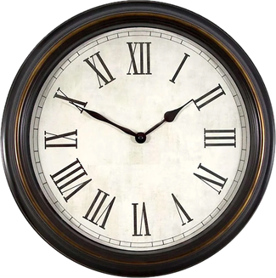
1. Object Library
2. Scene Synthesis
3. Detector-in-the-loop Quality Check
4. GRAID-based QA Generation
5. QA Pairs Output
Benches (3-5)
Objects are placed on a jittered grid with constraints (no heavy overlap, inside canvas, readable IDs, valid free space).
Final JPEG is run through YOLO. All expected objects must be detected with correct counts and good IoU match.
GRAID uses detected boxes and geometric rules to generate QA pairs via templates and predicates.
High-quality, image-grounded question-answer pairs.
...
Q: Which bench is closest to the agent (clock)?
Stop Signs (2-3)
...
A: 3
Closest
People (0-3 per bench)
Q: Which is closer to the agent, stop sign #1 or stop sign #2?
GRAID
Pairwise
...
A: 2
Animals (2-5 per stop sign)
Q: What is the relative direction of stop sign #3 to the agent?
Inputs
• Final image (JPEG)
• YOLO detections
(bounding boxes)
...
...
A: Northeast
Direction
Agent (1)
Q: To face bench #4, should the agent turn left, turn right, or is it already facing it?
• Jittered grid for benches & stop signs
• Animals sampled on circular ring around stop sign
• People sampled on front arc of bench
• Overlap checks, boundary checks, free-space checks
• Clock agent + red heading dot
• Visible ID tags for benches and stop signs
• All benches, stop signs, people, and animals detected
with correct class and count
• IoU-based one-to-one matching with placed objects
• Exactly one clock detected
• Pass -> keep the image
• Fail -> discard the image
GRAID Modules
• Question templates
• Applicability predicates
(SPARQ)
• Geometric decision rules
(2D box geometry)
A: Turn left
Heading
Q: The agent is facing the closest bench and wants to reach it. Should it keep straight, turn left, or turn right?
A: Turn right
Avoidance
Heading indicator (red dot)
⋮

