Slide 1
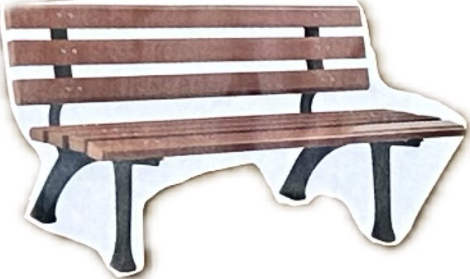
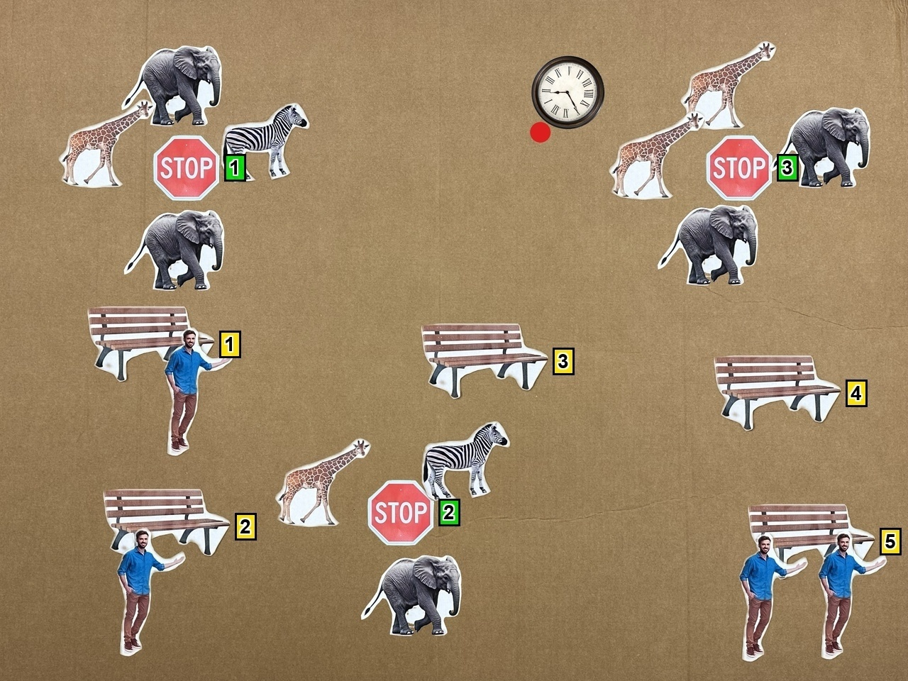
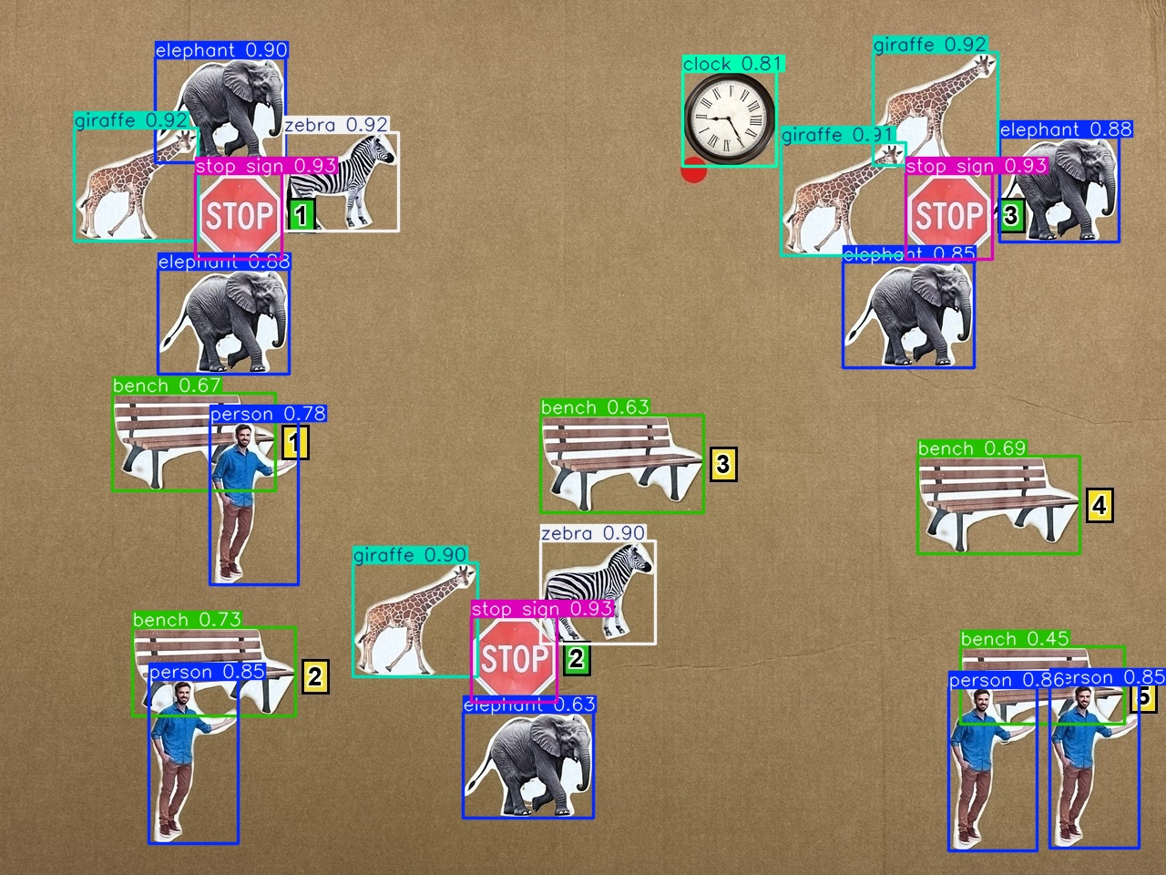



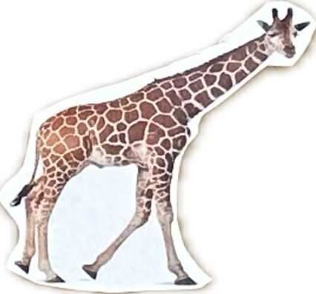
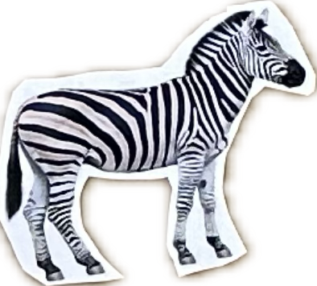
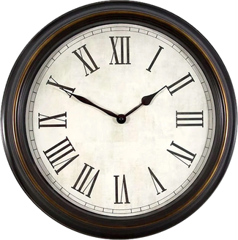
1. Object Library
2. Scene Synthesis
3. Detector-in-the-loop Quality Check
4. GRAID-based QA Generation
5. QA Pairs Output
Benches (3-5)
Constrained scene rendering Jittered layout · overlap checks · ID labels
YOLO validation on final JPEG Correct count · class · IoU match
Image-grounded QA generation Templates · predicates · 2D geometry
Image-grounded QA pairs Short answers Deterministic labels
...
Q: Closest Bench?
Stop Signs (2-3)
A: 3
Closest
...
People (0-3 per bench)
Q: Closer stop sign (1, 2) ?
GRAID
A: 2
Pairwise
...
Animals (2-5 per stop sign)
Q: Direction of stop sign #3 ?
A: Northeast
Direction
...
...
Image-grounded QA
generation
• templates
• geometric rules
• spatial predicates
Agent (1)
Q: Turn direction to bench #4 ?
A: Turn left
Heading
• jittered landmark layout
• overlap and boundary checks
• readable landmark IDs
• valid agent placement
• correct class and count
• IoU consistency
• one valid agent marker
• pass or discard image
Q: Obstacle-aware action?
A: Turn right
Avoidance
Heading indicator (red dot)
⋮

