Slide 1
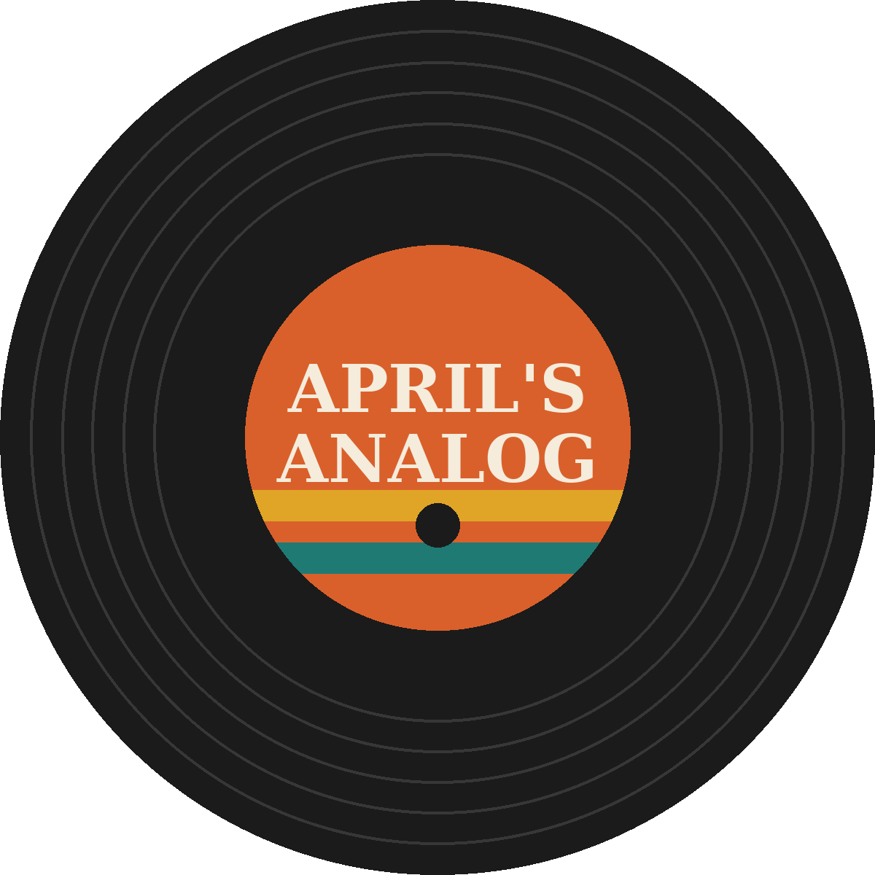
Analog Fest 2025
Recap: 3 nights, 12 bands, 610 fans
Notes:
Recap of last year's festival. Numbers, what worked, what broke.

Slide 2
Attendance: 610 tickets vs. goal of 700
87%
of goal
Sunday was the drag: 115 tickets

Slide 3
Sales: $15,800 in records, $6,200 at the bar

Slide 4
Top sellers
Artist | Title | Units
Needle Drop | Side B Forever (LP) | 48
Tape Hiss Society | Cassette | 40
The Velvet Static | Static Hearts | 31
Midnight Pressing | Graveyard Shift | 27
Honey Hollow | Reissue (180g) | 22

Slide 5
What worked
Label pop-ups in the listening bar. Crate & Needle sold out their table.
32 volunteers, zero no-shows on Friday
The local paper's writeup drove Saturday walk-ups
90 weekend passes, better than expected

Slide 6
What went wrong
PA tripped the breaker twice on Friday (one circuit for everything)
Ran out of wristbands Saturday at 9 pm
25-minute bar line on Saturday with one bartender
Posters arrived 4 days before the fest
Sunday record swap was empty after 2 pm
Saturday headliner ran 20 minutes over, noise complaint at 11:15

Slide 7
Fixes for 2026
Two dedicated 20-amp circuits: PA and backline
Second bartender Friday and Saturday
Order posters 4 weeks out, wristbands +20%
Rethink the Sunday swap slot
Hard stop at 11:00 pm, stage manager owns the clock

Slide 8
Thank you
Every band, especially Needle Drop for playing through the power cut
Marcus for running merch solo on Sunday, Dee for stage wrangling
Maya and the volunteer crew
Rick at Loud & Clear Audio and Hops & Grooves Brewing

