Slide 1
HUSGRUPPEN FINAL PRESENTATION
Cost Estimation Project
Group: mlproject
Machine Learning TMLS22

Slide 2
Problem statement
Currently, the company relies on a manual process to calculate cost estimates for customers. This process is not only time-consuming but also prone to human error and inconsistencies.
To enhance efficiency and customer experience, we want to implement an AI-driven solution that automates the cost estimation process by asking customers input parameters such as wall area, roof area, location, etc.

Slide 3
OUR INVESTIGATION Approach
Data Understanding and Preparation
- Examine the dataset and analyse the distribution of key features
-Identify important feature and assess multicollinearity between features
2. Data Augmentation
- Apply noise addition techniques to synthetic data points
-Ensure augmented data maintains the original feature distribution and validate augmented data
3. Model Exploration
- Train a baseline linear regression model and apply feature normalisation
-Explore model such as linear regression, SVM, XGB and MLP
5. Result
-Construction of equation using the best model to estimate construction cost
4. Model Evaluation
-Use MAE and R Squared to assess overall model fit
-Apply k-fold cross-validation to ensure model generalisability

Slide 4
Evaluation Procedure
Noisy data-augmentation on train set
Cross-Validation of 10 partitions
Model Evaluation & Final Pipeline
Repeated 10-Fold Cross-Validation Process:
Repeat the following process 10 times:
Select partition J as the test dataset and keep it hidden from the models.
Use all other partitions (except J) as the training dataset.
For each model [Linear Regression, Multilayer Perceptron, GBM, SVM]:
Train the model using the training dataset.
Predict values for the unseen test dataset (J).
Collect predictions and compare them against the actual values.
Calculate MAE for all predicted data across all models.
Balance performance and complexity to select the best approach.
Choose the winning model based on evaluation metrics.
Extract model parameters.
Use the results to explain to the company how the problem can be solved and applied.
RAW DATA (1)
RAW DATA (3)
RAW DATA (2)
RAW DATA (4)
PRE-PROCESSED
Split
Iterating
RAW DATA (5)
RAW DATA (6)
RAW DATA (7)
RAW DATA (8)
RAW DATA (9)
RAW DATA (10)
* 2-3 samples by partition
Goal: Ensure the model is suitable for the problem, measure expected performance, and evaluate its ability to generalize to new data.

Slide 5
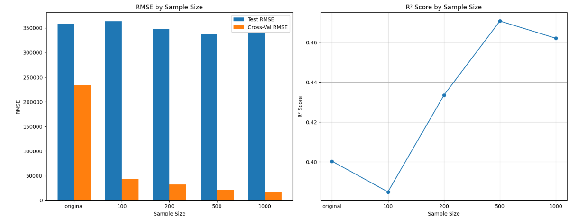
Result: Data Augmentation
Noisy data-augmentation on train set

Slide 6
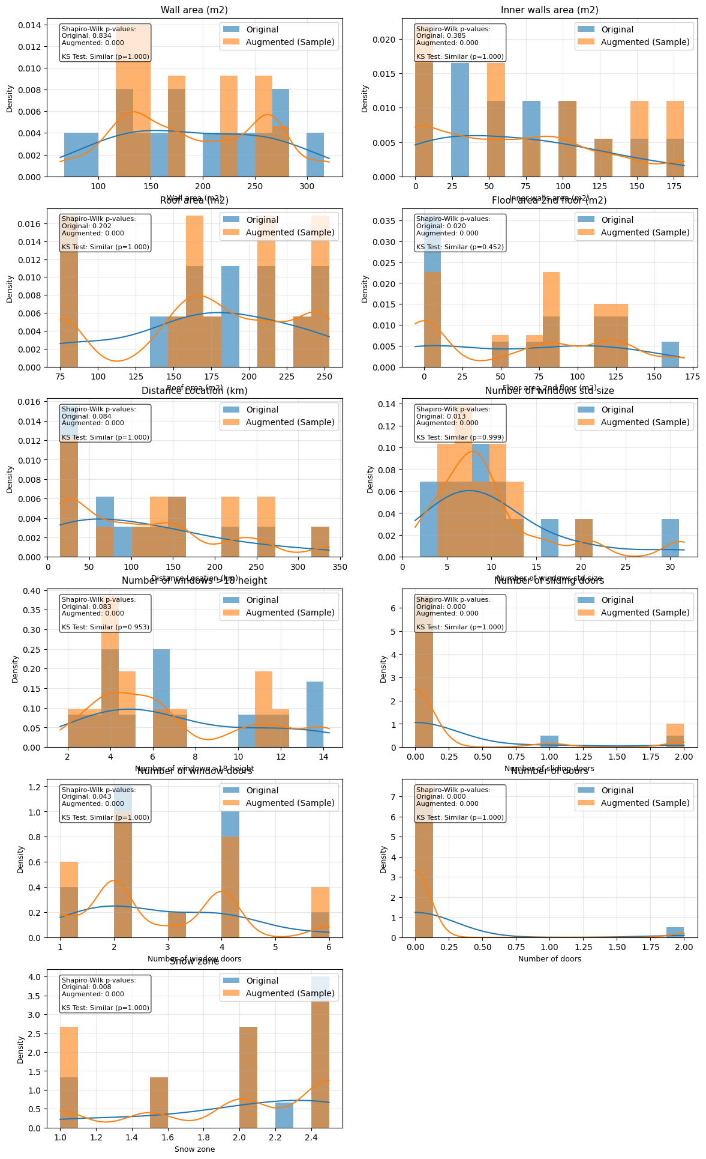
Result: Data Augmentation
Noisy data-augmentation on train set

Slide 7
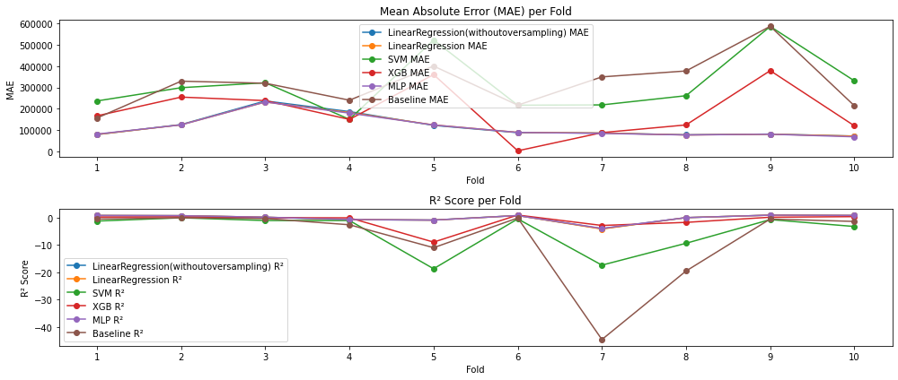
Result: Model selection

Slide 8
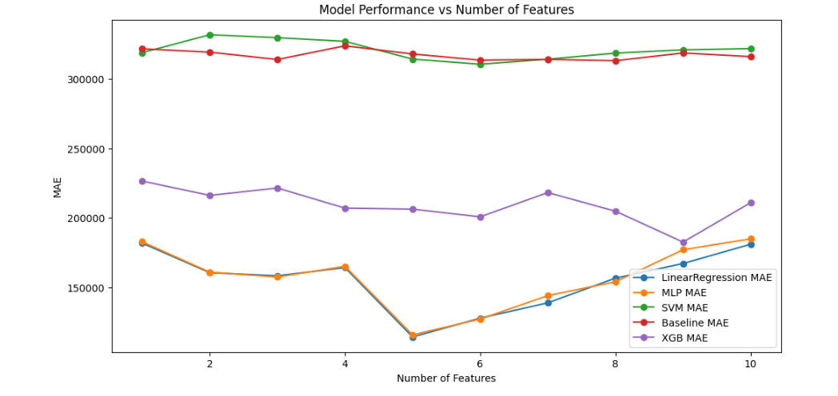
Optimal number of features
Top 5 Features
Wall area
Number Windows > 18
Number Sliding doors
Number Doors
Snow zone

Slide 9
Result: model selection
Metric | SVM | Baseline | MLP | LinearRegression(withoutoversampling) | LinearRegression | XGB
mae | 310,341.87 SEK | 312,418.18 SEK | 112,948.08 SEK | 114,233.90 SEK | 113,457.90 SEK | 190,477.79 SEK
r2 | -0.213698 | -0.072515 | 0.837154 | 0.83601 | 0.836306 | 0.481758

Slide 10
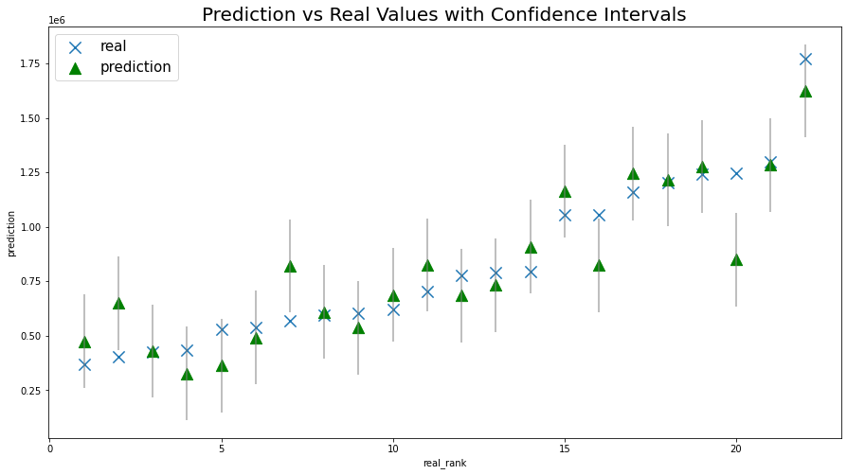
Result: final model performance

Slide 11
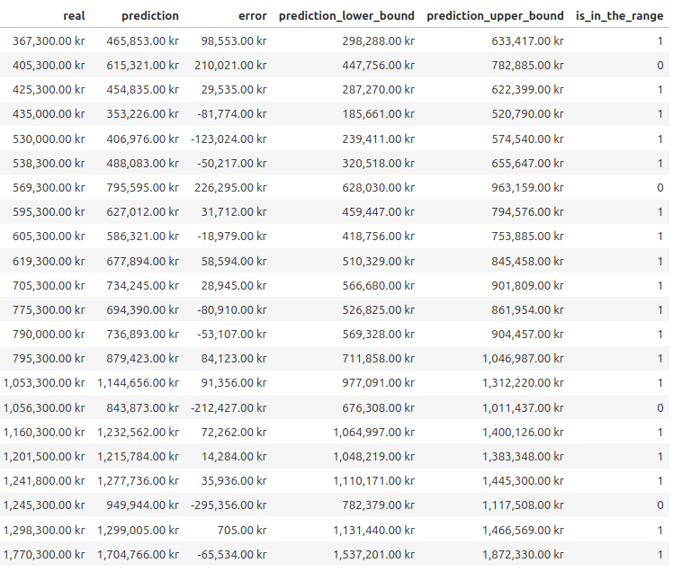
Result: final model performance

Slide 12
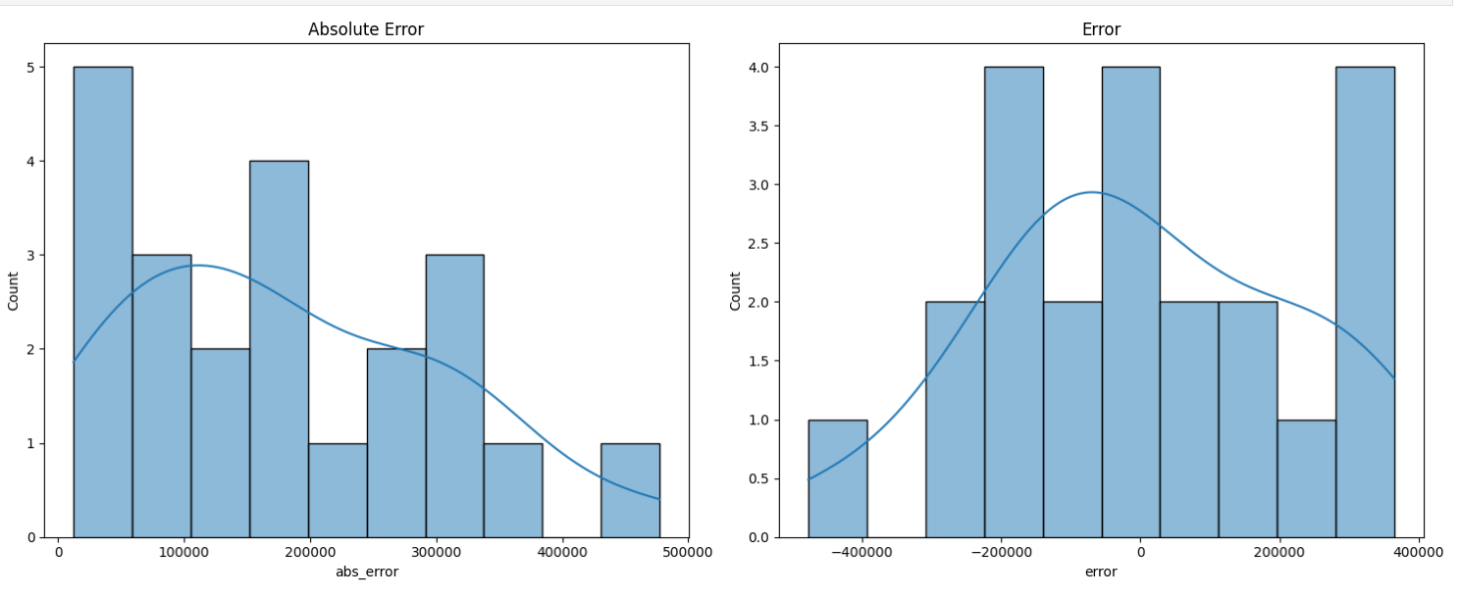
Result: Absolute error

Slide 13
Result
Using a confidence interval extending ±167,565kr, the true value falls within this range 81.82% of the time.​

Slide 14
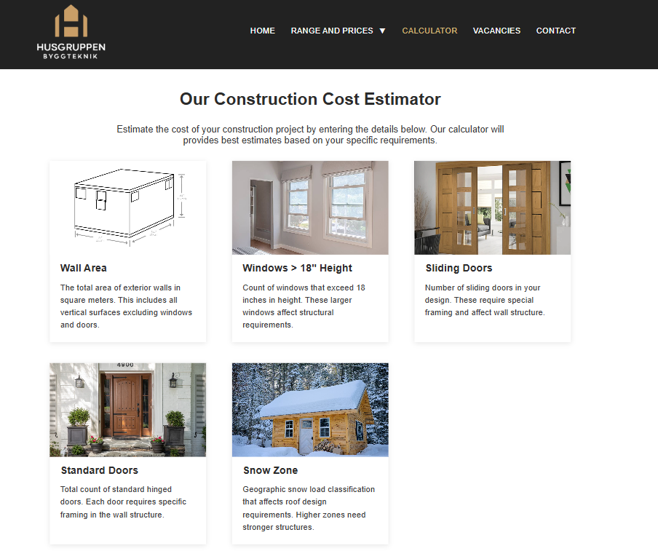
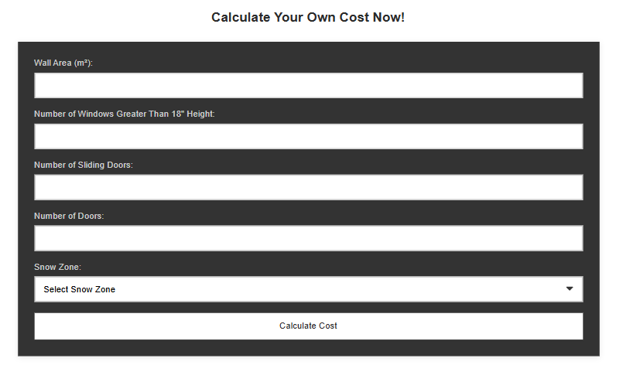
DEMO

Slide 15
REcommendations
TESTING AND VALIDATION
IMPLEMENTATION IN PRODUCTION
IMPROVE WITH MORE DATA
MAINTENANCE
Notes:
Testing and validation: First of all, the model should be tested by your team, by making test quotations and see if it matches our prediction; and possibly adjust the model according to your tests results.
Implementation in production: if you think the results are good enough, the model can be implemented, also very easy to implement in a web page, and as shown, its very fast and easy to use.
Improve with data: The more data we have, the more precise the model will be, so its important to give it as much data as possible to have the best result.
Maintenance: Its also important to update the model with possible prices fluctuation, like material shortage or sales, so that it reflects the reality as much as possible.

