Slide 1


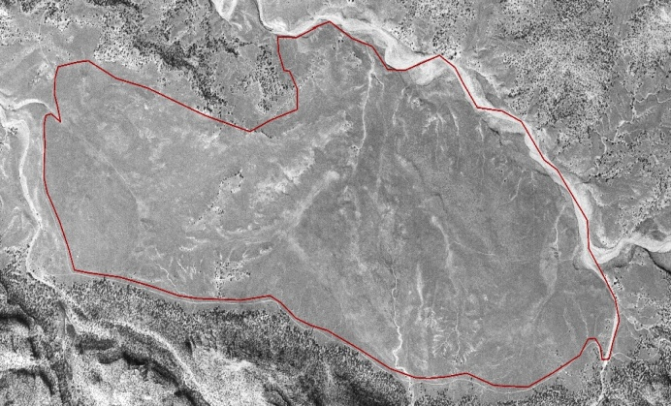
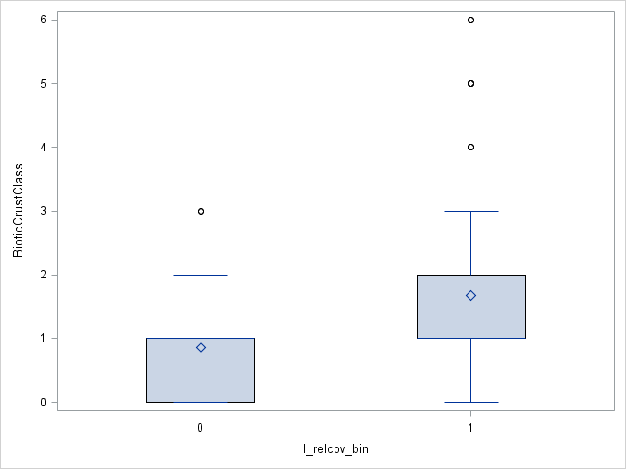
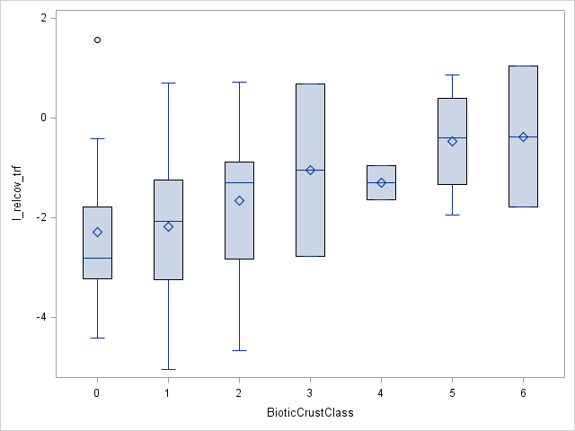
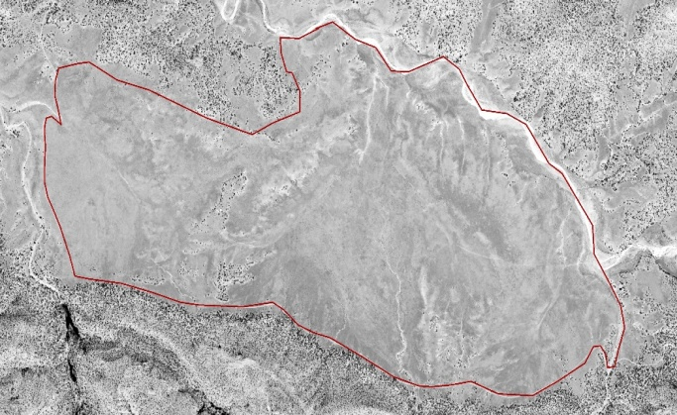
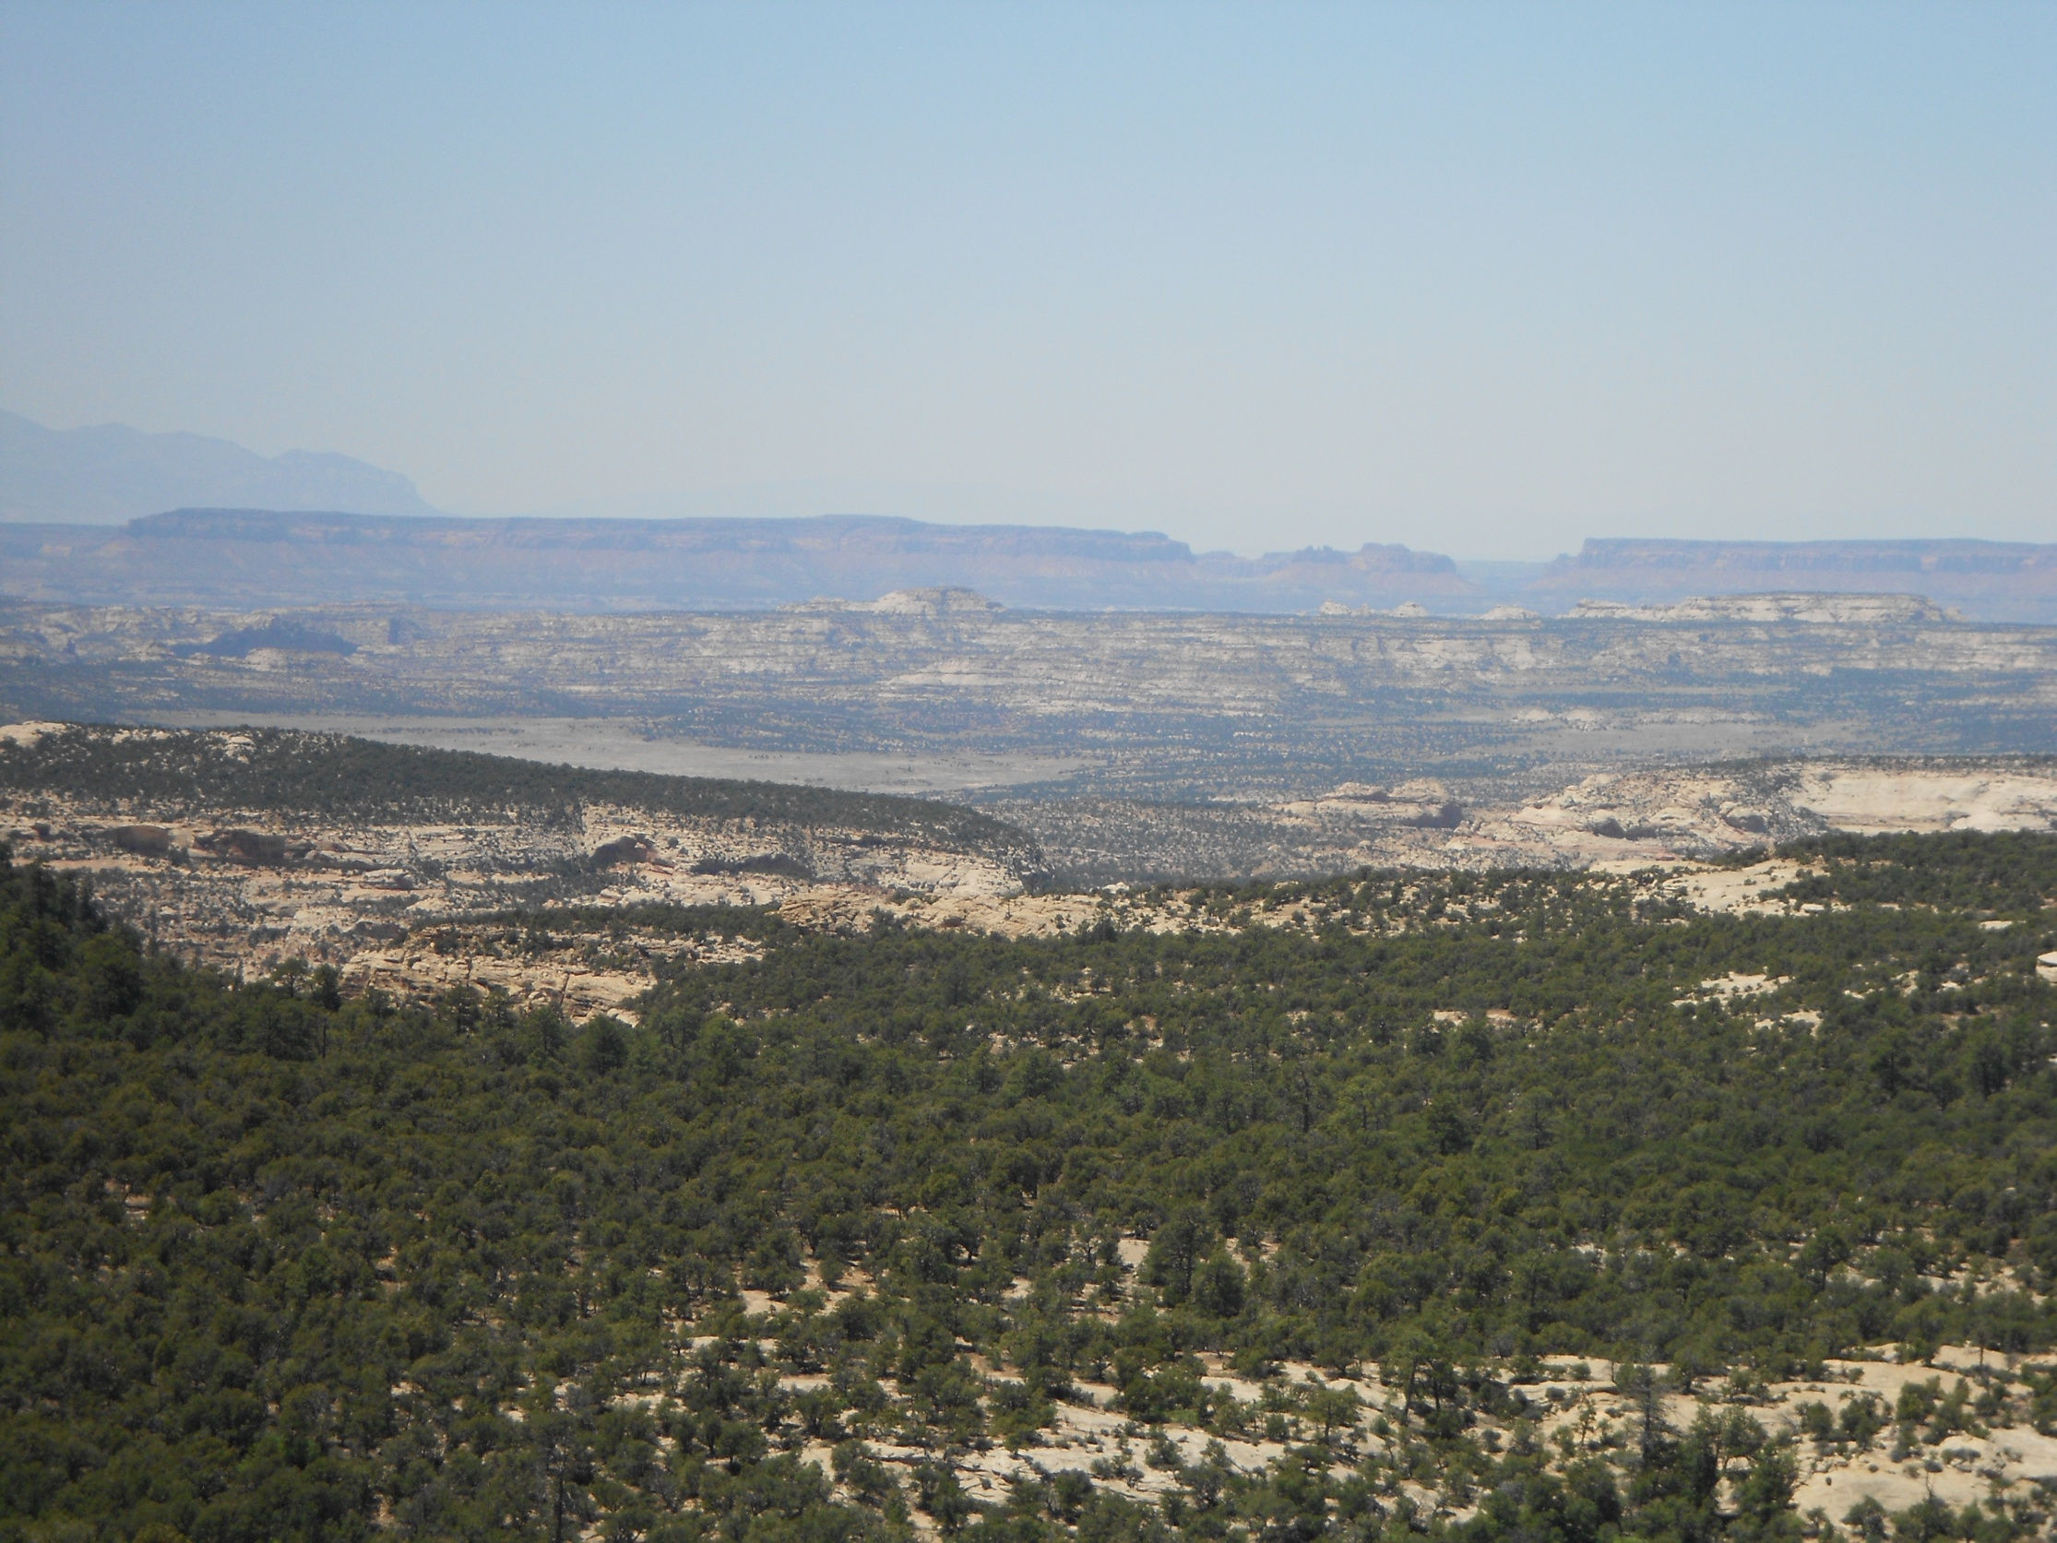
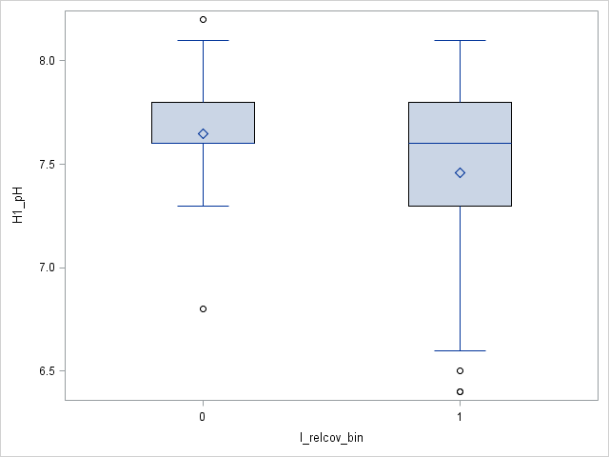
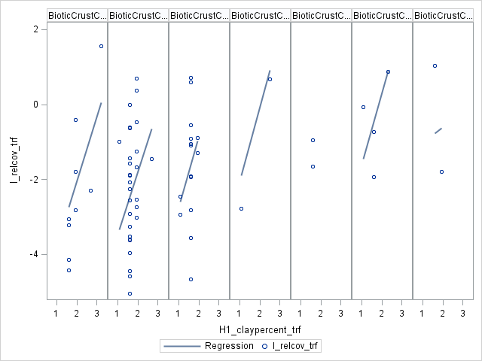
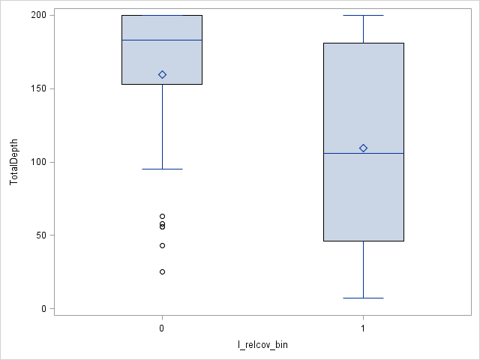

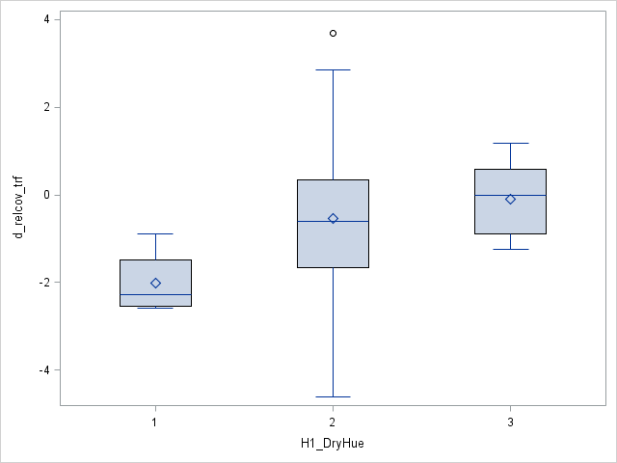
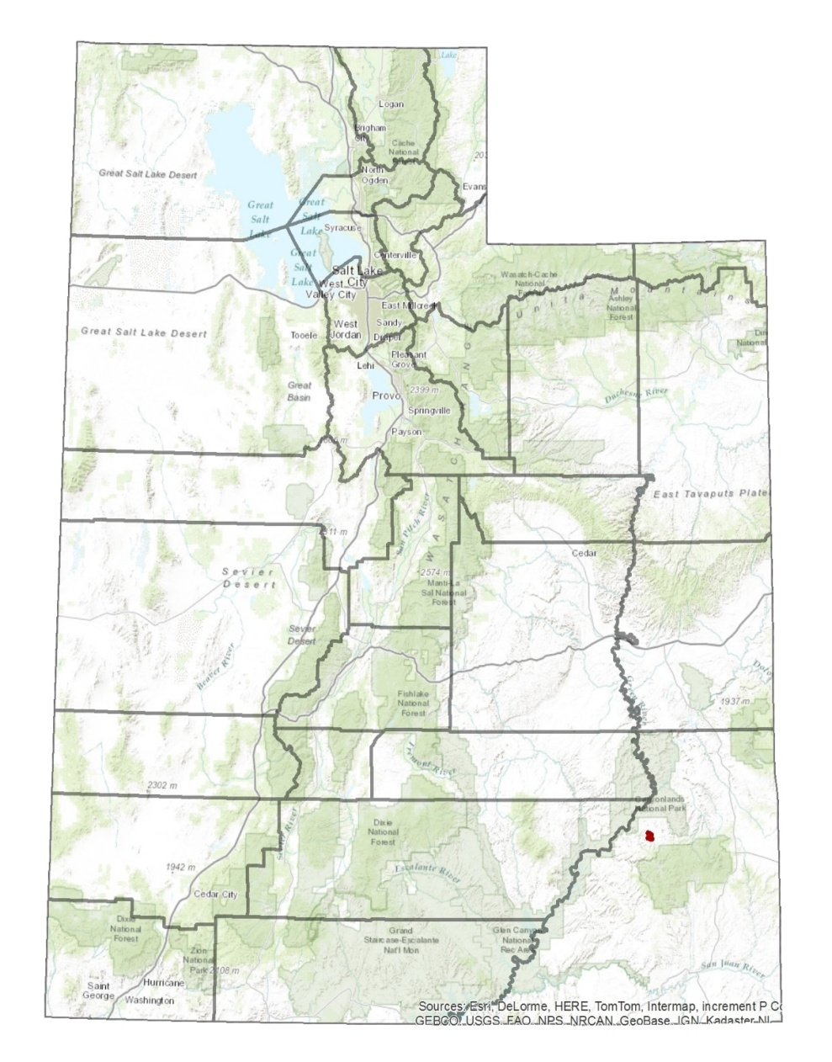
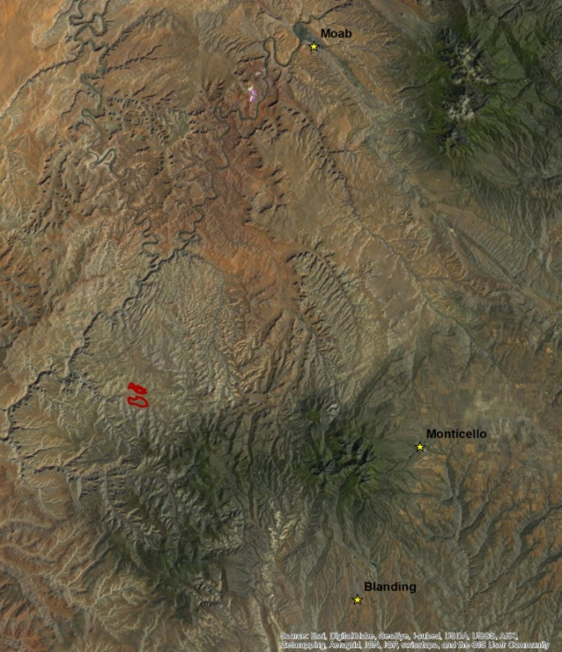
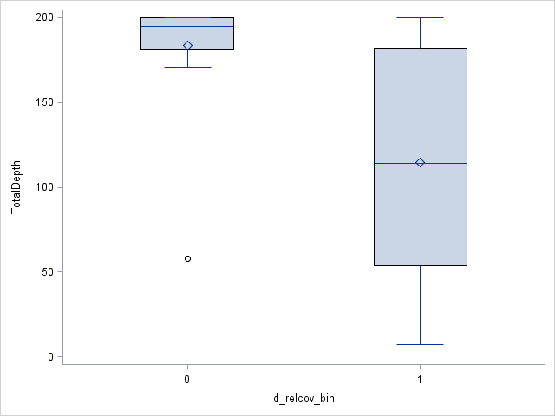
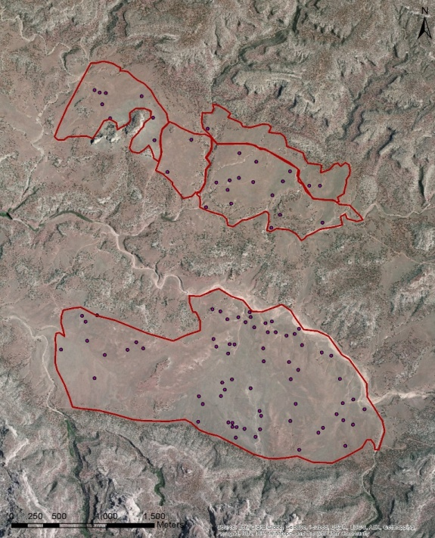
Sagebrush decline on the Colorado Plateau: A look at sagebrush and soils
Eugene Schupp eugene.schupp@usu.edu
April Darger april.darger@aggiemail.usu.edu
Introduction
Methods
A Look Through Time
Sagebrush ecosystems once covered approximately 150 million acres. Now overgrazing, fire suppression, invasive species, fragmentation, and a variety of other threats degrade this iconic ecosystem and regionally imperil over 350 species of associated plants and animals.
Growing concern for this problem has led to studies on the dynamics of sagebrush ecosystems and their obligate species, as well as the development of programs such as SageSTEP, and nonprofit organizations like Saving the Sagebrush Sea.
Much of this restoration attention is focused in the Great Basin, but very little is known about how sagebrush responds on the Colorado Plateau which has drier and monsoonal climatic conditions as well as different soils and vegetation.
The logit transformed relative cover of both live and dead sagebrush (Artemisia tridentata) were used in a two stage analysis with soils variables.
The first stage looks at presence/absence of live sagebrush and of dead sagebrush, and identifies significant soil variables.
The second stage takes only the presence occurrences and looks at how the magnitude of relative cover depends on the predictor soils variables.
In the late 1980’s sagebrush in and around Beef Basin began declining rapidly. The first image (top) shows an aerial photograph from 1975. The dark grey areas are shrubs, predominantly sagebrush. The second image (bottom) is of the same area in 2011. Much of the area previously covered in shrubs has converted to grasslands (light grey).
Live Sagebrush
Presence/Absence
Logit Transformed Relative Cover
Live sagebrush is present at all levels of biotic crust class, but most occur at the middle to lower classes. Absences occur when biotic crust class is absent (class 0), or not well developed (classes 1&2).
In general, relative cover increases as biotic crust class increases.
Overlooking Beef Basin from the Abajo Mountains
While live sagebrush occur throughout the range of pedon depths, they are more likely to be absent at deeper sites between 100cm and 200+cm.
Across the biotic crust classes, relative cover increases as surface horizon clay percent increases.
Surface horizon clay percent has been natural log transformed.
Live sagebrush do not appear to favor sites with less developed biotic crusts, depths much over 100 cm, or surface horizons where the pH is more basic and the percent clay is relatively low.
Dead sagebrush give us an indication of where these shrubs once grew, but have now disappeared or declined. Here we see that they are less likely to have grown where biotic crusts are not well developed, where soil profiles reach depths greater than 150cm, and where soils have a more yellow and less red hue.
These indicators all together paint a picture of sagebrush across the landscape. Beef Basin is an area characterized by flat plains surrounded by rocky outcrops . ……………….
Djfdkljladjoiejoije wijo idjidsajlkdjmljdsiojf daskmjdlkfjdskljs dlkjdaljeiji eojij’a
Discussion
Live sagebrush is found throughout the range of sampled pH, but is more likely to occur when surface horizon pH approaches neutral.
Photo taken by April Darger.
Objective
Determine which soil characteristics are influencing the presence of sagebrush on the landscape in order to ascertain where restoration efforts will potentially succeed.
Dead Sagebrush (Carcasses)
Study Site
Presence/Absence
Logit Transformed Relative Cover
This study was conducted in Beef Basin, Utah which is located in San Juan County and is just south of Canyonlands National Park and north of the Manti-La-Sal National Forest.
Dead sagebrush is present at all levels of biotic crust class, but most occur at the middle to lower classes. Absences occur when biotic crust class is absent (class 0), or not well developed (classes 1&2).
Acknowledgments
Committee: Eugene Schupp, Janis Boettinger, and Tom Monaco
Utah State University, Wildland Resources, and Ecology Center
BLM and USGS
The Nature Conservancy and Canyonlands Research Center
Funding Source: Utah Agricultural Experiment Station
Additional thanks to: Barry Baker, Colby Brungard, Michael Duniway, Kyle Nehring, and Eric Sodja
For information regarding this study contact April Darger at april.darger@aggiemail.usu.edu.
While sagebrush carcasses are present throughout the range of pedon depths, they are more likely to be absent at the deepest sites (>150cm).
The relative cover of sagebrush carcasses generally increases as the soil becomes redder and less yellow.

