Slide 1



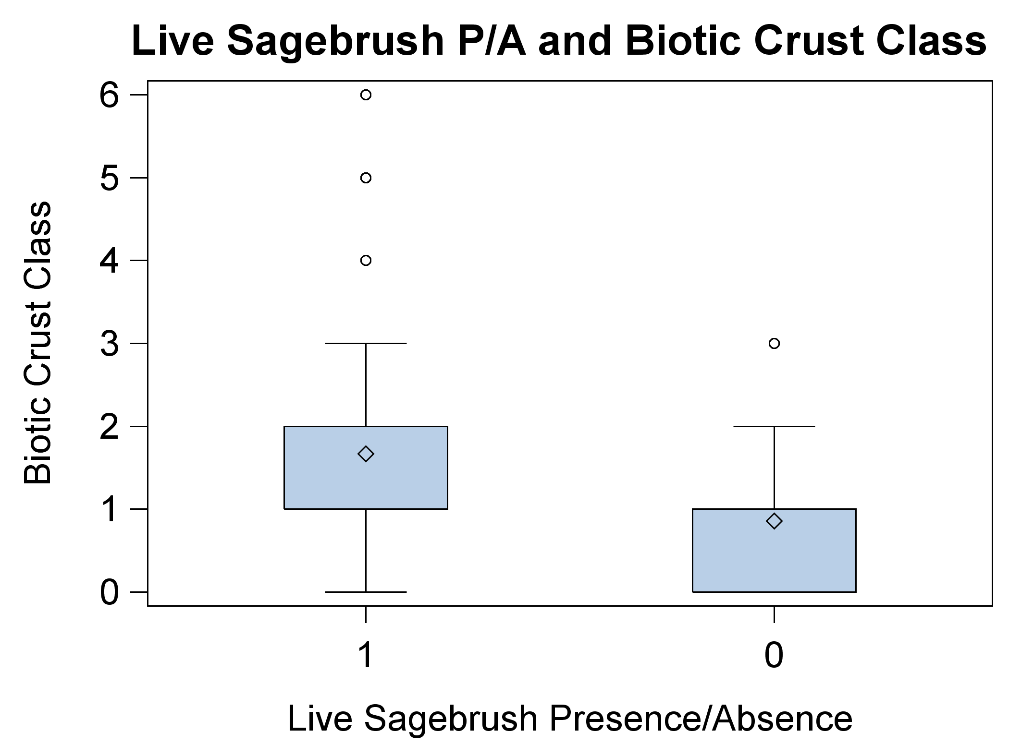
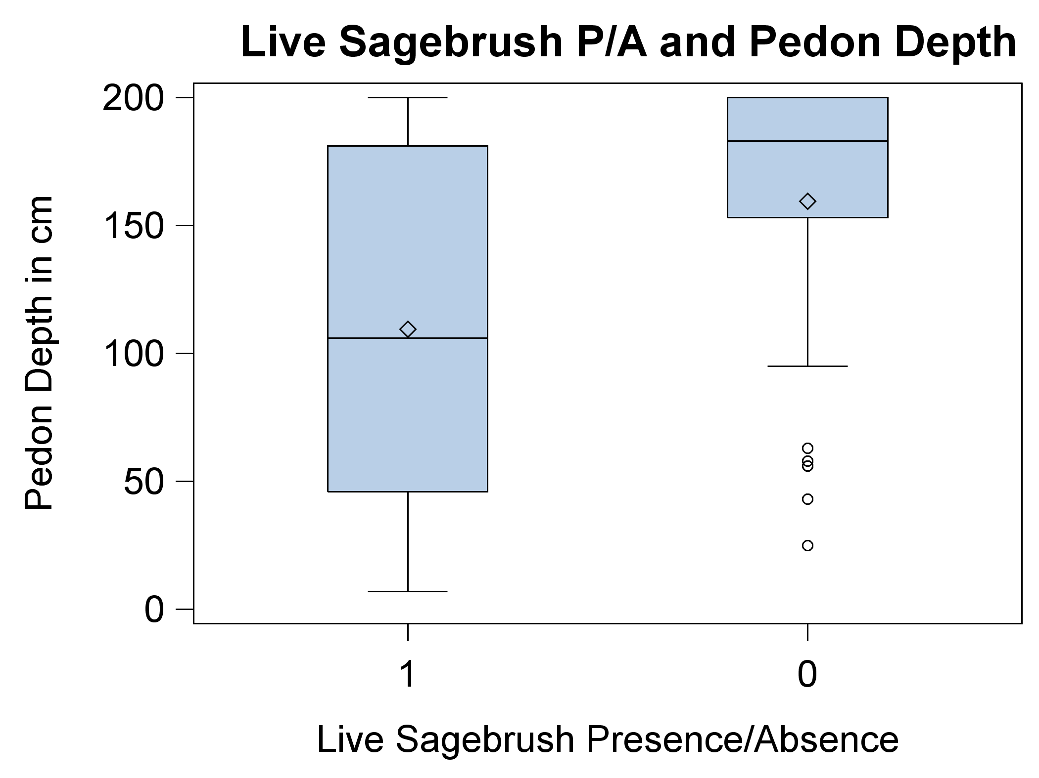
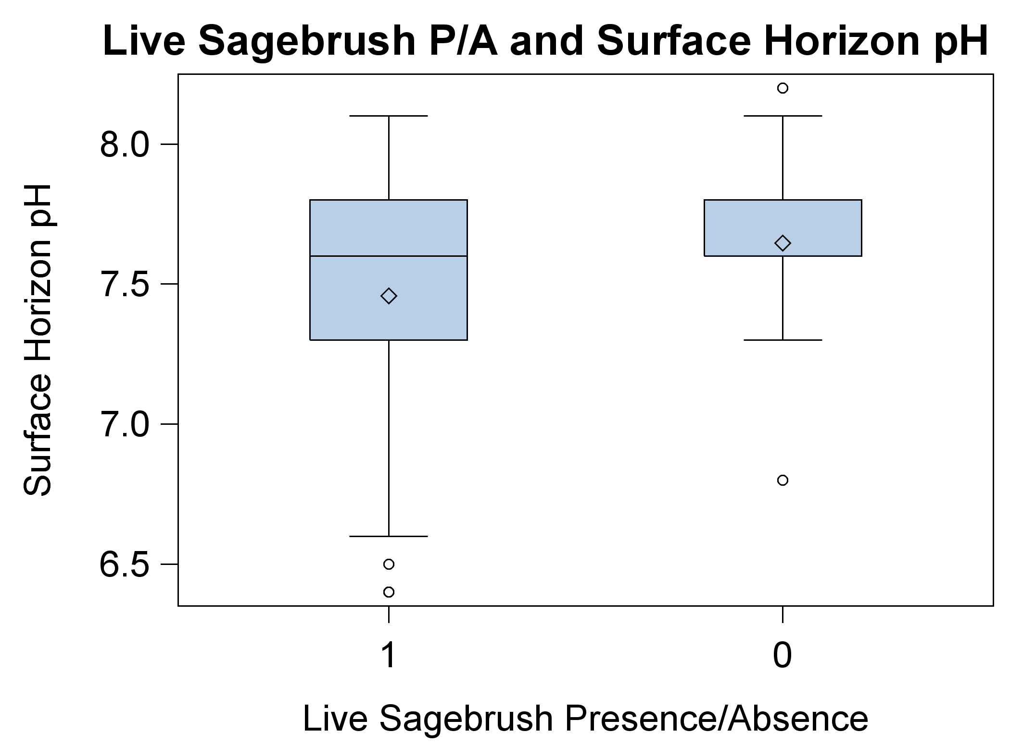
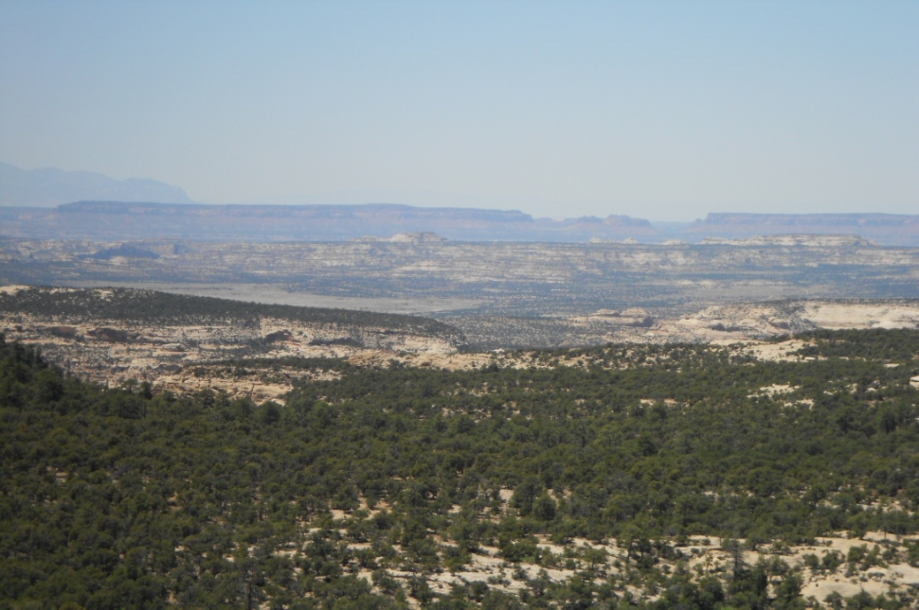
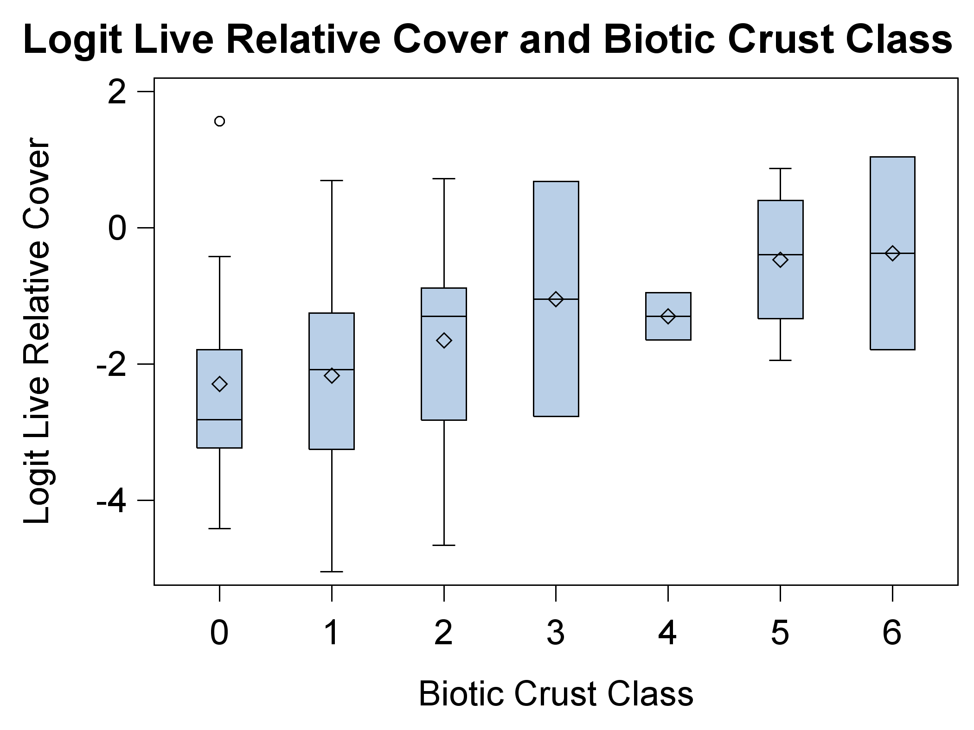
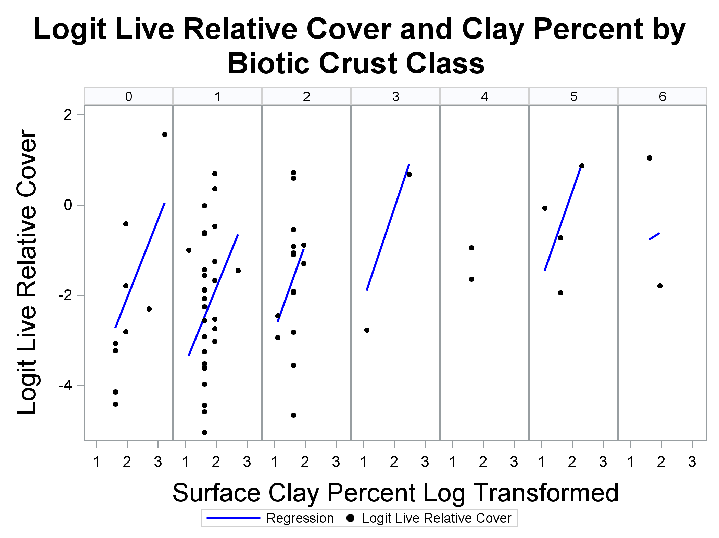
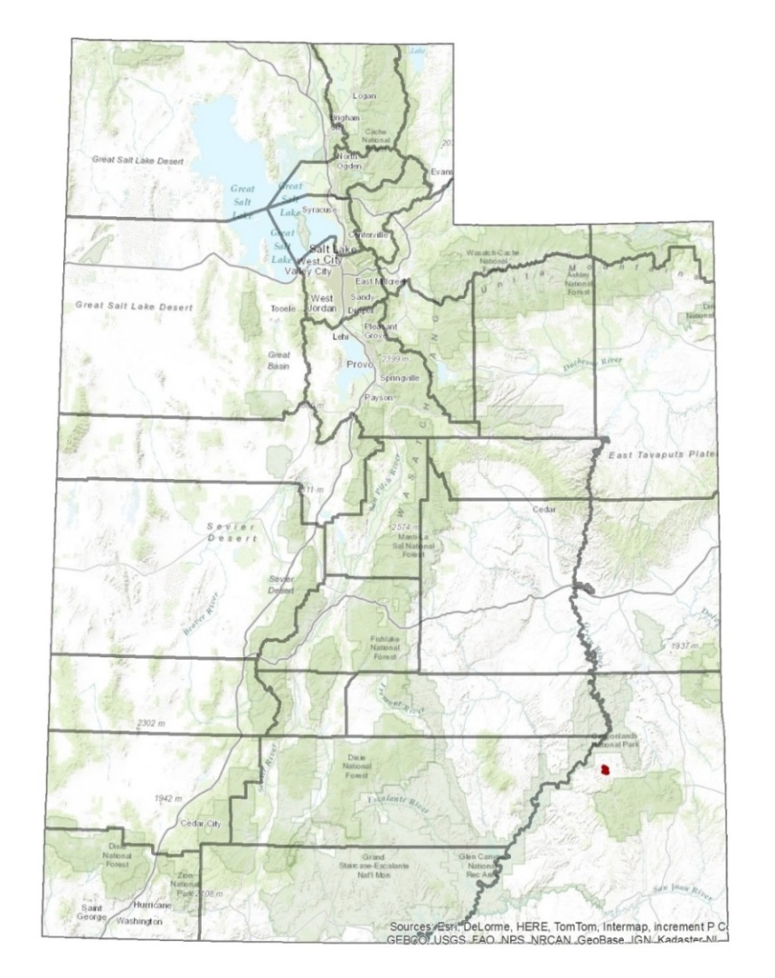

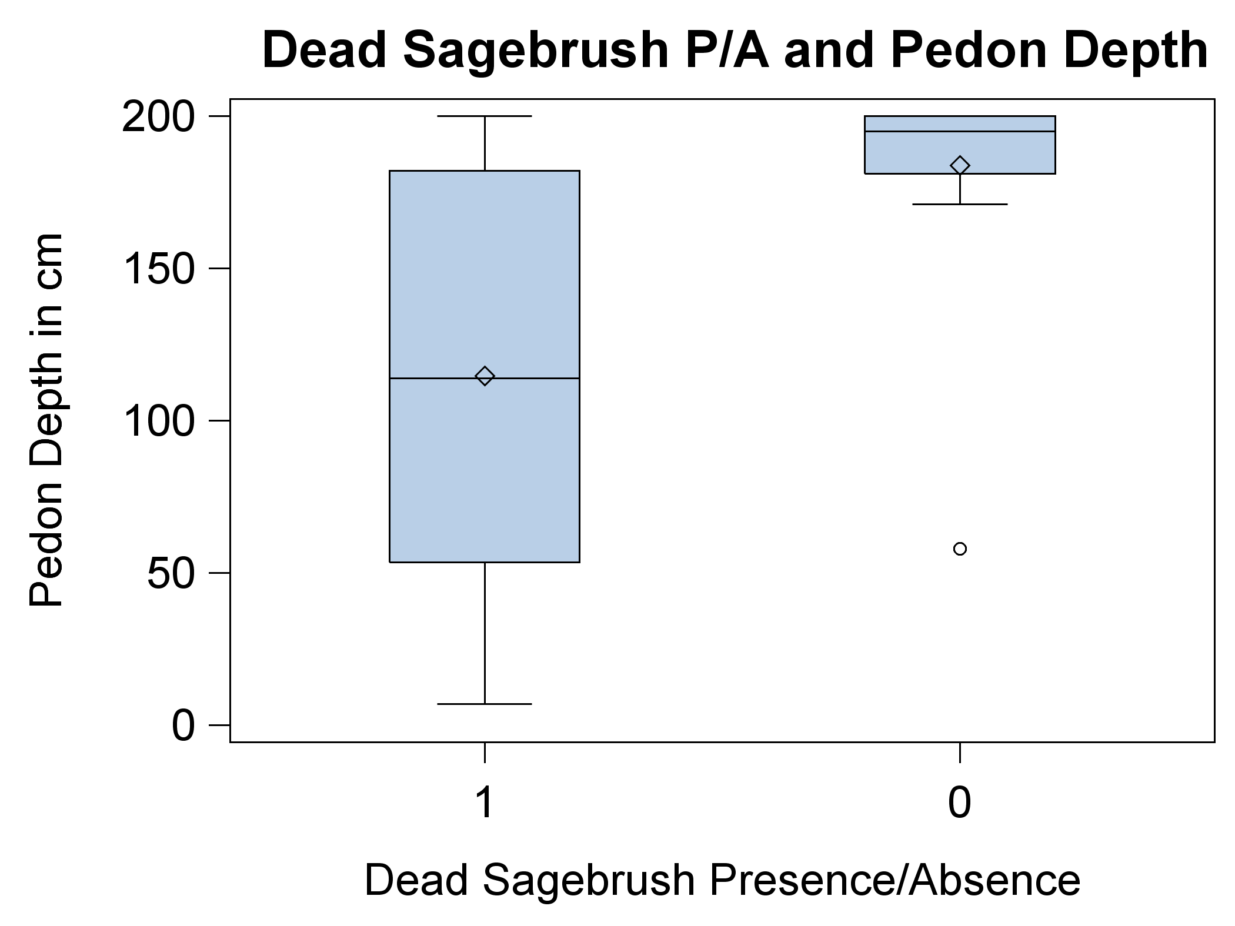
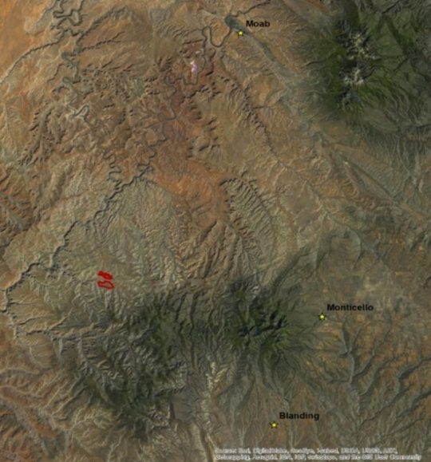
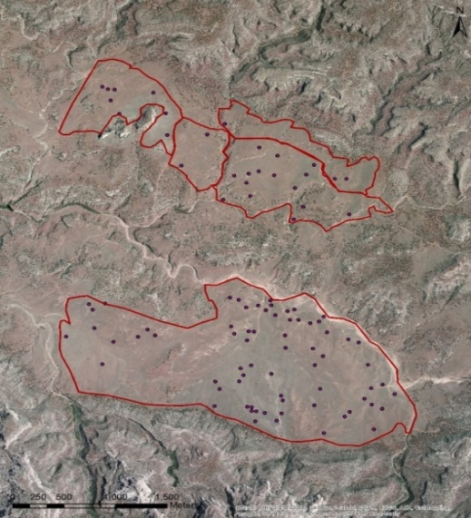
Sagebrush decline on the Colorado Plateau: A look at sagebrush and soils
April M. Darger^{1,2}, Eugene W. Schupp^{1,2}, Janis L. Boettinger³
Department of Wildland Resources¹, The Ecology Center², and Department of Plants, Soils, and Climate³
Utah State University, Logan, Utah 84322-5320
Introduction
Methods
Discussion
Sagebrush ecosystems once covered ≈ 150 million acres. Now natural and anthropogenic threats degrade this iconic ecosystem and regionally imperil over 350 species of associated plants and animals.
Growing concern has led to studies on the dynamics of sagebrush ecosystems and their obligate species, mostly in the Great Basin. However, little is known about how sagebrush responds on the Colorado Plateau, which has drier and monsoonal climatic conditions as well as different soils and vegetation.
In the late 1980’s sagebrush (Artemisia tridentata) in and around Beef Basin, Utah, began declining rapidly, with areas seeing 70% to100% die off, and a transition to grasslands.
The objective of this study is to determine which soil characteristics are associated with the presence of sagebrush on the landscape in order to ascertain where restoration efforts will potentially succeed.
In two of the southernmost plains of Beef Basin 99 sites were sampled. At each plot 5 transects 30m long were set up 7m apart. We collected Line Point Intercept (all 5 transects), Shrub Density (transects 1, 3, and 5), and Soil (2m auger, sampled 2m down from line 3)
In this preliminary analysis the logit transformed relative cover of both live and dead sagebrush were used in a 2 stage analysis with soils variables. The first stage looks at presence/absence of live sagebrush and of dead sagebrush, and identifies significant soil variables. The second stage takes only the presence occurrences and looks at how the magnitude of relative cover depends on the predictor soils variables.
Live sagebrush appear to favor sites with well-developed biotic crusts, shallower soils, and soil surface horizons where the pH is more acidic and with relatively high % clay.
Dead sagebrush give an indication of where these shrubs recently grew, but have now disappeared or declined. They may occur alone, in clusters of carcasses, or alongside live sagebrush. Here we see that they are more likely to have grown where biotic crusts are well developed, and where soil profiles are shallower, similar to the conditions under which we find live sagebrush.
These indicators together paint a picture of sagebrush across the landscape. Beef Basin is an area characterized by flat plains of deep sandy soil covered in grass, and interspersed and surrounded by shallow rocky outcrops. These shallower soils tend to have more sagebrush and often have more bare soil, and appear to be less disturbed, allowing for the formation of biotic crusts. They also often have slightly higher clay content which may be assisting the soil in retaining moisture.
When comparing the absence of live versus dead sagebrush in relation to pedon depth, we see that their potential range appears to be shrinking as the deeper soils become increasingly uninhabitable. This may be due to a changing climate which is dryer, and the deep sandy soils cannot retain sufficient moisture for sagebrush.
Live Sagebrush
Presence/Absence
Live sagebrush are:
Present at all levels of biotic crust class, which is a measure of the development biological soil crusts, but most occur at the middle to lower classes. Absences occur when biotic crust class is absent or not well developed (fig. 1a).
More likely to be absent at deeper sites between 100cm and 200+cm (fig. 1b).
More likely to occur when surface horizon pH approaches neutral (fig. 1c).
Overlooking Beef Basin from the Abajo Mountains
Logit Transformed Relative Cover
Live sagebrush relative cover:
Generally increases as biotic crust class increases (fig. 2a).
Increases across the biotic crust classes as surface horizon % clay increases. Surface horizon % clay has been natural log transformed (fig. 2b).
Photo taken by April Darger
Study Site
This study was conducted in Beef Basin, Utah which is located in San Juan County and is just south of Canyonlands National Park and north of the Manti-La-Sal National Forest.
Acknowledgments
Utah State University, Wildland Resources, and Ecology Center
BLM and USGS
The Nature Conservancy and Canyonlands Research Center
Funding Source: Utah Agricultural Experiment Station
Additional thanks to: Barry Baker, Colby Brungard, Michael Duniway, Tom Monaco, Kyle Nehring, and Eric Sodja
For information regarding this study contact April Darger: april.darger@aggiemail.usu.edu
Dead Sagebrush (Carcasses)
Dead sagebrush:
Are more often absent when biotic crust class is absent or not well developed (fig. 3a).
More likely to be absent at deeper sites above 150cm (fig. 3b).
North Plain and South Plain study sites, Beef Basin Utah

