Slide 1
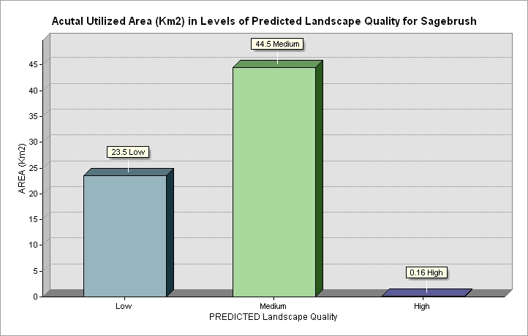
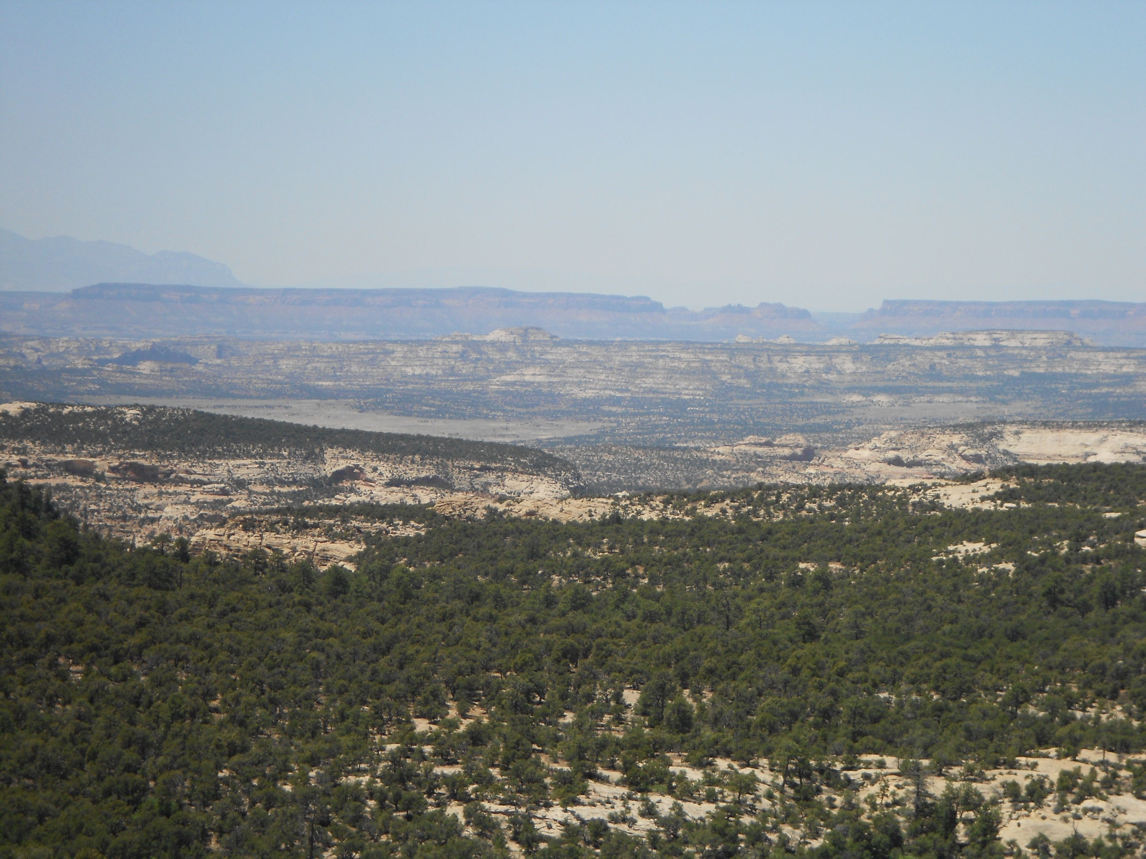
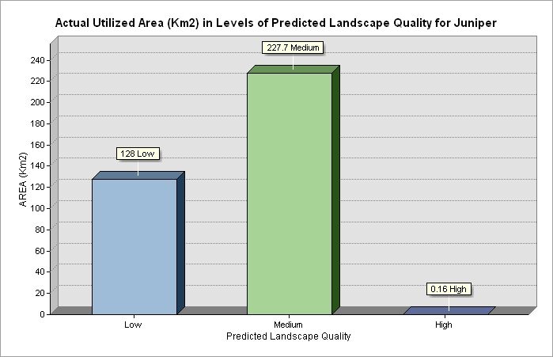
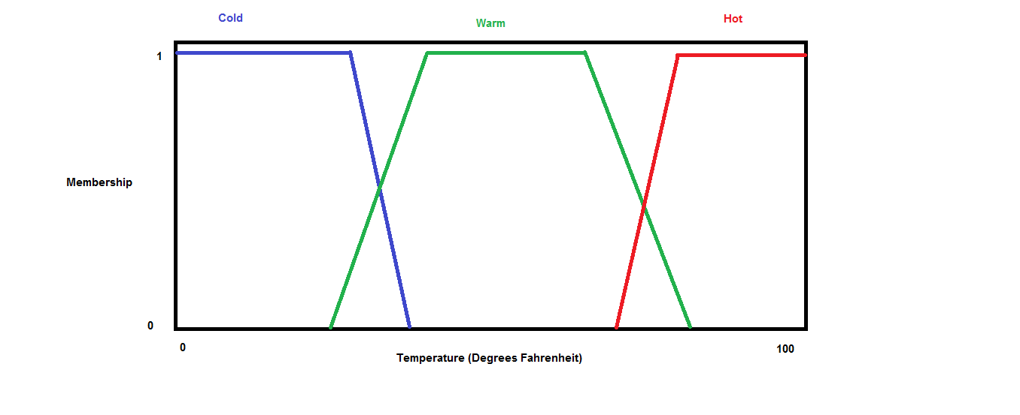
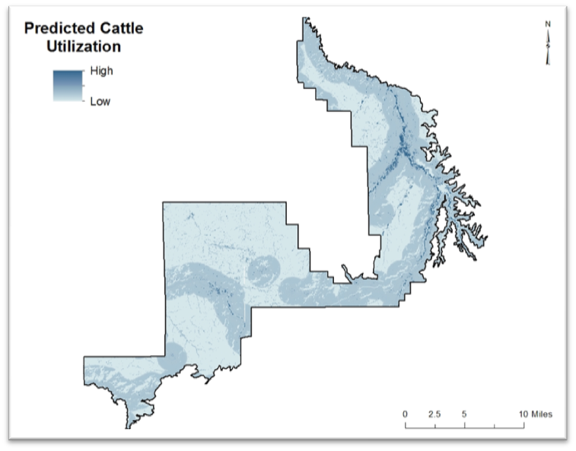
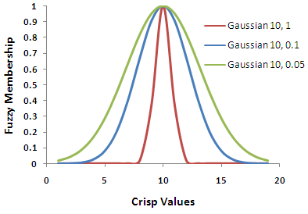
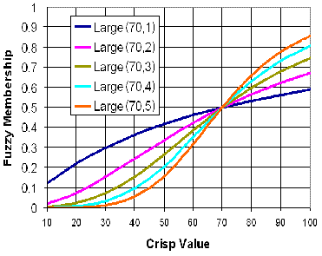
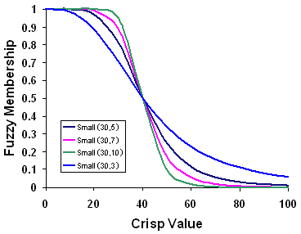
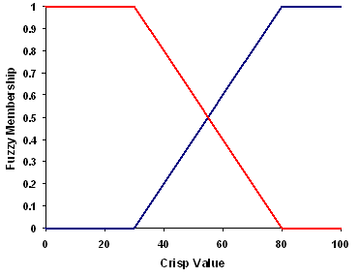
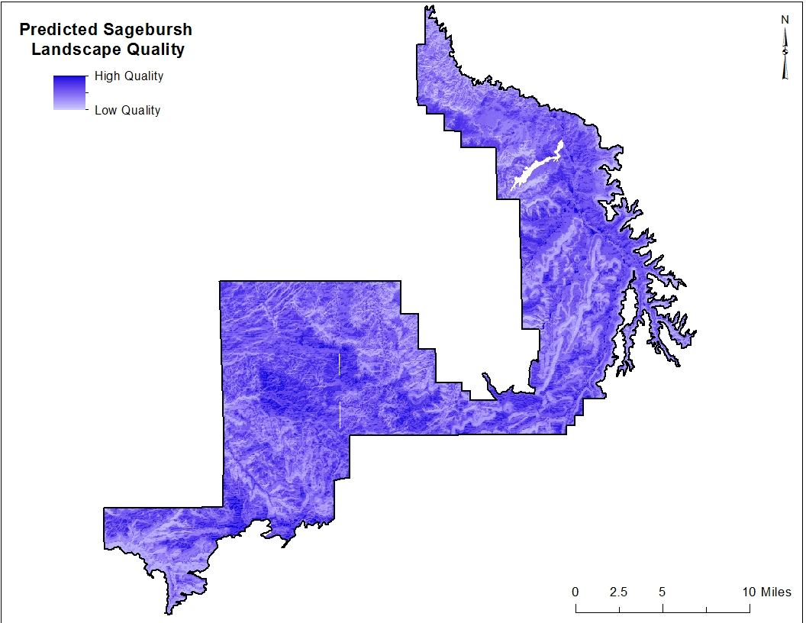
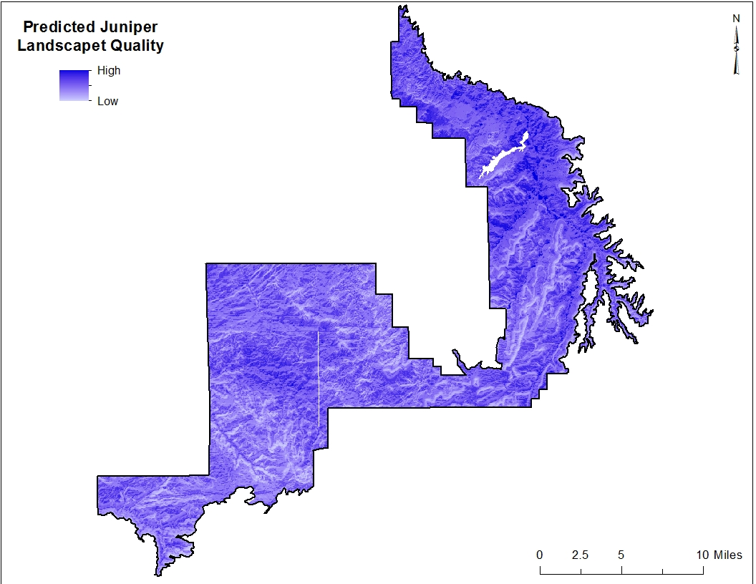
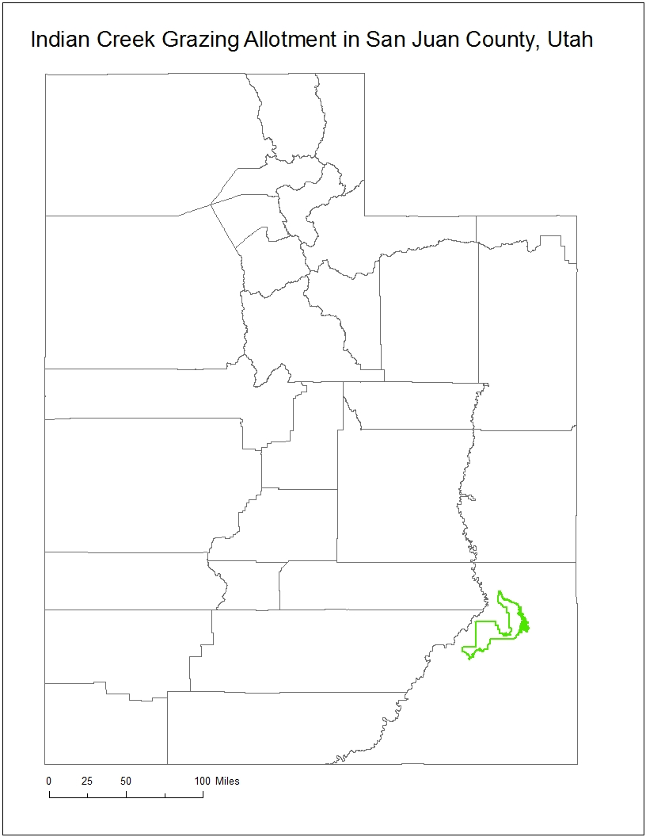
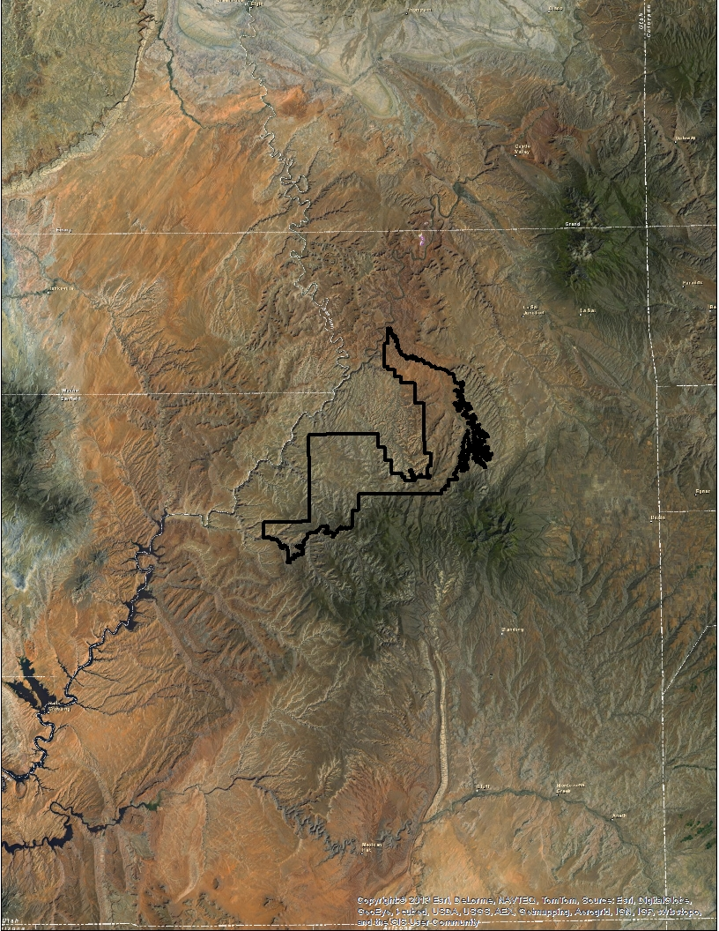
Predicting Quality of Habitat on a Landscape for Sagebrush and Juniper
April Darger
Major Advisor: Eugene Schupp
Introduction
Methods
Results and Discussion
Sagebrush ecosystems previously covered approximately 150 million acres.¹ Now overgrazing, fire suppression, invasive species, fragmentation, and a variety of other threats degrade this iconic ecosystem and regionally imperil over 350 species of associated plants and animals.¹
In the Beef Basin area of the Colorado Plateau sagebrush is being attacked from two fronts and mortality ranges from 40% to 100% .² Not only is sagebrush being invaded by juniper moving downward in elevation, but we are also seeing conversion to grassland in the lower elevation sites.²
This project is made up of two parts: the Cattle Habitat Utilization Model, and the Sagebrush and Juniper Landscape Quality Models.
The purpose of the Cattle Habitat Utilization Model is to predict which areas are more or less likely to be visited by cattle, which has implications on the suitability for vegetation. It was created using MatLab’s Fuzzy Logic Toolbox which takes various inputs and, based on a set of rules that the user defines through research of expert knowledge, provides an output on a 0-1 scale where 1 is full membership and 0 is no membership in the desired output (in this case predicted degree of cattle utilization).
For example:
In the Cattle Habitat Utilization Model Slope, Vegetation Type, and Euclidean Distance to Water were the inputs.
A rule stating that areas where 1) Slope was Low (flat), 2) Vegetation Type was Preferred, and 3) Euclidean Distance to Water was Near would result in a membership of 1 (full membership in predicted Cattle Habitat Utilization).
The figure below illustrates the idea behind fuzzy logic. Because different people may have a different opinion of when the temperature changes from cold to warm or from warm to hot, multiple opinions are taken into consideration. When cold (blue) has a membership of 1 it is definitely classified as cold, but when membership is between 0-1 it is ‘fuzzy’ about whether it is warm or cold.
The following two graphs show the results of the comparison between the Predicted Landscape Quality for both sagebrush and juniper and the current occurrence of these two vegetation types in the area.
Cattle Habitat Utilization Model
Overlooking Beef Basin from the Abajo Mountains
Sagebrush and Juniper Landscape Quality Models
These results show that both the Sagebrush and the Juniper Landscape Quality Models failed to accurately predict what areas of the landscape are high quality habitat for sagebrush and high quality habitat for juniper.
Reasons for this may include:
The Soil Type raster was categorical not continuous. It should not have been used in the Fuzzy Membership tool.
The Soil Type classification system was hasty and not well researched.
The mathematical equation expected to be used in the slope input did not yield the predicted results. An equation that did not make as much sense was used instead because it visually produced seemingly the most appropriate results.
In the future the Sagebrush and Juniper Landscape Quality Models should be rerun using better researched Soil Type classification and in MatLab’s Fuzzy Logic Toolbox rather than ArcMap’s Fuzzy Membership tool.
Also, for a more robust management recommendation an additional Grass Landscape Quality Model should be run as well.
The purpose of the Sagebrush and Juniper Landscape Quality Models is to predict which areas are more or less likely to be optimal habitat for sagebrush or for juniper. It was created using ArcMap’s Fuzzy Membership tool in conjunction with the Raster Calculator tool. The Fuzzy Membership tool takes continuous data and scales it between 0-1 based on a mathematical equation and midpoint defined by the user.
The four figures shown here are some visual representations of the types of equations used to scale the continuous data.
The Cattle Habitat Utilization Model, Slope, Aspect, Elevation, and Soil Type are inputs for the Landscape Quality analysis for both the sagebrush and juniper models.
The outputs of these five inputs into the Fuzzy Membership tool were then averaged in the Raster Calculator tool. This means that every cell in a raster was averaged with the cell in the same location of the other four rasters resulting in an output raster scaled between 0-1.
The two resulting Sagebrush and Juniper Predicted Landscape Quality rasters (above) were then compared to existing vegetation type rasters.
Photo taken by April Darger.
Objectives
Create a model that can predict areas on the landscape that are low, medium, and high quality habitat for sagebrush.
Create a model that can predict areas on the landscape that are low, medium, and high quality habitat for juniper.
Use these two vegetation models to inform future management decisions.
Study Site
This study was conducted on a modified version of the Indian Creek grazing allotment which encompasses Beef Basin. It is located in San Juan County, Utah and is just south of Canyonlands National Park.
Acknowledgments
Special thanks to my GIS Instructors Joe Wheaton, Shannon Wing Belmont, and Tommy Thompson. Your expertise and encouragement has been invaluable.
The four fuzzy membership graphs in the Methods section are from ESRI’s ArcGIS Resource Center . All other images were taken or produced by April Darger.
For information regarding the references in the subscripts 1 and 2 and for any other information contact April Darger at april.darger@aggiemail.usu.edu.

