Slide 1
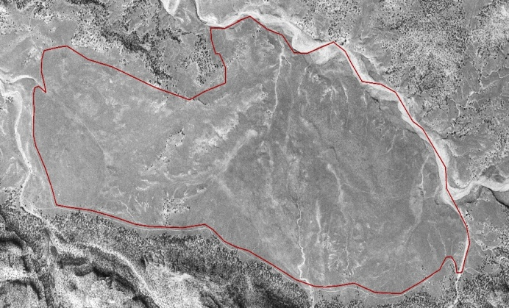
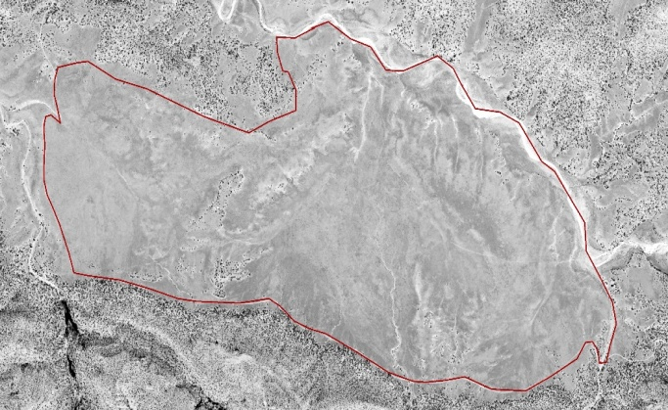
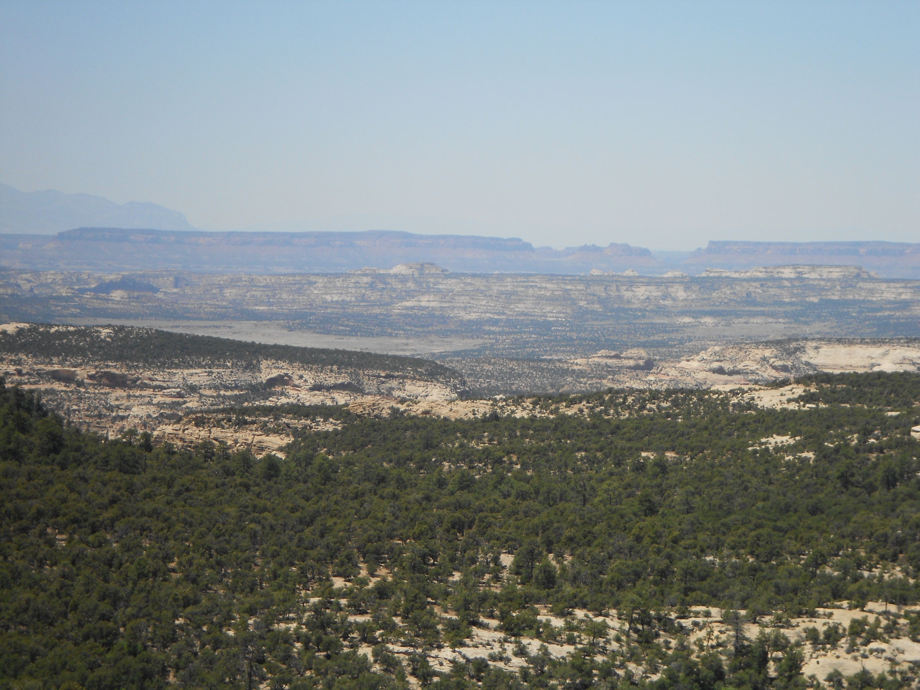
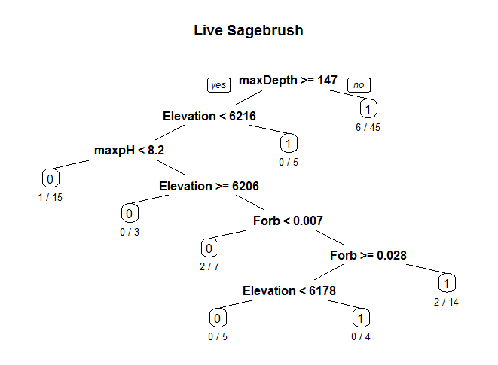
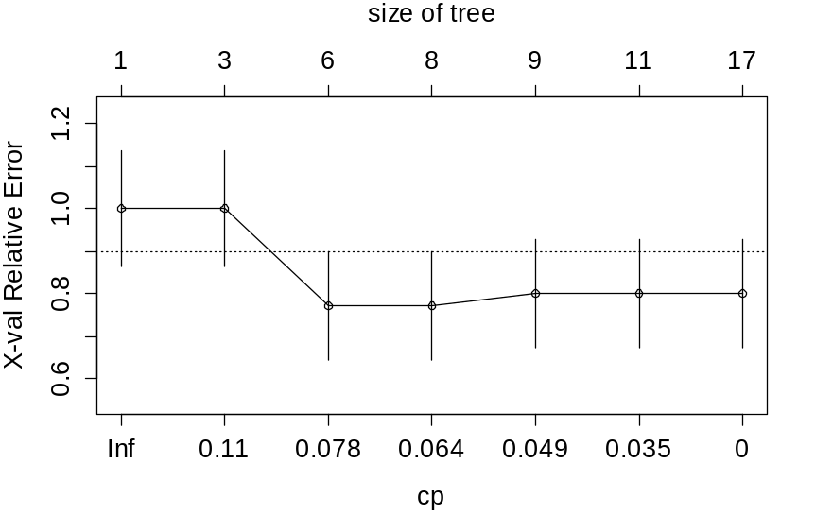
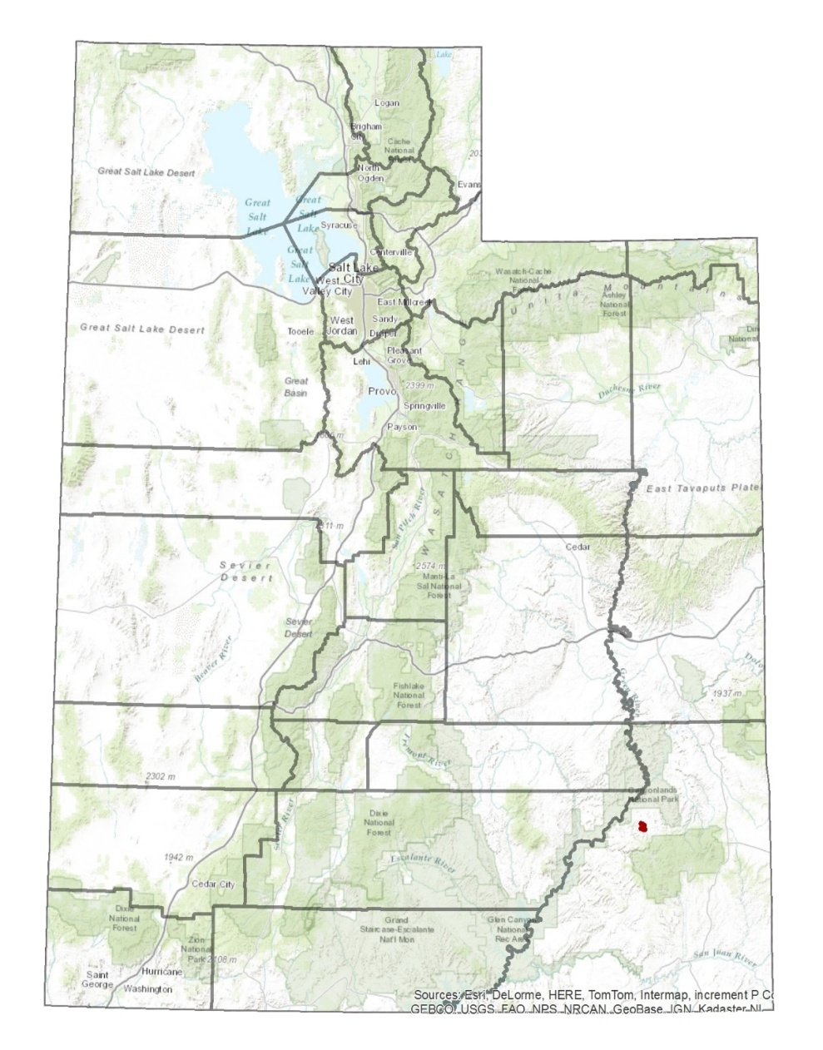
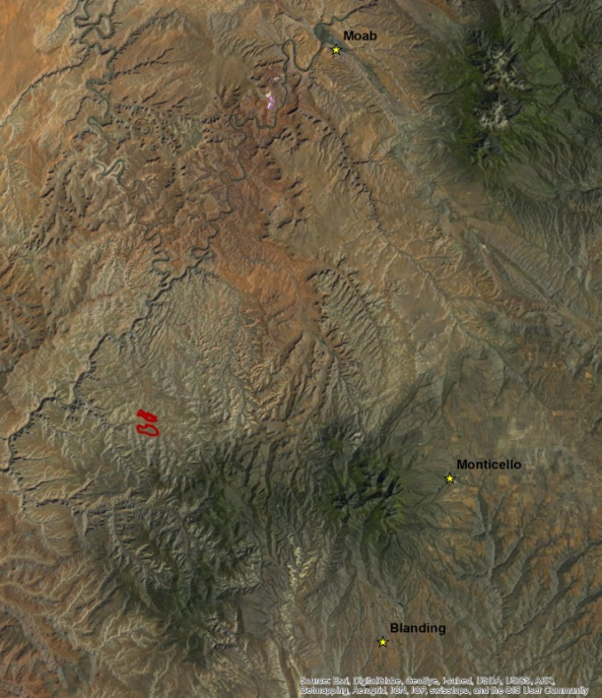
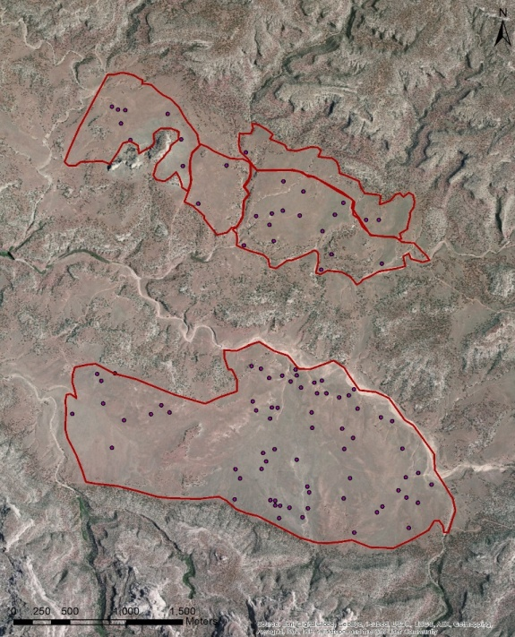
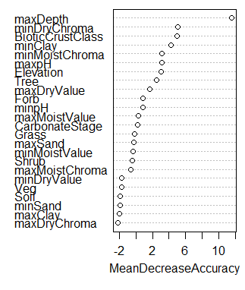
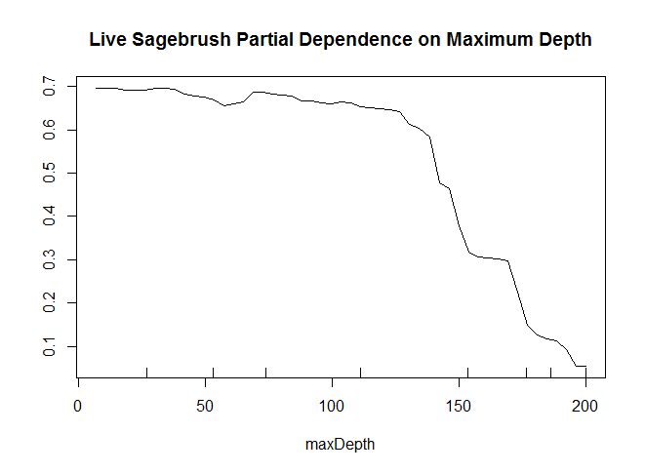
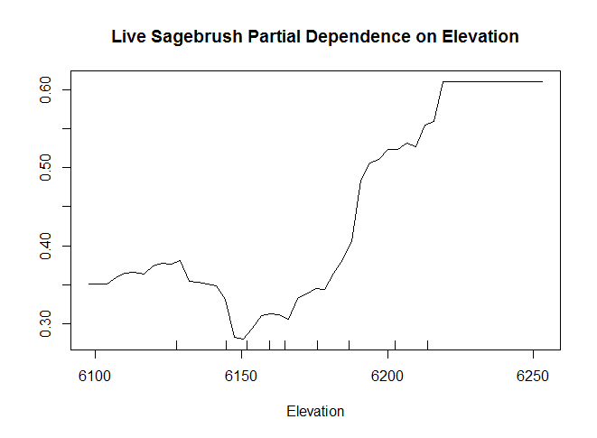
Sagebrush decline on the Colorado Plateau: A look at sagebrush and soils
April Darger
Major Advisor: Eugene Schupp
Introduction
Study Design
A Look Through Time
Sagebrush ecosystems once covered approximately 150 million acres. Now overgrazing, fire suppression, invasive species, fragmentation, and a variety of other threats degrade this iconic ecosystem and regionally imperil over 350 species of associated plants and animals.
Growing concern for this problem has led studies on the dynamics of sagebrush ecosystems and their obligate species, as well as the formation of nonprofit organizations like Saving the Sagebrush Sea, and programs such as SageSTEP.
Much of this restoration attention is focused in the Great Basin, but very little is known about how sagebrush responds on the Colorado Plateau which has drier and monsoonal climatic conditions as well as different soils and vegetation
Sites were randomly selected in ARC Map from two of the BLM’s proposed treatment polygons (North Plain and South Plain) based on NDVI values that had been split into 4 quartiles, and within one of the three dominant soil types (Begay, Ignacio/Leanto, and Mido) for a total of 12 plot types (NDVI by soil) with 6 to 10 sites sampled at each plot totaling 99 plots. See table below.
At each plot 5 transects 30m long were set up 7m apart. Data collected included Line Point Intercept (collected on all 5 transects), Shrub Density (collected on transects 1, 3, and 5), and Soil (2m auger, sampled 2m down from line 3)
In the late 1980’s sagebrush in and around Beef Basin began declining rapidly. The first image (top) shows an aerial photograph from 1975. The dark grey areas are shrubs, predominantly sagebrush. The second image (bottom) is of the same area in 2011. Much of the area previously covered in shrubs has converted to grasslands (light grey).
99 Total | SOIL TYPE
 |  | BEGAY | IGNACIO/LEANTO | MIDO
Vegetation Class | 1 | 10 | 7 | 8
 | 2 | 9 | 9 | 8
 | 3 | 10 | 8 | 6
 | 4 | 9 | 8 | 7
0 m
7 m
Transect 5
30 m
7 m
Transect 4
7 m
15 m
2 m
Transect 3
5 m
Transect 2
7 m
Transect 1
Results
Multivariate analyses include classification trees and random forests.
Line Point Intercept data: percent relative cover of tree, shrub, forb, and grass.
Shrub density data: presence/absence of sagebrush.
Soil data: horizon depth, maximum Munsell moist value and chroma, maximum Munsell dry value and chroma, maximum sand percent, minimum sand percent, maximum clay percent, minimum clay percent, maximum pH, minimum pH, elevation, carbonate stage, and biotic crust class.
Other soil factors were removed from the following analysis but are anticipated to be useful in future analysis.
Overlooking Beef Basin from the Abajo Mountains
Classification trees and random forests both found similar results in identifying maximum depth, elevation, and maximum pH as important.
Sadly, they also had similarly high error rates.
The error rates are currently so high that the results are not useful.
A notable problem with these results is the error rates.
Prior to cross validation the classification tree had an overall error rate of approximately 11 percent. After cross validation the overall error rate jumped up to between 30 and 40 percent
For random forests had a cross validated overall error rate of~37% when ran will all of the variables, and a cross validated overall error rate of ~ 36% when ran on only the important variables.
Also, soil factors that are anticipated to be useful for this analysis were not present because I have not yet found a meaningful way to reduce categorical data represented as characters which have several observations per plot to one observation per plot (multiple horizons in a single soil profile).
Classification Tree
Discussion and Some Major Problems
A cp value of .064 was found which corresponded to a tree with 8 terminal nodes.
Photo taken by April Darger.
The resulting tree demonstrated that sagebrush prefer sites with:
Soil depths less than ~150cm.
Elevations less than 6206 feet and forb cover roughly between 1 and 3 percent.
A few sagebrush sites also occur at sites greater than 6216 feet.
This tree also showed that sagebrush do not generally occur where:
Soil depth is greater than ~150cm, elevation less than 1216 feet, and a maximum pH less than 8.2 had the greatest concentration of absences (no sagebrush present).
Soil depth greater than ~150cm, elevation less than 6216 feet, max pH greater than 8.2, elevation greater than 6206 feet, and less than 1% forb cover.
Objectives
Better understand the vegetation communities that define this area.
Determine which soil characteristics are influencing the presence of sagebrush on the landscape.
Study Site
This study was conducted in Beef Basin, Utah which is located in San Juan County and is just south of Canyonlands National Park and north of the Manti-La-Sal National Forest.
Random Forest
The variable importance plot indicates that maximum depth, minimum dry chroma, biotic crust class, minimum clay, percentage, minimum moist chroma, maximum pH, elevation, and percent relative tree cover are important variables (left).
Partial dependence plots were made for these variables and the results for maximum depth and elevation are shown below.
The partial dependence plot for maximum depth (center) shows that sagebrush presence drops significantly at depths greater than 150cm.
The partial dependence plot for Elevation (right) shows that sagebrush occur most often at higher elevations, occur somewhat at lower elevations, but the mid elevation range has the least incidence of sagebrush
Acknowledgments
Committee: Eugene Schupp, Janis Boettinger, and Tom Monaco
Utah State University, Wildland Resources, and Ecology Center
Funding Source: Utah Agricultural Experiment Station
Additional thanks to: Barry Baker, Colby Brungard, Michael Duniway, Kyle Nehring, and Eric Sodja
The Nature Conservancy and Canyonlands Research Center
The BLM and USGS
For information regarding this study contact April Darger at april.darger@aggiemail.usu.edu.

