Slide 1
Netflix Stock Profile
A. Kissinger
06/21/2021
For the: Codecademy Visualization Capstone Project

Slide 2
Presentation Overview
Acting as a Data Visualization developer for Yahoo Finance I created a set of visualizations based on Netflix and Dow Jones stock data from 2017.
Visualizations in Presentation
Netflix Stock Prices per Quarter
Estimated vs Actual EPS in Cents
Revenue and Earnings per Quarter
Netflix vs Dow Jones Stock Prices

Slide 3
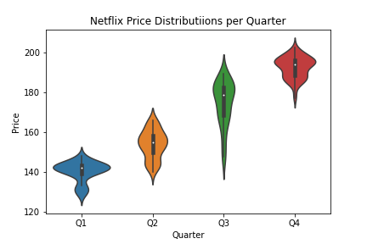
Netflix Stock Prices per Quarter
The data shows an increase in trend in Netflix stocks.
Most of the stock prices were between $140 - $195.
Lowest price: ~$122.
Highest price: ~$205.

Slide 4
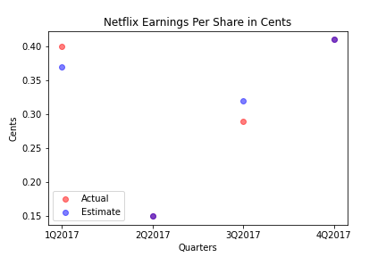
What is the Estimated vs Actual EPS (Cents)?
The purple dots are those where the actual and estimated earnings are the same
Another point
Notes:
I am unsure why the first set of points is so high. It might be my misunderstanding of the stock market.

Slide 5
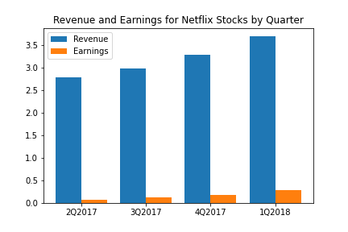
Revenue and Earnings per Quarter
Both revenue and earnings trend upwards as the year progresses.
The earnings are all less than 10% of the revenue.
The percent earnings are increasing by about 2% per quarter
Q1’s percent earnings were 2.4%
Q4’s percent earnings were 7.8%

Slide 6
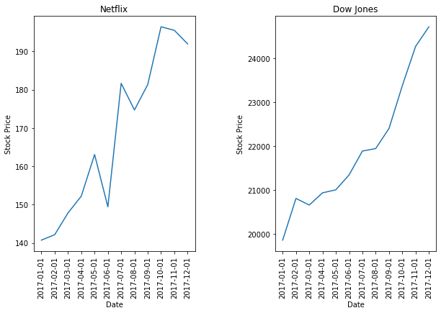
How does Netflix Compare to Dow Jones?
Both stocks trended upwards with similar slopes
Netflix was more volatile as it is not as smooth as Dow Jones
Netflix’s stock prices are lower than Dow Jones by more than two orders of magnitude.

