Slide 1
Netflix Stock Profile Visualizations
A. Kissinger
06/21/2021
For the: Codecademy Visualization Capstone Project

Slide 2
Presentation Overview
Acting as a Data Visualization developer for Yahoo Finance I created a set of visualizations based on Netflix and Dow Jones stock data from 2017.
Visualizations in Presentation
Netflix Stock Prices per Quarter
Estimated vs Actual EPS in Cents
Revenue and Earnings per Quarter
Netflix vs Dow Jones Stock Prices

Slide 3
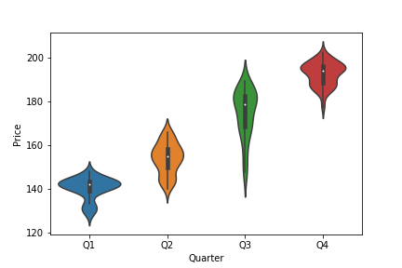
Netflix Stock Prices per Quarter
The data shows an increase in trend in Netflix stocks.
Most of the stock prices fell between $140 - $195.
The lowest price was ~$122.
The highest price: ~$205.

Slide 4
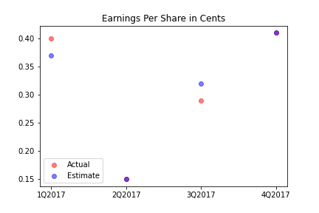
Estimated vs Actual EPS (Cents)
The purple dots are those where the actual and estimated earnings are the same
Another point

Slide 5
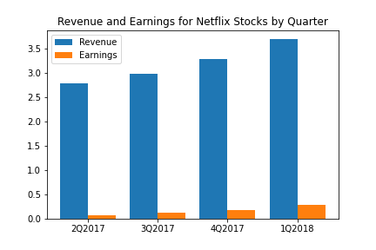
Revenue and Earnings per Quarter
Both revenue and earnings trend upwards as the year progresses.
The earnings are all less than 10% of the revenue.
The percent earnings are increasing by about 2% per quarter
Q1’s percent earnings were 2.4%
Q4’s percent earnings were 7.8%

Slide 6
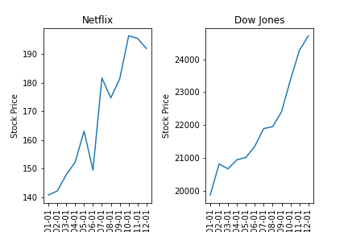
Netflix vs Dow Jones Stock Prices
Both stocks are trending upwards with similar slopes
Netflix was more volatile as it is not as smooth as DJ
Netflix’s stock prices are lower than DJ by two orders of magnitude.

