Slide 1
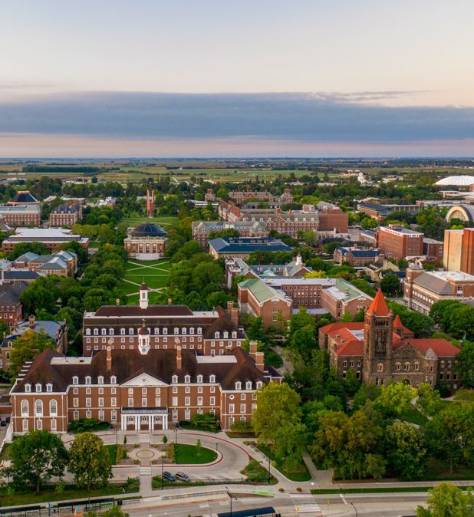


Workshop
April Novak
Assistant Professor
Nuclear, Plasma, and Radiological Engineering (NPRE)
University of Illinois, Urbana-Champaign

Slide 2
Welcome
Provide introduction to Monte Carlo methods and how to use OpenMC
Understand the unique features and advantages of OpenMC relative to other software
Have an enjoyable time!

Slide 3
Logistics
Instructor
Prof. April Novak (ajnovak2@illinois.edu)
Google Collab
Check your email for URL link

Slide 4
Workshop Timeline
Introduction to Monte Carlo theory
Introduction to OpenMC
OpenMC examples (interactive)

Slide 5
Google Collab Instructions
Step 1:
Open the google collab notebook via the URL sent to your email;
Press "File" in the menu bar and then "Save a copy in Drive";
Step 2:
The first cell needs to be run alone, because it will restart the kernel;
"Your session crashed for an unknown reason" will show at the bottom, just close it;
Run the second kernel and you are good to go.
Two versions of the notebook are available:
“Solutions” with all text populated
“Empty” for you to type along

Slide 6
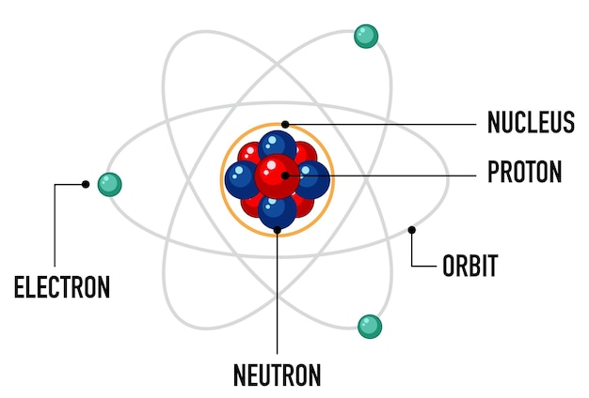
Neutron Physics 101

Slide 7

Scattering
$$n+{}_{}^{235}U→ {}_{}^{235}U+n$$

Slide 8

Capture
$$n+{}_{}^{235}U→ {}_{}^{236}U$$

Slide 9
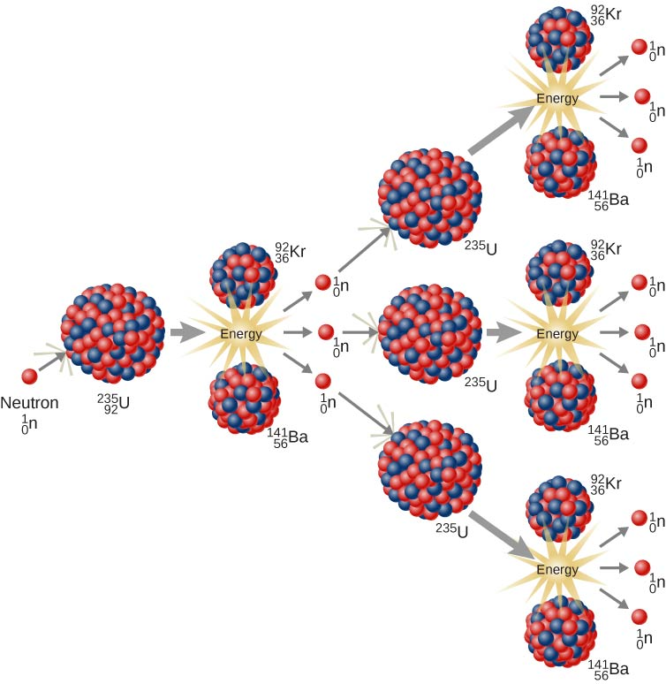
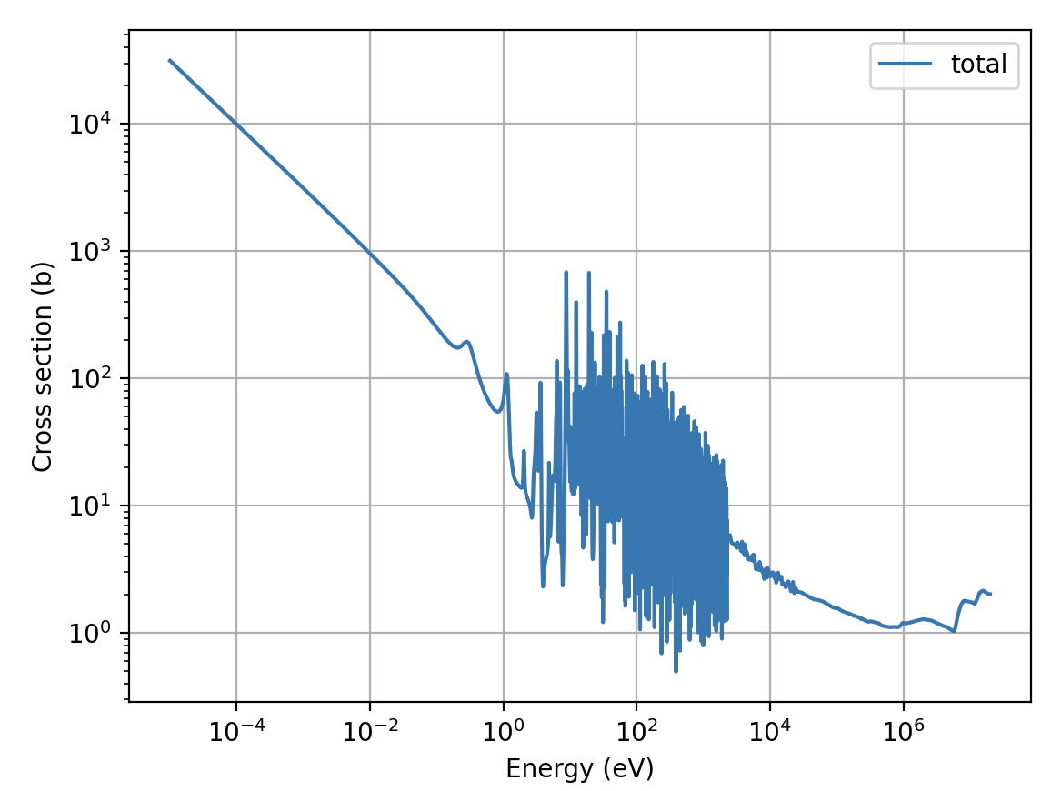
Fission
Highly radioactive, these also generate energy (later)
Produces very high-energy neutrons (2 MeV → 246 million mph)
Fission reaction is most likely at low energy (0.000000025 MeV)
Energy released is converted into heat

Slide 10
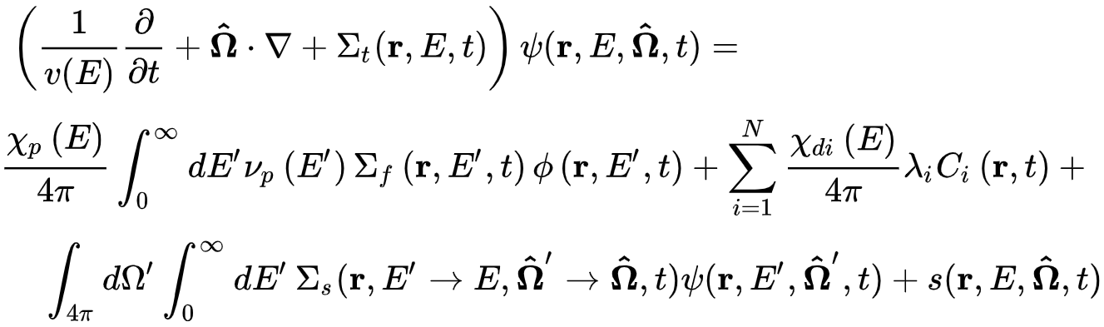
The Neutron Transport Equation

Slide 11
The Neutron Transport Equation
Neutron flux: how many neutrons at a given location?
Cross section: probability* a neutron undergoes a particular interaction
*per distance traveled

Slide 12
The Neutron Transport Equation
LOT of unknowns

Slide 13
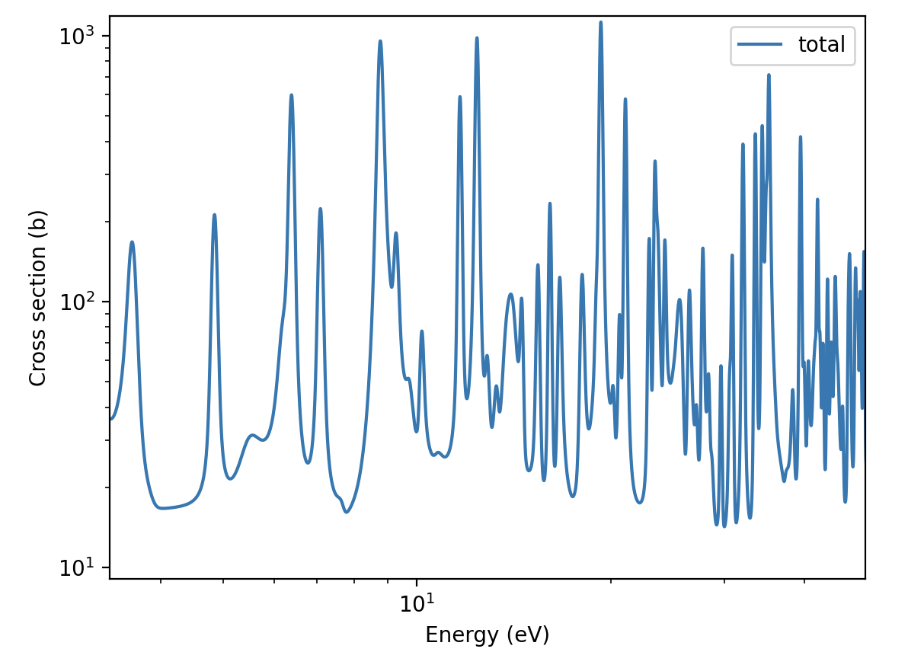
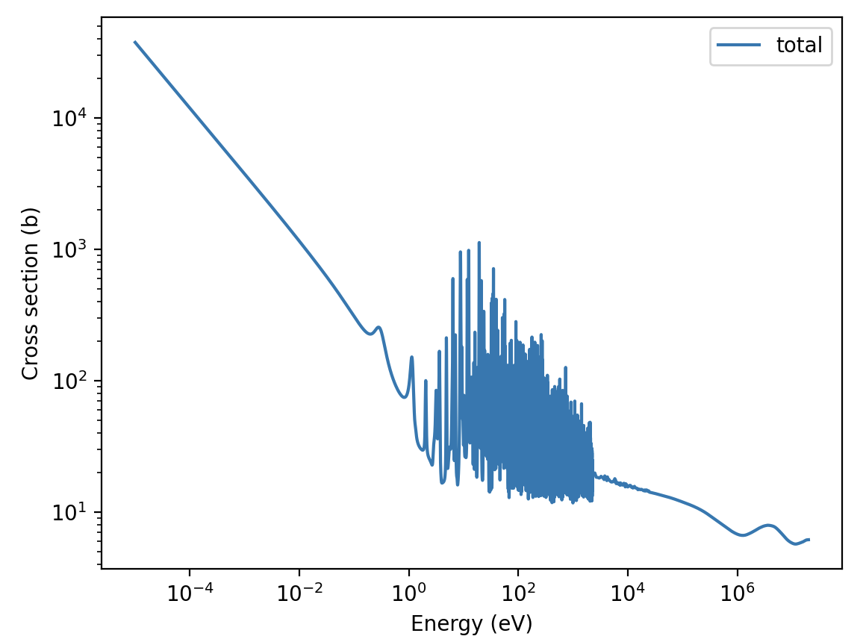
The Neutron Transport Equation
LOT of unknowns
VERY complicated functions of energy

Slide 14
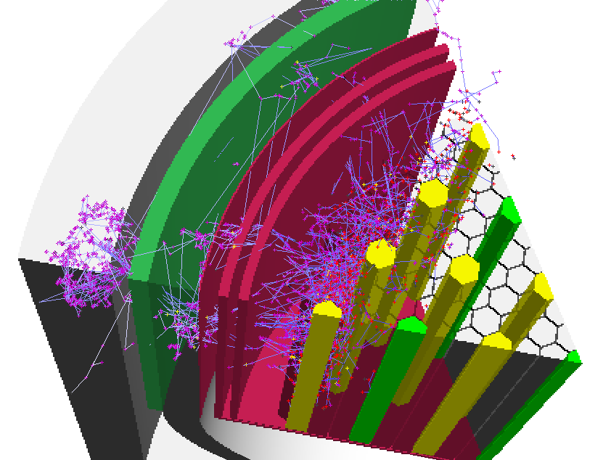
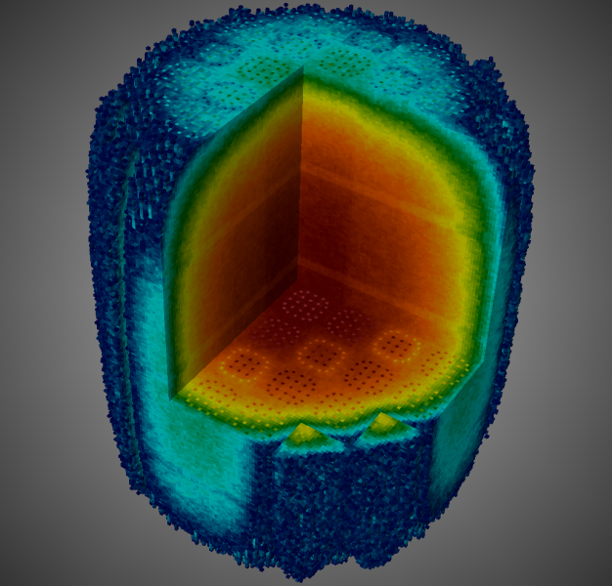
The Monte Carlo Method
We cannot predict with 100% certainty what happens to an individual neutron (random processes)
We can predict well what happens to a large collection of neutrons using statistical methods
Nuclear reactors have HUGE numbers of neutrons (10⁸/cm³)
Monte Carlo methods: statistical solution to the neutron transport equation
Sample distance to next collision
Sample type of collision
Sample outgoing energy, direction
and count the # fissions!

Slide 15
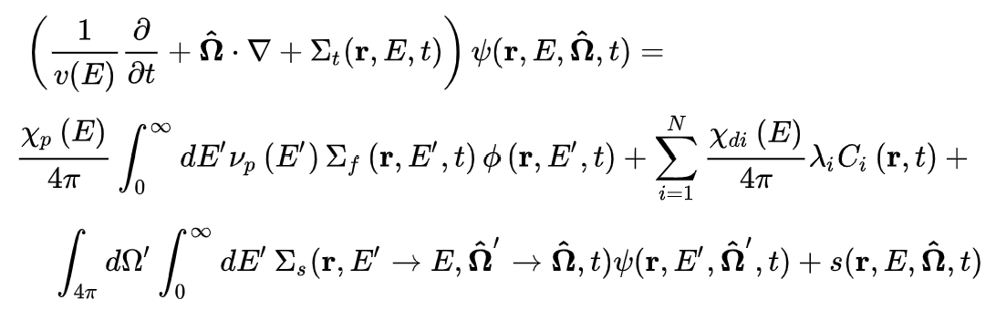
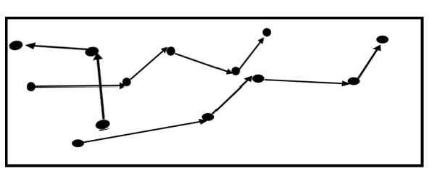
Neutron Transport Methods
Deterministic | Stochastic
Neutron Transport Equation is solved | Individual particles are tracked and averaged in a random walk directed by probabilities
Approximate geometry | Exact Geometry
Multigroup | Continuous and multigroup
Global numerical solution | Tallies
Shorter simulation times | Longer simulation times?
Parallelization is more challenging | Parallelization is easy

Slide 16
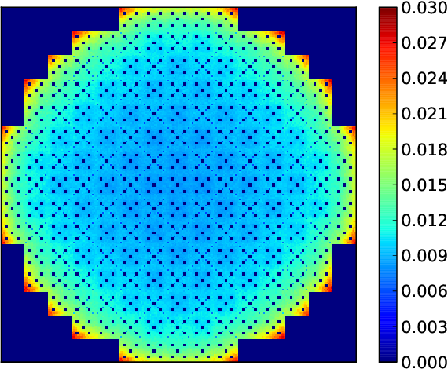
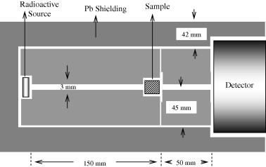
Neutron Transport Problems
Fixed Source Problem
Eigenvalue Problem
Radiation Shield
(image credit: E. Yilmaz)
Pressurized Water Reactor
(image credit: P. Romano)

Slide 17






Random Process
Discrete | Continuous
Coin
Flip
Response
Time
$outcome∈\left\{H,T\right\}$
$$outcome ∈\left[0 , ∞\right)$$
Reaction
Type
N
Distance To
Next Collision
n
n
$outcome∈\left\{Scattering, Absorption\right\}$
$$outcome ∈\left[0 , ∞\right)$$

Slide 18
How can we simulate a random process on computer?

Slide 19
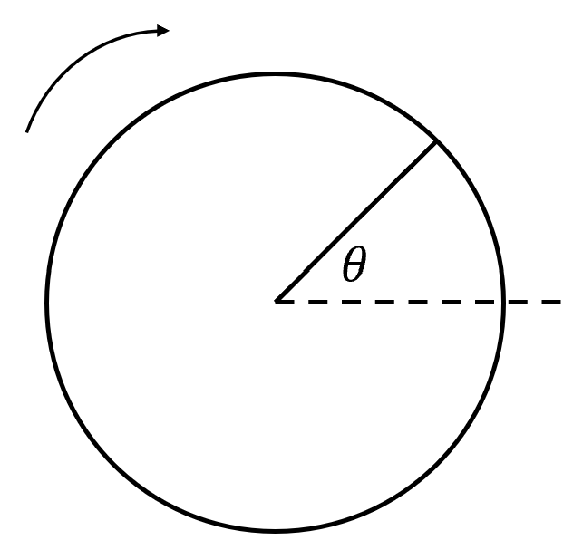


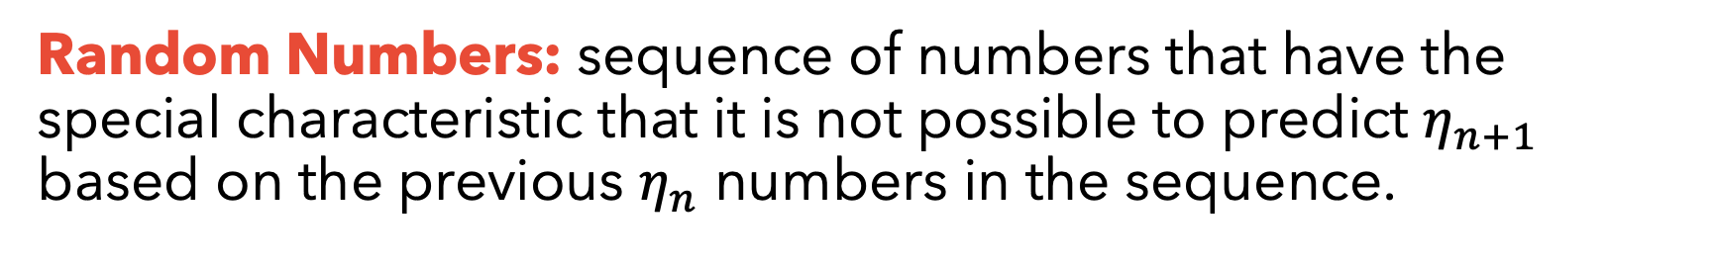
Random Numbers
Random Numbers: sequence of numbers that have the special characteristic that it is not possible to predict $η_{n+1}$ based on the previous $η_{n}$ numbers in the sequence.
Physical Random Number Generator | Pseudorandom number generator
 | An algorithm for generating a sequence of numbers whose properties approximate the properties of sequences of random numbers. Ex:
$$η=\frac{θ}{2π}$$

Slide 20
How can we convert the random number into a random variable?

Slide 21
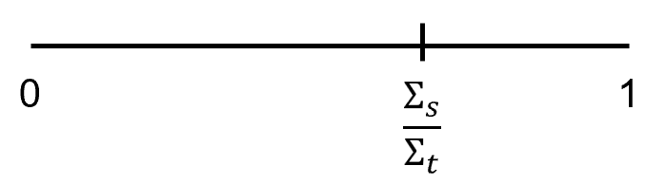

Sampling (Discrete)
Flipping a coin
Generate a random number ($η$) between $[0,1]$
if ($η$ < 0.5)
$outcome = ‘H’$
else
$outcome = ‘T’$
Sampling Reaction Type
Generate a random number ($η$) between $[0,1]$
if $\left(η <\frac{Σ_{s}}{Σ_{t}}\right)$
$reaction = ‘scattering’$
else
$reaction = ‘absorption’$

Slide 22
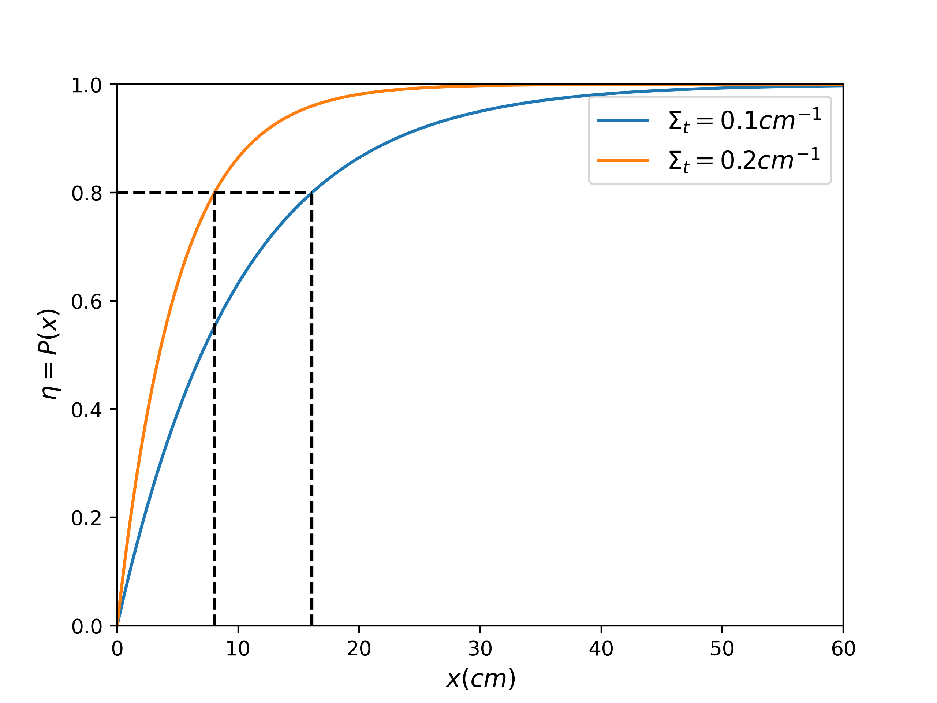









Sampling (Continuous)
Distance to next collision
Let $p(x)$ be the PDF of the distance to next collision.
Let $P\left(x\right)$ be the corresponding CDF.
Let $q\left(η\right)$ be the PDF of the random numbers generated.
$p\left(x\right)=Σ_{t}e^{−Σ_{t}x}$ $for 0≤x<∞$
$$P\left(x\right)=1−e^{−Σ_{t}x}$$
$q\left(η\right)=1$ $for 0≤η<1$
$$p\left(x\right)dx=q\left(η\right)dη$$
$$\int_{0}^{x}{p\left(x^{′}\right)dx^{′}}=\int_{0}^{η}{q(η^{′})dη^{′}}$$
$$P\left(x\right)=η$$
$$1−e^{−Σ_{t}x}=η$$
$$x=\frac{−ln⁡(1−η)}{Σ_{t}}$$

Slide 23
Let’s simulate a neutron random walk

Slide 24
Neutron Random Walk
Generate Neutron
Vacuum
leaked
Some more checks
d_{collision}< d_{surface}
no
Move to surface
yes
leaked
no
Move to collision site
yes
no
(absorbed)
Scattered
yes
Update velocity

Slide 25
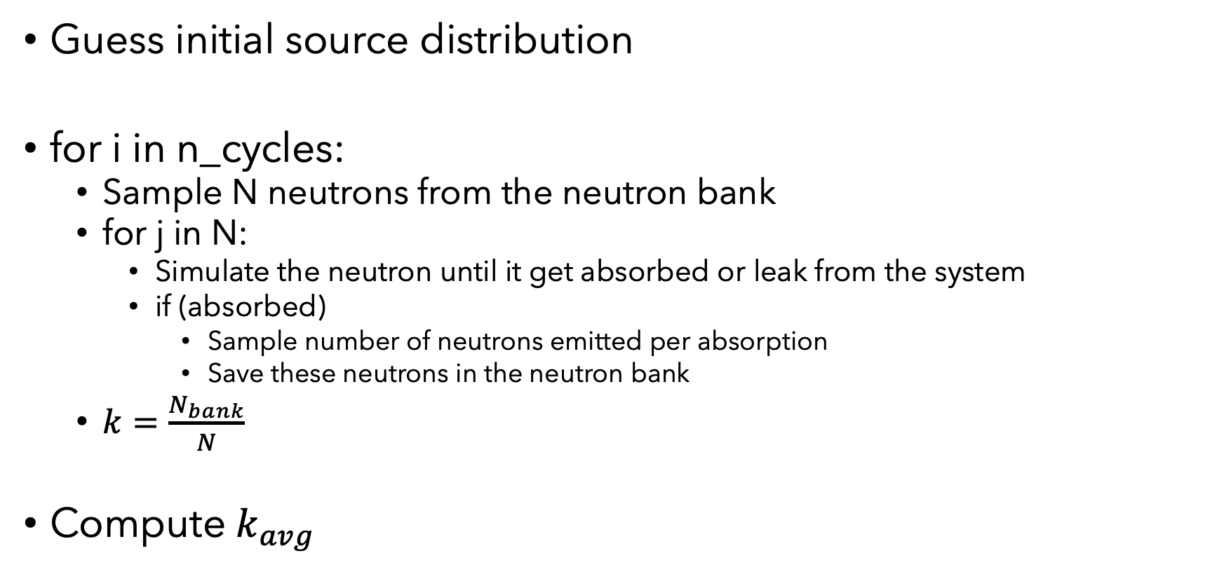
Criticality Algorithm
Guess initial source distribution
for i in n_cycles:
Sample N neutrons from the neutron bank
for j in N:
Simulate the neutron until it get absorbed or leak from the system
if (absorbed)
Sample number of neutrons emitted per absorption
Save these neutrons in the neutron bank
$k=\frac{N_{bank}}{N}$
Compute $k_{avg}$

Slide 26
Where are the results?

Slide 27
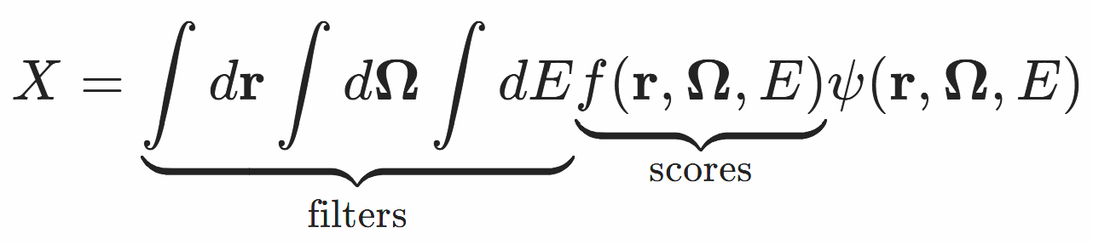
Tallies
Tallies are normalized to be per source particle
Tallies examples:
Flux
Current
Reaction rates
Energy deposition

Slide 28
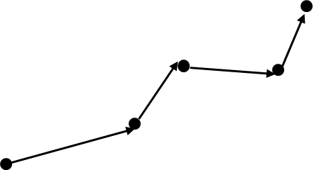
Tally Example
Shield
$$neutron surface crossing rate= \frac{number of neutrons crossing surface}{total number of neutrons simulated}×source intensity$$

Slide 29
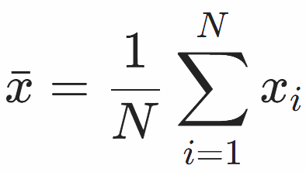
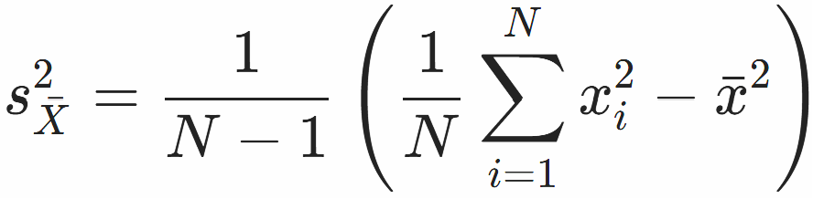


Statistics
Mean
Variance
Relative Error
Why MC is bad?
$$R=\frac{s_{\overline{X}}}{\overline{x}}$$
$$R∝\frac{1}{\sqrt{N}}$$

Slide 30
Questions?

