Slide 1



Workshop

Slide 2
Welcome
Provide introduction to Monte Carlo methods and how to use OpenMC
Understand the unique features and advantages of OpenMC relative to other software
Have an enjoyable time!

Slide 3
Logistics
Instructor
Prof. April Novak (ajnovak2@illinois.edu)
Google Collab
Check your email for URL link

Slide 4
Workshop Timeline
Introduction to Monte Carlo theory
Introduction to OpenMC
OpenMC examples (interactive)

Slide 5
Google Collab Instructions
Step 1:
Open the google collab notebook via the URL sent to your email;
Press "File" in the menu bar and then "Save a copy in Drive";
Step 2:
The first cell needs to be run alone, because it will restart the kernel;
"Your session crashed for an unknown reason" will show at the bottom, just close it;
Run the second kernel and you are good to go.
Two versions of the notebook are available:
“Solutions” with all text populated
“Empty” for you to type along

Slide 6
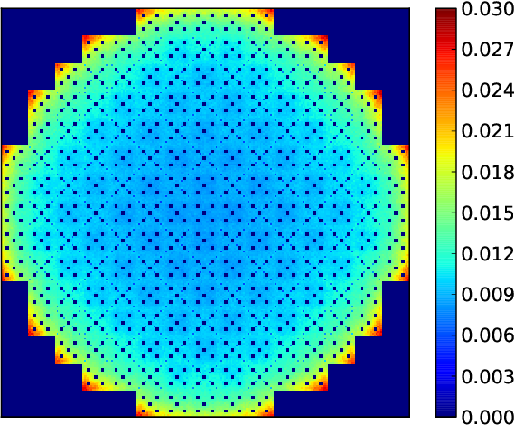
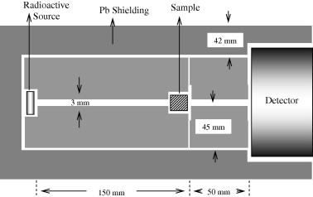
Neutron Transport Problems
Fixed Source Problem
Eigenvalue Problem
Radiation Shield
(image credit: E. Yilmaz)
Pressurized Water Reactor
(image credit: P. Romano)

Slide 7
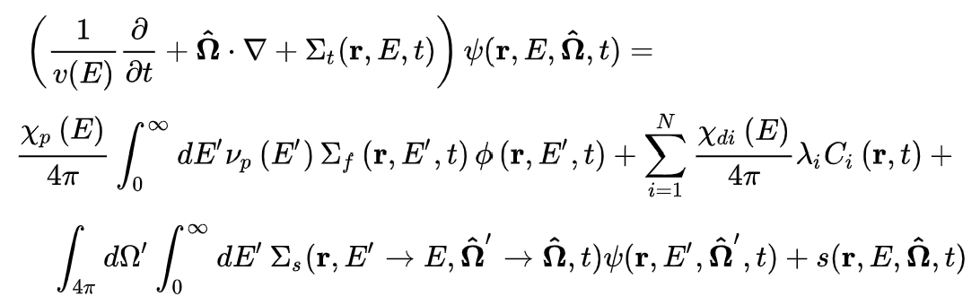
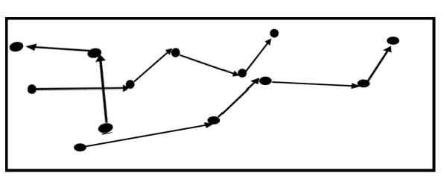
Neutron Transport Methods
Deterministic | Stochastic
Neutron Transport Equation is solved | Individual particles are tracked and averaged in a random walk directed by probabilities
Approximate geometry | Exact Geometry
Multigroup | Continuous and multigroup
Global numerical solution | Tallies
Shorter simulation times | Longer simulation times?
Parallelization is more challenging | Parallelization is easy

Slide 8






Random Process
Discrete | Continuous
Coin
Flip
Response
Time
$outcome∈\left\{H,T\right\}$
$$outcome ∈\left[0 , ∞\right)$$
Reaction
Type
N
Distance To
Next Collision
n
n
$outcome∈\left\{Scattering, Absorption\right\}$
$$outcome ∈\left[0 , ∞\right)$$

Slide 9
How can we simulate a random process on computer?

Slide 10
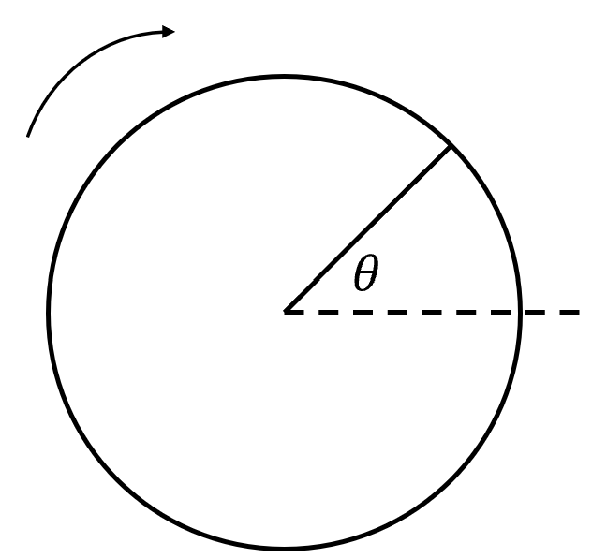


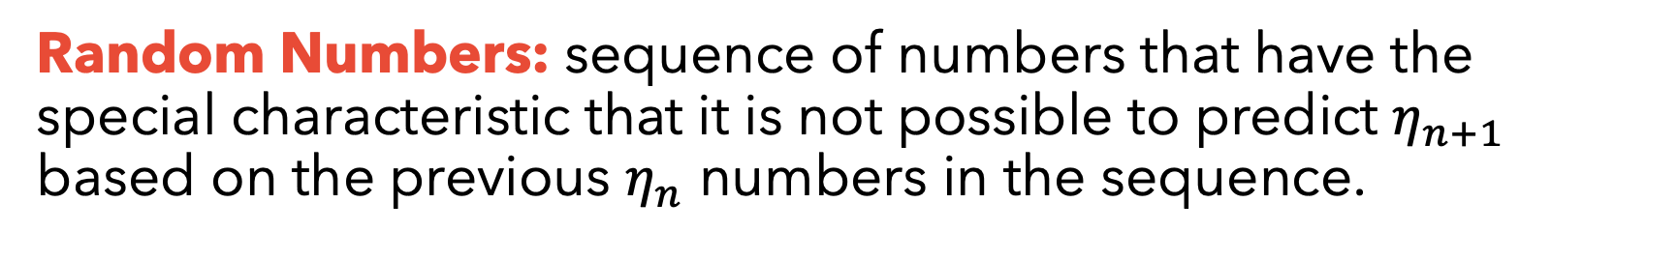
Random Numbers
Random Numbers: sequence of numbers that have the special characteristic that it is not possible to predict $η_{n+1}$ based on the previous $η_{n}$ numbers in the sequence.
Physical Random Number Generator | Pseudorandom number generator
 | An algorithm for generating a sequence of numbers whose properties approximate the properties of sequences of random numbers. Ex:
$$η=\frac{θ}{2π}$$

Slide 11
How can we convert the random number into a random variable?

Slide 12
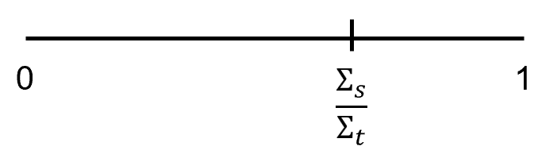

Sampling (Discrete)
Flipping a coin
Generate a random number ($η$) between $[0,1]$
if ($η$ < 0.5)
$outcome = ‘H’$
else
$outcome = ‘T’$
Sampling Reaction Type
Generate a random number ($η$) between $[0,1]$
if $\left(η <\frac{Σ_{s}}{Σ_{t}}\right)$
$reaction = ‘scattering’$
else
$reaction = ‘absorption’$

Slide 13
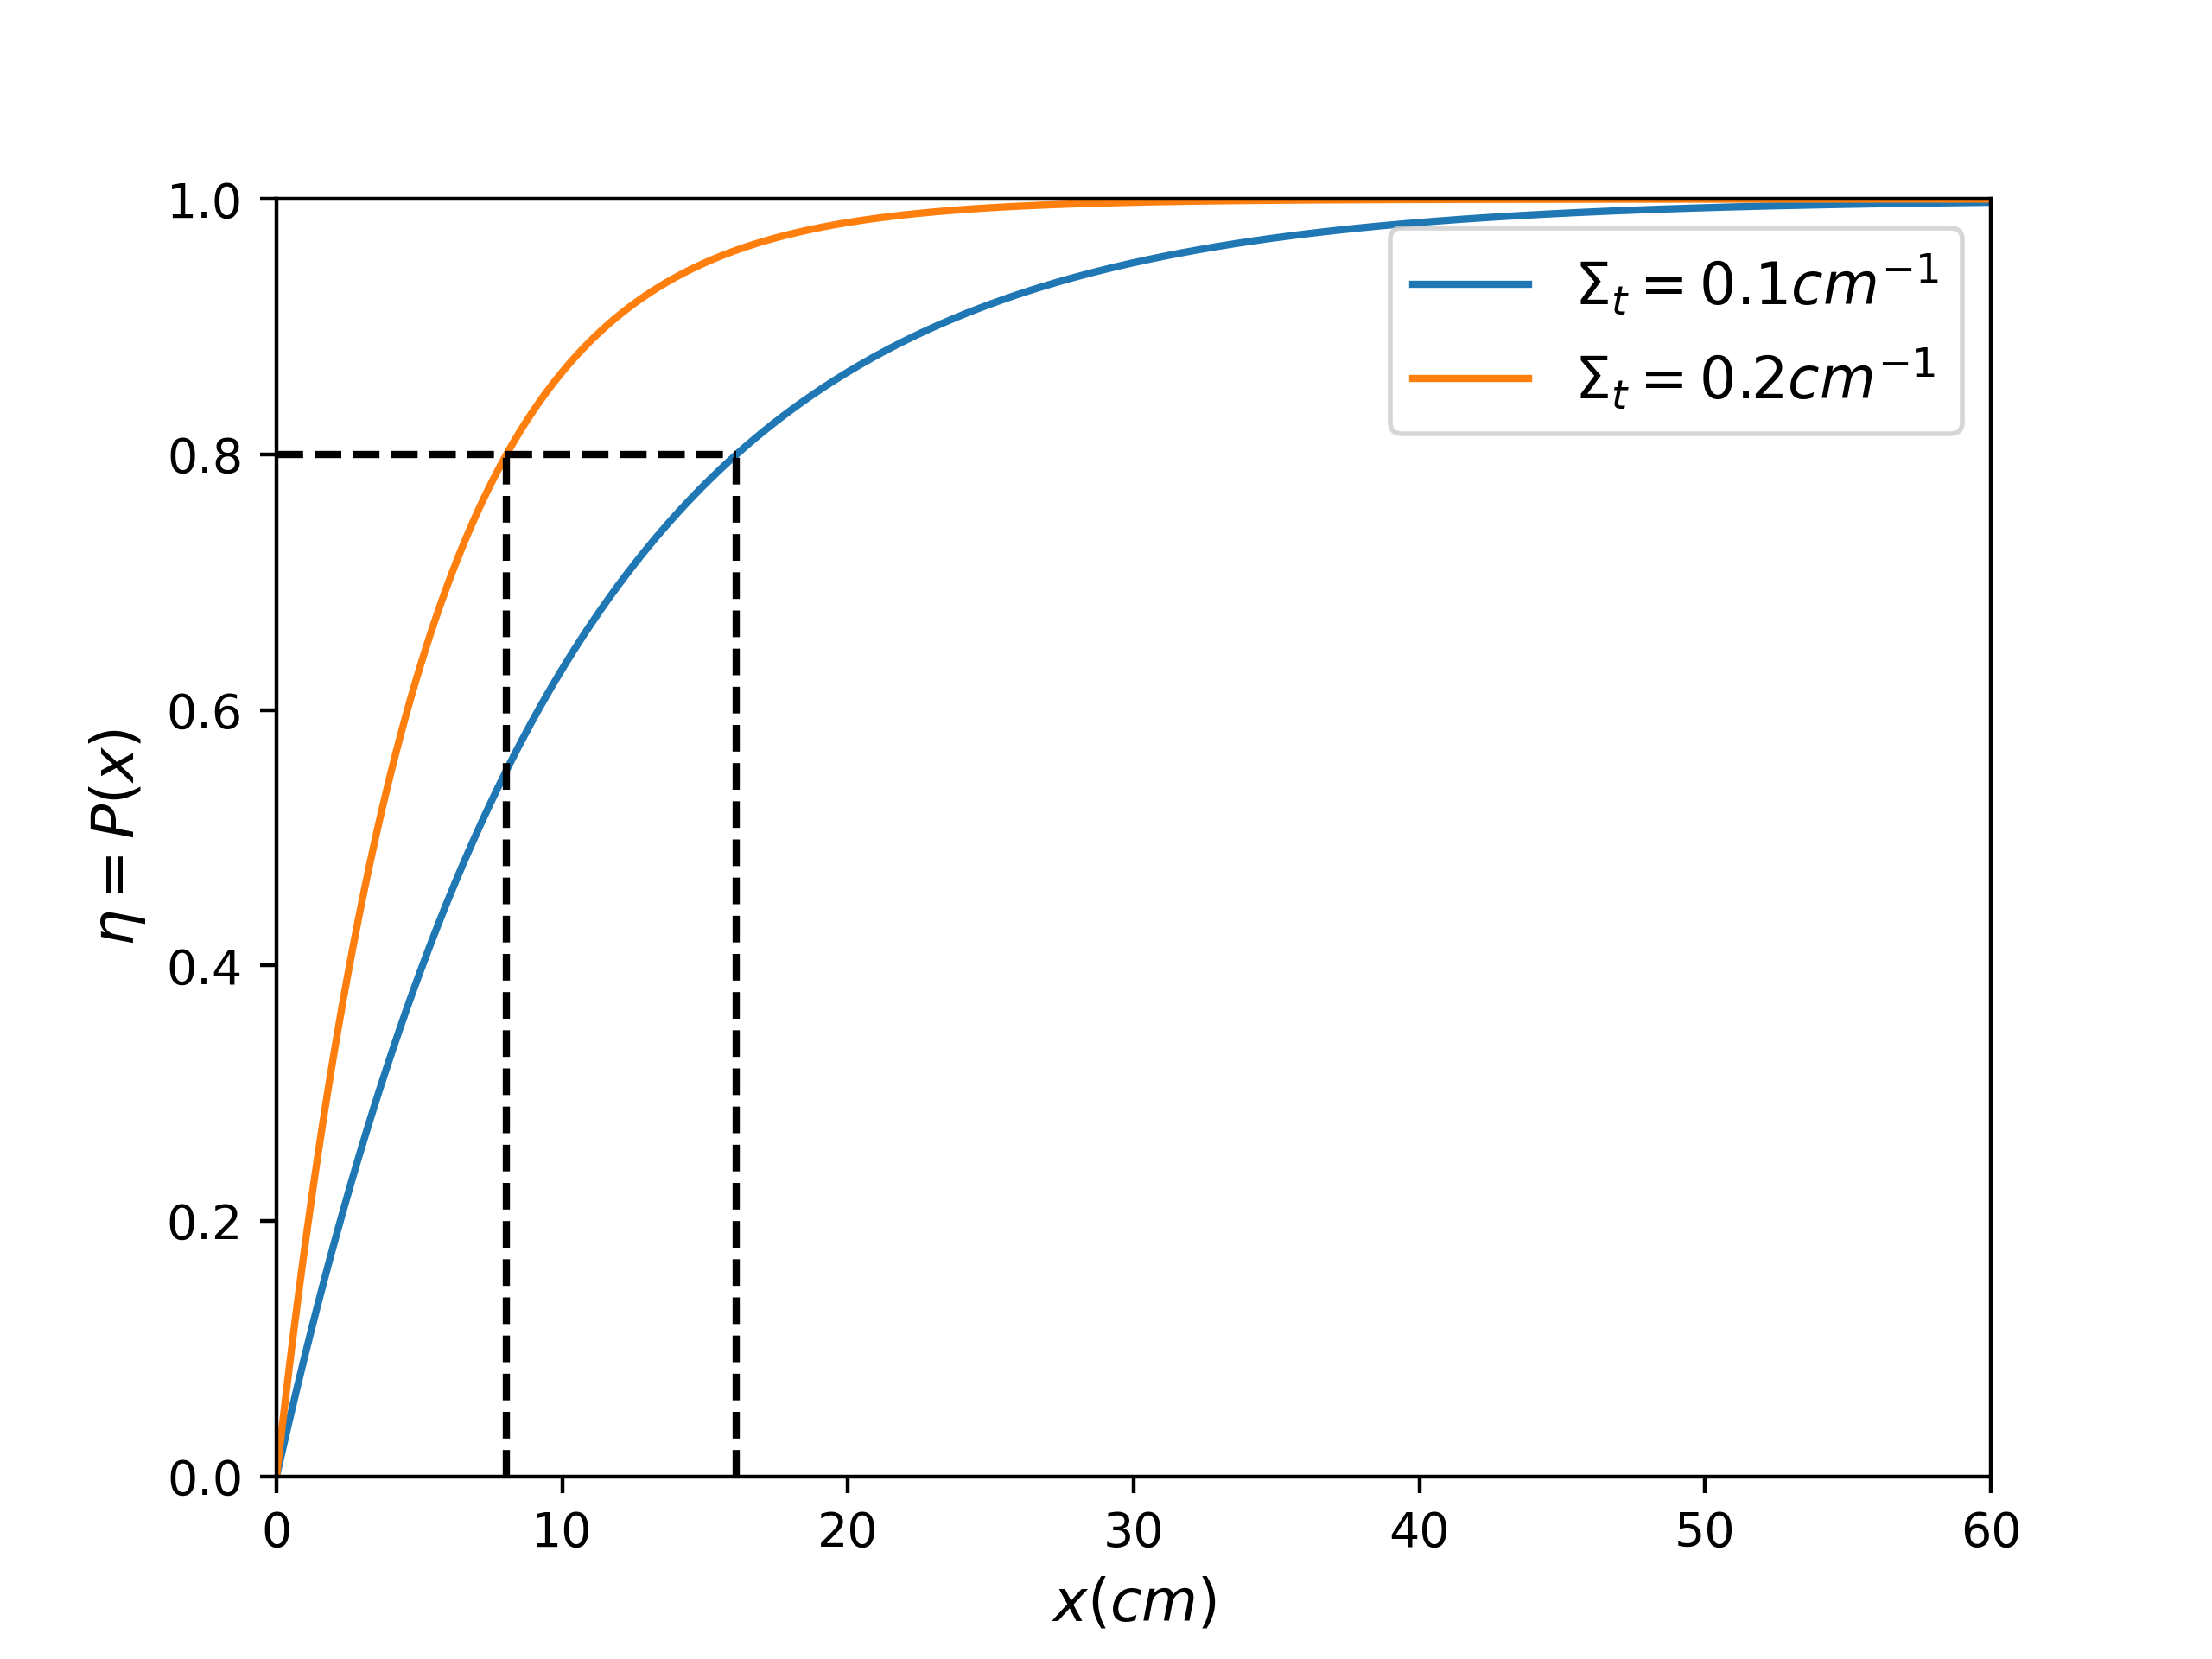









Sampling (Continuous)
Distance to next collision
Let $p(x)$ be the PDF of the distance to next collision.
Let $P\left(x\right)$ be the corresponding CDF.
Let $q\left(η\right)$ be the PDF of the random numbers generated.
$p\left(x\right)=Σ_{t}e^{−Σ_{t}x}$ $for 0≤x<∞$
$$P\left(x\right)=1−e^{−Σ_{t}x}$$
$q\left(η\right)=1$ $for 0≤η<1$
$$p\left(x\right)dx=q\left(η\right)dη$$
$$\int_{0}^{x}{p\left(x^{′}\right)dx^{′}}=\int_{0}^{η}{q(η^{′})dη^{′}}$$
$$P\left(x\right)=η$$
$$1−e^{−Σ_{t}x}=η$$
$$x=\frac{−ln⁡(1−η)}{Σ_{t}}$$

Slide 14
Let’s simulate a neutron random walk

Slide 15
Neutron Random Walk
Generate Neutron
Vacuum
leaked
Some more checks
d_{collision}< d_{surface}
no
Move to surface
yes
leaked
no
Move to collision site
yes
no
(absorbed)
Scattered
yes
Update velocity

Slide 16
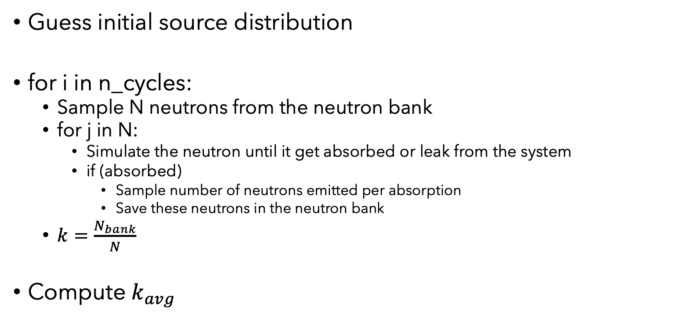
Criticality Algorithm
Guess initial source distribution
for i in n_cycles:
Sample N neutrons from the neutron bank
for j in N:
Simulate the neutron until it get absorbed or leak from the system
if (absorbed)
Sample number of neutrons emitted per absorption
Save these neutrons in the neutron bank
$k=\frac{N_{bank}}{N}$
Compute $k_{avg}$

Slide 17
Where are the results?

Slide 18
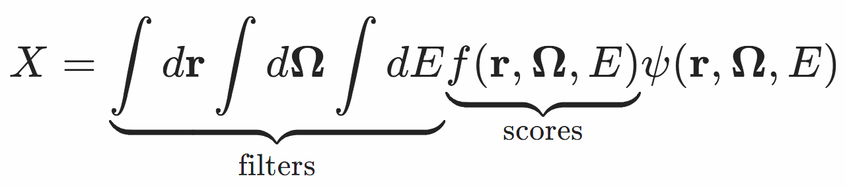
Tallies
Tallies are normalized to be per source particle
Tallies examples:
Flux
Current
Reaction rates
Energy deposition

Slide 19
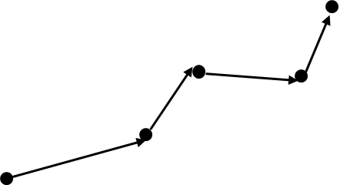
Tally Example
Shield
$$neutron surface crossing rate= \frac{number of neutrons crossing surface}{total number of neutrons simulated}×source intensity$$

Slide 20
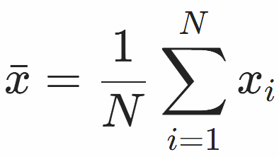
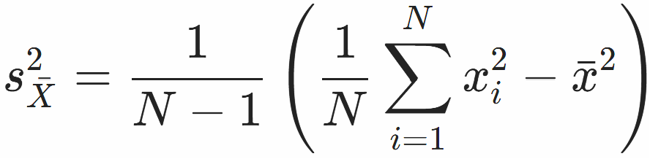


Statistics
Mean
Variance
Relative Error
Why MC is bad?
$$R=\frac{s_{\overline{X}}}{\overline{x}}$$
$$R∝\frac{1}{\sqrt{N}}$$

Slide 21
Questions?

