Slide 1
Conversation Tutorial

Slide 2
Conversation
#intents
+
@entities
+
Dialog

Slide 3
#context
State information for a conversation
Conversation service state
Conversation uid, turn counter,
Application state
user selections, timestamps, etc
JSON object that is passed back and forth between your application and the Conversation service.
Application MUST maintain the context between turns
Notes:
Context
There are a handful of things to be aware of in using the Conversation Service
1. How application data is structured and specified in the context object is left up to the user
The Conversation Service does not provide any guidelines on how to structure the application data you want to store in the context object. The only requirement is that it is a valid JSON object.
2. Conversation is stateless.
What this means is that, as a client of the Conversation Service, you’re responsible for maintaining your own state. You’ll have to add and update whatever data you want to make available to the dialog with each request. The Conversation Service will echo back whatever you send to it, and update it when it evaluates a specific dialog node if that node contains an update statement for a context variable.
3. Conversation also uses the context object to persist some state
These state variables currently include a conversation_id, the dialog_stack, a dialog_turn_counter, and the dialog_request_counter.
"system": {
"dialog_stack": [
"node_9_1471394498445"
],
"dialog_turn_counter": 2,
"dialog_request_counter": 2
}
The context variables returned in a Conversation response MUST be included in a subsequent request made to the Conversation Service.
It will not store any of the state you send to it at any point in time. Unless you persist the state yourself when the conversation ends, it’ll get dumped.
any state you’d like to persist between conversation turns. Anything you provide in the context of the request will be returned in the response.
You can think of the context state to the Conversation Service in interpreting variables used in a dialog tree (either on the conditions for entering a node or for the output response provided at a node).
The input The context variable is the object available to clients of the Conversation Service to persist any state that might be useful to them in creating a dialog.

Slide 4
Example context
^{"context": {}
"my_dessert_string": "ice-cream",
"toppings_array": ["onion", "olives"],
^{"age_number": 18,}
^{"complex_object": {}
^{"user_firstname" : "Peter",}
^{"user_lastname" : "Pan",}
^{"has_card" : false}
} }

Slide 5
Dialog tree evaluation
conversation_start
contextual node – the node to start dialog evaluation at after the user’s next turn
Evaluation looks top to bottom at a level to match the entry conditions for a node
Stage 1: child nodes of the contextual node are
Stage 2: top level of dialog nodes.
Top level should contain an “anything_else”
contextual node for next round = first child node of matching node if non-leaf; otherwise the conversation_starts node
Notes:
Contextual node id is added to the context.system.dialog_stack property

Slide 6
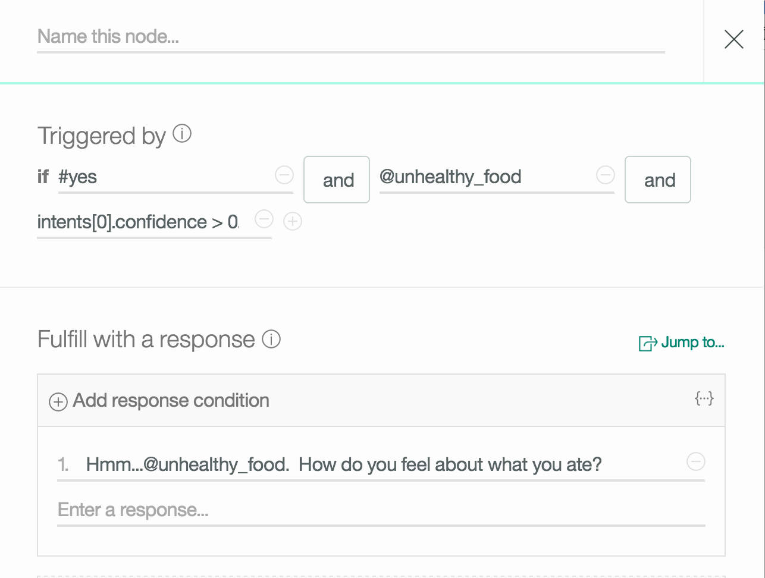
Dialog node

Slide 7

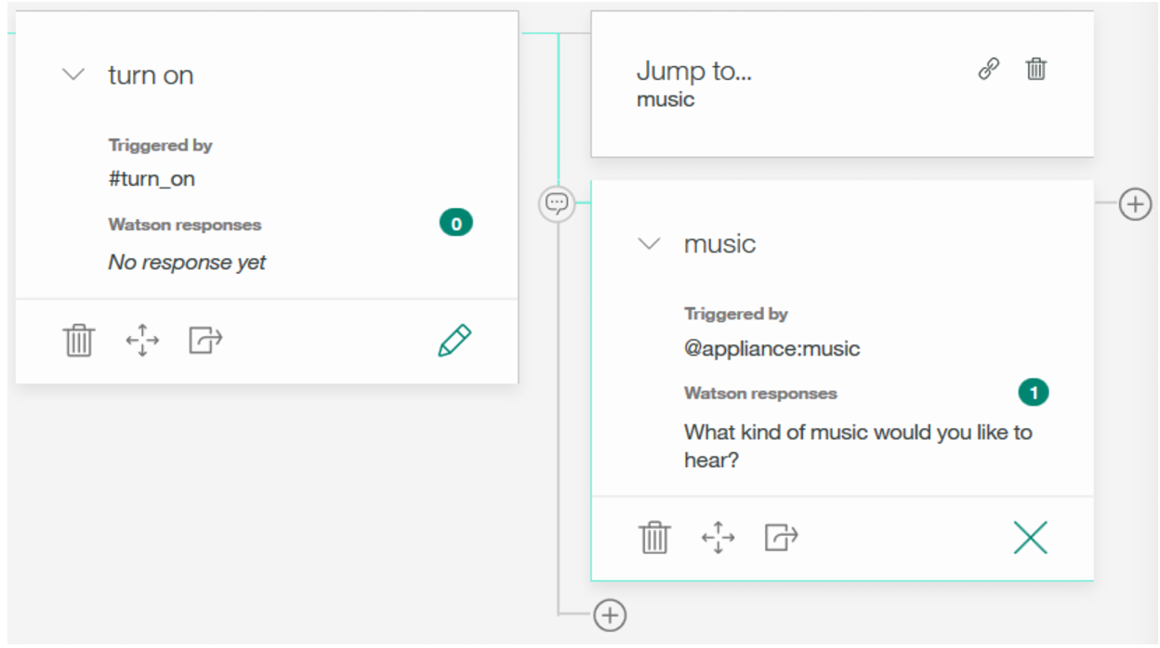
Changes the flow of dialog
Allows you to reuse common dialog sub-trees

