Slide 1
Predicting to Open a New Chinese Restaurant in St. Louis
Capstone Project - The Battle of the Neighborhoods
Han Zhang
6/14/2020

Slide 2
Outline
Introduction
Objective
Data Acquisition
Methodology
Result and Discussion
Conclusions

Slide 3
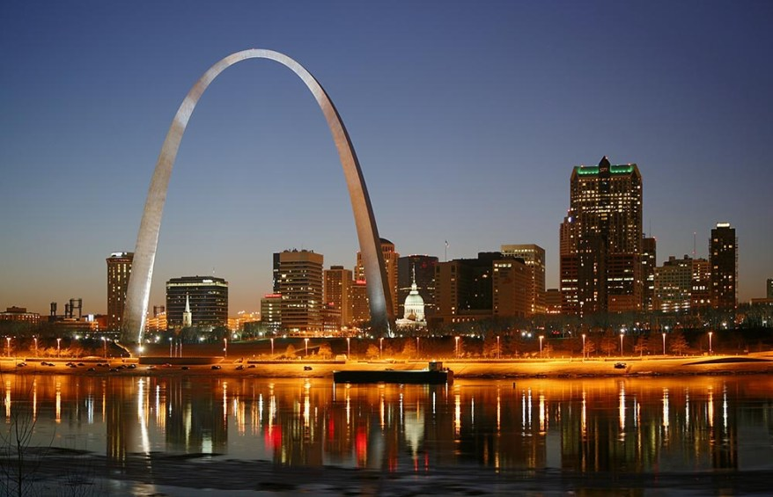
Introduction
St. Louis locates in the Mid-west of the Unites States, which is the largest metropolitan area in the state of Missouri.
American-style restaurants are most common type of restaurants in St. Louis.
Increases the demand for the diversity of its food culture, like Chinese food.
Photo source: https://entomologytoday.org/2019/11/14/explore-st-louis-things-to-see-and-do-in-st-louis-during-entomology-2019/

Slide 4
Objective
Find optimal location candidates in St. Louis for the stakeholders that interest in opening an Authentic Chinese restaurant

Slide 5
Data Acquisition
79 neighborhoods in St. Louis
Data needs to be acquired for analysis
The population of each neighborhood
The existing restaurants in each neighborhood
The shops near the neighborhood.

Slide 6
Methodology
The key methodologies to process data are:
The list of neighborhoods in St. Louis from Wikipedia
The address of the neighborhoods will be obtained by using St. Louis Coordinate Datasheet
The number and types of restaurants will be obtained by using Foursquare API
The number of shops will be obtained by using Foursquare API

Slide 7
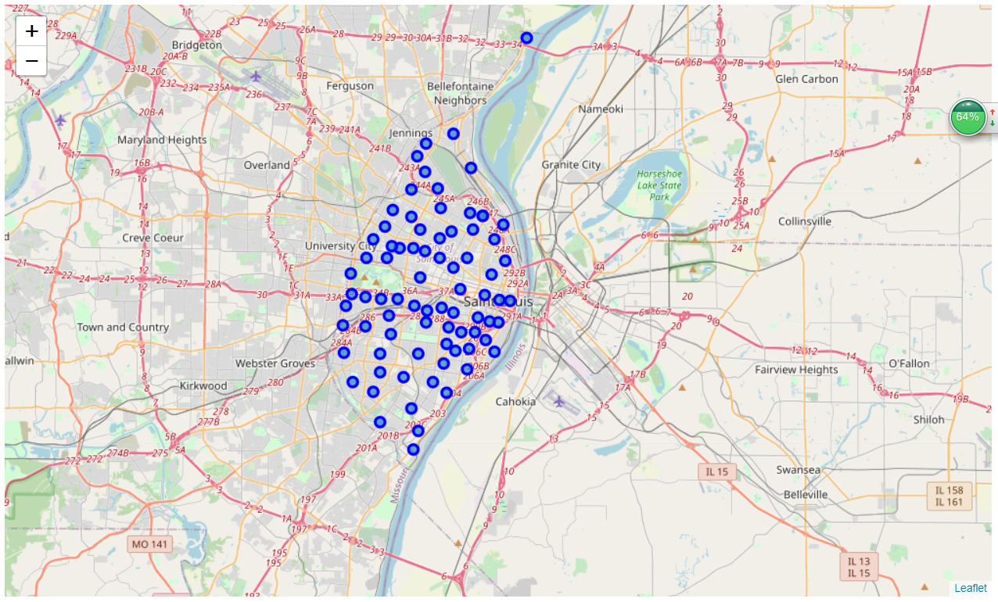
Methodology
Cleaning and Visualizing the Neighborhoods
Import the neighborhood information and coordinates of the neighborhoods.
Clear the data and form a new dataframe with neighborhood, population, latitude, and longitude.
Visualize the location of the 79 neighborhoods on the map.

Slide 8
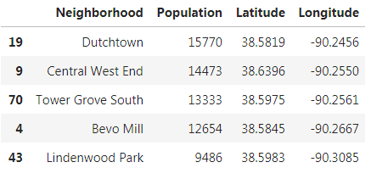
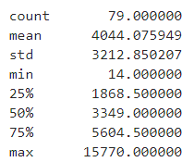
Results and Discussion
Explore the neighborhoods in St. Louis
Descending the neighborhoods by the population
The population ranges from 15,770 to 14 people for the 79 neighborhood communities
Mean population is 4044.

Slide 9
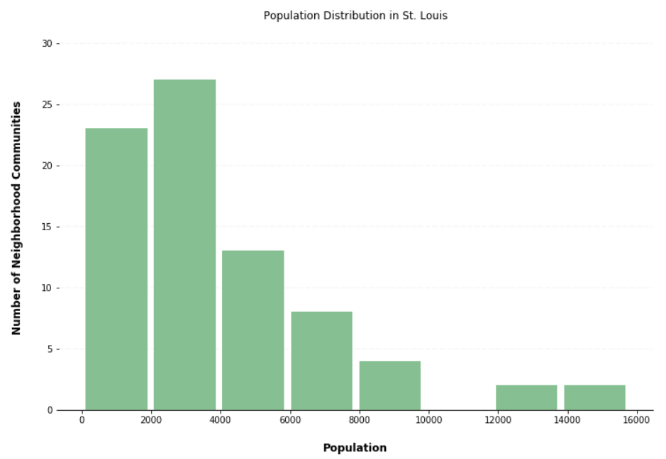
Results and Discussion
Explore the neighborhoods in St. Louis
Divided the population in 8 ranges
Bar chart to visualize relation between population and the number of neighborhood communities
Neglect population less than 2000
56 communities left

Slide 10
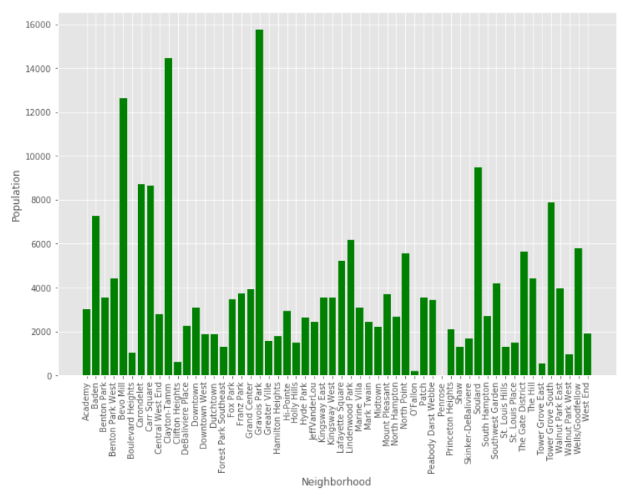
Results and Discussion
Explore the neighborhoods in St. Louis
Visualize the population of each neighborhoods

Slide 11
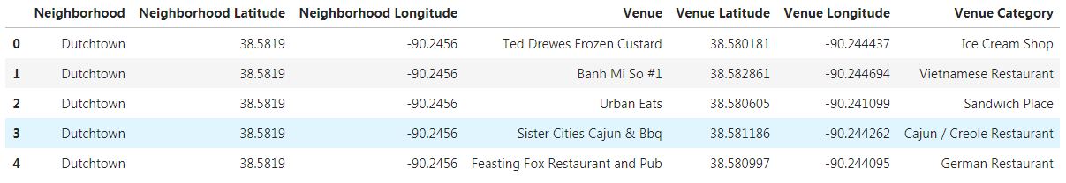
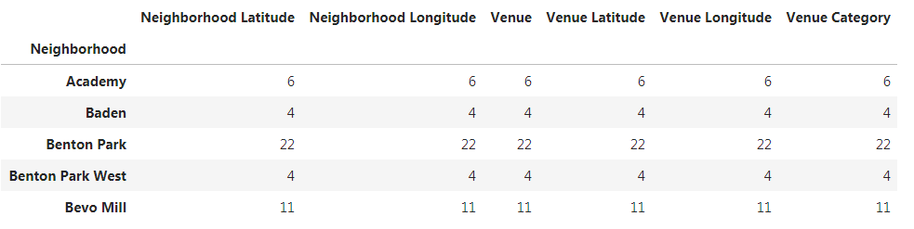
Results and Discussion
Explore the venues of all the neighborhoods
Using Foursqure API to get the venues of each neighborhoods and group them by neighborhood.

Slide 12
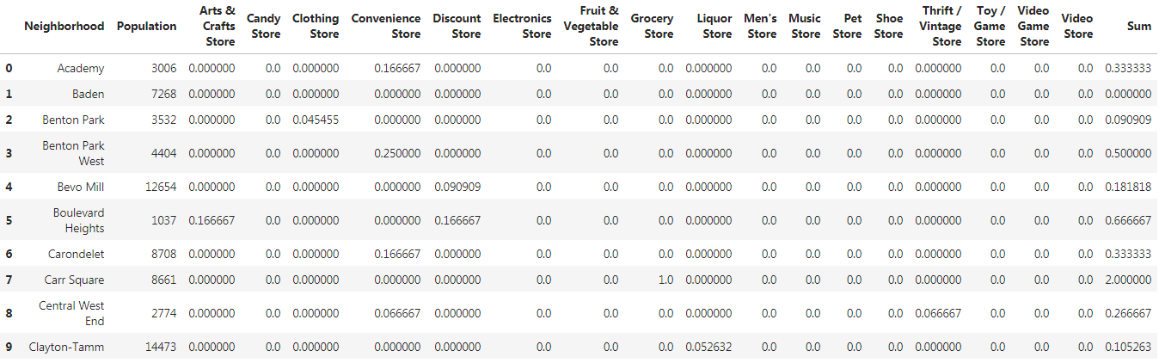
Results and Discussion
Explore the shops in all venues
Filter the stores in the overall venues with mean frequencies and the summation of frequencies.

Slide 13
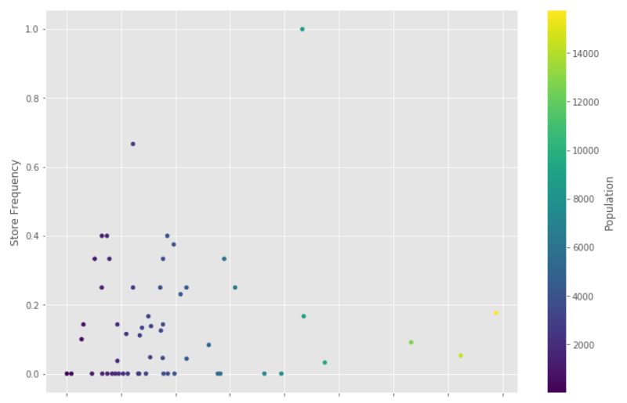
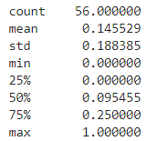
Results and Discussion
Explore shop frequency with population
Scatter plot to show the relation between shop frequency and population.
The mean shop frequency is 14.6%

Slide 14
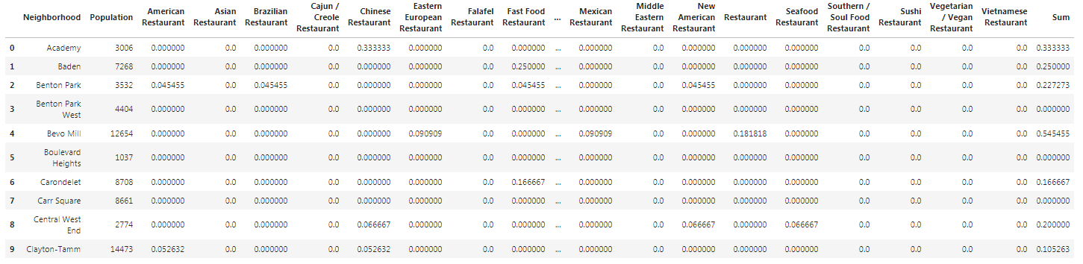
Results and Discussion
Explore the restaurants in St. Louis
Filter the restaurants in the overall venues with mean frequencies and the summation of frequencies.
Total 26 types of restaurants in St. Louis

Slide 15
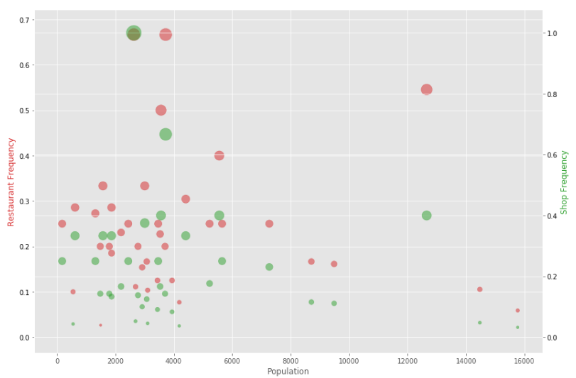
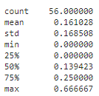
Results and Discussion
Explore restaurant frequency with population
Bubble chart to show the relation among restaurant frequency, shop frequency and population.
The mean shop frequency is 16.1%

Slide 16
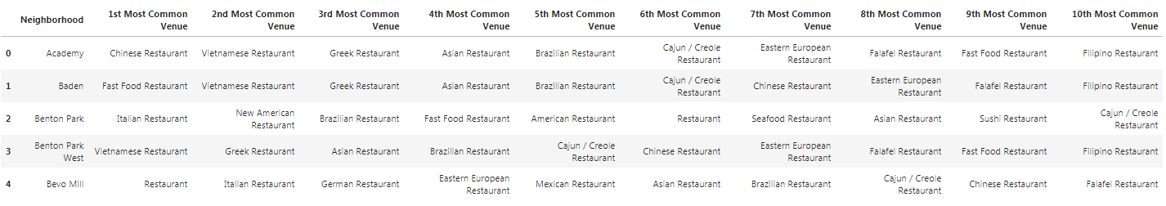
Results and Discussion
Cluster the neighborhoods by restaurant venues
List most 10 common venues of the restaurants

Slide 17
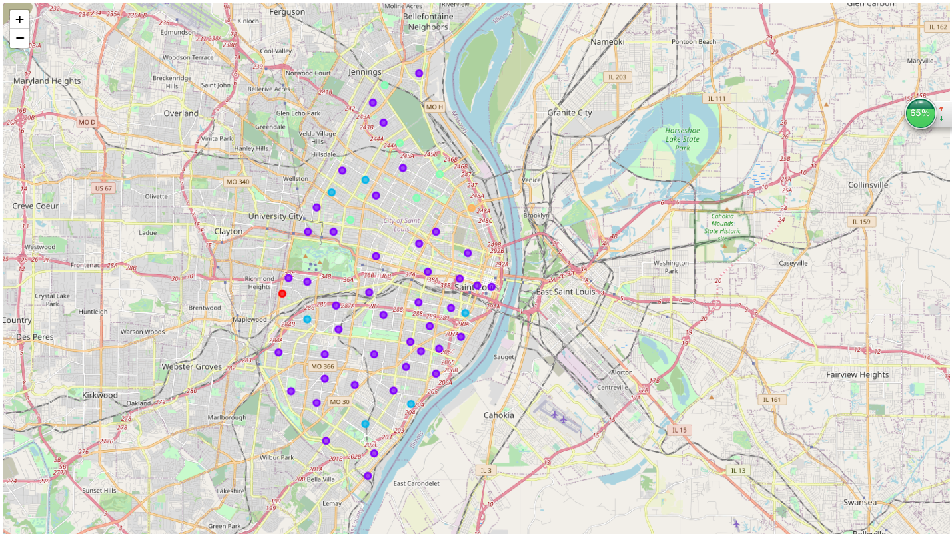
Results and Discussion
Cluster the neighborhoods by restaurant venues
Cluster the neighborhoods by restaurant in 5 groups

Slide 18
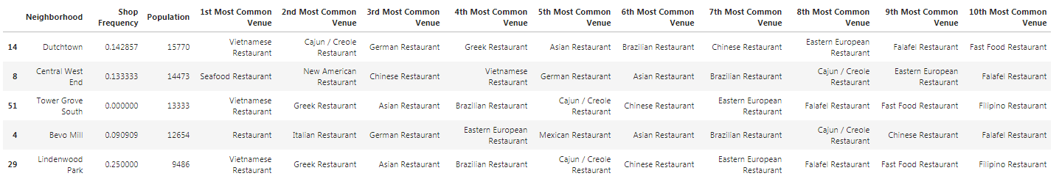
Results and Discussion
Comprehensively analyze the restaurant information with shops in each cluster
Cluster 1
Cluster 2
43 neighborhoods

Slide 19
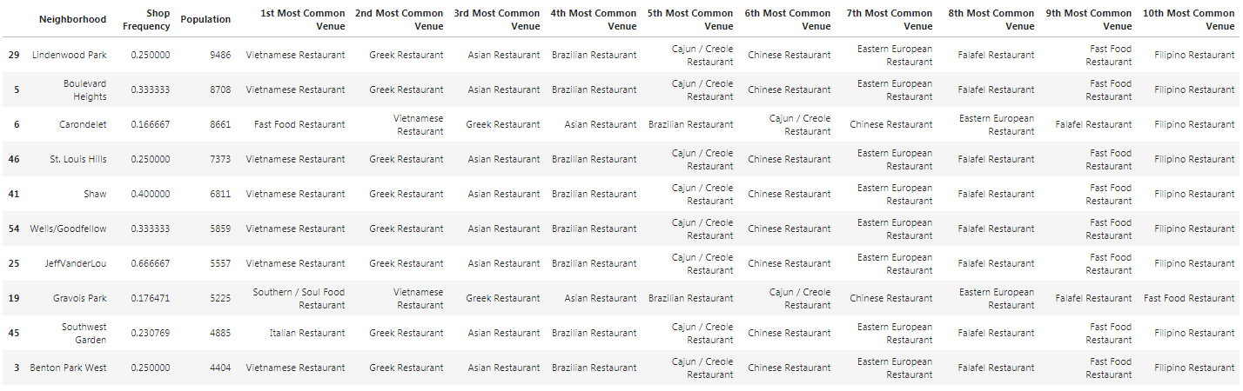
Results and Discussion
Comprehensively analyze the restaurant information with shops in each cluster
Cluster 2
Filter with shop and population larger than mean value

Slide 20
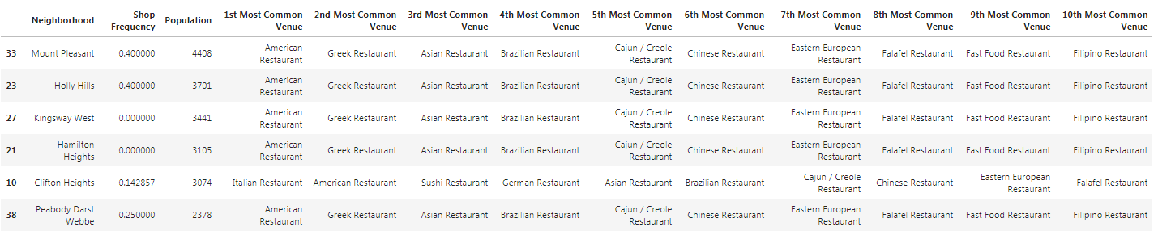
Results and Discussion
Comprehensively analyze the restaurant information with shops in each cluster
Cluster 3
6 neighborhoods

Slide 21
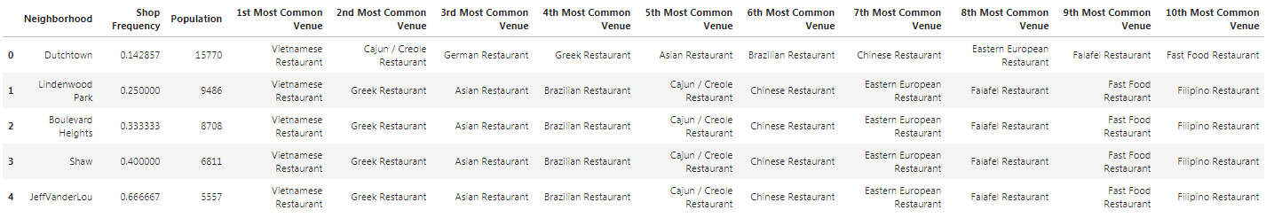
Results and Discussion
Final Decision
Final 5 candidates for stockholders to open a new Chinese restaurant

Slide 22
Conclusions
The objective of this project is reached.
Provide 5 candidates for the stockholders to open a new Chinese restaurant in St. Louis
Population is major considered factor; Shop frequency is secondary considered factor.
Five candidate neighborhoods are:
Dutchtown, Lindenwood Park, Boulevard Heights, Shaw, JeffVanderLou

